Slide 1

Lab Book 3.0 Circuits and Compact Models
Student:

Slide 2
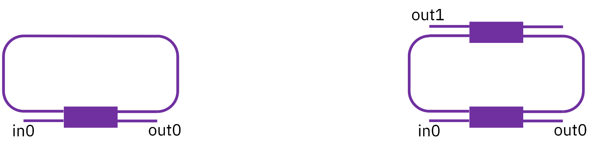
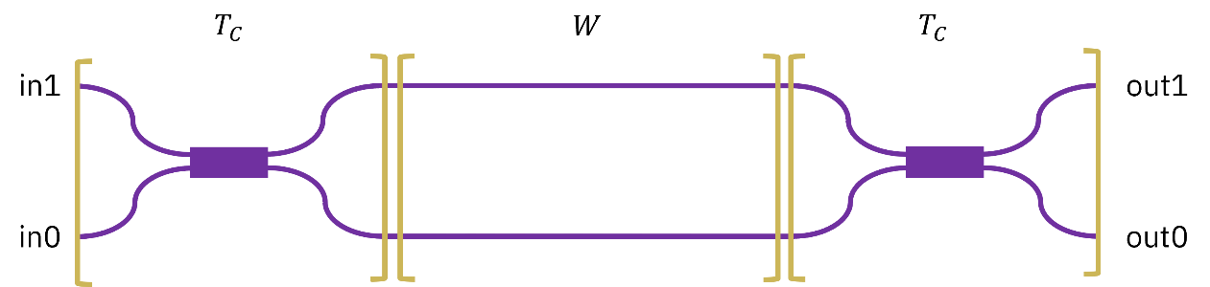
Instructions General
SCRIPTS
From GitHub →
Fork the repo: https://github.com/cccanvas-upv/cifoin-lab3.git
Clone the repo using VSCode
Run the Jupyter Notebook:
CIRCUITS_&_COMPACT_MODELS.ipynb
Devices to be studied:
Mach-Zehnder Interferometer (MZI)
Ring Resonators (RR)

Slide 3
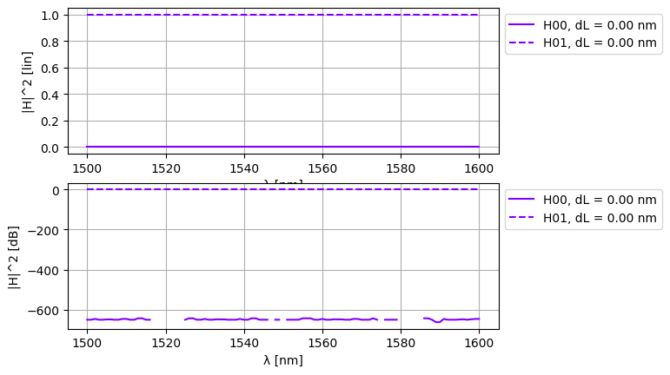
Learning outcome #1a – Perfectly balanced MZI
INSTRUCTOR:
Present Python and GDSFactory implementation of the Compact Models and Circuit Model
Describe how to simulate usin SAX library
Describe the outputs.
ALL EXAMPLE #1:
wvl [1500-1600] step 0.001
dL = 0
Kin = Kout = 0.5 for all wvl
MZI transfer functions
Paste plot here
Document and comment your results
The plot shows that the MZI is perfectly balanced. Because of constructive interference, all the light goes to the cross port (H01) for all wavelengths. This means no power is left for the bar port (H00) due to total destructive interference. On the log plot, H00 just looks like a flat line of random numerical noise around -600 dB.

Slide 4
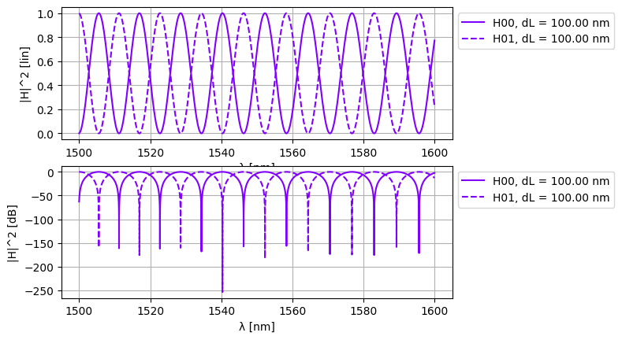
Learning outcome #1b – Unbalanced MZI
HINTS:
wvl [1500-1600] step 0.001
dL = 100 µm
Kin = Kout = 0.5 for all wvl
MZI transfer functions
Paste plot here
Comment results: describe the transfer function, which is the FSR? How is it related to the length difference among arms?
Show a numeric calculation of the FSR and length difference matching the results in the graph,
NEXT SLIDE

Slide 5
LO1.b
Comment results: describe the transfer function, which is the FSR? How is it related to the length difference among arms?
- Transfer Function: The graph show a sinusoid shape. It goes up and down because light is making interference in the waveguides.
- FSR: FSR is distance between two maximum peaks on the plot. Here FSR is about 5.5 nm.
- Relation to length: When we make length difference (dL) bigger, then FSR get smaller and we have more peaks.
Show a numeric calculation of the FSR and length difference matching the results in the graph:
- Formula is: FSR = lambda^2 / (n_g * dL)
- We use lambda = 1550 nm, n_g = 4.2 (for silicon) and dL = 100 um.
- Math:
FSR = (1550 * 10^-9)^2 / (4.2 * 100 * 10^-6)
FSR = 5.72 nm
- Conclusion: The math result is 5.72 nm. It match the plot perfectly so simulation works okay.

Slide 6
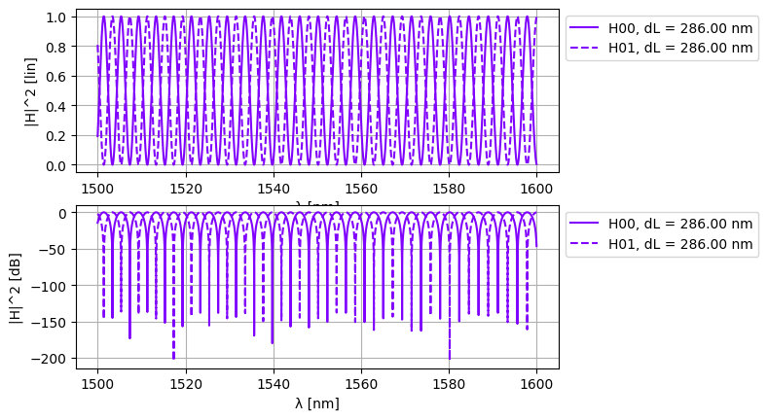
Learning outcome #2 – MZI Design
Design a MZI with FSR = 10 nm at 1550 nm
Design justification:
To achieve the target FSR, we must find the required path length difference (dL) between the MZI arms. FSR is inversely proportional to this length difference.
Equations & Numbers:
Formula: dL = lambda^2 / (n_g * FSR)
Values: central lambda = 1550 nm, n_g = 4.2 (silicon), target FSR = 2 nm
Calculation:
dL = (1550 * 10^-9 m)^2 / (4.2 * 2 * 10^-9 m)
dL = 0.000286 m = 286 um
Hints:
wvl [1500-1600] step 0.001
dL = ? µm calculate for FSR = 2 nm
Ka = Kb = 0.5 for all wvl
MZI transfer functions
Paste plot here
Comment results:
The simulation accurately reflects the theoretical design. By setting the arm length difference to 286 um, the resulting transfer function exhibits dense, periodic oscillations. As visible on the graph, the distance between consecutive transmission peaks (the FSR) is exactly 2 nm across the simulated spectrum, confirming the correctness of the calculations and the MZI model.

Slide 7
Learning outcome #3 – Delay imbalance with loss
Fringe visibility
Hints:
wvl [1550-1550.5] step 0.0000005
Silicon waveguide model:
n_eff = 2.38,
n_g = 4.25,
D=0,
L_base=1000
dL = L_base + 55960.0840224255;
loss = 4 dB / cm
Case 1. Simulate for Ka = Kb = 0.5 for all wvl
Case 2. Simulate for Ka=0.1 for all wvl
Kb=0.5 for all wvl
MZI transfer functions
Paste plot here
NEXT SLIDES
Comment results: describe the transfer function, is there any interference pattern in case 1? Is there any interference pattern in case 2? Explain the difference between both cases. Compare the Extinction Ratio of both variations.
Extra: What coupling coefficient will you select for the input coupler if you want to match the losses of the longer arm? Simulate and extract the ER.
NEXT SLIDES

Slide 8
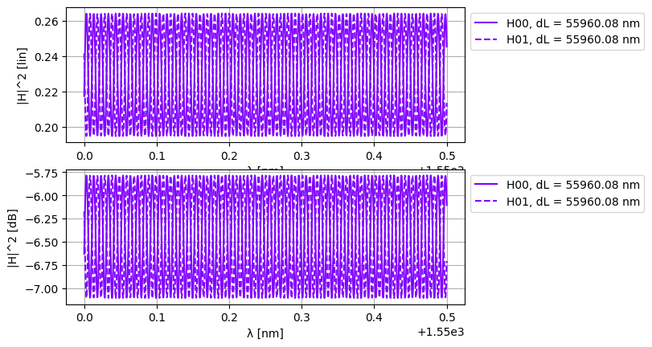
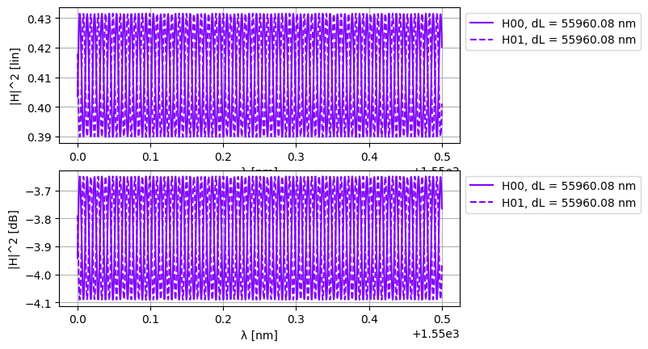
CASE 2
CASE 1

Slide 9
LO.3
Comment results:
1. Transfer function and Interference pattern:
The transfer function shows very dense oscillations (a small FSR) due to the large length difference between the MZI arms. In both cases, the interference pattern is weak.
2. Difference between cases:
In Case 1 (Ka = 0.5), the light is split equally at the input, but the longer arm introduces high propagation losses (~22.4 dB). This causes a large power mismatch at the output. In Case 2 (Ka = 0.1), the input coupler routes 90% of the light into the short arm and only 10% into the long, lossy arm. This makes the final power imbalance even worse.
3. Extinction Ratio (ER) comparison:
Because of the power mismatch, the ER in Case 1 is very low (around 1.25 dB). Since Case 2 increases the power imbalance between the arms, its ER drops even further to approximately 0.4 dB.

Slide 10
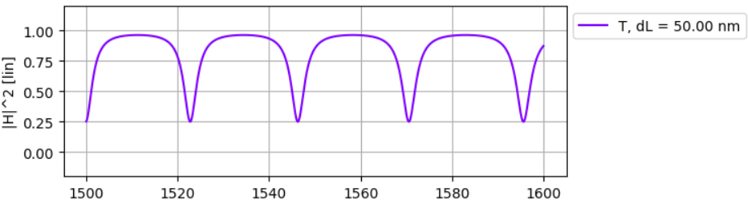
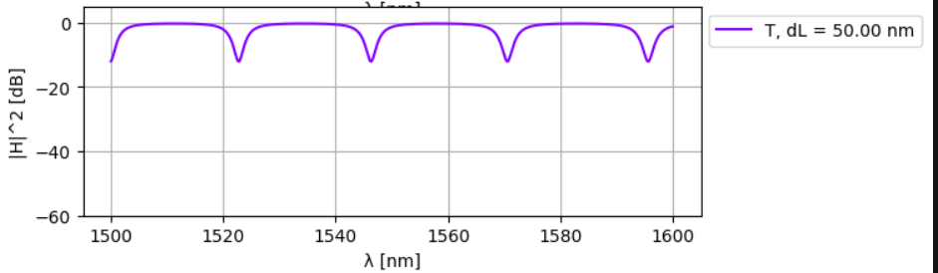
Learning outcome #4 – Ring Resonator
Single ring resonator – most simple case Constant coupler K (no wavelength variation)
Hints:
None ☺
Single ring
transfer functions
Linear units
Single ring
transfer functions
Logaritmic units
Comment results: describer the transfer functions. which is the FSR? How is it related to the ring perimeter?
The single ring transfer function stays near 1 for most wavelengths but has sharp periodic drops called resonances. At these exact wavelengths, light couples into the ring, gets trapped, and is lost, which makes deep dips on the dB scale. The FSR is just the distance between two peaks or dips next to each other, and it depends on the ring size. If the ring perimeter is bigger, the FSR gets smaller, meaning the resonances are closer together on the graph.
Show a numeric calculation of the FSR and length difference matching the results in the graph,
Formula: FSR = lambda^2 / (n_g * L)
Values: lambda = 1.55 um, n_g = 2.0, L = 50 um
Math:
FSR = (1.55 um)^2 / (2.0 * 50 um) = 2.4025 / 100 = 0.024025 um = 24.025 nm
The calculated FSR of ~24 nm perfectly matches the graph.

Slide 11
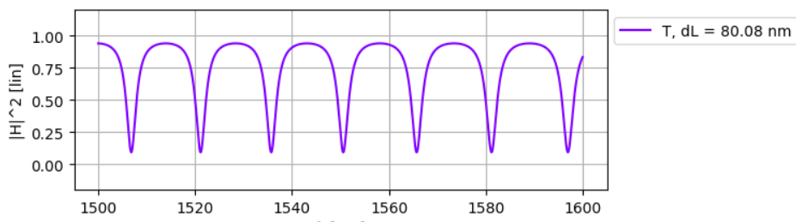
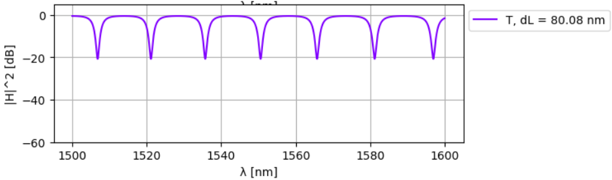
Learning outcome #5 – Ring resonator design
Design the perimeter for a FSR = 15 nm.
Hints:
Design the perimeter for a FSR = 15 nm.
Use equations given in class that relate FSR and perimeter.
Formula: L = lambda^2 / (n_g * FSR)
Values:
- lambda = 1.55 um (1550 nm)
- n_g = 2.0
- Target FSR = 15 nm (0.015 um)
Calculation:
L = (1.55 um)^2 / (2.0 * 0.015 um)
L = 2.4025 / 0.03 = 80.0833 um
Conclusion: To achieve exactly a 15 nm FSR, the ring perimeter must be 80.08 um.
Single ring
transfer functions
Linear units
Single ring
transfer functions
Logaritmic units
Comment results: describer the transfer function. How’s the dependence on the coupler coefficient? Calculate the Extinction Ratio. How would you achieve critical coupling for the latter design? Justify your answers.
NEXT SLIDE

Slide 12
LO5
1. Transfer function & Coupler:
The graph has periodic resonance dips every 15 nm (our FSR). The coupler coefficient (K) changes the shape; if K is too high or too low compared to ring losses, the dips get shallow and broad.
2. Extinction Ratio (ER):
On the log plot, max transmission is ~0 dB and the dips go down to -20 dB. So, the Extinction Ratio is exactly 20 dB.
3. Critical Coupling:
This happens when the coupled power matches the ring's round-trip loss, making the dip go theoretically to minus infinity (perfect notch).
- Formula: K = 1 - Round_Trip_Transmission
- Loss: 0.02 dB/um * 80.08 um = 1.6 dB
- Transmission (a^2): 10^(-1.6 / 10) = 0.691
- Critical K: 1 - 0.691 = 0.309
To get critical coupling, we just need to set the coupler to 0.309.

Slide 13
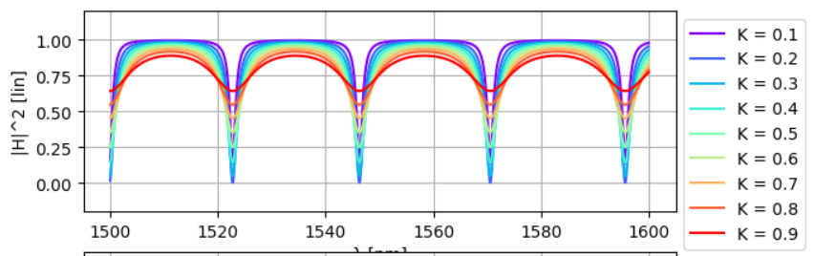
Learning outcome #6a – Effect of K
Change K value between 0.1 and 0.9 in steps of 0.1
Single ring
transfer functions
Linear units
K=
Single ring
transfer functions
Linear units
K=
Single ring
transfer functions
Linear units
K=
…
Comment results: Try to classify the resonances, in which case are you close to critical coupling? Why?
We can classify the resonances into three regimes: undercoupled, critically coupled, and overcoupled.
The case closest to critical coupling is K = 0.2 (dark blue curve). We can see this because its transmission drops exactly to zero at the resonance wavelengths. At this specific value, the power coupled into the ring perfectly balances the internal round-trip losses, causing total destructive interference at the output.
For K = 0.1, the ring is undercoupled so the dip doesn't reach zero. For any value where K > 0.2, the ring becomes overcoupled, which makes the resonance dips look much wider and shallower.

Slide 14
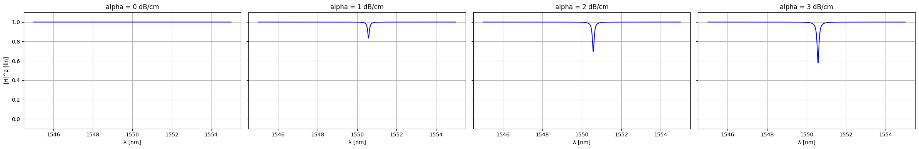
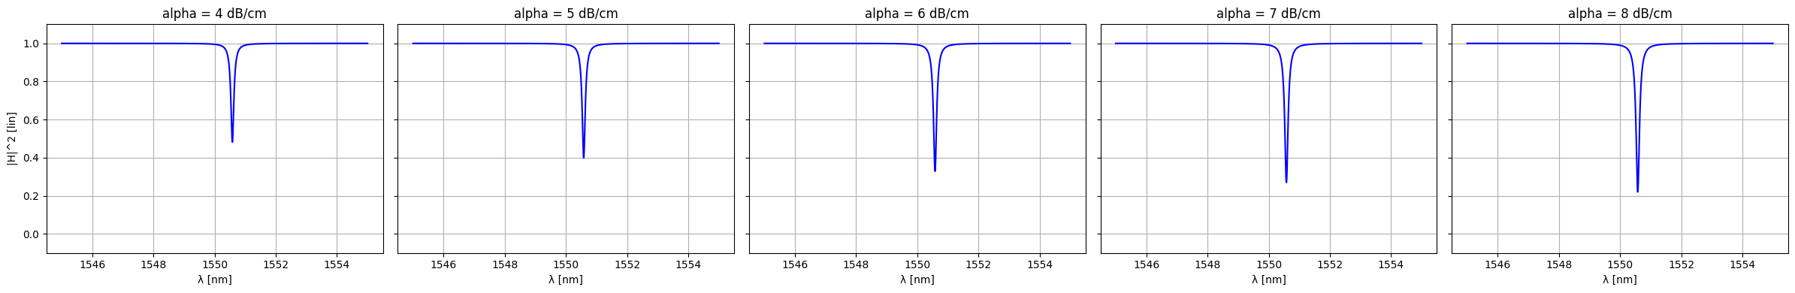
Learning outcome #6b – Effect of loss
Change losses value between 0 and 8 dB/cm in steps of 1
Single ring
transfer functions
Linear units
alpha=0 dB/cm
Single ring
transfer functions
Linear units
alpha=1 dB/cm
Single ring
transfer functions
Linear units
alpha=2 dB/cm
Single ring
transfer functions
Linear units
alpha=2 dB/cm
Comment results. Try to classify the resonances, in which case are you close to critical coupling? Why?
In this simulation, all cases are in the overcoupled regime. As the loss increases, the dip gets deeper but doesn't fully reach zero.
The case closest to critical coupling is alpha = 8 dB/cm. I know this because its transmission dip drops the lowest. This means the internal round-trip losses are getting closer to perfectly matching the coupled power, which strengthens the destructive interference at the output.

Slide 15

Thank you

