Slide 1

Lab Book 3.0 Circuits and Compact Models
Student:

Slide 2
Instructions General
SCRIPTS
From GitHub →
Fork the repo: https://github.com/pascualmunoz/cifoin-lab4.git
Clone the repo using VSCode
Open folder / repo in VSCode
Open terminal: uv sync
Run the Jupyter Notebook:
LAYOUT_STUDENT.ipynb
Points
LO1: 3 points
LO2: 3 points
LO3: 1 points
LO4: 3 points

Slide 3
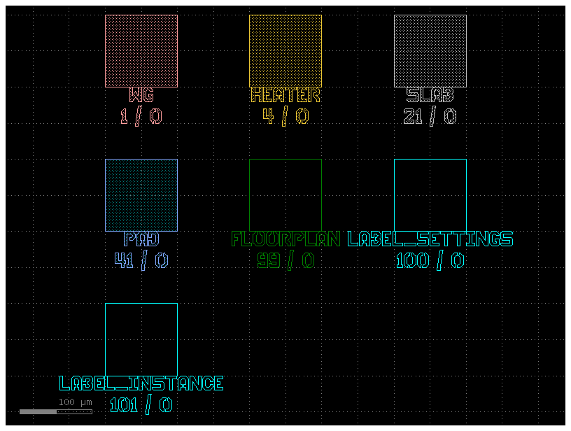
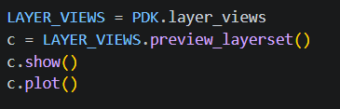
Learning outcome #1a – Notebook section 1. Technology “We will work with the demo UPVfab PDK. Let's view the layer distribution of this PDK”
Paste code to view the layer distribution of this PDK
Paste plot of layers here
A PDK is Process Design Kit, it contains the files and rules from the factory to help us design the photonics chip.
In general, the layers for layout in a PDK represent the physical masks and materials that the factory use to build the chip step by step.
For our particular PDK we find the following layers, with number and label/description: WG is 1 / 0, HEATER is 4 / 0, SLAB is 21 / 0, PAD is 41 / 0, FLOORPLAN is 99 / 0, LABEL_SETTINGS is 100 / 0, and LABEL_INSTANCE is 101 / 0. Also the notebook say we only use Layer 1 for the passive devices.

Slide 4
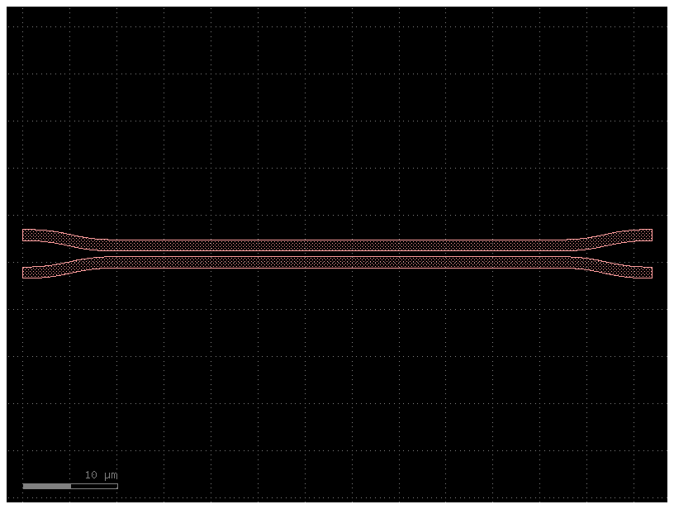
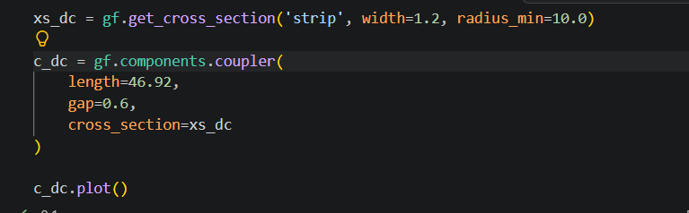
Learning outcome #1b – Notebook section 1. Technology – 1 slide per component “Use your design results from Lab2 and Lab3 to create layout instances of your designed components: DCs, MMIs, MZIs & Ring Resonators”
Component code
Component screenshot
This is the directional coupler designed in Lab 2. It was optimized for a 50:50 power split. The gap between the waveguides is 0.6 um, and the waveguide width is 1.2 um. The total coupling length for a 50% split is around 46.92 um L_pi

Slide 5
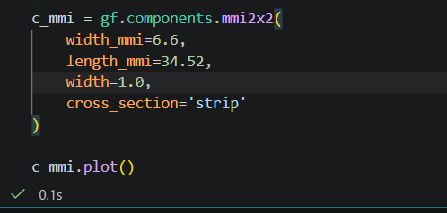
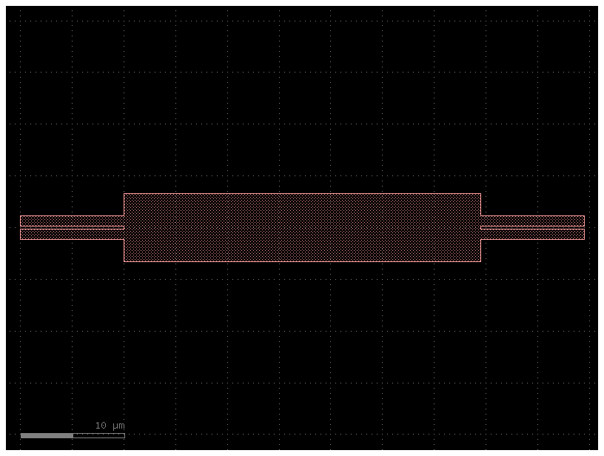
Learning outcome #1b – Notebook section 1. Technology – 1 slide per component “Use your design results from Lab2 and Lab3 to create layout instances of your designed components: DCs, MMIs, MZIs & Ring Resonators”
Component code
Component screenshot
This is the 2x2 MMI coupler designed in Lab 2. The multimode body width (W_MMI) is 6.6 um, and the optimized body length (L_MMI) is around 34.52 um. After optimizing the input and output waveguide widths, the coupler achieved very low excess loss (around 0.08 dB).

Slide 6
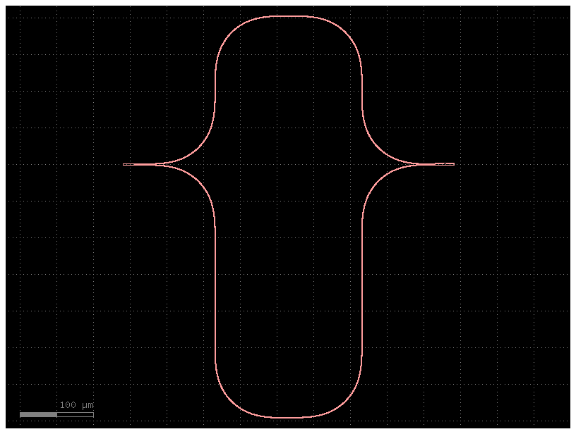
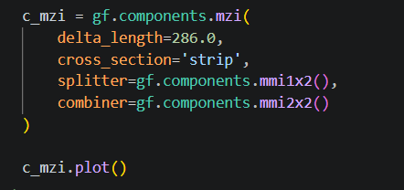
Learning outcome #1b – Notebook section 1. Technology – 1 slide per component “Use your design results from Lab2 and Lab3 to create layout instances of your designed components: DCs, MMIs, MZIs & Ring Resonators”
Component code
Component screenshot
This is the unbalanced Mach-Zehnder Interferometer (MZI) studied in Lab 3. It was designed to get a Free Spectral Range (FSR) of 2 nm. According to the calculations, the required path length difference between the arms (dL) is exactly 286 um. MMI couplers were used to split and combine the signals.

Slide 7
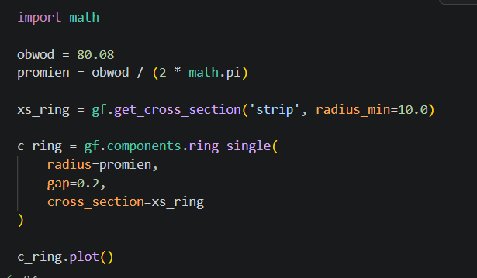
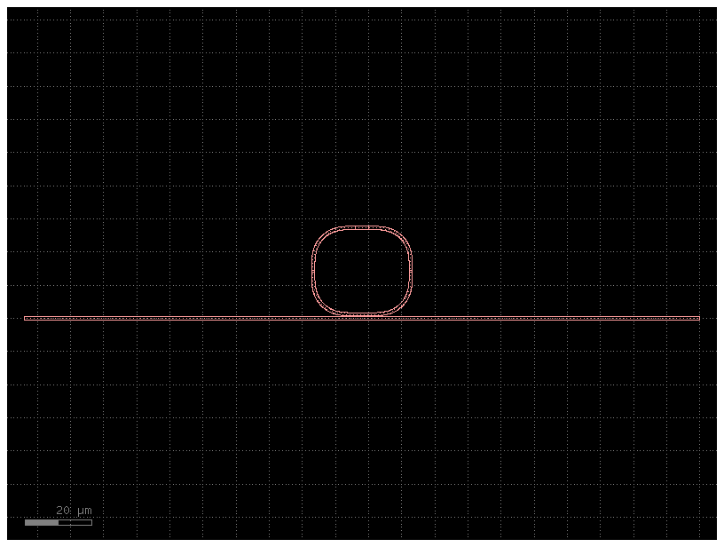
Learning outcome #1b – Notebook section 1. Technology – 1 slide per component “Use your design results from Lab2 and Lab3 to create layout instances of your designed components: DCs, MMIs, MZIs & Ring Resonators”
Component code
Component screenshot
This is the ring resonator designed in Lab 3. The parameters were chosen to achieve a Free Spectral Range (FSR) of 15 nm. Based on theoretical formulas, the total circumference was calculated to be 80.08 um, which gives a ring radius of about 12.75 um.

Slide 8
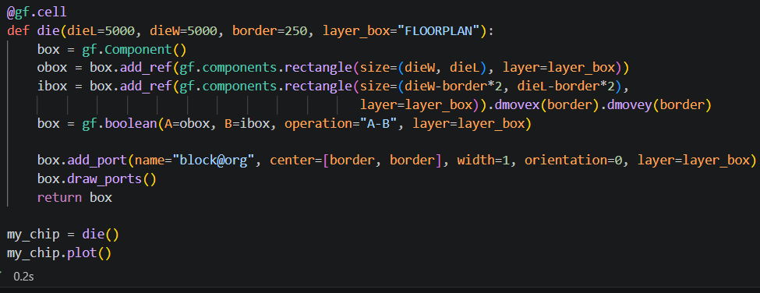
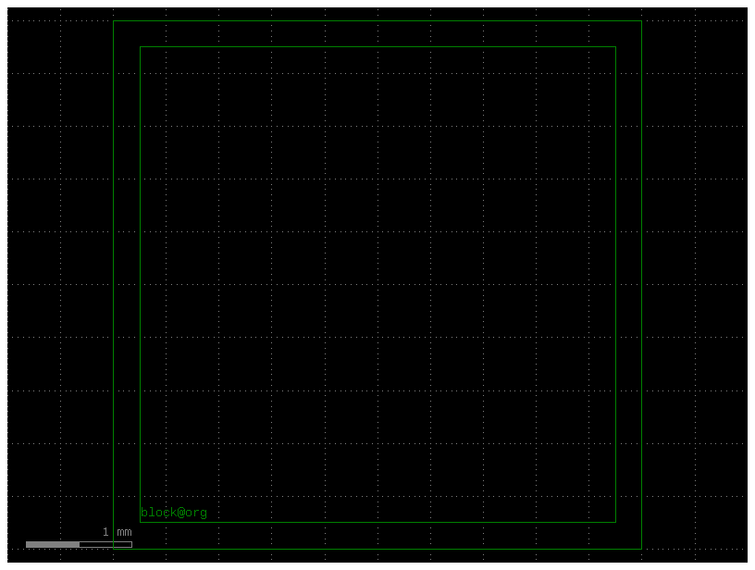
Learning outcome #2a – Notebook section 2. Layout Fundamentals “Once that we have a working 'new' component, we shall convert it into a Cell. This will allow us to have a hierarchical design”
Example code for
“A die (chip) for a photonic layout”
Example die
screenshot
This is the die layout exactly as provided in the nootebook. It creates a chip with a 250 um border for dicing. The @gf.cell decorator turns this entire layout into a reusable component so I can use it as the main floorplan for my photonic circuits

Slide 9
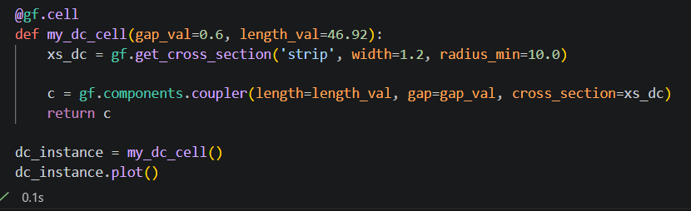
Learning outcome #2a – Notebook section 2. Layout Fundamentals – 1 slide per component “Use your design results from Lab2 and Lab3 to create layout instances of your designed components: DCs, MMIs, MZIs & Ring Resonators” → Make cells for all your components
Component as cell code
Component as cell screenshot

Slide 10
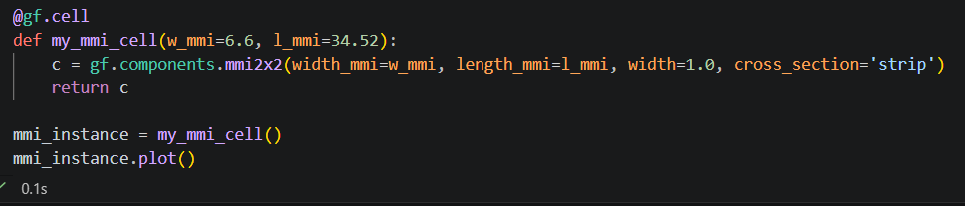
Learning outcome #2a – Notebook section 2. Layout Fundamentals – 1 slide per component “Use your design results from Lab2 and Lab3 to create layout instances of your designed components: DCs, MMIs, MZIs & Ring Resonators” → Make cells for all your components
Component as cell code
Component as cell screenshot

Slide 11
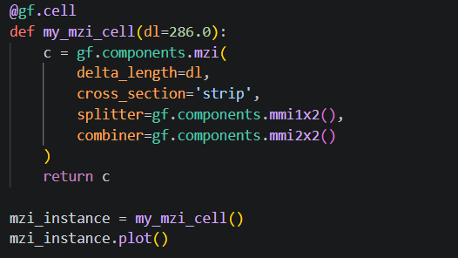
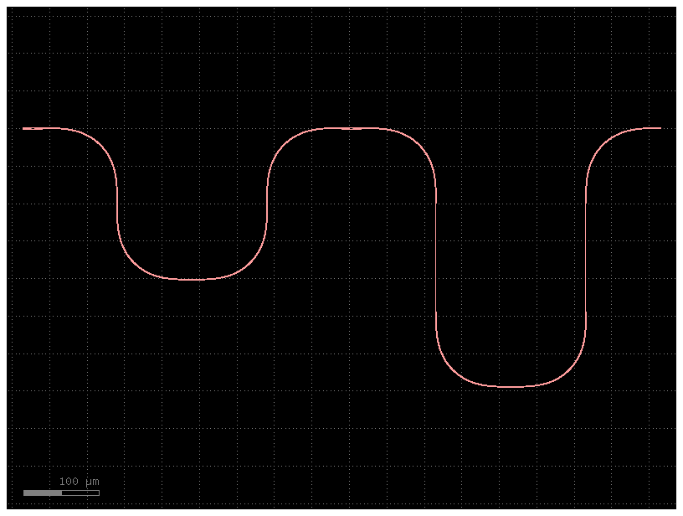
Learning outcome #2a – Notebook section 2. Layout Fundamentals – 1 slide per component “Use your design results from Lab2 and Lab3 to create layout instances of your designed components: DCs, MMIs, MZIs & Ring Resonators” → Make cells for all your components
Component as cell code
Component as cell screenshot
I don’t know why it’s like that. I used the same core code as in #1b.
Mayby it’s sth with the visualisation.

Slide 12
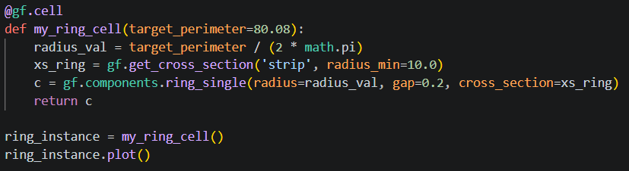
Learning outcome #2a – Notebook section 2. Layout Fundamentals – 1 slide per component “Use your design results from Lab2 and Lab3 to create layout instances of your designed components: DCs, MMIs, MZIs & Ring Resonators” → Make cells for all your components
Component as cell code
Component as cell screenshot

Slide 13
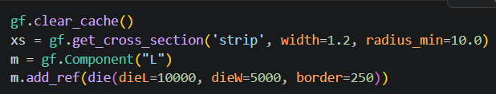
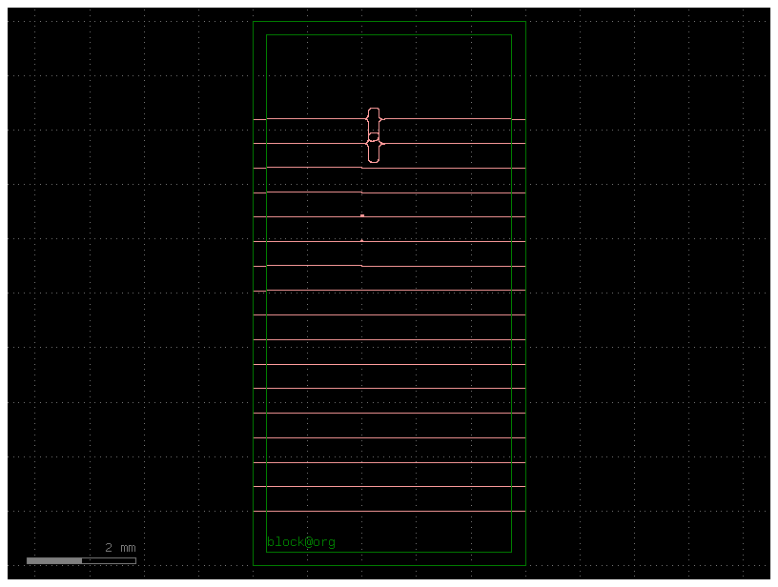
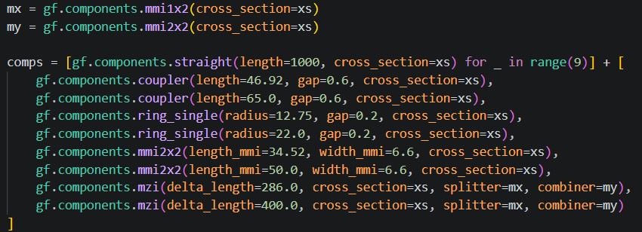
Learning outcome #3 – Notebook section 3. Complete layout
Python code block 1:
First, I set up the main layout and added the 5x10 mm die. I also created a custom cross-section with a 1.2 um width to make sure all parts fit together without any width errors.
Python code block 2:
Next, I put all the required devices into one single list. This list includes 9 straight waveguides and two of each component from the previous labs (MMIs, DCs, rings, and MZIs).
Complete layout screenshot
screenshot

Slide 14
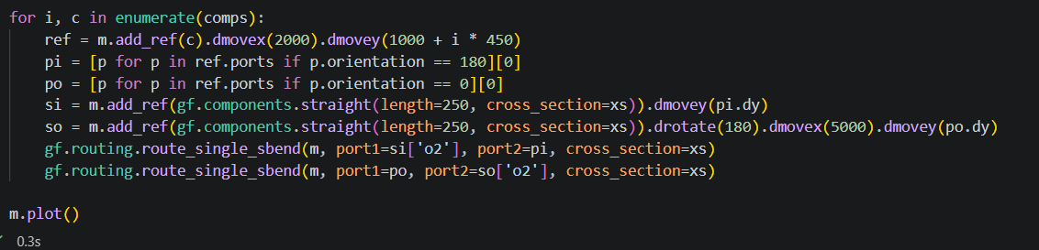
Learning outcome #3 – Notebook section 3. Complete layout
Python code block 3:
Using a loop, I placed each component in the middle of the chip. To find the right connection points, I filtered the ports by their angle: 180 degrees for the left input and 0 degrees for the right output.
Python code block 4:
Finally, I placed short straight waveguides on the left and right edges of the chip to act as I/O ports. I connected them to the main components using the route_single_sbend function.
Complete layout screenshot
screenshot

Slide 15
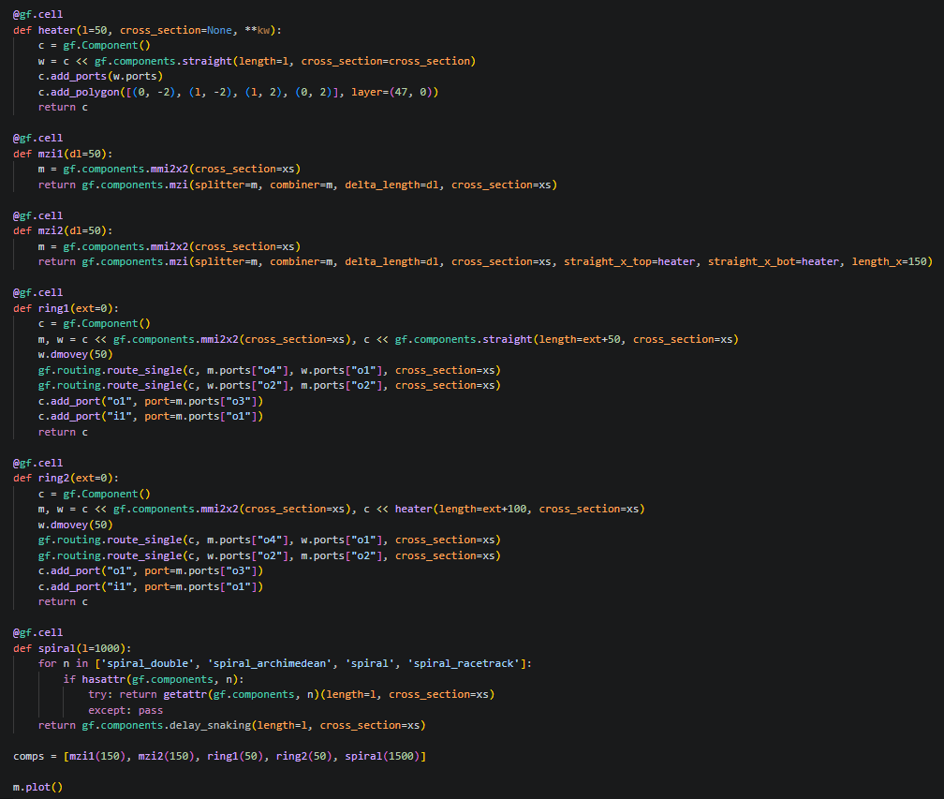
Learning outcome #4 – Notebook section 4. Exercises – 1 slide per bullet point
Code for A)
Part a) Creating components
- Create a cell component for a unbalanced MZI, using 2x2 50:50 MMIs with arm length difference as parameter
- Create a cell component based on the previous, where the arms have thermal tuners on top of each one
- Create a cell component for an all-pass ring resonator, using 2x2 50:50 MMIs, with extra length parameter for different perimeters
- Create a cell component based on the previous, where the ring has a thermal tuner on top along all the perimeter
- Create a cell component based on existing GDSfactory spiral components, with length as parameter
Part b) Creating die
- Create a die W = 5 mm x L = 10 mm
- Create an array of I/Os spaced at 250 µm (as much I/Os as the width allows)
- Create a cell component of this die, with I/Os accessible to connect
Part c) Floorplaning and die layout
- Make an instance of the die as host component for your layout
- Add 3 sets of 3 straight waveguides, from left to right of the die, top, middle and bottom of the die
- Add 2 of each of the components above, with different lengths
- Connect all your components to the I/Os
Screenshot for …

Slide 16
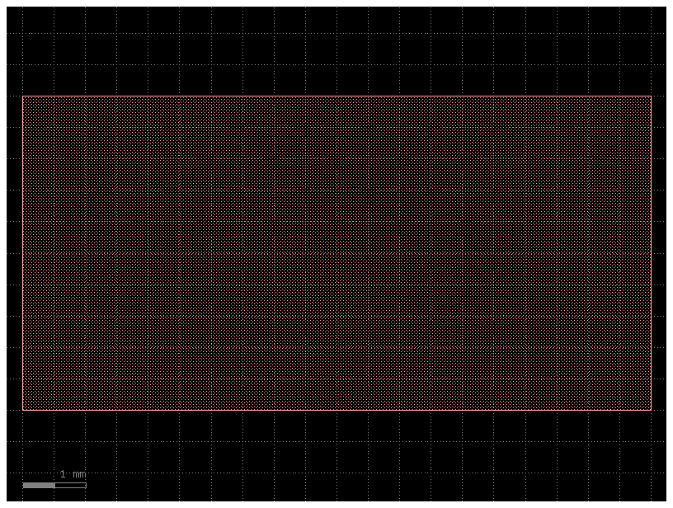
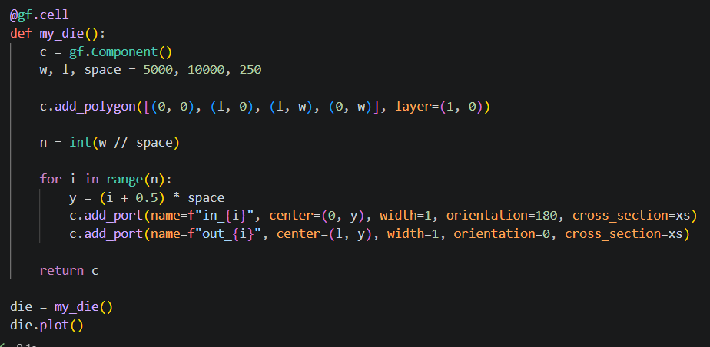
Learning outcome #4 – Notebook section 4. Exercises – 1 slide per bullet point
Code for B)
Part a) Creating components
- Create a cell component for a unbalanced MZI, using 2x2 50:50 MMIs with arm length difference as parameter
- Create a cell component based on the previous, where the arms have thermal tuners on top of each one
- Create a cell component for an all-pass ring resonator, using 2x2 50:50 MMIs, with extra length parameter for different perimeters
- Create a cell component based on the previous, where the ring has a thermal tuner on top along all the perimeter
- Create a cell component based on existing GDSfactory spiral components, with length as parameter
Part b) Creating die
- Create a die W = 5 mm x L = 10 mm
- Create an array of I/Os spaced at 250 µm (as much I/Os as the width allows)
- Create a cell component of this die, with I/Os accessible to connect
Part c) Floorplaning and die layout
- Make an instance of the die as host component for your layout
- Add 3 sets of 3 straight waveguides, from left to right of the die, top, middle and bottom of the die
- Add 2 of each of the components above, with different lengths
- Connect all your components to the I/Os
Screenshot for …

Slide 17
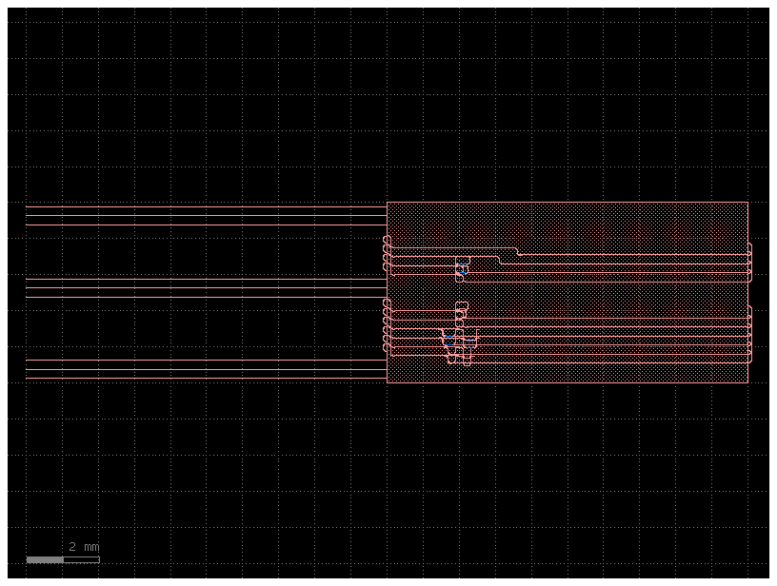
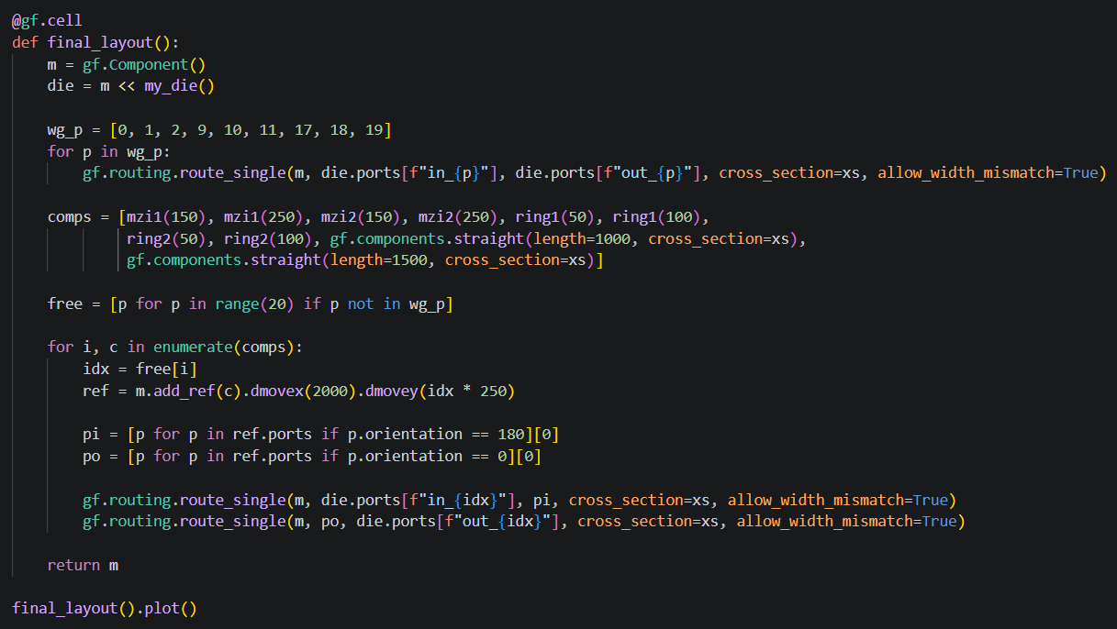
Learning outcome #4 – Notebook section 4. Exercises – 1 slide per bullet point
Code for C)
Part a) Creating components
- Create a cell component for a unbalanced MZI, using 2x2 50:50 MMIs with arm length difference as parameter
- Create a cell component based on the previous, where the arms have thermal tuners on top of each one
- Create a cell component for an all-pass ring resonator, using 2x2 50:50 MMIs, with extra length parameter for different perimeters
- Create a cell component based on the previous, where the ring has a thermal tuner on top along all the perimeter
- Create a cell component based on existing GDSfactory spiral components, with length as parameter
Part b) Creating die
- Create a die W = 5 mm x L = 10 mm
- Create an array of I/Os spaced at 250 µm (as much I/Os as the width allows)
- Create a cell component of this die, with I/Os accessible to connect
Part c) Floorplaning and die layout
- Make an instance of the die as host component for your layout
- Add 3 sets of 3 straight waveguides, from left to right of the die, top, middle and bottom of the die
- Add 2 of each of the components above, with different lengths
- Connect all your components to the I/Os
Screenshot for …

Slide 18

Thank you

