Slide 1







x
Felixitously facilitates optimal food inventory management.
A spike in energy prices coupled with skyrocketing consumer inflation has accelerated the cost-of-living crisis.
We tackle food waste on four distinct levels.
Optimise the food inventory management
Incentivise volunteering
and donations
Provide recipe ideas
Build a macro marketplace

Slide 2
x
An exemplary Felixitously
user journey walks you through our app.

Slide 3






x
Our technical landscape encompasses various technologies.
Develop mobile app (iOS or Android) using Flutter framework.
Leverage existing Cloud provider services (AWS or GCP) for deployment.
Suggest recipe via content-based recommender system (Python v3.8.0).
Build backend APIs (Python v3.8).
Aggregate third-party data from NGOs, food suppliers, and other non-profitable players.
Optimise bills using NLP (info on utensils and kitchen appliances) to determine kw utilisation per recipe.

Slide 4

x
The Felixitously ML algorithm targets food waste at its core.
Azure DB
Recipes
User preferences
Start
Prioritise by nutrition, energy cost and time
Recommendation engine
Suggested list of items
Food inventory
Ingredients’ expiry date

Slide 5
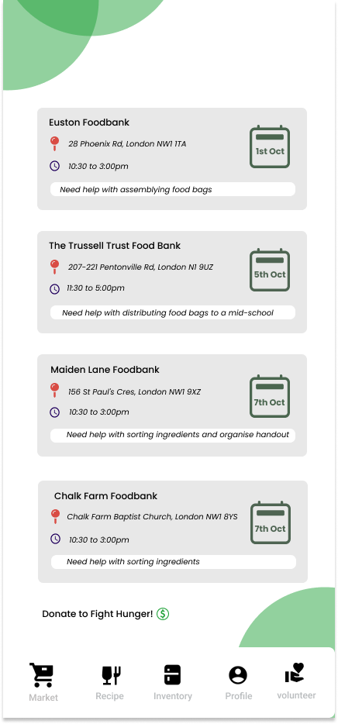
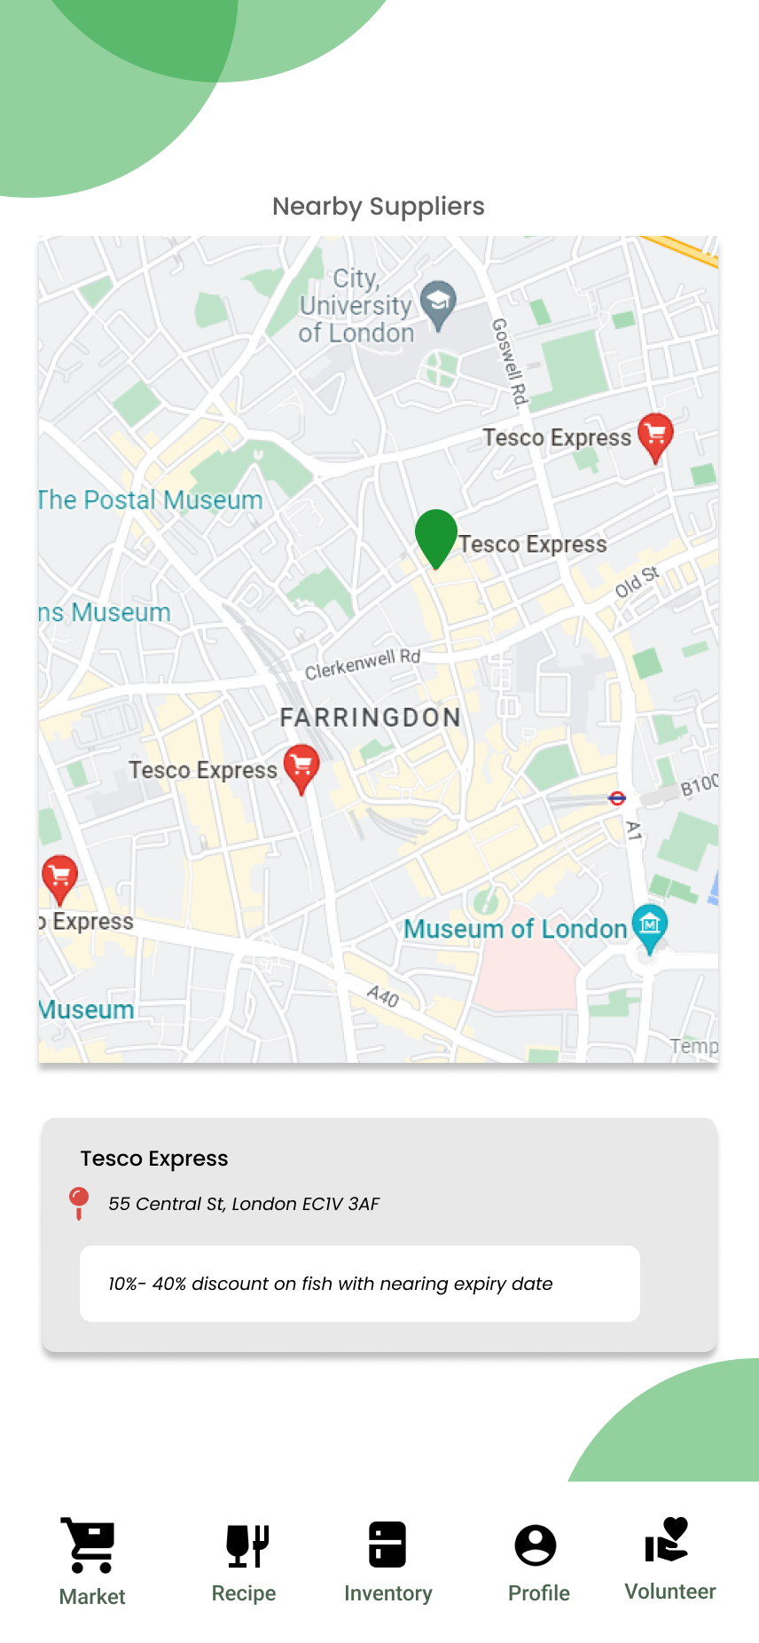
x
Our X-factor comprises
the provision of both a communal market place
as well as a
volunteering and
donation feature.

