Slide 1
Mobile IP: Part 2
Discovery, Registration and Tunneling

Slide 2
Learning Objectives
Introduction to different phases of Mobile IP
Understanding how a mobile node search the agents using Discovery process
Understand how care-of-addesses are acquired
Understand the registration process in which a mobile registers its care-of-addesses with Home Agent
Understand techniques of Tunnelling and encapsulation

Slide 3

Goals of Agent Discovery
Where Am I?
What are the addresses available?
Who is the agent here?

Slide 4

Agent Advertisement
Agents advertise by ICMP Router Discovery messages
Forein Agent
Foreign Agent
Mobile Node
Home Agent

Slide 5
The network part of agent’s address is same as mine
Haash !!!
I ‘m home
Foreign Agent
Foreign Agent
172.16.116.35
(Agent address)
Mobile Node
Agent Solicitation
Home Agent
172.16.116.23
(Home Adress)

Slide 6
The network part of agent’s address is diff. from my part….
OMG !!!
I m in another network
I need COA
Foreign Agent
Foreign Agent
Agent Advertisement
192.168.1.35(Agent address)
Mobile Node
Home Agent
172.16.116.23
(Home Adress)

Slide 7
I have a care-of-address now
192.168.1.35
(FA care-of-address)
Foreign Agent
Foreign Agent
Agent Advertisement
192.168.1.35(Agent address)
Mobile Node
172.16.116.23
(Home Adress)

Slide 8
I am ICMP header for Mobile IP..I have something extra
type =16 | length | Sequence number
Registration Lifetime |  | R | B | H | F | M | G | r | T | Reserved
COA1
COA2
R-bit: registration with this agent is required even when the mobile node uses a co-located COA.
B-bit: The Foreign agent is busy to take any registrations
H-bit: Agent is home agent
F-bit: Agent is foreign agent
M-bit: Minimal encapsulation is used for encapsulation
G-bit: Generic routing encapsulation is used
r-bit: was initially set to V in first version of mobile IP (RFC 2002) suggested use of header compression and should be ignored.
T-bit: reverse tunneling.
COA1 and COA 2 are advertised care-of-address. Mobile node can have them

Slide 9
Let me Search the Agent
Foreign Agent
Foreign Agent
Agent Solicitation RFC 1256
Mobile Node
172.16.116.23
(Home Adress)

Slide 10

DHCP for rescue
There is no foreign agent
Foreign Agent
All foreign agents are busy
Mobile Node
Co-located care-of-address

Slide 11
I am ICMP header for Mobile IP..I have something extra
type =16 | length | Sequence number
Registration Lifetime |  | R | B | F | M | G | R | T | Reserved
COA1
COA2
type = 16
length = number of COA provided with the message. It is equal to 6+4*(no. of addresses)
Registration lifetime = maximum lifetime specified by the agent in seconds which the node can request during registration;
Sequence No. = total no. of advertisements sent during initialization.

Slide 12
Registration
Mobile node registers the obtained care-of-address with the Home Agent
Informs Home Agent with its current location
Process depends on type of care-of- address:
  Foreign Agent COA
  Co-located care-of-address

Slide 13
Case 1: COA is that of Foreign Agent
MN: Mobile Node
FA: Foreign Agent
HA: Home Agent
MN
FN
HA
Registration request
Registration request
Registration reply
Registration reply

Slide 14
Case 1: COA is Co-located care-of-address
MN: Mobile Node
HA: Foreign Agent
MN
HA
Registration request
Registration reply

Slide 15
Registration Request
type =1 | S | B | D | M | G | r | T | x | lifetime
Home address
Home agent /foreign agent
COA
Identification
Extensions
S bit : MN wants previous mobility bindings to be retained
B bit is set if MN wishes to receive broadcast messages as HA
D bit indicates that MN uses co-located address
M bit : minimal encapsulation.; G bit : generic routing encapsulation.
T bit indicates reverse tunneling from the FA
r & x are set to zero
Life time = validity of registration in seconds. A zero indicates the registration and all the bits set to one indicates infinite time

Slide 16
Registration Reply
type =3 | code | lifetime
Home address
Home agent
COA
Identification
Extensions
Registration | Code | Explanation
Successful | 0 | Registration accepted
 | 1 | Registration accepted, but simultaneous mobility bindings unsupported
Denied by FA | 66 | Insufficient resources
 | 67 | Mobile node failed authentication
 | 68 | Home agent failed authentication
 | 69 | Requested lifetime > advertised limit
 | 88 | Home agent unreachable
Denied by HA | 130 | Insufficient resources
 | 131 | Mobile node failed authentication
 | 132 | Foreign agent failed authentication
 | 133 | Registration identification mismatch
 | 136 | Unknown Home agent address

Slide 17
Successful Registration
Mobile Binding maintained at HA.
Mobile Binding: Home address + care-of-address + Registration lifetime in secs
Mobile should register again before the binding period expires

Slide 18
Tunneling and Encapsulation
Tunnel : Data stream between two endpoints
HA FA
Tunnel headers when FA COA is used
HA MN
Tunnel header when co-located care-of-address is used
Encapsulated Packet
Encapsulated Packet

Slide 19
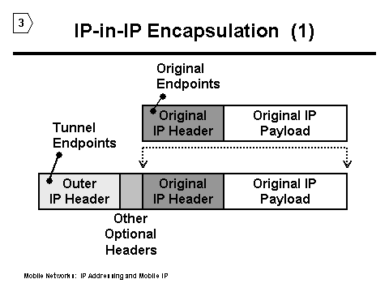
Encapsulation
Putting one data packet as data of another packet
IP-within-IP
Minimal IP
Generic IP

Slide 20
IP-within-IP Encapsulation
Mandatory , RFC 2003
Version = 4 | IHL |  | DS (TOS) | Total length
IP identification |  |  |  | flags | fragment offset
time to live |  | Protocol = 4 |  | Header checksum
IP address of HA (source)
Care-of-address of MN (Destination)
Version = 4 | IHL |  | DS (TOS) | Total length
IP identification |  |  |  | flags | fragment offset
time to live |  |  |  | Protocol = 4 | Header checksum
IP address of CN (source)
Home address of MN (Destination)
Outer Header
Inner Header

Slide 21
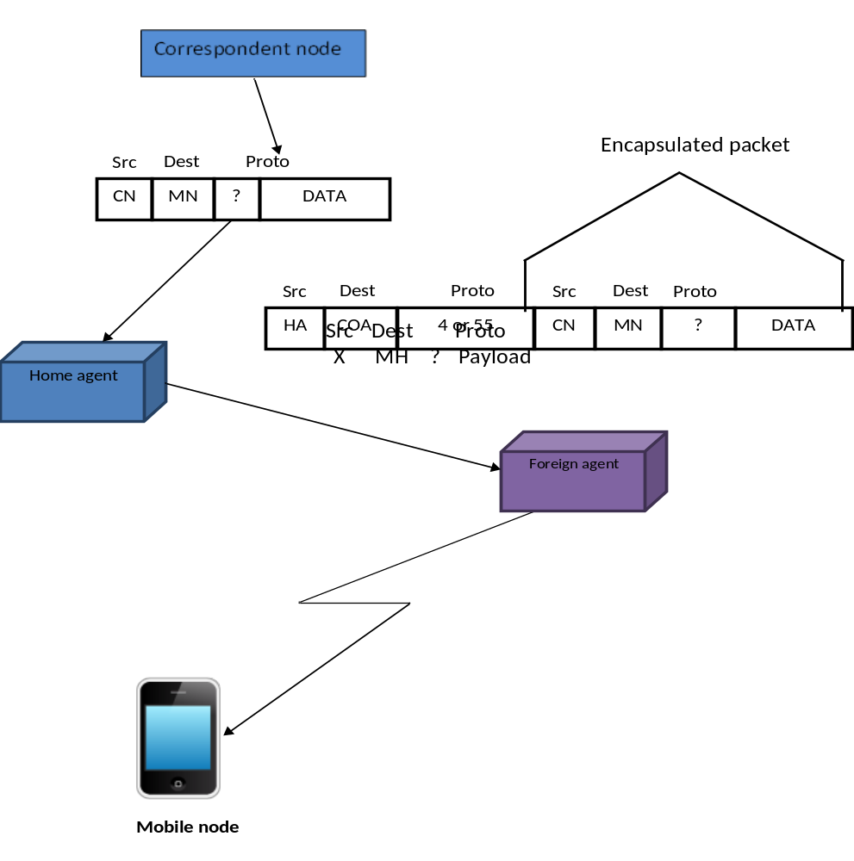

Slide 22
Minimal Encapsulation
Optional : RFC,2004
Cannot be used with fragmented packets
Inner header is modified
version | IHL |  | DS (TOS) | Total length
IP identification |  |  |  | Flags | Fragment offset
Time to live |  | Protocol =55 |  | Header checksum
IP address of HA
Care-of address of COA
Lay 4 protocol | S |  | reserved | IP checksum
Home address of MN
Original sender IP address (id S=1)
TCP/UDP/…payload
Outer header
Inner
Header
With less fields

Slide 23
Generic Encapsulation
Provides support to network layer protocol other than IP
Allows packet of one protocol to be data part of packet of another protocol
RFC 1701,RFC 2784
Original Header | Original data
Outer header | GRE header | Original header | Original data
New header | New data

