Slide 1
Certificate Authority
General Overview

Slide 2
Objective
Module that has dual goals:
Can run as independent system for enterprise grade CA
Can be an embedded modules (library) for other software modules that requires the X.509 and keypair management
CA system
Workflow system to manage issuer keypairs for subscriber’s certificate lifecycle
Standard Maker-Checker/Approval workflow should be in place
All high trust online security system should apply here

Slide 3
Database
Credential
Keep user profile
Each user will have single entry, with respective role assigned
Each user will have dual keypairs – signing & KEM, protected by password
Each user will NOT have certificate
Public key is signed by eligible admin (refers RBAC) who created the credential *
Keypair
Keep keypair info – Only signing for now
Keypair will have initial status of ”pending”, when there is no certificate yet
Eligible admin (refers RBAC) can create
Self-sign certificate
Certificate Signing Request (CSR)

Slide 4
Role Base Access Control (RBAC)
Role | Access
CA Admin | Manage system parameters Manage CA Admin, Key Admin, RA Admin & Auditor View audit trail (app + security) Initialize system keypairs and certificates Manage remote access credentials (CRUD)
Key Admin | Manage Key Admin Manage private key store (e.g HSM, software) Manage keypair (CRUD) Authorized Key Ceremony
RA Admin | Manage RA Officer Manage RA Admin View application audit trail
RA Officer | Request certificate issuance by sending in CSR and cert profile
Auditor | View audit log (app + security) Oversee Key Ceremony

Slide 5
X.509 Certificate Hierarchy
Root CA
Subject expiry date cannot be later then issuer
Sub CA
Sub CA
Sub CA
Sub CA
Sub CA
Sub CA
Leaf Issuer
Subscriber
Subscriber
Subscriber
Subscriber

Slide 6
Keypair Protection
Keypair Protection | Meaning | Target Keypair Type
Split auth token | Split the password or auth token that activate the private key | Root keypair (Ent. CA / embedded) Sub root keypair (Ent. CA / embedded)*
Split key | Split the private key itself into threshold scheme | Root keypair (embedded) Sub root keypair (Ent. CA / embedded)*
Credential owned | Keypair is owned by the creator Creator can delegate the access of the keypair to another user | Sub root keypair (Ent. CA / embedded) – Leaf Issuer
* More common on non-leaf issuer because of operational issue

Slide 7
System Bootstrap
Bootstrap Credential
1st CA Admin | Create credential (with sign & KEM keypair), user given password
Keypair ACL | Create credential (with sign & KEM keypair), random password encrypted by 1st CA Admin’s KEM public key
System Keypair
:root – System Root | Create keypairs (sign only), random password encrypted by 1st CA Admin’s KEM public key
:sub_root – Operational Root | Create keypairs (sign only), random password encrypted by 1st CA Admin’s KEM public key
:strap_ca_remote_service_host_signing_key | Create keypairs (sign only), random password encrypted by 1st CA Admin’s KEM public key
:strap_ca_remote_service_host_cipher_key | Create keypairs (sign only), random password encrypted by 1st CA Admin’s KEM public key

Slide 8
Root Key Creation (Enterprise)
Key Admin 1
Key Ceremony
Authorized
Oversee/Supervise
Auditor
Key Admin 2
Whole key ceremony is:
Attended by all stakeholders
The whole process is video recorded
Part of certification submission
Generate Keypair
Store Keypair in HSM
Generate either:
Self-Sign Certificate OR
CSR
Password to activate keypair is split into threshold scheme (Supported by HSM)

Slide 9
Root Key Creation (Embedded) Sub Root Key Creation
Store Keypair in HSM
Generate Keypair
Store Keypair in software keystore
Generate either:
Self-Sign Certificate OR
CSR
Either option:
Password to activate keypair is split into threshold scheme (HSM or Software)
Private key is split into threshold scheme (Software)
Creator decide what to do (HSM & Software)

Slide 10
Certificate Renewal – Key Rollover
Root CA
Subject expiry date cannot be later then issuer
Sub CA
Sub CA
Sub CA
Sub CA
Sub CA
Sub CA
Subscriber
Subscriber
Subscriber
Subscriber

Slide 11
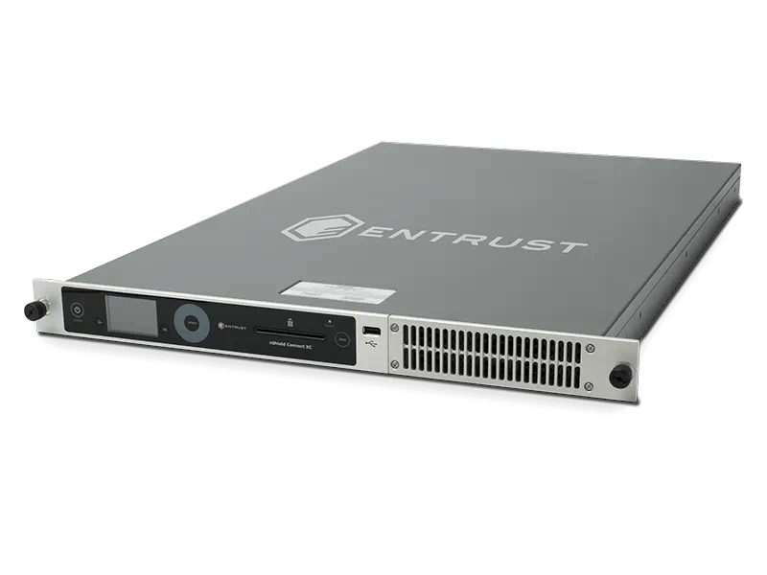
Full CA Environment (Enterprise)
Private Network Zone
RA System
(Web Services + Portal)
CA Engine
Mutual
Authentication
HSM
LDAP
(Certificate + CRL)
Online Certificate Status Protocol (OCSP)
Digital Time Stamping *

Slide 12
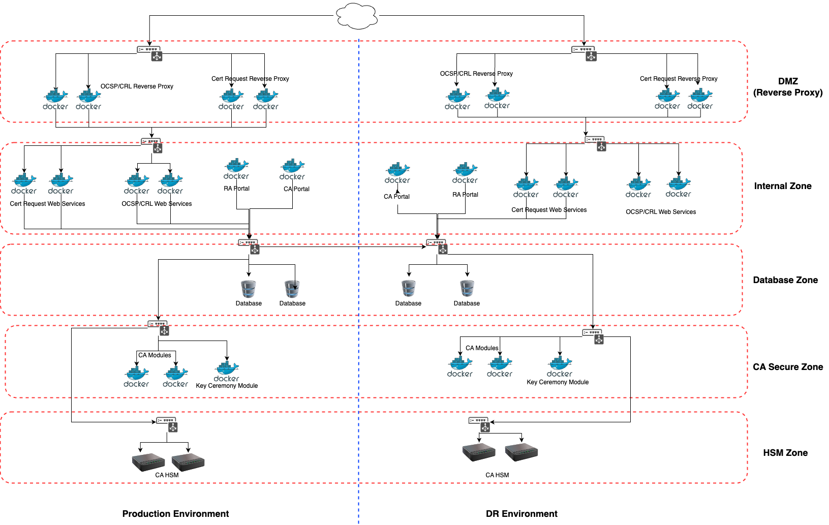

Slide 13
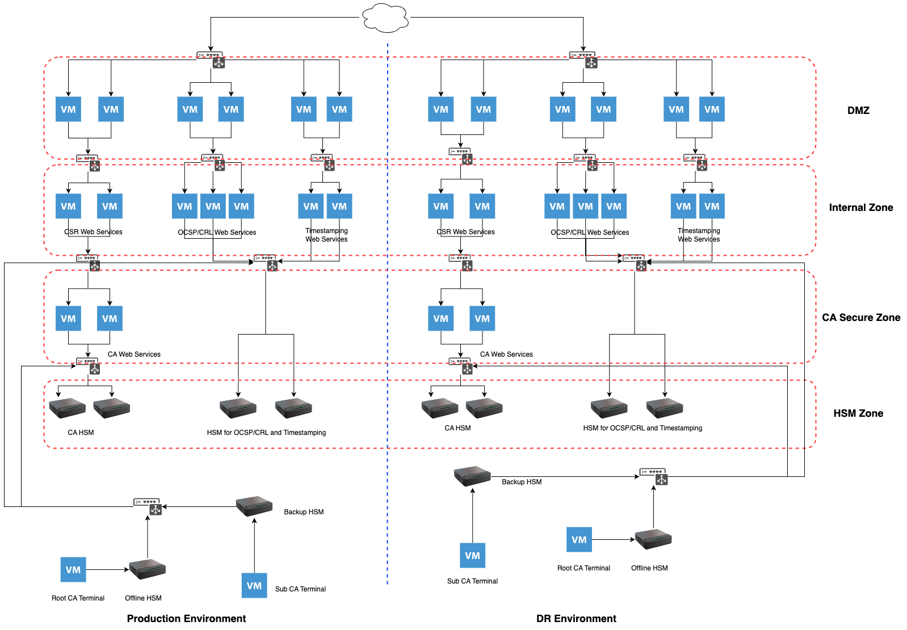

Slide 14
Module | Status | Incomplete
CA Engine | 80% Completed | Maker-Checker CRL generation OCSP generation Hybrid certificate (R&D) – Multi Signature / algo KEM signature Support HSM
RA Engine | 20% Completed | Maker-Checker CSR verification (PQC) – Portal (R&D) Cert profile – Portal Cert Suspension / Revocation – Portal System Config – Portal User Management – Portal Subscriber Management (PQC) – Portal CRL config - Portal
OCSP Service | 10% | Web services
Digital Time Stamping | 10% | Engine – Time source sync Portal – Management Web services – Client to call

Slide 15


End-to-End Post Quantum (PQC) Security Solution
From military to basic security infrastructure until cross border secure platform to boost e-economy
Ensure an e-Sovereign Tomorrow
hello@antrapol.com

