Slide 1
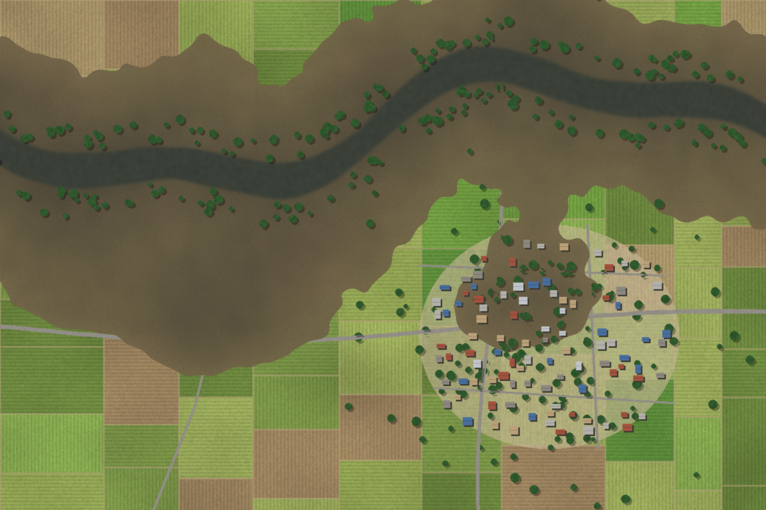

PROJECT PRESENTATION
Flood Extent Mapping Using Drone Imagery
Deep-learning segmentation and GIS analytics for rapid flood assessment and emergency response
Group 16
Harsh Yadav- 2611MC04
Ratnesh Pandey- 2611MC19
Saurav Kumar- 2611MC08
Antra Sinha- 2621MA06
Notes:
Introduce the topic: using drones to rapidly map where floodwater is, and using AI and GIS to turn those images into maps and numbers that disaster managers can act on.

Slide 2

01
Motivation: why flood mapping matters
06
Image preprocessing
Outline
02
Existing methods and their gaps
07
Water detection and deep learning
From a drone flight to a decision-ready flood impact map
03
Problem statement and objectives
08
Flood mask and GIS area analysis
04
System architecture
09
Impact assessment and applications
05
Data acquisition and flight planning
10
Challenges, future scope and conclusion
2
Notes:
Walk through the structure: motivation, the gap in current methods, the proposed pipeline stage by stage, results, applications and limitations.

Slide 3





01 · MOTIVATION
Floods are the most frequent disaster, and time is critical
3,254
44%
1.6 bn+
73%
major floods recorded worldwide between 2000 and 2019
of all recorded disaster events in 2000–2019 were floods
people affected by floods over the same twenty years
of Bihar’s geographical area (68,800 of 94,160 km²) is flood-affected
Why rapid mapping? In the first hours after a flood, rescue teams must know where the water is, which roads are cut off and which settlements are stranded. Conventional surveys take days; decision-makers need a reliable flood map within hours.
Sources: UNDRR & CRED, The Human Cost of Disasters 2000–2019 (2020); FMISC, Water Resources Dept., Govt. of Bihar.
3
Notes:
Floods and storms dominated disasters in 2000–2019. Bihar is India’s most flood-prone state: about 73% of its area is flood-affected and about 76% of North Bihar’s population lives under recurring flood threat. The key point is speed: response decisions depend on knowing the flood extent quickly.

Slide 4

02 · BACKGROUND
Existing flood mapping methods and their gaps
Criterion | Ground survey | Optical satellite (e.g., Sentinel-2) | SAR satellite (e.g., Sentinel-1) | Drone (UAV)
Spatial resolution | Point observations | 10 m | ~10 m pixel spacing | 1–5 cm GSD
Response / revisit | Days to weeks | ~5 days | 6–12 days | On demand, within hours
Clouds & weather | Unaffected, but unsafe in floodwater | Blocked by monsoon cloud cover | Penetrates clouds | Flies below clouds; grounded by heavy rain or wind
Coverage | Very small | Very large (290 km swath) | Very large (250 km swath) | Local (a few km² per flight)
Detail of roads & houses | High, but slow | Low | Low; speckle and urban errors | Very high
Cost | Labour-intensive | Free data | Free data | Low operating cost
Takeaway: drones fill the gap between wide-area but coarse satellite monitoring and detailed but slow ground surveys.
4
Notes:
Satellites are excellent for regional overviews: Sentinel-1 radar works through clouds, but at ~10 m it cannot show which individual houses or road segments are flooded. Optical satellites are blocked by monsoon clouds. Drones give centimetre detail on demand, at the cost of smaller coverage.

Slide 5





03 · PROBLEM & OBJECTIVES
What this work sets out to achieve
Acquire
Capture high-resolution, georeferenced aerial imagery of flood-affected areas with UAVs.
Detect
Problem statement
Segment water-covered pixels using image processing and deep-learning models.
Develop an automated, end-to-end system that converts post-flood drone imagery into a georeferenced flood-extent map and quantitative impact statistics, fast enough to guide emergency response.
Map
Generate clean flood masks and vector flood boundaries.
Quantify
Compute the inundated area with GIS tools in a projected coordinate system.
Assess
Identify affected roads, buildings and agricultural land for decision-makers.
5
Notes:
The five objectives map directly onto the stages of the pipeline shown next: acquire, detect, map, quantify and assess.

Slide 6










04 · METHODOLOGY
End-to-end system architecture
Input: post-flood UAV imagery
Auxiliary GIS layers: OSM roads, building footprints, land use, pre-flood water
1. Data acquisition
2. Preprocessing
3. Water segmentation
4. Post-processing
5. GIS analysis
6. Decision support
UAV flights over the flooded area; RGB or multispectral images with GNSS tags
Photogrammetry to orthomosaic and DSM; georeferencing; tiling
Deep-learning model (U-Net / DeepLabv3+) predicts water per pixel
Thresholding, morphology, noise removal, polygonization
Flood area, boundary, overlay with roads, buildings and cropland
Flood maps, impact reports and dashboards for responders
OUTPUTS
Flood extent map
Flooded area (ha)
Affected roads (km)
Affected buildings
Crop loss (ha)
6
Notes:
Six stages. The deep-learning segmentation (highlighted) is the core, but the GIS stage is what converts pixels into actionable numbers. Auxiliary vector layers such as OpenStreetMap roads and building footprints are brought in at the GIS stage.

Slide 7
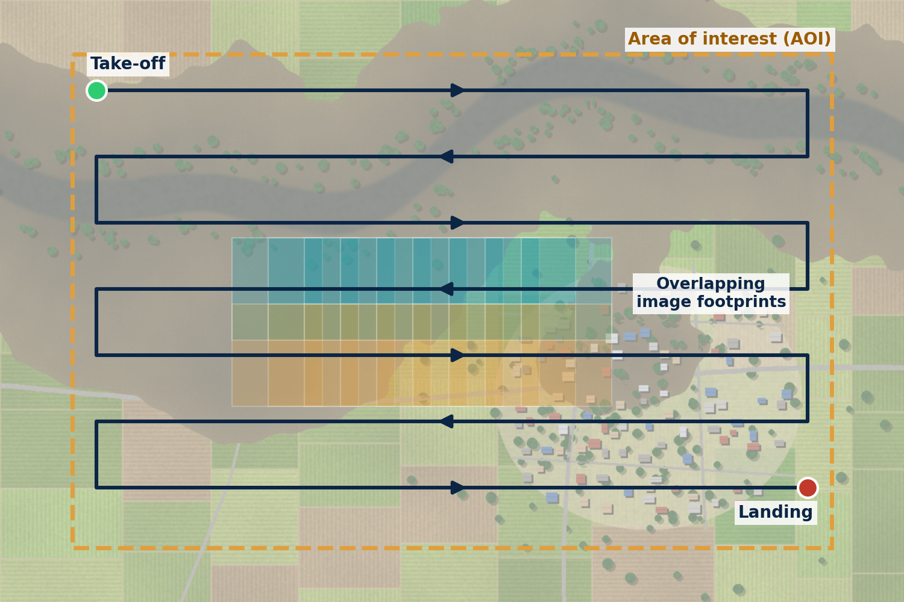
05 · DATA ACQUISITION
Drone survey design and flight planning
Parameter | Typical setting
Platform | Multirotor for small sites; fixed-wing VTOL for large areas
Sensor | RGB camera; optional multispectral with NIR band
Flight altitude | 80–120 m AGL (≤ 120 m in India’s green zones)
Front / side overlap | 75–80% / 65–70% for reliable mosaicking
Georeferencing | RTK/PPK GNSS or ground control points
Timing | Close to flood peak; avoid solar noon to limit sun glint
Ground Sampling Distance (GSD)
GSD = (Sensor width × Altitude) / (Focal length × Image width)
Example: 13.2 mm × 100 m / (8.8 mm × 5472 px) ≈ 2.7 cm per pixel
Lawn-mower (grid) flight pattern with overlapping image footprints over the area of interest
7
Notes:
Flight planning determines data quality. High overlap is needed because floodwater is a uniform, low-texture surface, which makes feature matching difficult. GSD tells us the ground size of one pixel; the example uses a 1-inch sensor camera at 100 m and gives about 2.7 cm per pixel. In India, the Drone Rules 2021 allow flights up to 400 ft (120 m) in green zones without prior permission.

Slide 8
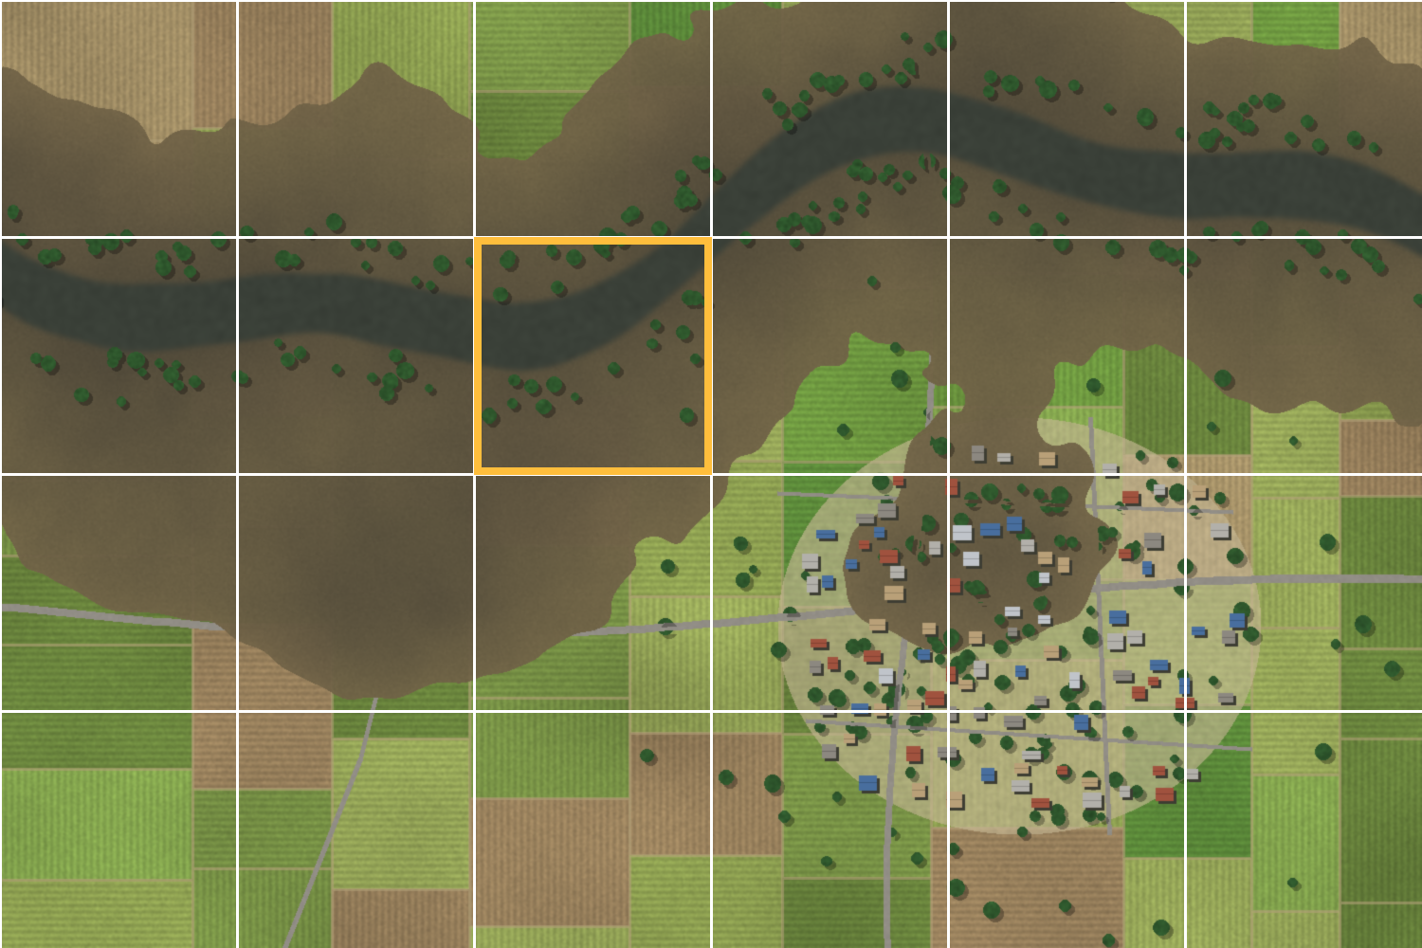



06 · PREPROCESSING
From raw photos to analysis-ready tiles
1
2
3
4
5
Image quality check
Structure-from-Motion
Orthomosaic & DSM
Georeferencing
Tiling & normalisation
Discard blurred, over-exposed and oblique frames
Match tie points and run bundle adjustment to align images
Seamless, distortion-free map plus surface elevation model
Tie to GCPs / RTK; reproject to UTM (e.g., Zone 45N for most of Bihar)
512 × 512 px tiles with overlap; normalise and augment
Photogrammetry: Agisoft Metashape, Pix4Dmapper, OpenDroneMap (WebODM)
Geoprocessing: GDAL, Rasterio, QGIS for reprojection, clipping and tiling
Augmentation: Flips, rotations, brightness/contrast and hue shifts to mimic turbid water and lighting changes
Orthomosaic split into tiles; highlighted tile = one model input
8
Notes:
Photogrammetry stitches hundreds of overlapping photos into one georeferenced orthomosaic. Projecting to a metric UTM system is essential so that later area calculations come out in square metres. Tiling is needed because a full orthomosaic is far too large to feed into a neural network at once.

Slide 9


07 · WATER DETECTION
Techniques for identifying water-covered regions
SELECTED
Index & threshold based
Classical machine learning
Deep learning (CNNs)
HOW IT WORKS
NDWI = (Green − NIR) / (Green + NIR) for multispectral drones
Colour (HSV) rules and Otsu thresholding for RGB drones
STRENGTHS
Fast; no training data needed
LIMITATIONS
Fails on muddy water, shadows and sun glint; thresholds do not transfer between sites
HOW IT WORKS
Random Forest or SVM on colour, texture (GLCM) and index features
Object-based image analysis (OBIA)
STRENGTHS
Works with small labelled sets; interpretable
LIMITATIONS
Hand-crafted features; limited spatial context
HOW IT WORKS
U-Net, DeepLabv3+, SegFormer learn features end-to-end
Pixel-wise water / non-water prediction
STRENGTHS
Highest accuracy; handles turbid water and partial submergence
LIMITATIONS
Needs labelled data and GPU training
9
Notes:
Index methods like NDWI (McFeeters, 1996) need a near-infrared band, which most low-cost drones lack. Floodwater in the Gangetic plains is heavily silt-laden and brown, so simple colour thresholds confuse it with wet soil. Deep learning uses spatial context and is therefore selected for this work.

Slide 10
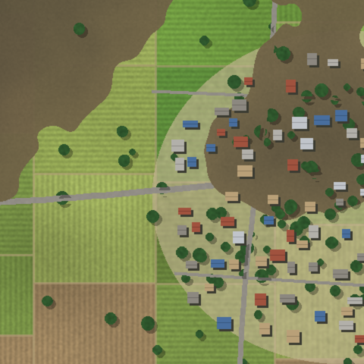

07 · DEEP LEARNING MODEL
U-Net encoder–decoder for water segmentation
ENCODER
DECODER
Training configuration
Input | 512 × 512 × 3 RGB tiles
Backbone | ResNet-34 encoder, ImageNet pre-trained
Output | 1×1 conv + sigmoid: water probability
Loss | Binary cross-entropy + Dice
Optimiser | Adam, learning rate 1×10⁻⁴
Schedule | Batch 8; up to 100 epochs with early stopping
Alternatives | DeepLabv3+, SegFormer
Input tile
Water mask
512² · 64
256² · 128
128² · 256
64² · 512
32² · 1024
3×3 conv + ReLU (encoder)
3×3 conv + ReLU (decoder)
2×2 max-pool (down)
2×2 up-conv (up)
Skip connection (concatenate)
Bottleneck
10
Notes:
U-Net (Ronneberger et al., 2015) has a contracting encoder that captures context and an expanding decoder that recovers precise boundaries. Skip connections pass fine spatial detail across, which is why U-Net draws sharp water edges. Dice loss is combined with cross-entropy to cope with class imbalance when only a small part of a tile is water.

Slide 11

07 · DATA & EVALUATION
Training datasets and evaluation metrics
Benchmark UAV flood datasets
Pixel-level confusion matrix
Dataset | Event | Images | Flood-relevant labels
FloodNet (2021) | Hurricane Harvey, Texas, 2017 | 2,343 (3000 × 4000 px) | Water; flooded / non-flooded buildings and roads
RescueNet (2023) | Hurricane Michael, Florida, 2018 | 4,494 | Water; road-clear / road-blocked; building damage levels
Regional dataset (proposed) | Monsoon floods, North Bihar | Field UAV survey tiles | Binary water / non-water masks for local conditions
 | Predicted water | Predicted non-water
Actual water | TP | FN
Actual non-water | FP | TN
Precision
TP / (TP + FP)
How much predicted water is real
Recall
TP / (TP + FN)
How much real water is found
F1 / Dice
2 · P · R / (P + R)
Balance of precision and recall
IoU
TP / (TP + FP + FN)
Overlap of prediction and ground truth
Models pre-trained on public datasets are fine-tuned on local imagery, because silt-laden Gangetic floodwater looks very different from US hurricane floods.
11
Notes:
FloodNet (Rahnemoonfar et al., 2021) and RescueNet (Rahnemoonfar et al., 2023) are the main public high-resolution UAV disaster segmentation datasets. IoU is the primary metric because plain pixel accuracy is misleading when most pixels are non-water.

Slide 12
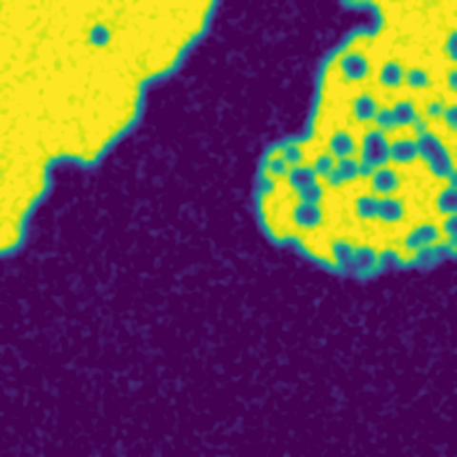
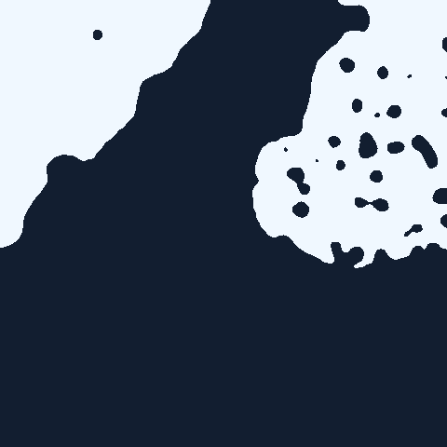


08 · FLOOD MASK GENERATION
From model probabilities to a clean flood mask
Drone tile
Probability map
Raw mask (p > 0.5)
Refined flood mask
RGB input from the orthomosaic
Model output: 0 (dry) to 1 (water)
Speckle noise; holes under roofs and trees
After morphology and area filtering
Morphological opening
Closing & hole filling
Minimum mapping unit
Polygonize & simplify
Removes isolated false-water pixels
Fills gaps under roofs and tree canopy
Drops blobs smaller than a set area
Raster to vector; Douglas–Peucker smoothing
12
Notes:
The network outputs a probability for every pixel. A 0.5 threshold gives a raw mask that is noisy and has holes where rooftops or trees hide the water. Morphological operations and a minimum-area filter clean it up, and polygonization converts it into vector flood boundaries for GIS.

Slide 13
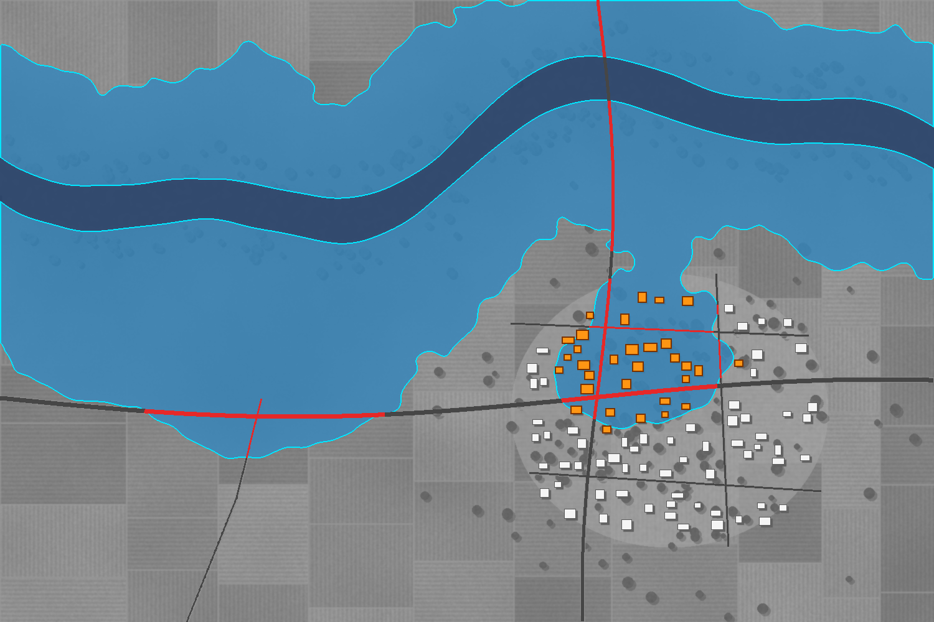

08 · RESULT
Drone orthomosaic to GIS flood map
(a) Post-flood drone orthomosaic
(b) Segmented flood extent with impact layers
Permanent river
Flood extent
Flood boundary
Flooded road
Affected building
Unaffected building
Demonstration scene: simulated 1.5 km × 1.0 km rural study area (river, cropland and village) used to illustrate the pipeline output.
13
Notes:
Left: what the drone sees, a muddy flood spreading from the river into cropland and the western part of a village. Right: the same area after segmentation and GIS overlay. Newly flooded area is separated from the permanent river channel; submerged road segments and buildings touching floodwater are highlighted.

Slide 14
08 · GIS ANALYSIS
Calculating flood area and boundaries
1
Polygonize
Convert the refined raster mask into vector flood polygons (GDAL / Rasterio).
66.4 ha
44%
2
Project to metric CRS
Reproject to UTM so that areas are measured in m², not degrees.
newly flooded area
of the 150 ha study area inundated
3
Remove permanent water
Subtract the pre-flood river and pond layer to isolate new inundation.
10.3 ha
76.7 ha
4
Measure & export
Compute area and perimeter; export boundaries as GeoJSON, Shapefile or KML.
permanent river excluded from flood extent
total water surface detected
Flooded area A = N_{flood} × GSD²
Flood extent = post-flood water − permanent water
Demo: 664,078 px × (1 m)² = 664,078 m² ≈ 66.4 ha
GIS tools: QGIS · ArcGIS Pro · GDAL / Rasterio · GeoPandas
14
Notes:
Area is simply the number of flood pixels times the ground area of one pixel, but only in a projected, metric coordinate system. The permanent river must be subtracted, otherwise normal water bodies would be counted as flood. Figures shown are from the demonstration scene on the previous slide.

Slide 15

09 · IMPACT ASSESSMENT
Identifying affected roads, buildings and farmland
Asset | GIS data source | Spatial operation | Result (demo scene)
Roads | OpenStreetMap road network | Line–polygon intersection; clip and measure length | 1.58 of 4.28 km submerged
Buildings | OSM / Google Open Buildings footprints | Polygon-in-polygon test with small buffer | 31 of 95 buildings affected
Agricultural land | Cropland layer (e.g., ESA WorldCover) | Polygon overlay (intersection) and area | 61.3 of 122.1 ha flooded
Settlement area | Built-up / village boundary | Intersection and area | 5.15 of 17.62 ha flooded
Operational use: submerged road segments are removed from the network to compute passable rescue routes; affected buildings give a first estimate of stranded households.
15
Notes:
The flood polygons are overlaid on vector layers. Road length inside the flood polygon gives kilometres of submerged road; buildings intersecting the flood are counted as affected; cropland intersected gives hectares of potential crop loss for compensation. Numbers are from the demonstration scene.

Slide 16






09 · APPLICATIONS
Supporting disaster management and emergency response
Search & rescue
Evacuation & access routes
Relief distribution
Locate stranded households and prioritise rescue zones for boat teams.
Find passable roads and safe approach routes for vehicles and boats.
Place relief camps and supply drops on dry, reachable ground.
Damage & compensation
Infrastructure monitoring
Flood modelling & planning
Evidence-based assessment of houses and crops for relief payments and insurance.
Detect embankment breaches, overtopped roads and threatened bridges.
Validate hydraulic models and update flood-hazard zonation maps.
16
Notes:
Stress who uses the outputs: State Disaster Management Authorities and district administration for rescue and relief, agriculture departments for crop-loss compensation, and water resources departments for embankment monitoring and planning.

Slide 17









10 · DISCUSSION
Challenges and future scope
Challenges
Future scope
Turbid & reflective water
Muddy water resembles bare soil; sun glint saturates pixels
Onboard edge AI
Real-time segmentation on embedded GPUs during flight
Hidden water
Water under trees, roofs and shadows is invisible from above
Flood depth estimation
Combine water edges with DSM / DEM elevation
Limited endurance
Short multirotor flights; large areas need many sorties
Drone + SAR fusion
Satellites for wide area, drones for high-detail hotspots
Weather & regulation
Wind and rain ground flights; Drone Rules 2021 airspace zones
Multi-temporal monitoring
Track flood rise and recession over successive days
Data & compute
Thousands of images to process; scarce labelled local data
Live WebGIS dashboard
Automatic alerts and maps for disaster authorities
17
Notes:
Be honest about limitations: silt-laden water and sun glint are the main sources of error, and water hidden beneath vegetation cannot be seen optically. Future work focuses on real-time onboard inference, depth estimation with elevation models and fusion with Sentinel-1 radar.

Slide 18

CONCLUSION
Key takeaways
Drones deliver centimetre-level, on-demand imagery exactly when and where satellites fall short.
Deep-learning segmentation turns thousands of images into accurate, georeferenced flood masks with minimal manual effort.
GIS analysis converts masks into decision-ready numbers: flooded hectares, cut-off roads, affected houses and crops.
Flood extent and impact map generated by the pipeline
The end-to-end pipeline shortens the time from flight to actionable map, strengthening flood response in regions such as Bihar.
18
Notes:
Summarise the contribution: the combination of drone imagery, deep learning and GIS produces rapid, detailed and quantitative flood information that directly supports emergency response.

Slide 19
SOURCES
References
UNDRR & CRED (2020). The Human Cost of Disasters: An Overview of the Last 20 Years (2000–2019). United Nations Office for Disaster Risk Reduction.
Flood Management Improvement Support Centre (FMISC), Water Resources Department, Government of Bihar. History of floods in Bihar.
Rahnemoonfar, M., Chowdhury, T., Sarkar, A., Varshney, D., Yari, M., & Murphy, R. R. (2021). FloodNet: A high resolution aerial imagery dataset for post flood scene understanding. IEEE Access, 9, 89644–89654.
Rahnemoonfar, M., Chowdhury, T., & Murphy, R. (2023). RescueNet: A high resolution UAV semantic segmentation dataset for natural disaster damage assessment. Scientific Data, 10.
Ronneberger, O., Fischer, P., & Brox, T. (2015). U-Net: Convolutional networks for biomedical image segmentation. MICCAI 2015, LNCS 9351, 234–241.
Chen, L.-C., Zhu, Y., Papandreou, G., Schroff, F., & Adam, H. (2018). Encoder-decoder with atrous separable convolution for semantic image segmentation. ECCV 2018.
Xie, E., Wang, W., Yu, Z., Anandkumar, A., Alvarez, J. M., & Luo, P. (2021). SegFormer: Simple and efficient design for semantic segmentation with transformers. NeurIPS 2021.
McFeeters, S. K. (1996). The use of the Normalized Difference Water Index (NDWI) in the delineation of open water features. International Journal of Remote Sensing, 17(7), 1425–1432.
Ministry of Civil Aviation, Government of India (2021). The Drone Rules, 2021.
European Space Agency. Copernicus Sentinel-1 and Sentinel-2 mission overviews.
19

Slide 20

Thank you

