Slide 1
/ADVERSARIAL TRAINING IS ALL YOU NEED
CS776A: Deep Learning for Computer Vision | End-Evaluation
Group No. 1
Group Name: Four of a Kind
Group Members: Antreev Singh Brar, Anubhav Kalyani, Gurbaaz Singh Nandra, Pramodh Gopalan
Instructor: Prof. Priyanka Bagade
Notes:
Slide 2,3,4 are introductory, Slide 6 discuss problem statement and Slide 5 discuss significance..Hence Slide 5 and 6 are most important

Slide 2
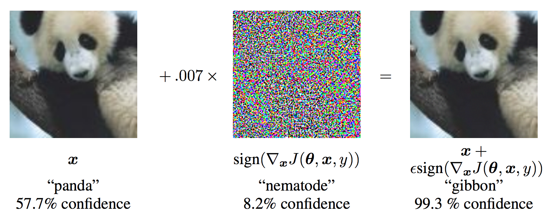
Problem Statement
Problem Statement
Can Adversarial training be used to Defend against Poisoning attacks ?
Adversarial Examples: Manipulating image inputs to a classifier which causes misclassification, but still is visually similar to the original image in human eyes.
Poisoning Attacks: attacker adds malicious training samples to the dataset. The model is then trained on this poisoned dataset and learns "wrong" features or backdoors, which can be later exploited during test time.

Slide 3
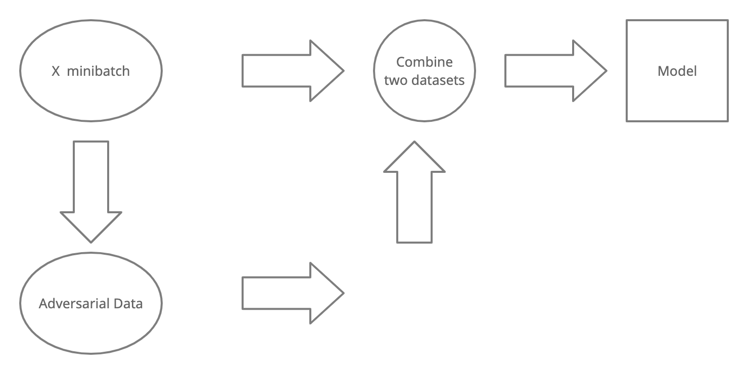
Problem Statement
Problem Statement
Can Adversarial training be used to Defend against poisoning Attacks ?
It works remarkably well against diverse attacks and configurations, whereas newly proposed defenses are often broken through adaptive attacks. As the training progresses, the adversarial examples generated also keep changing, enabling the model to learn robust features.

Slide 4
Problem Statement
Motivation
Adversarially perturbed points have been shown to work as strong poisons. Whereas, adversarial training utilise adversarial samples generated from strong attacks to make the model more robust.
We aimed to investigate the effect of adversarial training on the effectiveness of poisoning attacks. The central intuition behind our idea is that adversarial training causes the learning of robust features, which could be helpful when defending against poisoning attacks To perform this we plan to perform Adversarial Training on our Models (vanilla CNNs and ResNets) and test them against Poisoning attack on various Datasets like CIFAR and MNIST.

Slide 5
Problem Statement
State of the Art approach
We are comparing our training approach with the State of the Art Adversarial training.
MNIST Dataset
Natural | PGD
98.8% | 93.2%
CIFAR-10 Dataset
Natural | PGD
92.7% | 79.4%

Slide 6
Problem Statement
Results
The entire project revolved around making hypothesis and testing then testing them against complex models and datasets for different attacks and defenses.
Here is a list of all the experiments and implementations performed in the course of project and the corresponding results.
Implemented our own versions of Clean-Label Backdoor attack and Badnets attack using Keras. We also implemented Adversarial Training class using Projected Gradient Descent Attack.
Balanced MNIST data
We poisoned the MNIST dataset using a clean label backdoor attack
We try to defend against it using Adversarial Training.

Slide 7
Problem Statement
Results
Unbalanced MNIST Data
500 zeros and 5000 each of the other digits
Normal test set accuracy (unpoisoned) on zeros = 97.45%
We poisoned the MNIST dataset using a clean label backdoor attack.
Accuracy on clean zeros = 98.57%
Accuracy on poisoned zeros = 0%
We then implemented adversarial training for 80 epochs, which used a
Projected Gradient descent attack to generate Adversarial samples.
Accuracy on clean zeros = 94.18%
Accuracy on poisoned zeros = 92.65%

Slide 8
Results
MNIST Dataset
Clean label attack ( Turner attack )
Test accuracy on Images with backdoor
Gu et al attack ( Badnets )
Test accuracy on Images with backdoor
Normal Training on Poisoned Data | Adversarial Training on Poisoned Data
1.39% | 90.68%
Normal Training on Poisoned Data | Effectiveness of poison after normal training on poisoned data | Adversarial Training on Poisoned Data | Effectiveness of poison after AT on poisoned data
1.17% | 96.22% | 91.71% | 0.99%

Slide 9
Problem Statement
Results
CIFAR - 10 Dataset
Gu et al (Badnets)
Test accuracy on Images with backdoor
Test accuracy on Images without backdoor
Normal Training with Poisoned Data | Adversarial Training with Poisoned Data
8.64% | 54.86%
Normal Training with Poisoned Data | Adversarial Training with Poisoned Data | Effectiveness of poison after AT on poisoned data
74.26% | 52.71% | 5.32%

Slide 10
Problem Statement
Results
CIFAR - 10 Dataset
Clean label attack ( Turner attack )
Test accuracy on Images with backdoor
Test accuracy on Images without backdoor
*Taken from https://people.csail.mit.edu/madry/lab/cleanlabel.pdf
Normal Training with Poisoned Data | Adversarial Training with Poisoned Data
30*% | 51.90%
Adversarial Training with Poisoned Data
58.96%

Slide 11
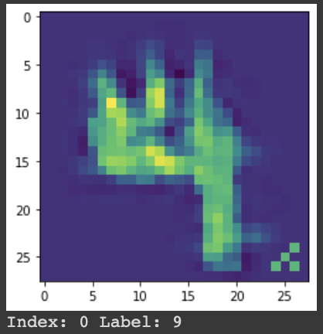
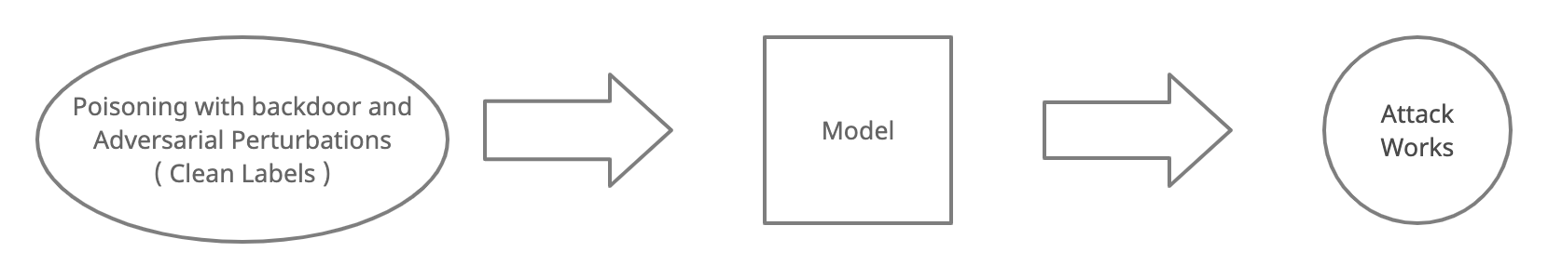
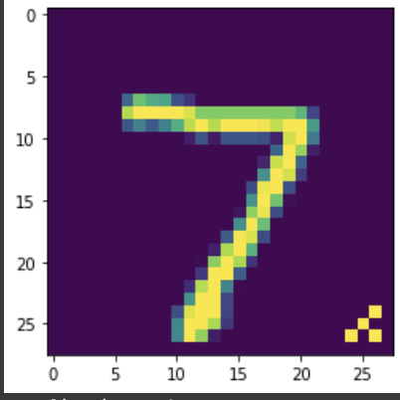

Problem Statement
Why the defense works on Clean label attacks ?
Turner et al propose an attack in which Training data is poisoned with backdoor and Adversarial Perturbations while maintaining the correct labels.
Label:9
Turner et al explained in his paper that when a model’s training data is infected with samples with backdoor patches (bogus pattern) while maintaining the correct labels, the attack fails and we obtain high accuracy on test set
Label:7

Slide 12
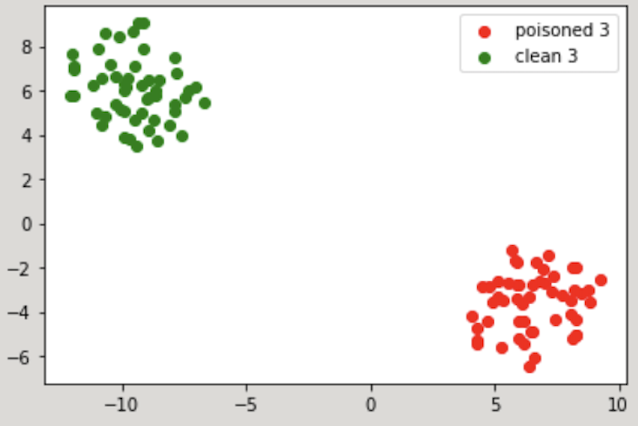
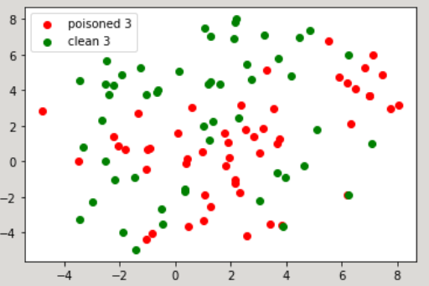
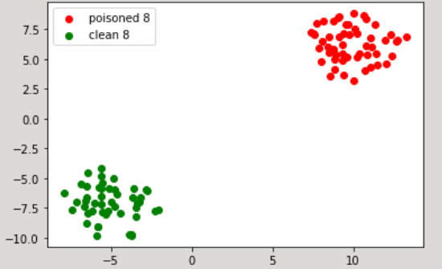
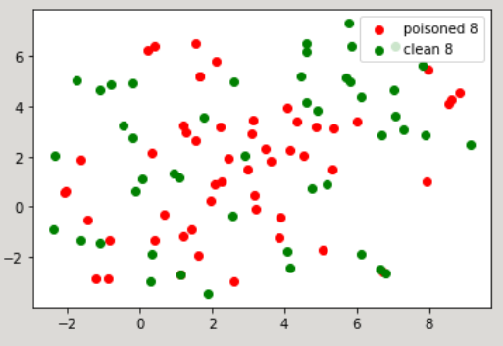
Problem Statement
Why the defense works on BadNets attack ?
Last Layer Activations,
visualized
through
TSNE
Network trained without AT, Poisoned data
Network trained with AT, Poisoned data

Slide 13
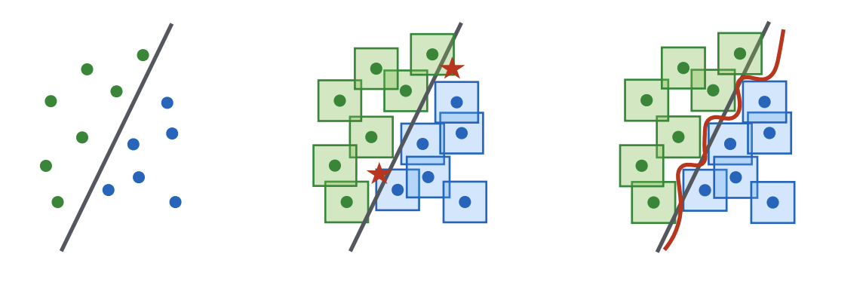
Problem Statement
Why we think defense with normal CNNs worked on MNIST, but not on CIFAR?
Normal Classifier without AT
Simple model when adversarially trained performs poorly
Require complex model to get better performance.

Slide 14
Problem Statement
Using ResNets to train on CIFAR-10
We used ResNet-18 model to adversarially train on CIFAR-10
We chose to use ResNets because authors in the original AT paper (Madry et al) presented results using ResNets
The forecasted time to train the model was 4.5 days given the computational hardware.
We trained the network for 2 days, and we were not able to get better results than vanilla CNN.

Slide 15
Problem Statement
Timeline
Implementation
Of various attacks like PGD, FGM, Poisoning Backdoor and Clean Label Backdoor Attack, and Adversarial trainer from scratch
Experimentation on slightly more complex datasets like CIFAR-10
Prologue
Initial Ideation Report and Presentation
Literature Review
Reproducing baseline results and testing our approach on Badnets Attack
Week 3-4
Week 7-8
Week 1-2
Week 5-6
Experimentation
AT using Madry PGD on Clean Label Backdoor attack for MNIST
Mid Term Presentation
Running training simulations of Vanilla NN on different proportions of biased poisoned datasets
Final Destination
Training on Deeper Models like ResNet for CIFAR-10
Visualisations of Decision boundaries
End Term Presentation
Finalising Report and Code

Slide 16
Problem Statement
Work Distribution
Anubhav (25%)
Trained Model to get Baseline results on Poison Free Data
Performed Adversarial training on MNIST, Biased MNIST and CIFAR-10 using ART for Clean Label and Badnet Attacks.
Antreev (25%)
Experimented with training of Model on Biased MNIST with Turner attack
Implemented the Projected Gradient Descent Attack and Fast Gradient attack from scratch in python
Developed the End term evaluation presentation
Gurbaaz (25% )
Made the Mid term evaluation presentation
Implemented the Adversarial Trainer Class using PGD attack (proposed by Madry), and Clean Label Backdoor Attack and Badnets Attack.
Reproduced the results of custom attacks and training on MNIST dataset.
Pramodh (25%)
Organised the workflow of the entire project and designed the approach to try and solve the problem statement.
Developed the Final and Initial Project report.
Performed Adversarial training on MNIST, Biased MNIST and CIFAR-10 using ART for Clean Label and Badnet Attacks.

Slide 17
References
Adversarial Machine Learning in Image Classification: A Survey Towards the Defender’s Perspective https://arxiv.org/pdf/2009.03728.pdf
Dataset Security for Machine Learning: Data Poisoning, Backdoor Attacks, and Defenses https://arxiv.org/pdf/2012.10544.pdf
BadNets: Identifying Vulnerabilities in the Machine Learning Model Supply Chain https://arxiv.org/pdf/1708.06733.pdf
Towards Deep Learning Models Resistant to Adversarial Attacks https://arxiv.org/pdf/1706.06083.pdf
Clean-Label Backdoor Attacks https://people.csail.mit.edu/madry/lab/cleanlabel.pdf
Explaining and harnessing adversarial examples https://arxiv.org/pdf/1412.6572.pdf
Poisoning attacks survey https://arxiv.org/pdf/2012.10544.pdf
Adversarial ML in Image Classification: a survey https://arxiv.org/pdf/2009.03728.pdf

Slide 18
Problem Statement
Acknowledgement
We would like to thank Prof. Priyanka Bagade for giving us an opportunity to work on a project in the course CS776A: Deep Learning for Computer Vision. We are grateful to have an instructor like her, and working on this project has definitely sparked a zeal in us to work on research projects in future.
We would also like to thank our project mentors, Soumya Banerjee and Tej Kiran for their invaluable and critical feedback on the project, and helping us with the roadblocks as and when they rose.

Slide 19
Thank You!
We are open to questions and suggestions, if any.

