Slide 1
/ADVERSARIAL TRAINING IS ALL YOU NEED
CS776A: Deep Learning for Computer Vision | Project Idea
Group No. 1
Group Name: Four of a Kind
Group Members: Antreev Singh Brar, Anubhav Kalyani, Gurbaaz Singh Nandra, Pramodh Gopalan
Instructor: Prof. Priyanka Bagade
Notes:
Slide 2,3,4 are introductory, Slide 6 discuss problem statement and Slide 5 discuss significance..Hence Slide 5 and 6 are most important

Slide 2
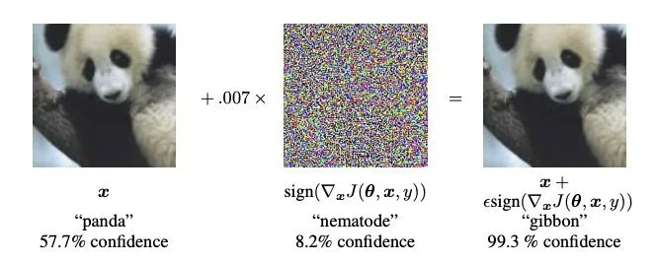
/Adversarial Attacks
CS776A: Deep Learning for Computer Vision | Project Idea
Adversarial image is an image that is intentionally manipulated by adding adversarial perturbation to a natural image, unchanged to the human eye.
https://viso.ai/deep-learning/adversarial-machine-learning/
Most extensive studies of adversarial machine learning have been conducted in the area of image recognition, where modifications are performed on images, causing the classifier to produce incorrect predictions.
Introduction

Slide 3
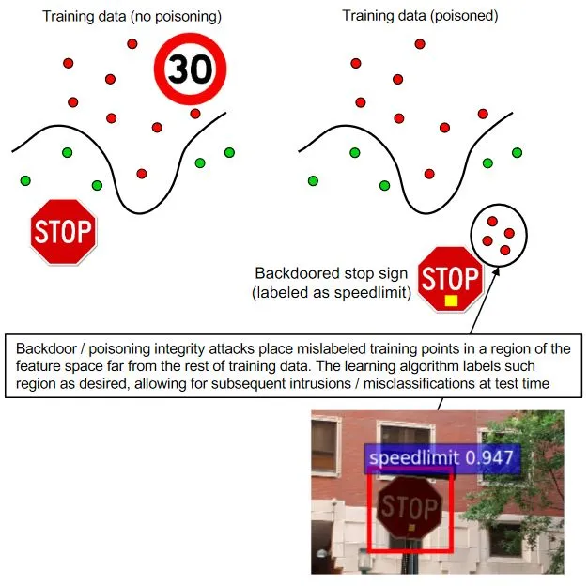
/Poisoning Attacks
CS776A: Deep Learning for Computer Vision | Project Idea
This type of adversarial attack occurs during the training time itself.
Typically involves manipulating and contaminating the train data with malicious train samples.
Model trained on such poisoned dataset learns false features, which can later be exploited by the attacker during deployment.
https://viso.ai/deep-learning/adversarial-machine-learning/
A Category of Adversarial Attacks

Slide 4
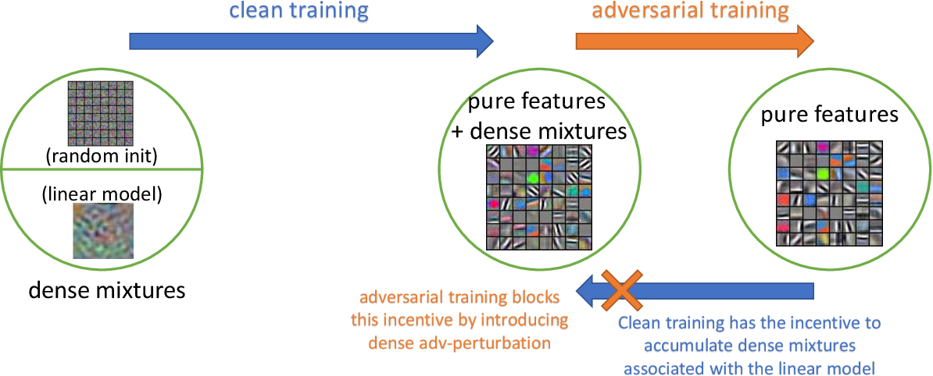
/Adversarial Training
CS776A: Deep Learning for Computer Vision | Project Idea
A defense method used to increase adversarial robustness by retraining the model on adversarial examples.
Adversarial examples are generated at each iteration based on current state of the model, and are used to retrain the model.
Considered to be a reliable defense against adversarial attacks, as it cannot be broken by adaptive attacks.
https://arxiv.org/pdf/2005.10190.pdf
Defenses

Slide 5
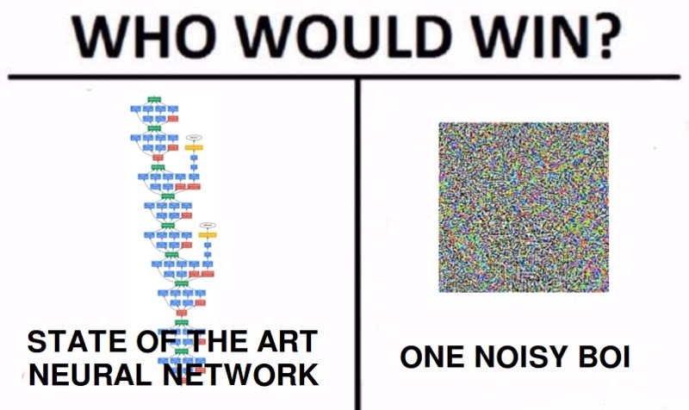
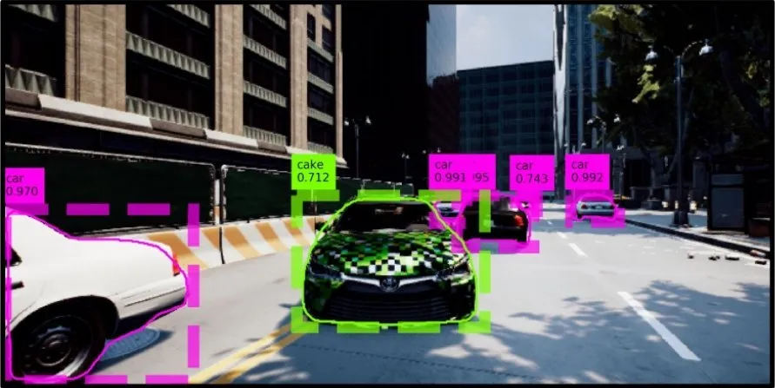
/Importance
/Security of Deep Learning
/Rapidly Evolving Space
/Impact on real-life situations
CS776A: Deep Learning for Computer Vision | Project Idea
With machine learning rapidly becoming core to organizations economy, the need to protect them is growing fast.
Cat and mouse game: some propose defenses, others break them
Domains like self-driving cars and AI-driven healthcare are most prone to hazard and has human lives at stake
Why?

Slide 6
/Can Adversarial training defend against Poisoning attacks?
CS776A: Deep Learning for Computer Vision | Project Idea
Hence we arrive at the problem statement we aim to answer.
Adversarially perturbed points have been shown to work as strong poisons.
Whereas, adversarial training utilise adversarial samples generated from strong attacks to make the model more robust.
Interesting to observe the results when one is tested against the other. We aim to do this in a computationally less expensive approach than existing research.
Problem Statement

Slide 7
/THANKS!
CS776A: Deep Learning for Computer Vision | Project Idea
/We are open to questions and suggestions, if any.
The End

