Slide 1
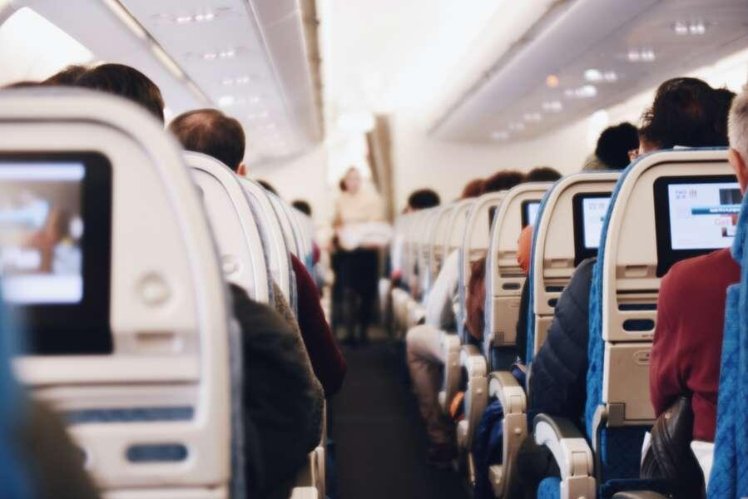
Airline Customer Satisfaction

Slide 2
INTRODUCTION
Project Idea : The primary goal is to forecast if a potential customer will be satisfied with the service, given the specifics of the parameter values
Motivation : To enhance the business value and customer loyalty of an aviation company, it is essential for Airlines to know their customer perception to offer them the most satisfying flying experience

Slide 3
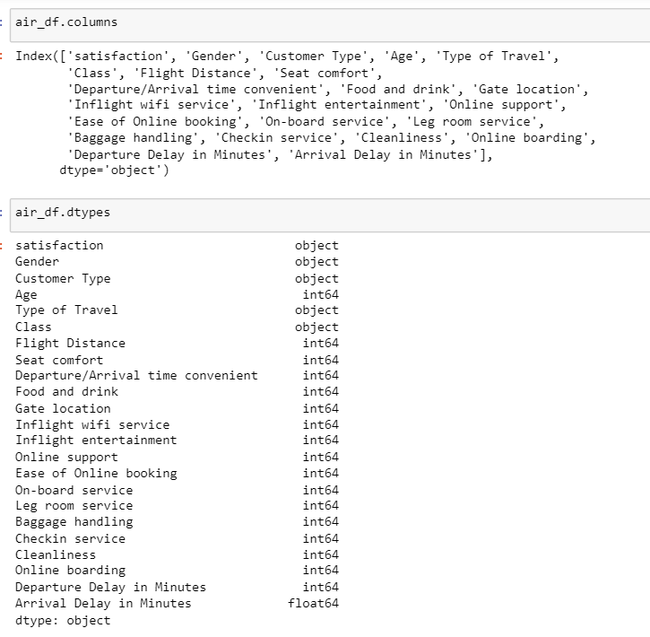
DATA DESCRIPTION
This data set contains a survey on air passenger satisfaction. The following classification problem is set:
It is necessary to predict which of the two levels of satisfaction with the airline the passenger belongs to
Satisfied
Dissatisfied
We have 1,29,880 rows and 23 rows in our dataset.
Dependent variable/Target variable : satisfaction
Independent variables: Attributes like Gender, Customer Type , Age etc.

Slide 4
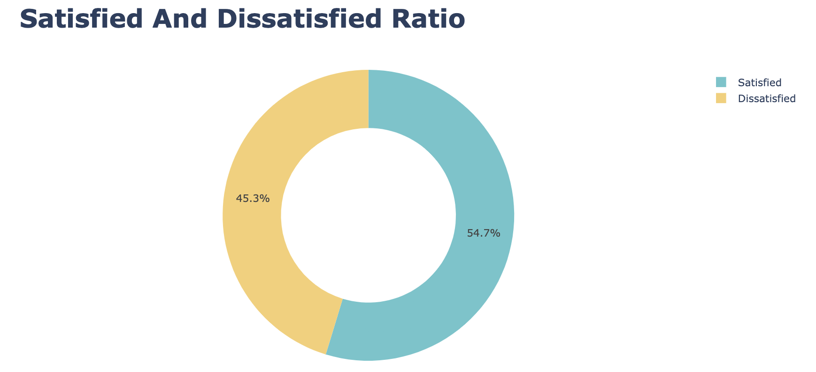
DATA VISUALIZATION

Slide 5
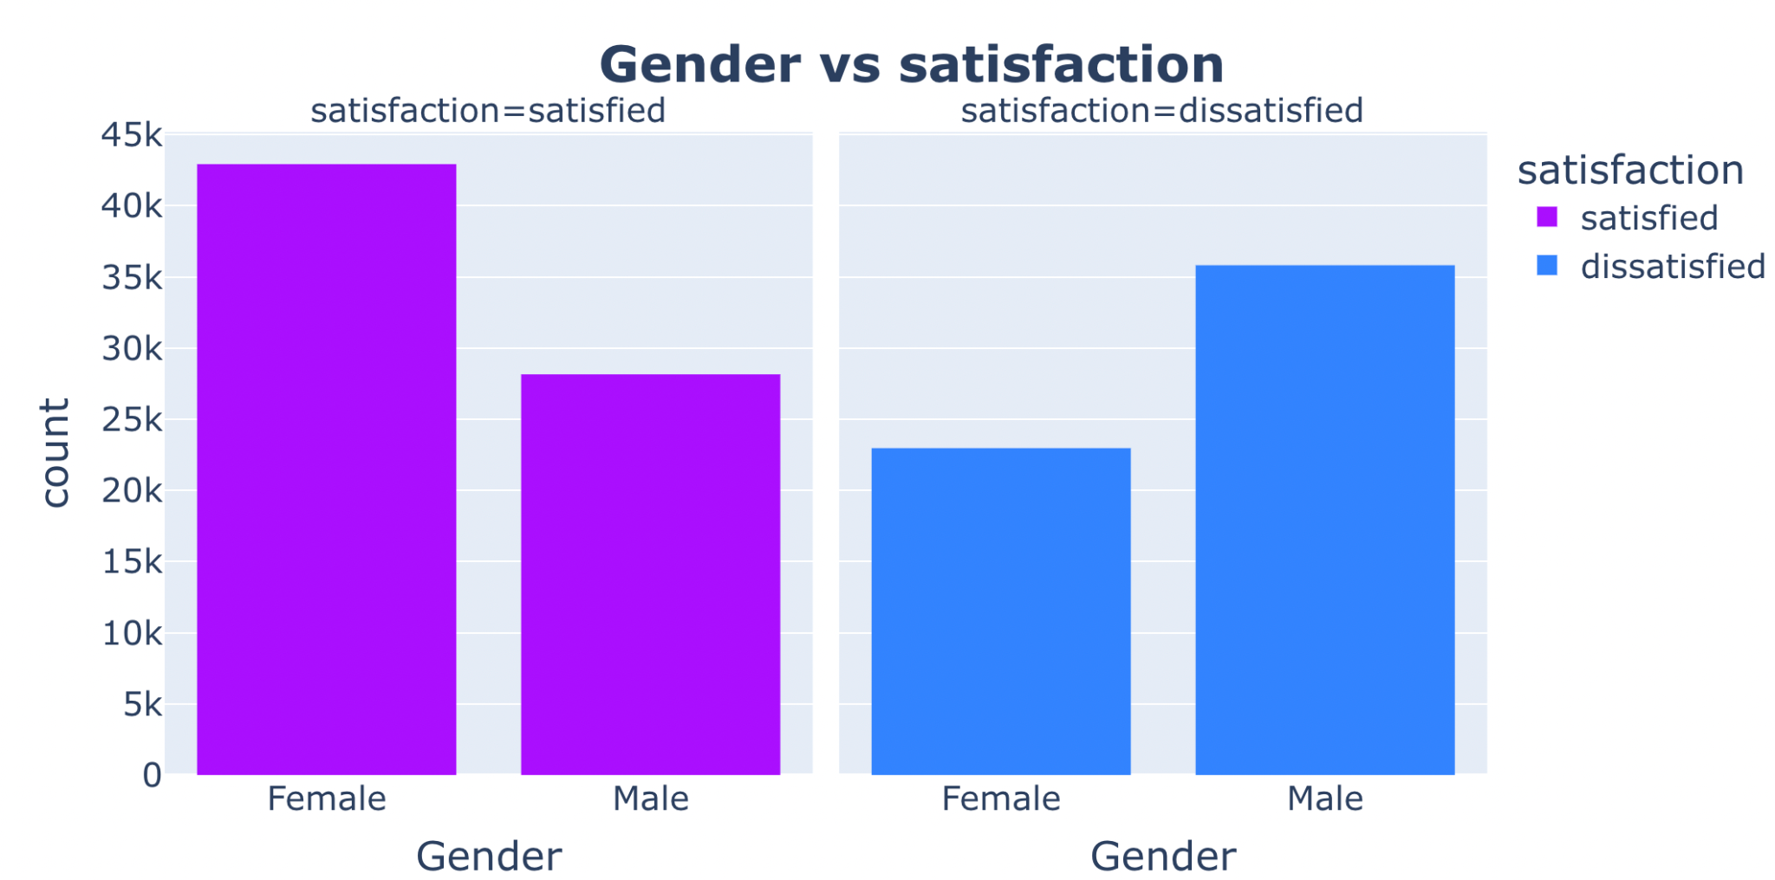

Slide 6
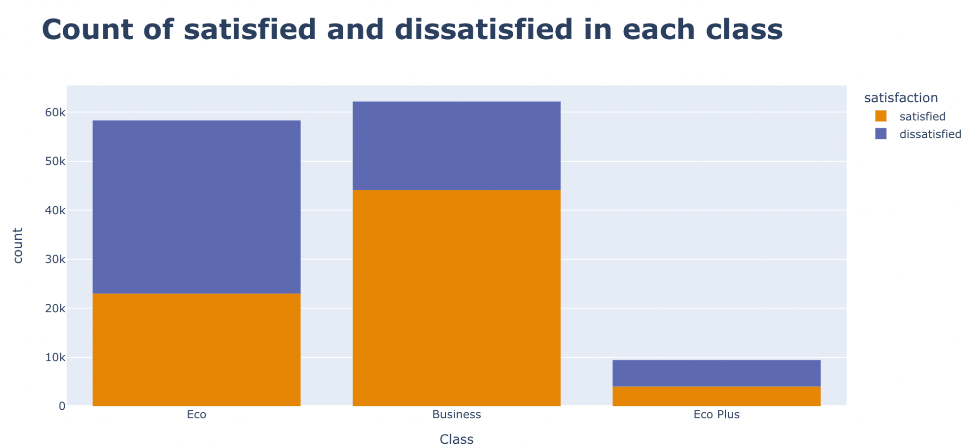

Slide 7
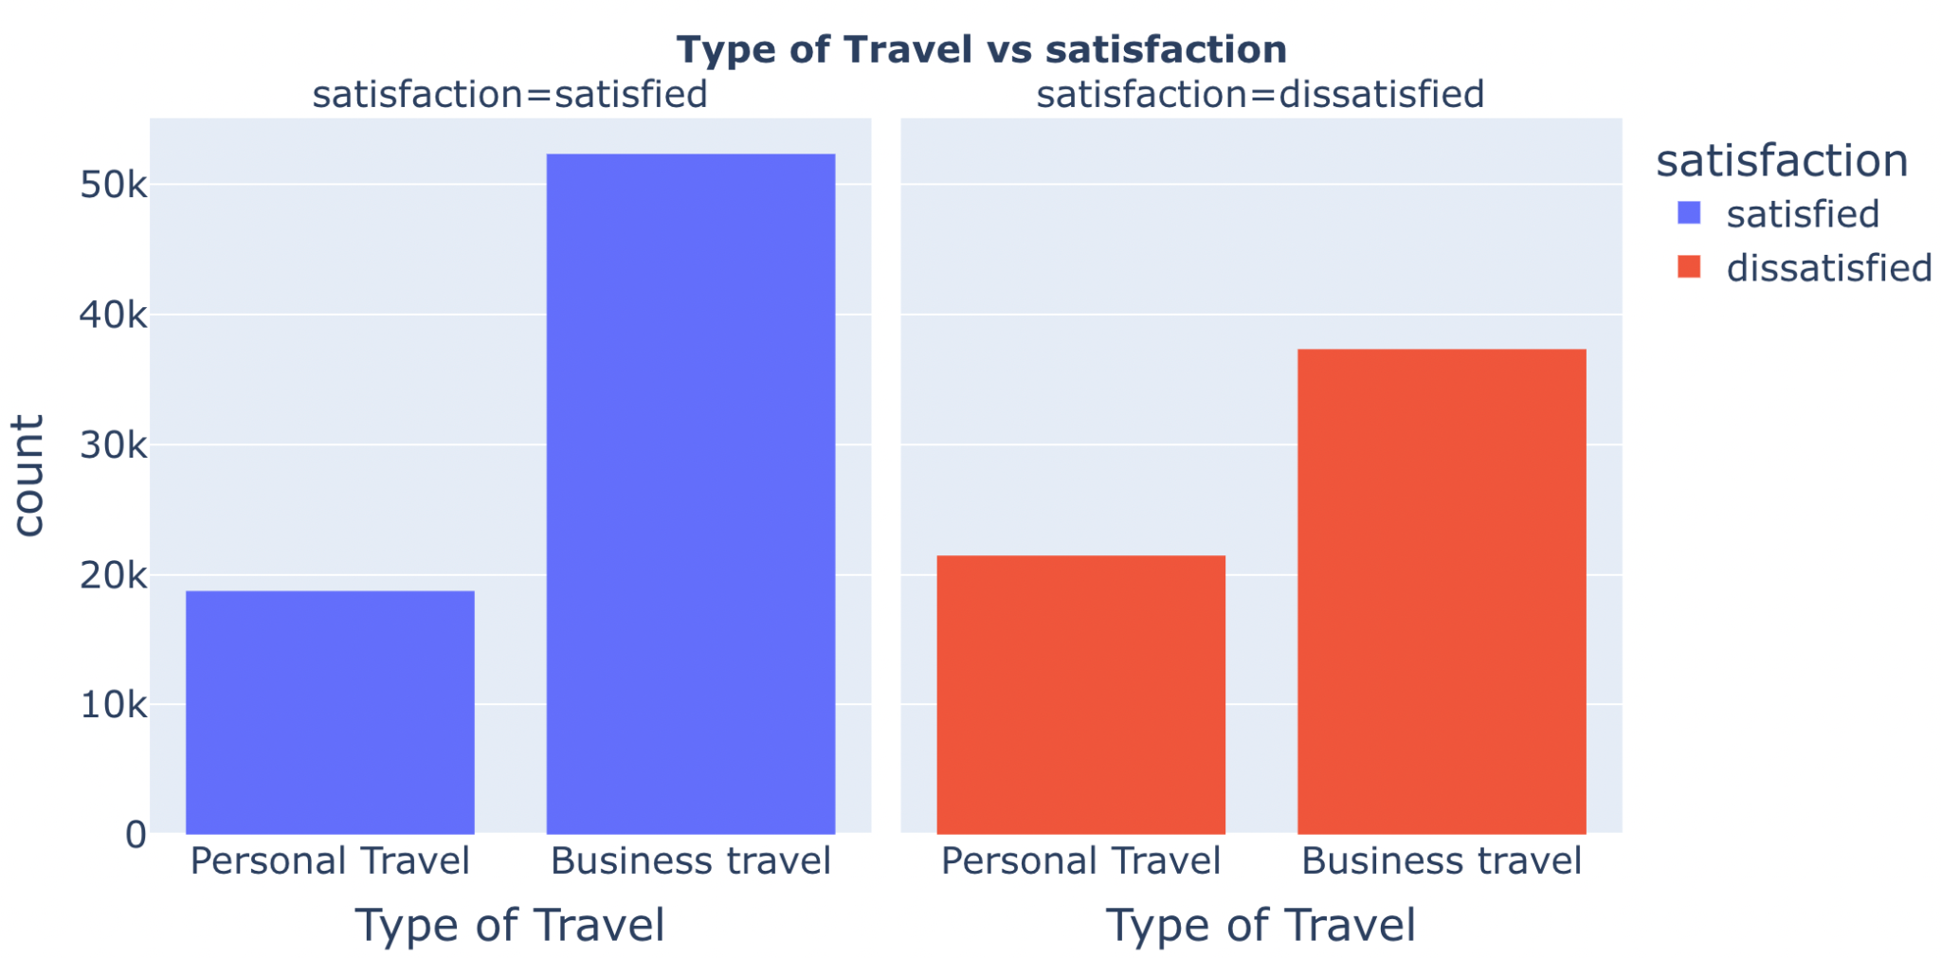

Slide 8
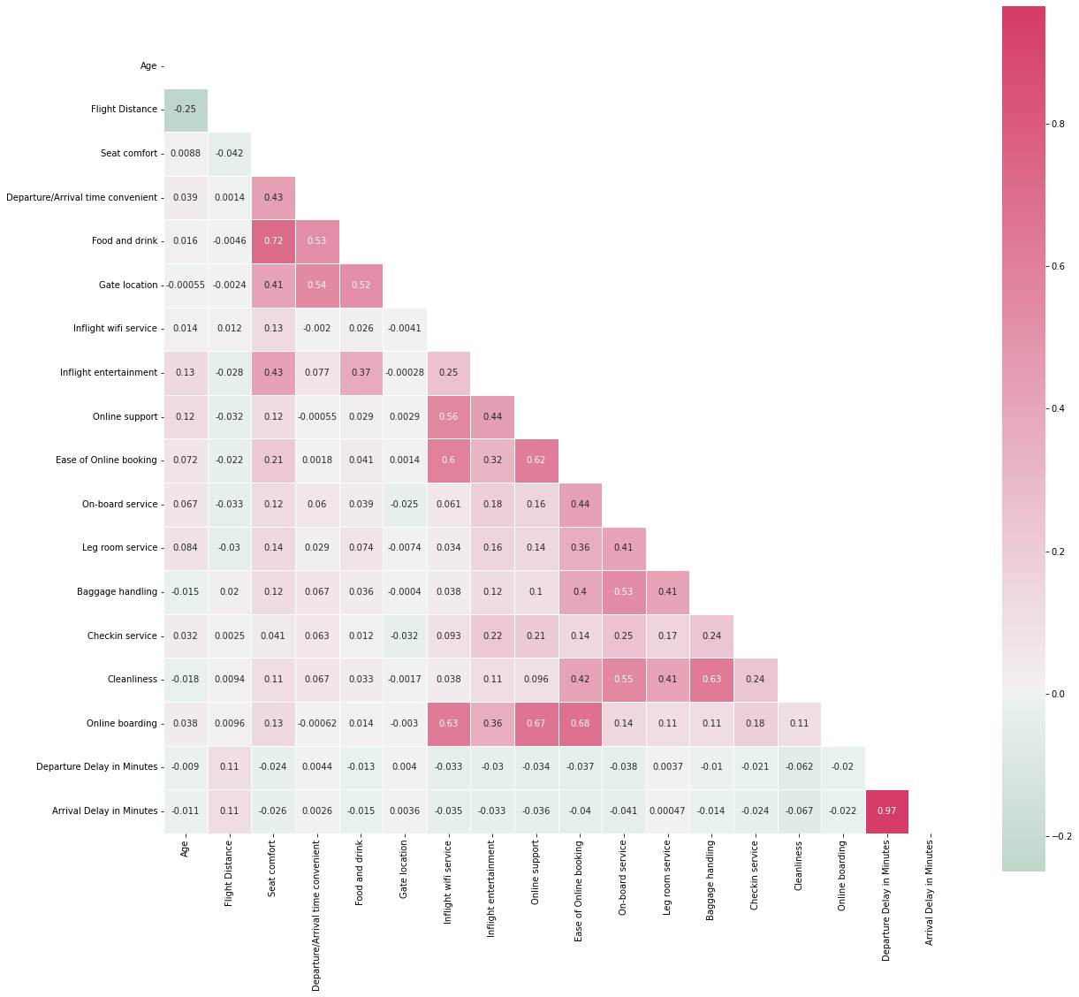
CORRELATION PLOT
If we observe the correlation plot, the columns ‘Arrival Delay in Minutes’ and ‘Departure Delay in Minutes’ are highly correlated with correlation value of 0.97.
Hence we exclude the column ‘Arrival Delay in Minutes’ to avoid multicollinearity

Slide 9

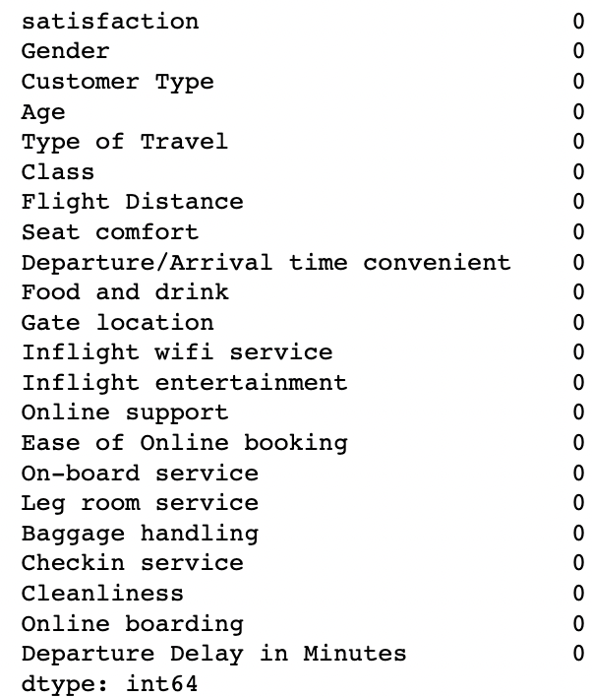
DATA PREPROCESSING
We have discovered the dataset for duplicates. There are no duplicates found in the dataset.
We checked for count of null values in each column. There are no null values found in the dataset.

Slide 10
DATA PREPROCESSING
We divided the dataset into training and testing datasets.
We used encoding in order to convert categorical values of features into numerical ones.
We have discovered few outliers which are greater than max and smaller than min for each column and removed them.
Max value = Q3+1.5(Q3-Q1) , Min value = Q1-1.5(Q3-Q1)
Min max scaler is applied to ensure that it is in the given range between 0 and 1.

Slide 11
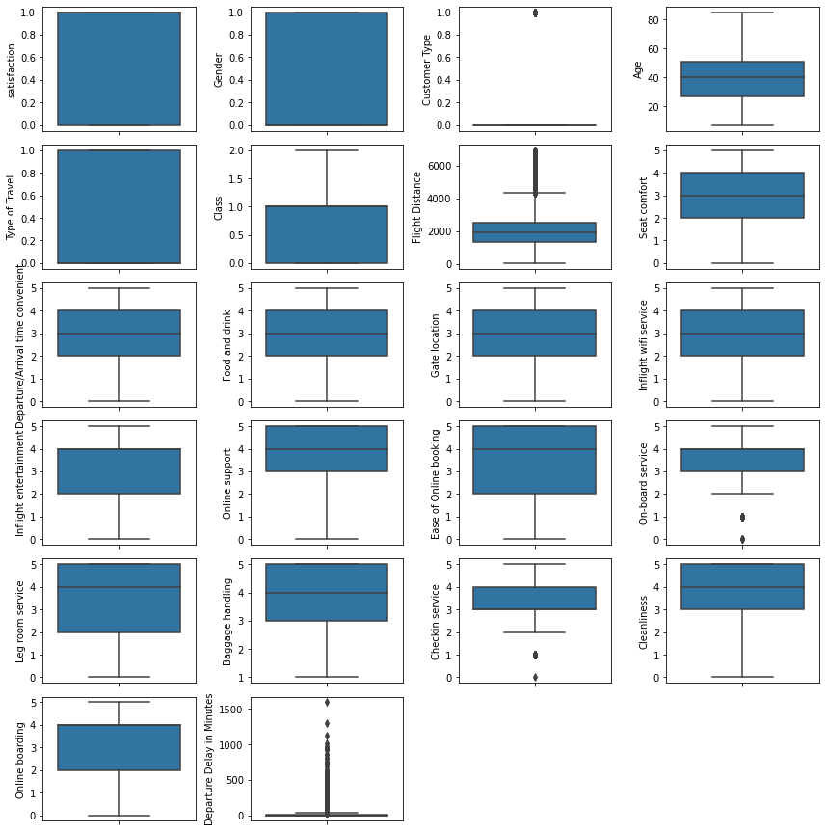
Box plots for each column showing outliers

Slide 12
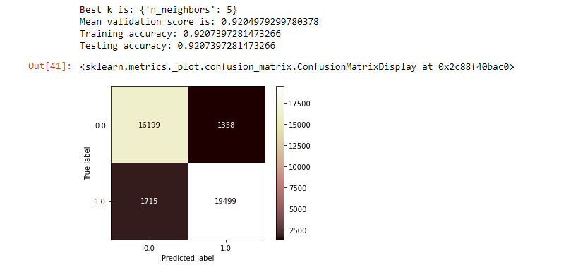
MODELLING
Model 1 : KNN with hyperparameter tuning

Slide 13
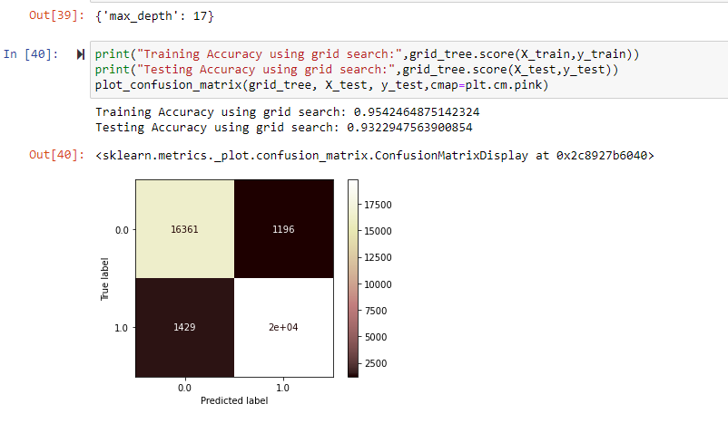
Model 2 : Decision Tree with hyperparameter tuning

Slide 14
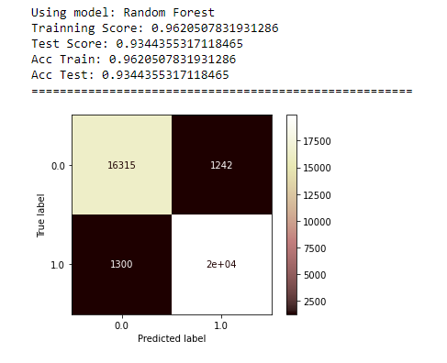
Model 3 : Random Forest

Slide 15
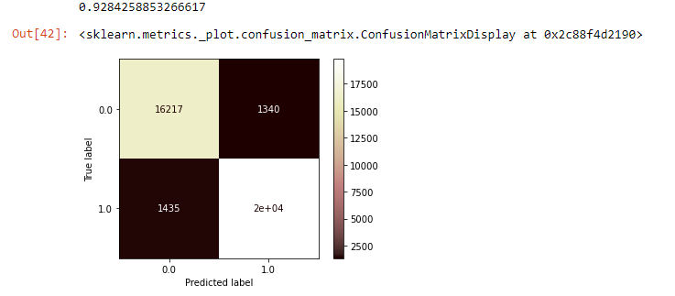
Model 4 : AdaBoost

Slide 16
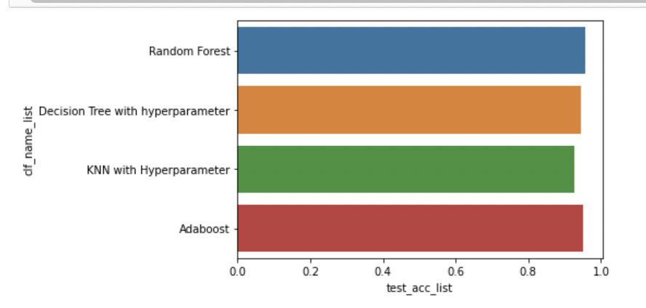

Slide 17
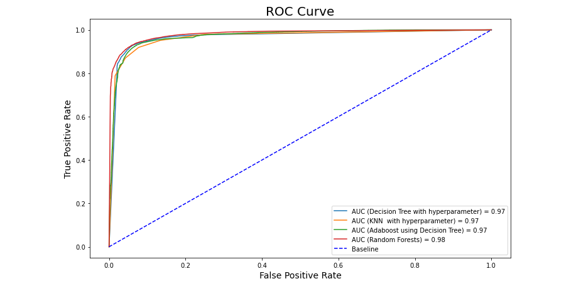
Model Comparison
From our observation, we have seen that the ROC for Random Forest model is high when compared to the other models.

Slide 18
Conclusion
From our analysis, we conclude that Random Forest model is the best model.
Based on our visualization graphs, even though the satisfaction ratio is higher than the dissatisfied one we are trying to provide certain factors to bridge the gap between both of them resulting in higher satisfaction ratio.
Service of economy class should be made better, by incorporating better staff and refreshments, since they have higher dissatisfaction rate.
Also, males should be allowed to carry an extra bag like females as males have a higher dissatisfaction count.

Slide 19
Future Scope
To try implementing PCA or Dimension reductionality as the unsupervised machine learning technique to reduce the dimensionality of the dataset and preserve the original structure inherit to the original dataset.
PCA being a statistical process that converts the observations of correlated features into a set of linearly uncorrelated features with the help of orthogonal transformation.
Furthermore, the future scope is to try incorporate L1 Regularization i.e. Lasso regression as an advanced regression model.

Slide 20
THANK YOU

