Slide 1
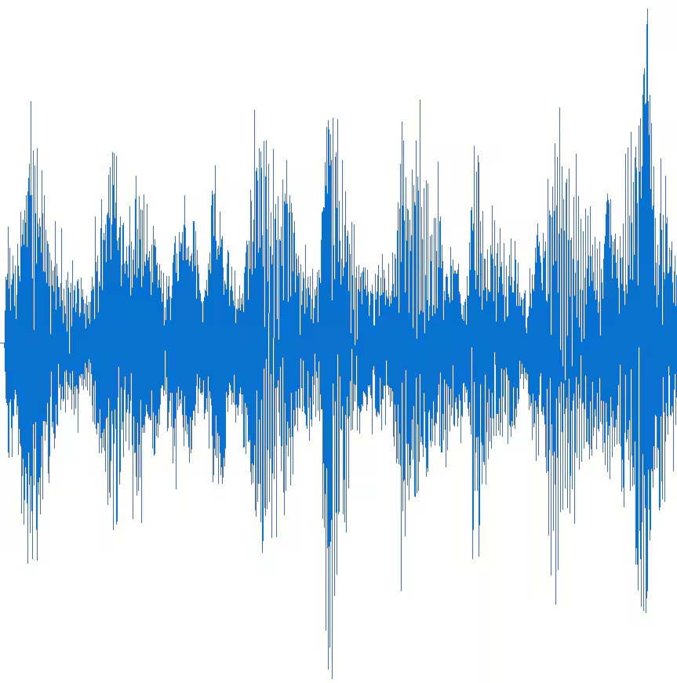
Preprocessing
ML classifier
Input
Output
47 hours of DeepShip recordings

Slide 2
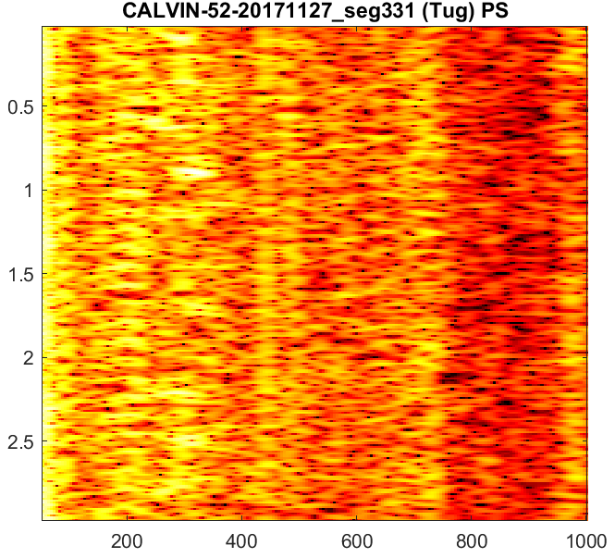
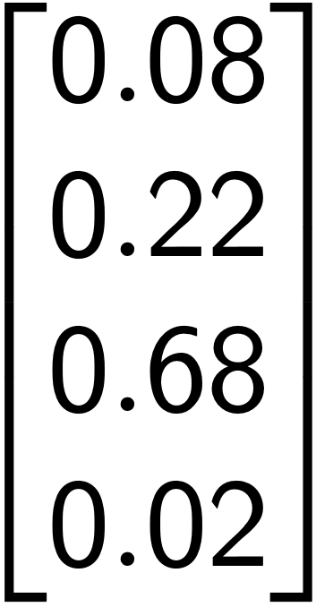


Preprocessing
Model
Class probabilities
47 hours of DeepShip recordings
Power spectrogram

Slide 3
Raw sonar data
Noisy and unstructured
Hard to classify
Preprocessing
Enhanced features
Improved classification
Cleaner signal

Slide 4
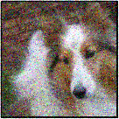
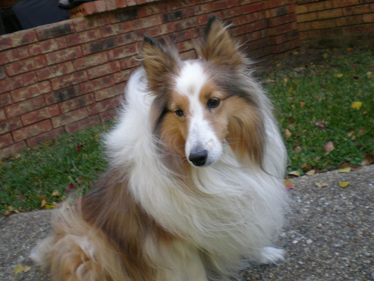
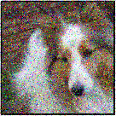
Irfan
U-Net
192x192 patch
ImageNet10K
Encoder-decoder architectures
Gaussian noise

Slide 5
Denoising techniques
Conventional methods
Deep learning methods
Mapping-based
Masking-based
Supervised
Unsupervised
Noise2Noise

