Slide 1
Azure Batch AI Training Service
Train, Test, Evaluate
Deep Learning and Other AI Models

Slide 2
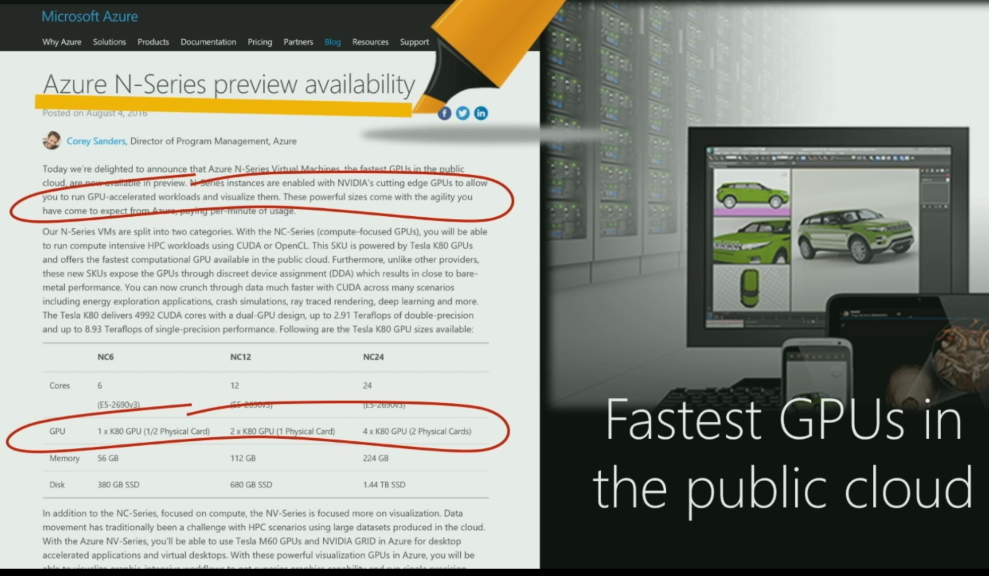
GPUs in Azure
Notes:
Azure introduced GPUs with its N-Series preview availability
There are 3 types on configurations available for deep learning tasks
NC6 with 1 X NVIDIA Tesla K80 GPU
NC12 with 2 X NVIDIA Tesla K80 GPUs
NC24 with 4 X NVIDIA Tesla K80 GPUs

Slide 3
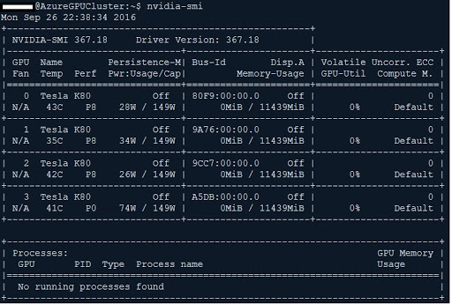
Azure GPU DSVM
Used Ubuntu 16.04 N-Series VM
NC24 VM with 4 NVIDIA Tesla K80
Notes:
Azure introduced GPUs with its N-Series preview availability
There are 3 types on configurations available for deep learning tasks
NC6 with 1 X NVIDIA Tesla K80 GPU
NC12 with 2 X NVIDIA Tesla K80 GPUs
NC24 with 4 X NVIDIA Tesla K80 GPUs

Slide 4
Recipe for Powerful AI
Lots of experimentation
Lots of GPUs
Lots of training data
Need to run Training at scale!

Slide 5
Challenges of Training at Scale
Deploy virtual machines
Install Drivers and dependencies
Manage Cost
Queue Work
Handle monitoring and Failures
Keep things secure
Training on compliance restricted data
Cleanup when done

Slide 6
Azure Batch AI Training Service
Managed Service
Supports Role Based Access Control
Hierarchical Quota Management
Easily Provision VMs at scale
Load based automatic scaling
Run experiments in Parallel
Run in Containers or directly on VM
Run any toolkit (CNTK, Tensorflow, Caffee, Chainer…)
Only compute cost. Service is free

Slide 7
Train and Deploy Custom AI End-to-End
Azure Batch AI Training
On CNTK
Your Data (Images, Text, Logs, Time Series…)
Azure Machine Learning
Azure Data Lake
SQL Server
Your Data
+
Training With Scale-Out
GPU Clusters on Demand
=
Intelligence In Your
Apps and Data Services

Slide 8
Experiences Specialized for Learning
Compute Cluster Management
Auto Scaling
Mount Azure File Share, Network File System
BYO (Bring Your Own) File System
Use GPUs, InfiniBand, MPI, Grpc
Hierarchical Quota Management

Slide 9
Experiences Specialized for Learning
Job Management
Ability to submit and monitor 1000’s of job in Parallel
Multi machine distributed jobs
Output directories management
Environment variables

Slide 10
Experiences Specialized for Learning
Integrated Container Support
SSH setup for multi node jobs
Automatic directory mappings from VM, including mounted volumes
Azure Managed container repository
Bring Your Own container
Caching of containers

Slide 11
Experiences Specialized for Learning
Toolkit support
CNTK, Tensorflow, Caffe, Chainer, Custom
Model management
Publish Model
StdOut, StdErr, Model Logs, intermediate models

Slide 12



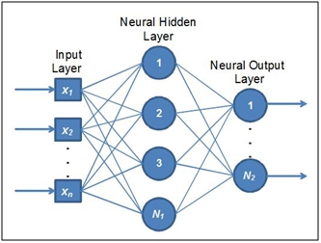
Experience Specialized for Learning
Azure Disk Resource
Azure Files
Batch AI Training Service
NFS
GPU
GPU
GPU
GPU
GPU
GPU
GPU
GPU
Create NFS
GPU
GPU
GPU
GPU
GPU
GPU
GPU
GPU
GPU
GPU
GPU
GPU
GPU
GPU
GPU
GPU
GPU
GPU
GPU
GPU
GPU
GPU
GPU
GPU
CreateCluster
GPU
NFS
Azure Files
Intermediate Models
Progress Logs
Final Model
Training Data
Base Model Script
Run Jobs
Mounted NFS/Azure Files
Delete Cluster

Slide 13
Summary
Automatic NFS creation and Management
Compute cluster with GPU
Distributed Job scheduling
Output directory management
Model Management
Log file Management

Slide 14
How Relates To…
Data Science VM (DSVM)
Get started with DSVM: Desktop in Azure for model development
Scale out training with Batch AI: can use DSVM for software
Go from one to many

Slide 15
Next Steps
Register for Preview:
https://aka.ms/batchaitraining
Support: askbatchai@microsoft.com

