Slide 1
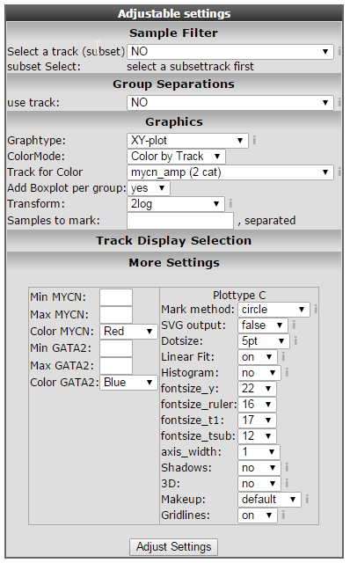
Notes:
Name:FindGenes_linearFitAdjust

