Slide 1
SwipeKey
Better Design for Smartwatch Keyboard
Notes:
----- 會議記錄 (15/6/12 11:03) -----
Improving designing for swipe keyboard. Don’t over claim

Slide 2
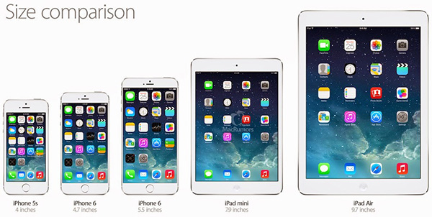
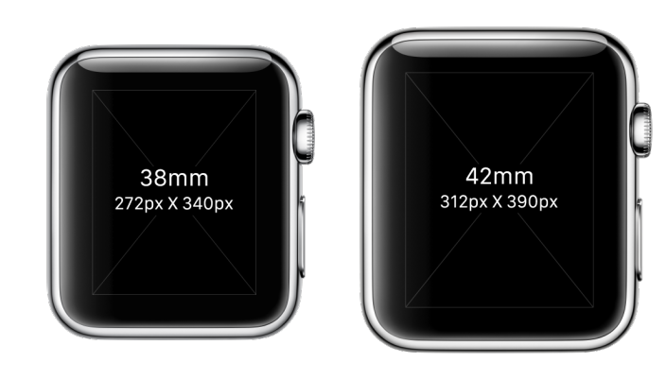
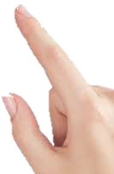
The size of smartwatch screen is too small to implement regular keyboard

Slide 3
So, there are lots of ways to increase the effective size of each button
Touch time
Multiple move
Touch force
Swipe direction
N-fold keyboard

Slide 4
Related Works
SwipeBoard: 2-fold swipe keyboard
ZoomBoard: 2-fold touch keyboard
SplitBoard: 2-fold swipe + touch keyboard
FlickKey: 8 direction swipe and 1 touch button
MessageEase: special swipe

Slide 5
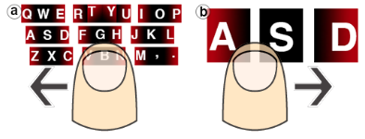
SwipeBoard
2 fold swipe keyboard
(effective button size x28)

Slide 6
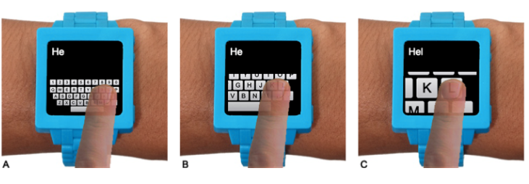
ZoomBoard
2~3 fold touch keyboard
(effective button size x3)

Slide 7

SplitBoard
2 fold swipe then touch keyboard
(effective button size x2)

Slide 8
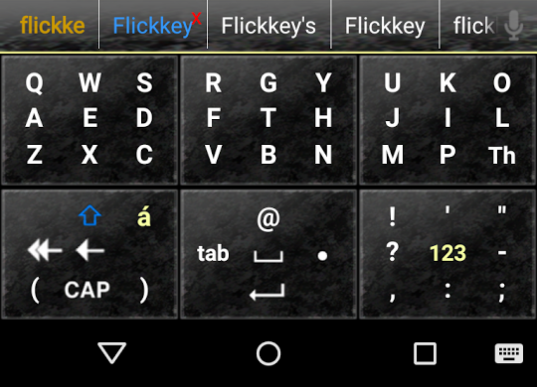
FlickKey
9 swipe direction button
(effective button size x3)

Slide 9
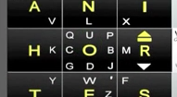
MessageEase
Center with 9 swipe direction and edge with 2~3 direction
(effective button size x3)

Slide 10
What is a better design of a specific size of smartwatch ?

Slide 11
What an Optimal Input Required !
Low input error – Clear input identification and no complicate layout or movement
Less move – Increase input speed

Slide 12
SwipeKey Satisfies All Conditions
Low input error – Make effective button size N times larger, where N is how many entry each button. Consistent and simple move lower error rate
Less move – One move is better than two.

Slide 13
Assumption
We used square shaped button to make sure that user could move to the correct angle. For example if the button with aspect ratio 2 then it would be hard to swipe to direction with 45 degree from horizontal

Slide 14
User Studies-1
Virtual watch size(30*30 mm).
20 users need to record left/right hand and finger contact area
Button size test: 4, 9, 16, 25, 36 -> in order test, each test 1 mins; check error rate and speed
Swipe direction test: 4, 5, 6, 7, 8, 9, 10, 11 -> in order test, each test 1 mins; check error rate and speed
35~40 entry test(Key to button combination) : 40 / 2 * 20 / 3 * 12 / 4 * 9 / 5 * 7 / 6 * 6 / 7 * 5 / 8 * 5 / 9 * 4 -> counter balance order test, each test 1 mins; check error rate and speed

Slide 15
User Study 1 Questionnaire
When you would find it is difficult to swipe to the correct direction(2, 2+1, 4, 4+1, 6, 6+1, 8, 8+1, 10, 10+1, Never)
What size of button you start to feel it is hard to touch the correct button(2x2, 3x3, 4x4, 5x5, 6x6, Never)
Have difficulties in correct input for this layout(Strongly disagree, disagree, neutral, agree, strongly agree)
If you need to repeated selecting objects from a group of things(above 30), which methods you would like to use. (40 buttons / 2 key * 20 buttons / 2+1 key * 12 buttons / 4 key * 9 buttons / 4+1 key * 7 buttons / 6 key * 6 buttons / 6+1 key * 5 buttons / 8 key * 5 buttons / 8+1 key * 4 buttons)

Slide 16
User Studies-2
Virtual watch size(30*30 mm). Keyboard is filled lower half screen.
Four different types of keyboard to be compared: SwipeBoard; 9-dir keyboard; 4-dir keyboard; 5/8-dir keyboard
12 users x 4 layout x 30 sentences
Counter balance in layout order and sentence order
Check soft error rate(delete % in total key-in number) and WPM(after 100% correct key-in)

Slide 17
Pre User Study 2 Result
WPM of 1st 10 sentences
sentence

Slide 18
User Study 2 Questionnaire
Please order the preference of four type of layouts
Have difficulties in finding the desired character for this keyboard (Strongly disagree, disagree, neutral, agree, strongly agree)
Have difficulties in key-in some of the character for this keyboard. Please describe the issue.
It is easy to key-in short sentences for this keyboard.
It is easy to learn how to use this keyboard.

Slide 19
Contributions
A systematic study of the design rule of swipe selection
An optimal keyboard design for smartwatch
Achieve a entry speed of xxx WPM faster than state-of-art yyy WPM

Slide 20
Back Up

Slide 21
What an Optimal Input Required !
Low input error – input identification
Less move – Increase input speed
Consistent and simple movement – complexity decreases speed, increase error and makes user harder to learn.

Slide 22
SwipeKey Satisfy All Conditions
Low input error – make effective button size N times larger, where N is how many entry each button.
Less move – One swipe /touch every input
Consistent and simple movement – Only one swipe / touch

