Slide 1
User Study Design

Slide 2
User Study 1
Estimate the relation of number of directions and accuracy/speed
Goal: to optimize the number of direction in the same size of screen
To decide the most optimal number of directions, we have to make user to swipe the direction according to the position of red color
After swipe for 1 mins, we get data for each graph and see whether the direction can be estimated correctly and input speed.

Slide 3
Numbers of direction
User screens:
Number of direction: 1~9
Result:
Two graph with
Speed at transverse axis
Error rate horizontal axis

Slide 4
Graph
2 direction
3 direction 2swipe+touch

Slide 5
Graph
4 direction
5 direction
4swipe+touh

Slide 6
Graph
6 direction
7 direction
6swipe+touch

Slide 7
Graph
8 direction
9 direction

Slide 8
Flow of user study one
Choose 24 people(half men, half women) and make them attend this test one by one
Randomly ordering graph to all people, and make them follow the red color to swipe to the same direction.
After finish the trial, we collect the correct swipe(the swipe direction is within the red region) of each person and make two graphs
Total time is around 10 mins

Slide 9
Expected Figure for Swipe+Touch

Slide 10
User Study 2
Estimate the relation of size of each button and accuracy/speed
Goal: to optimize the size of button in the same size of screen
To decide the optimal size, we first choose the size of screen with smartwatch, and divide it into number of buttons
Then, making the button which users have to touch with red color, repeating the trial for several times and calculate the speed and accurancy

Slide 11
Size of area
User screens:
Number of buttons in fixed screen: 1,4,9,16,25
Result:
Two graph with
accuracy / speed at transverse axis
Error rate horizontal axis

Slide 12
Graph
1 button
4 buttons

Slide 13
Graph
9 buttons
16 buttons

Slide 14
Graph
25 buttons
36 buttons

Slide 16
Flow of user study two
Choose 24 people(half men, half women) and make them attend this test one by one
Distributing each graph to 4 people(randomly chosen), and make them touch the red color button, repeat this process for total with 24 times
After finish the trial, we collect the correct touch action( point out the red button) of each person and make two graphs
Total time is around 5 mins

Slide 17
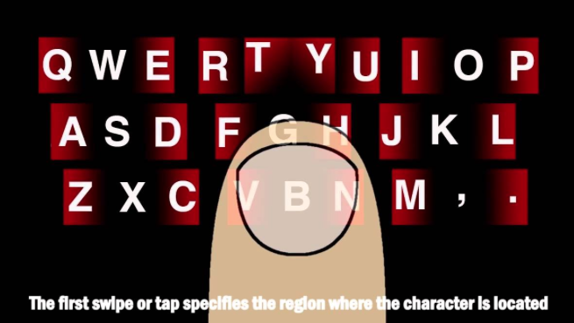
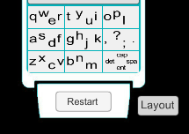
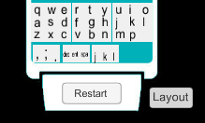
User Study 3
We will compare 5 different key board –
qwerty / swipeboard / 3 swipe / 4 swipe / 9 swipe
Swipeboard
4 dir key
9 dir key

Slide 18
Each graph test will write 10 randomly predetermined sentence from PhraseSet.
We will hold 5 distributed order test

