Slide 1
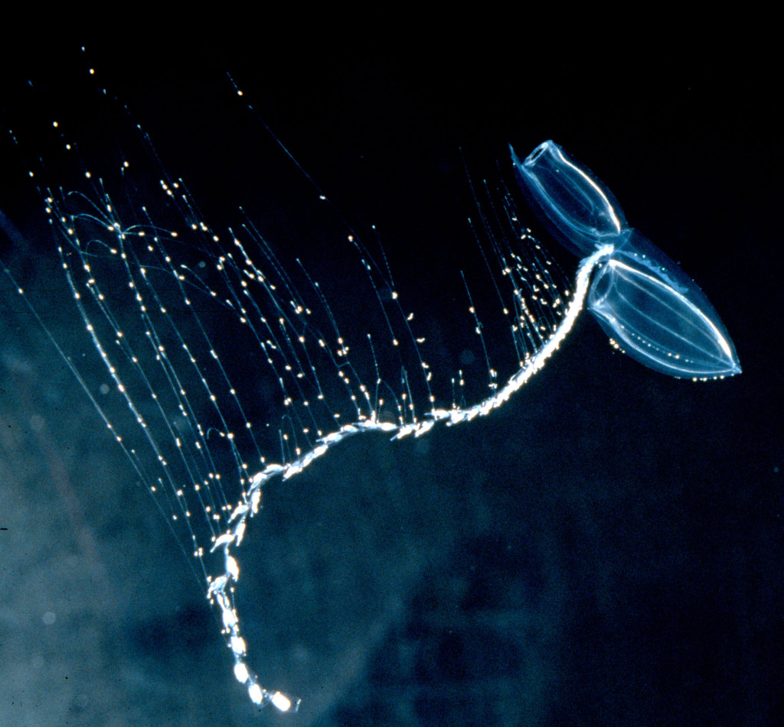
Siphonophore Phylomorphoecospaces
Phylogenetic distribution of functional morphology and predatory relationships in Siphonophores

Slide 2
What is a siphonophore?
Colonial superorganisms:
Feeding bodies (gastrozooids) with a tentacle
with multiple tentilla
Tentilla: Side branches with cnidobands full of nematocysts
Midwater animal plankton predators

Slide 3
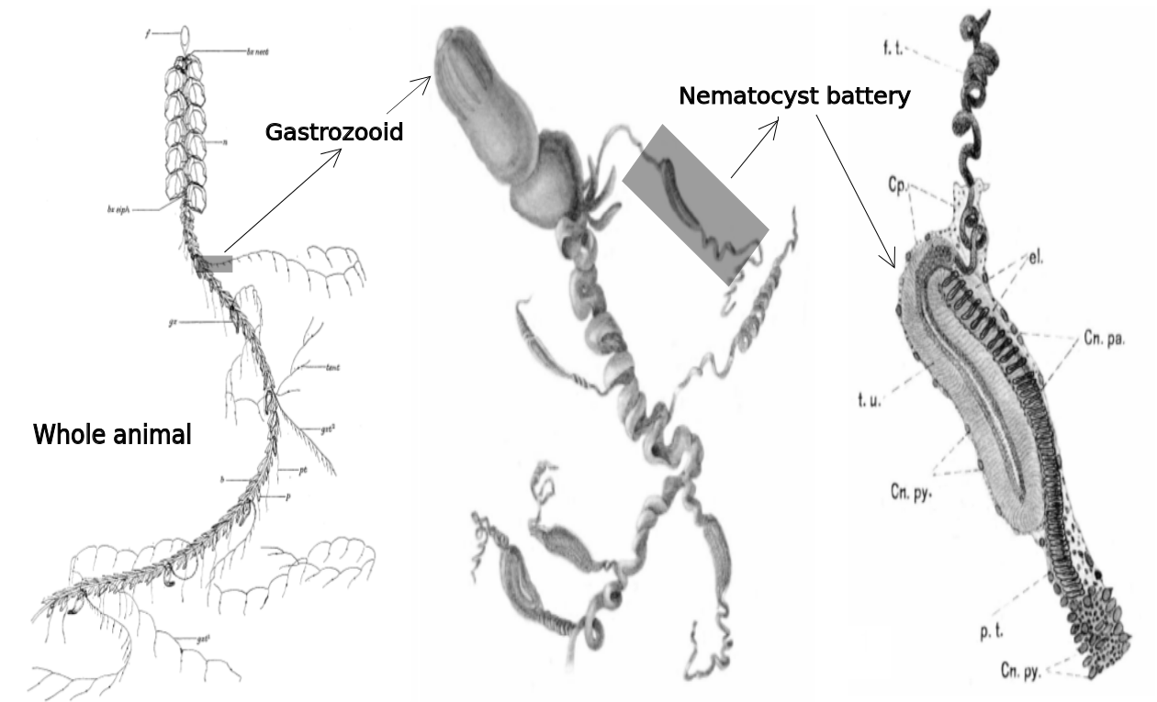

Slide 4
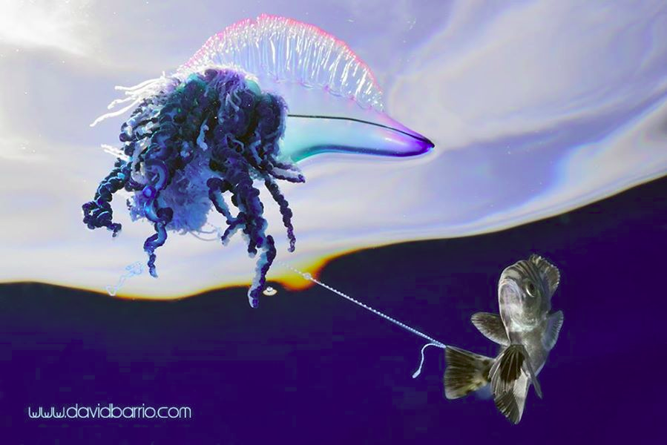

Slide 5
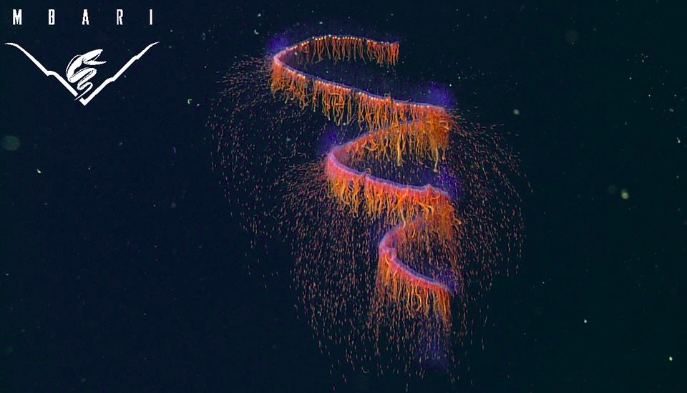

Slide 6
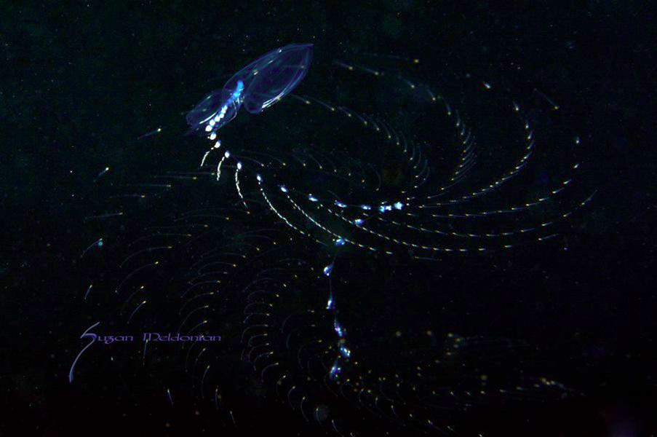

Slide 7
Siphonophore nematocysts (cnidomics)
Mapstone, G. M. (2014). PloS one, 9(2), e87737.

Slide 8
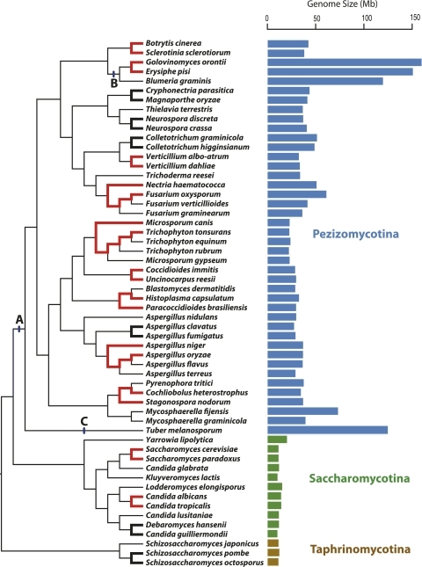
Kelkar, Y. D., & Ochman, H. (2012). Genome biology and evolution, 4(1), 13-23.

Slide 9
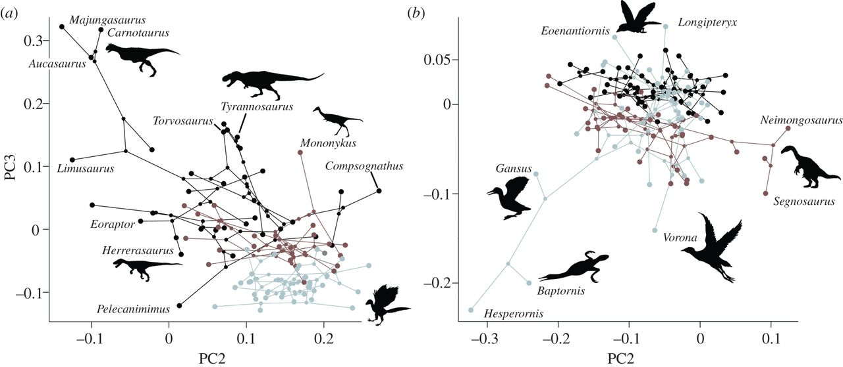
Phylomorphospace?
Scatterplot of morphological or ecological variables
Dots connected by their phylogenetic relationships
R package: phytools
Benson, R. B., & Choiniere, J. N. (2013). Proceedings of the Royal Society of London B: Biological Sciences, 280(1768), 20131780.

Slide 10
Interactive Siphonophore Phylomorphospace:
https://rawgit.com/antropoteuthis/finalproject/master/ISCPhylomorphospace_expanded.html
Interactive Siphonophore Phylogenetic food web:
https://rawgit.com/antropoteuthis/finalproject/master/ISBPhylofoodweb.html

Slide 11
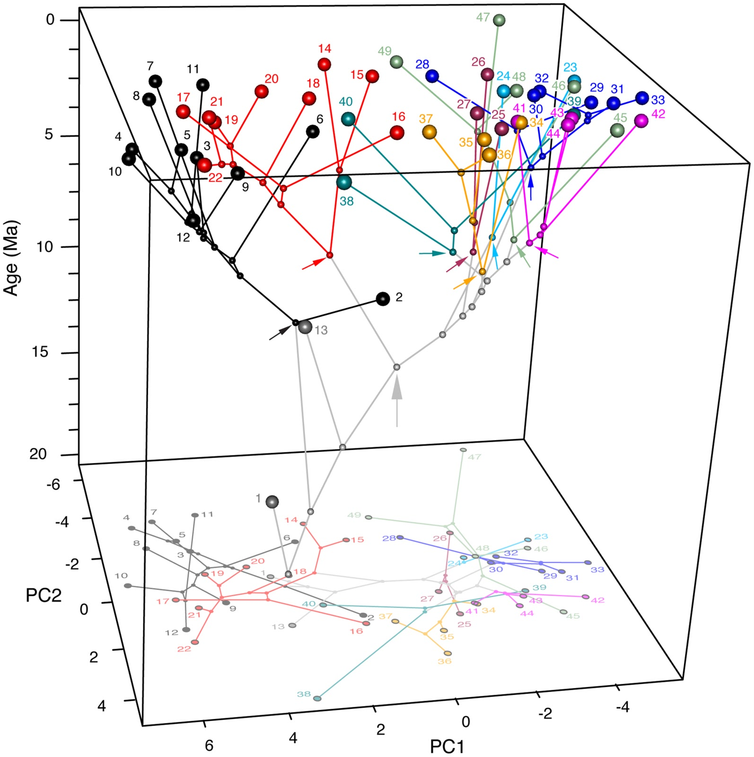
Chronophylomorphospace. Source: Sakamoto, M., & Ruta, M. (2012). PLoS One, 7(7), e39752.

Slide 12
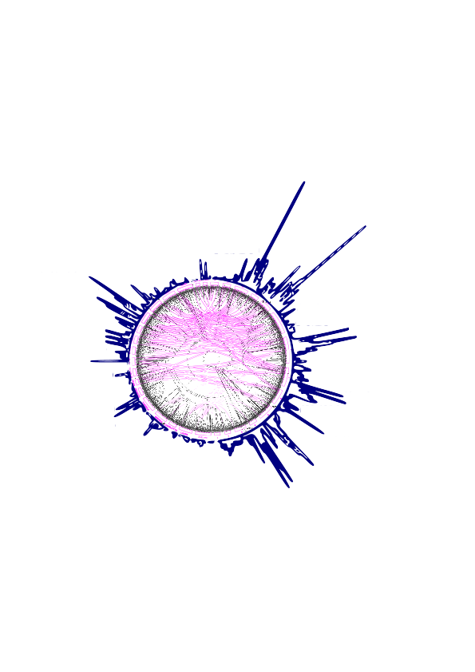
Phylomorphoecogram

