Slide 1
TREC&Zoomer研究

Slide 2
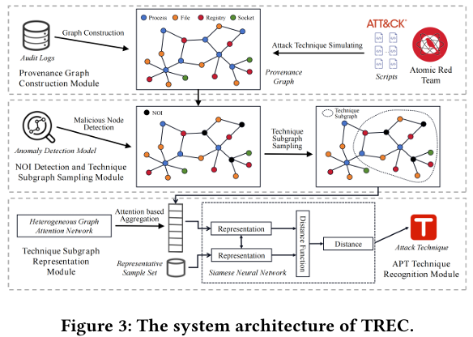
TREC
Notes:
4/15流程圖
elastic 算TTP個數 準確率來比比看

Slide 3
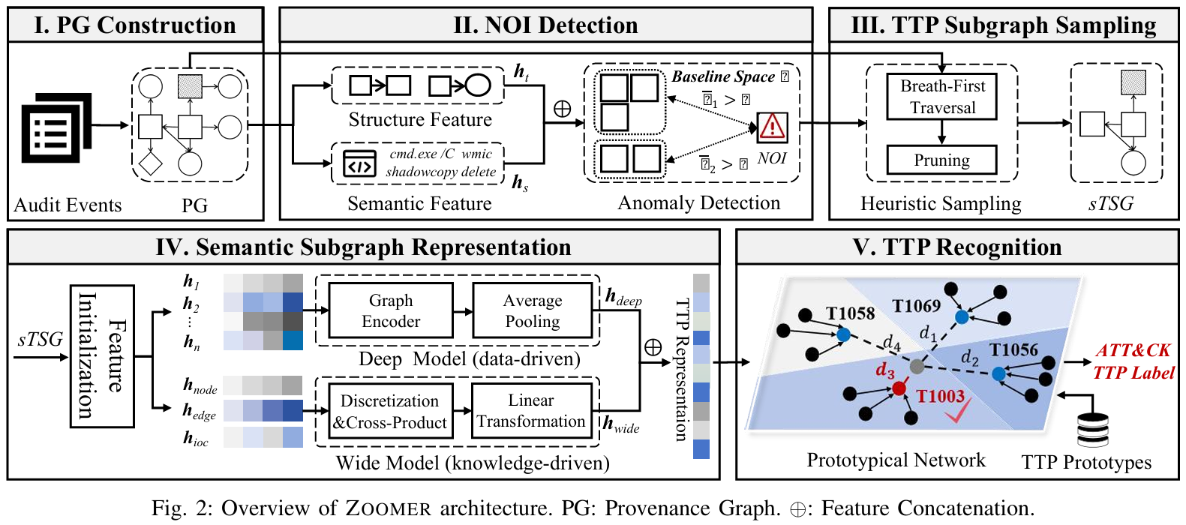
ZOOMER - Overview

Slide 4
Zoomer - Training
Training:C1~C5
Testing:C6~C7
Inferrence:C8
Higaisa admin338 (backdoor) APT28 (RDP) FIN7 (Winword) CobaltGroup (Winword) Gamaredon (Winword) Patchwork (Winword) GorgonGroup (Winword)
Epochs ： 50
Batch Size：8
loss function：CrossEntropyLoss
C1
~
C8

Slide 5
