Slide 1
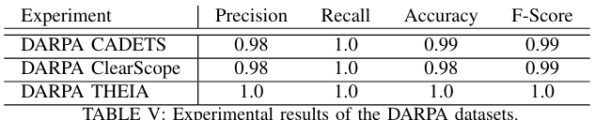
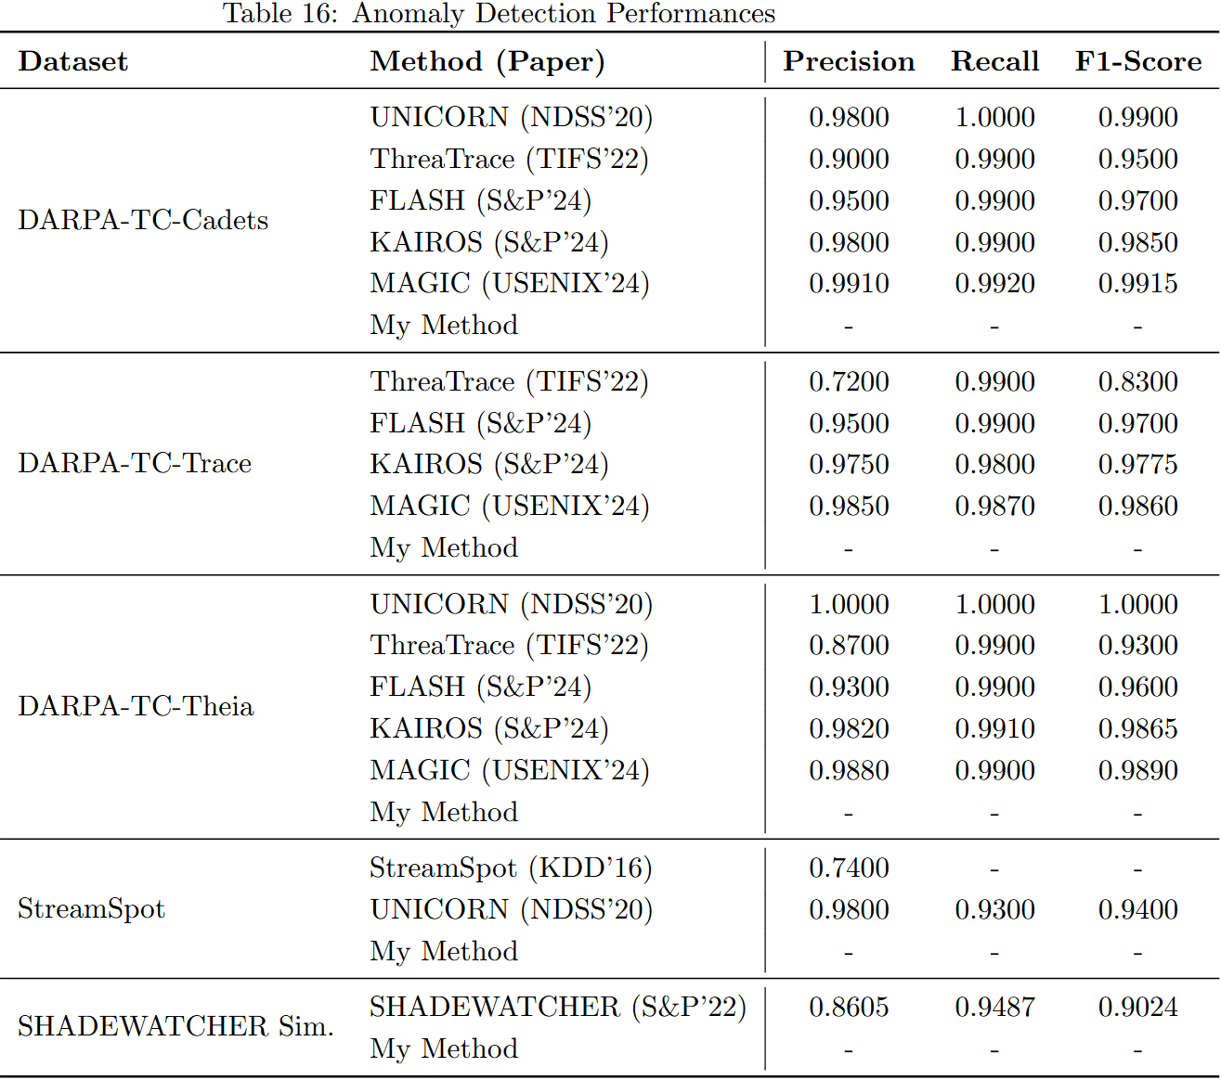
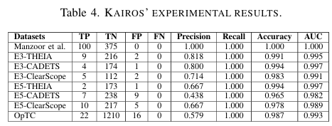
Anomaly Detection
Unicorn
KAIROS

Slide 2
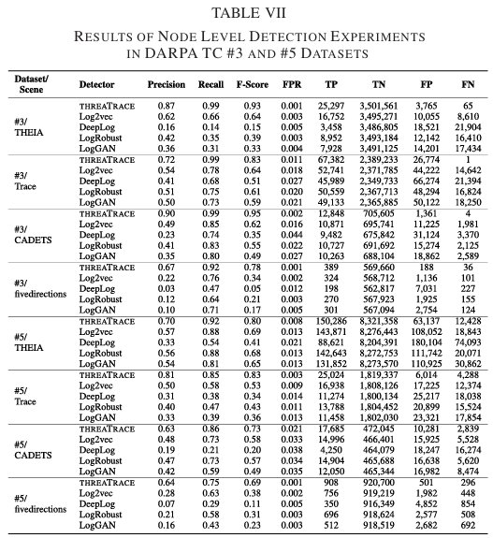
Anomaly Detection - ThreaTrace

Slide 3
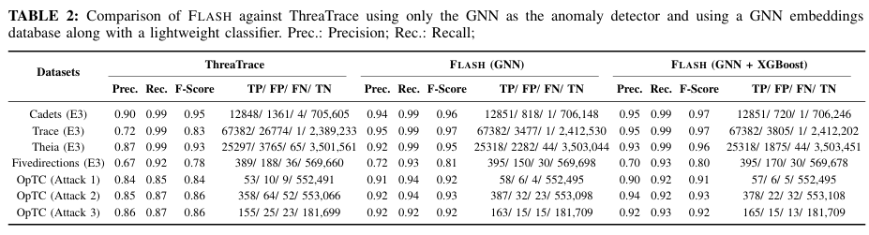
Anomaly Detection - ThreaTrace & Flash

Slide 4
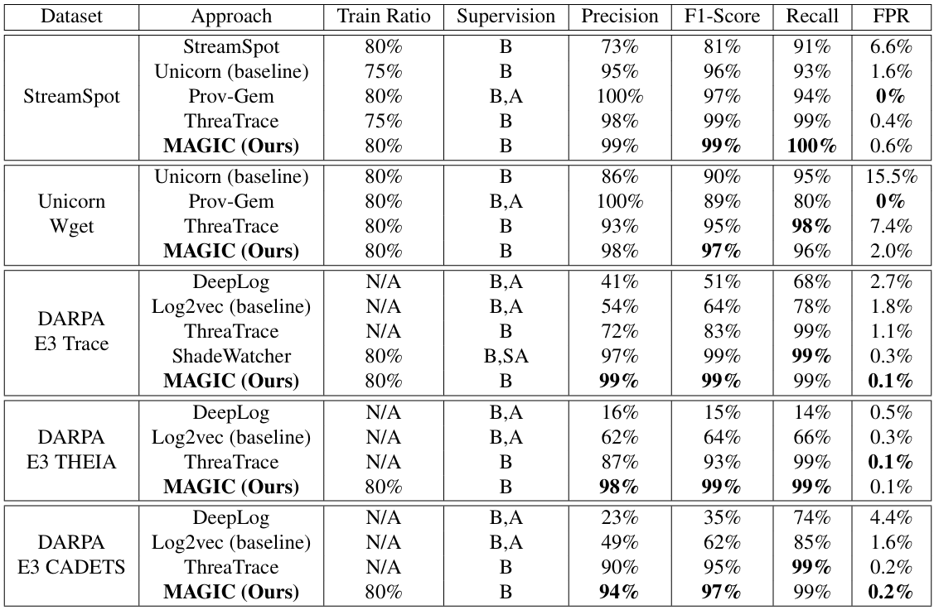
Anomaly Detection - MAGIC

Slide 5
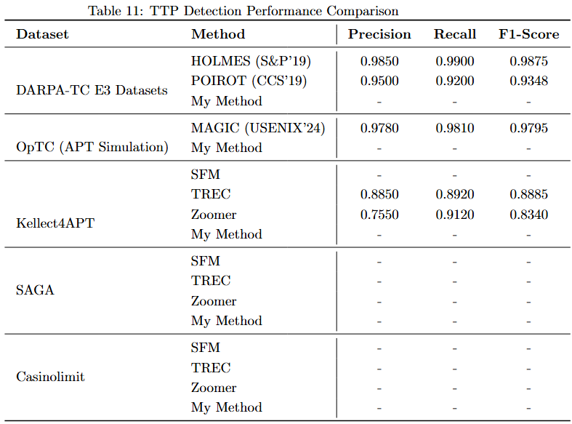
TTP Detection
Notes:
zoomer也放進來 直接拿它表格

Slide 7
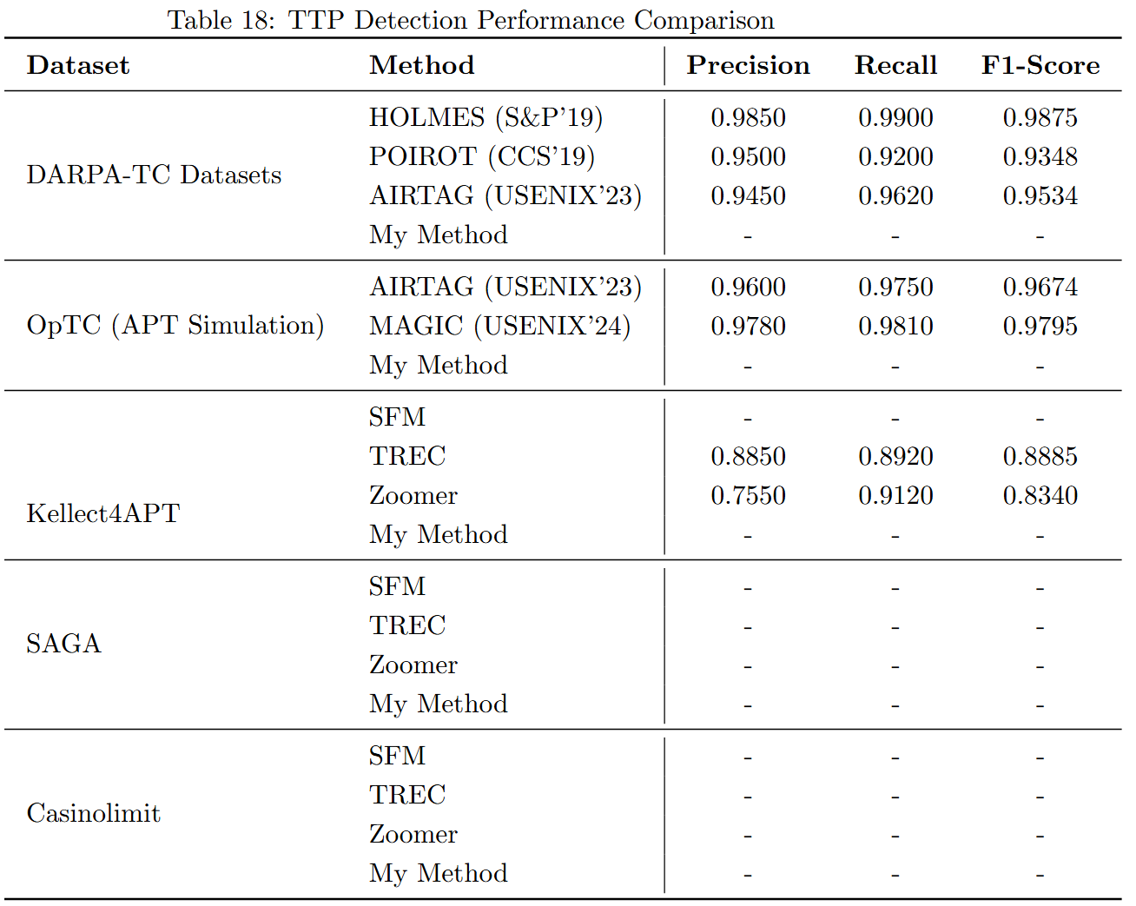
SAGA
Train:
16900 abilities
Total Events: 7,949,998 events
Benign : 4,146,957 events (52.16%)
Malicious : 3,803,041 events (47.84%)
Test:
Known APT Campaigns C1~C8
SFM (C1,3,5,7,8)

Slide 8
Kellect4APT
Train: (SAGA)
16900 abilities
Total Events: 7,949,998 events
Benign : 4,146,957 events (52.16%)
Malicious : 3,803,041 events (47.84%)
Test:
1 sample per TTP and cross-validation.
65 TTPs
414 samples

Slide 9
Casinolimit
Train: (SAGA)
16900 abilities
Total Events: 7,949,998 events
Benign : 4,146,957 events (52.16%)
Malicious : 3,803,041 events (47.84%)
Test:
all campaigns
Notes:
Casino limit是機器為單位(Multi-host + network)
label是人標的，跟一般的APT可能不太一樣

Slide 10

Darpa E3 Datasets
Dataset | Training Dates(僅選擇 APT 攻擊發起前的良性活動日期) | Validation Date | Test Dates (mostly attack days) (APT 攻擊活動發生的日期)
E3-THEIA | 2018-04-03 / 04 / 05 | 2018-04-09 | 2018-04-10 / 12, 2018-04-11
E3-CADETS | 2018-04-02 / 03 / 04 | 2018-04-05 | 2018-04-06, 2018-04-07
E3-ClearScope | 2018-04-04 / 05 / 06 | 2018-04-07 | 2018-04-10, 2018-04-11
Using generated data from Darpa E3
Notes:
AirTag用的是自己錄的和Atlas和DEPIMPACT

Slide 11
Darpa E3 Datasets
Train: (SAGA)
16900 abilities
Total Events: 7,949,998 events
Benign : 4,146,957 events (52.16%)
Malicious : 3,803,041 events (47.84%)
Test:
Notes:
AirTag用的是自己錄的和Atlas和DEPIMPACT

Slide 12
Darpa E3 Datasets
Train:
僅選擇 APT 攻擊發起前的良性活動日期
E3-THEIA 使用 2018-04-03 至 05 日的數據；E5-THEIA 使用 2019-05-08 與 09 日的數據
Test:
APT 攻擊活動發生的日期
E3-THEIA 使用 2018-04-10 至 12 日；E5-THEIA 使用 2019-05-14 與 15 日
Using generated data from Darpa E3
Notes:
AirTag用的是自己錄的和Atlas和DEPIMPACT

Slide 13
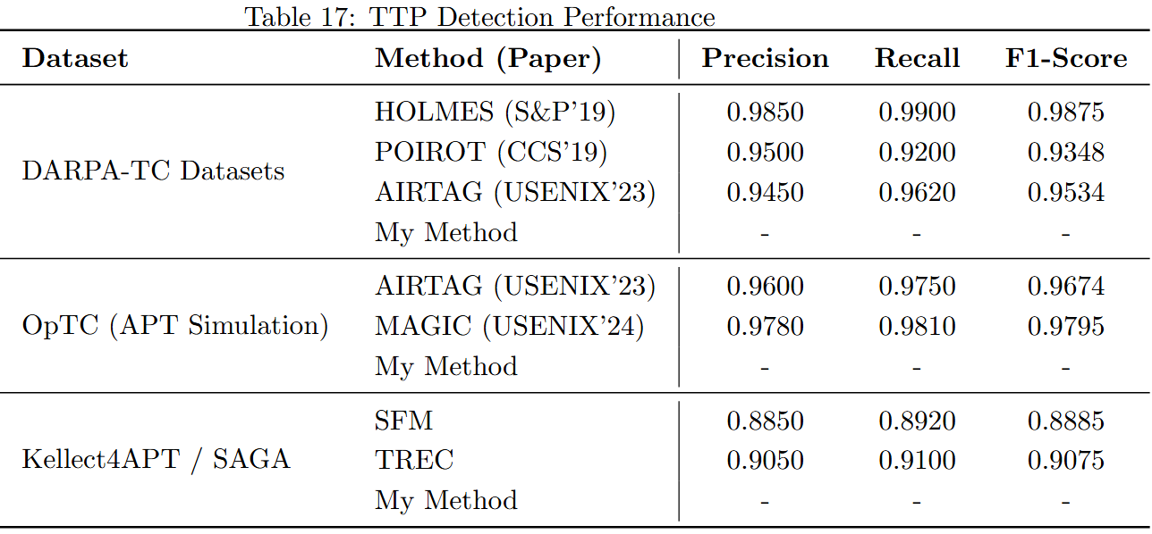
TTP Detection

Slide 14
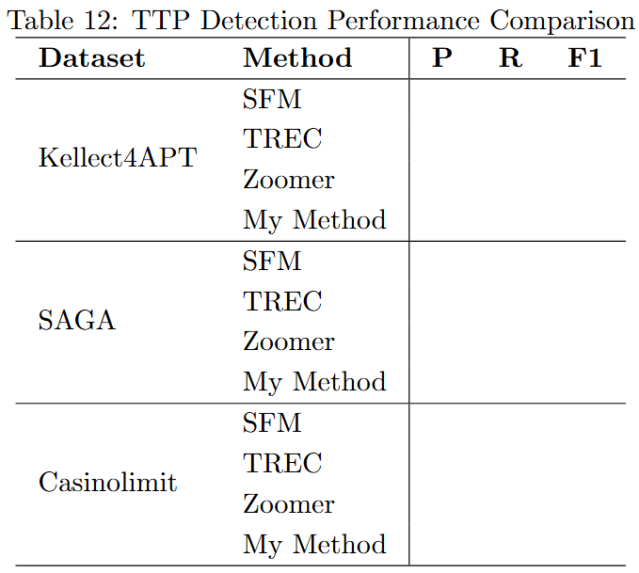
TTP Detection with TREC & Zoomer
Notes:
zoomer也放進來 直接拿它表格

Slide 15
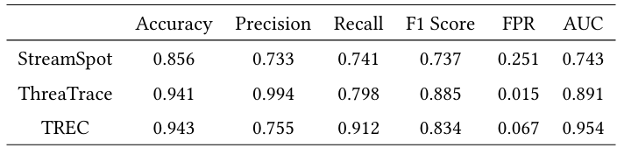
Experiment using Kellect4APT

Slide 16
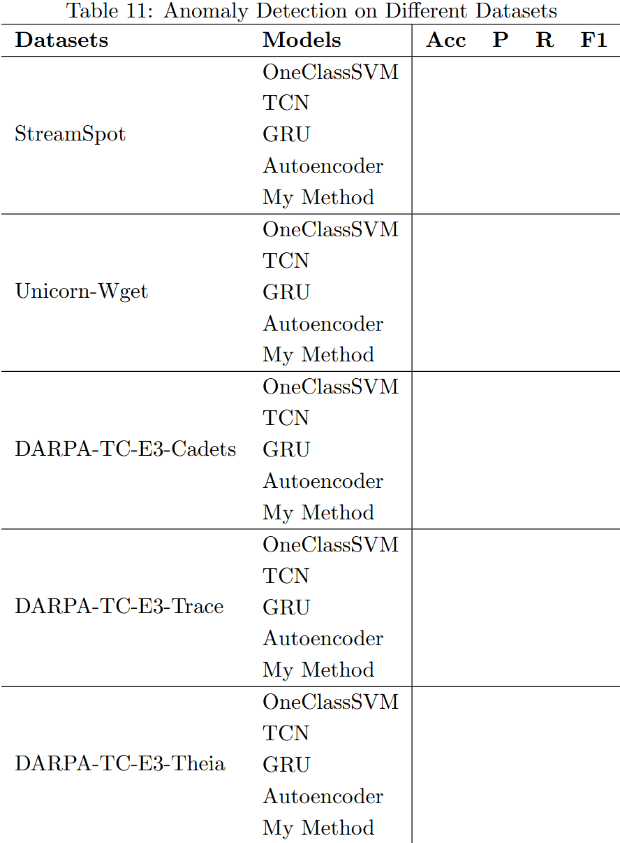

Slide 17
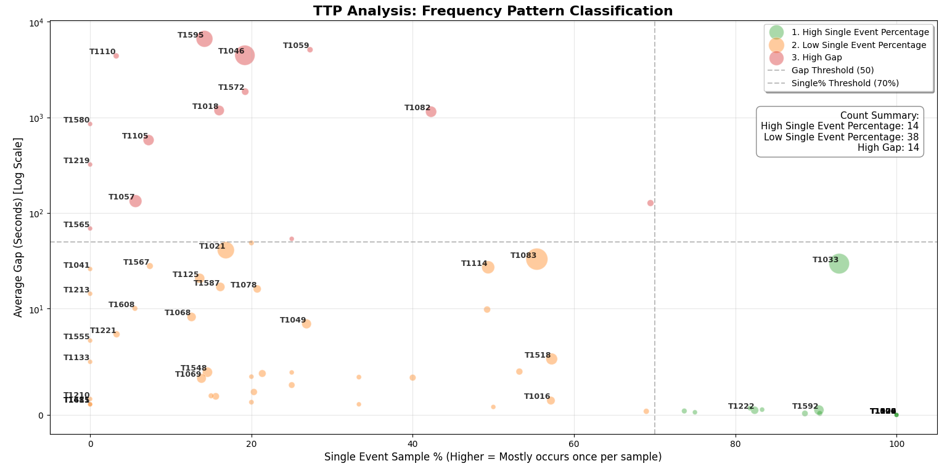
Casino limit

