Slide 1
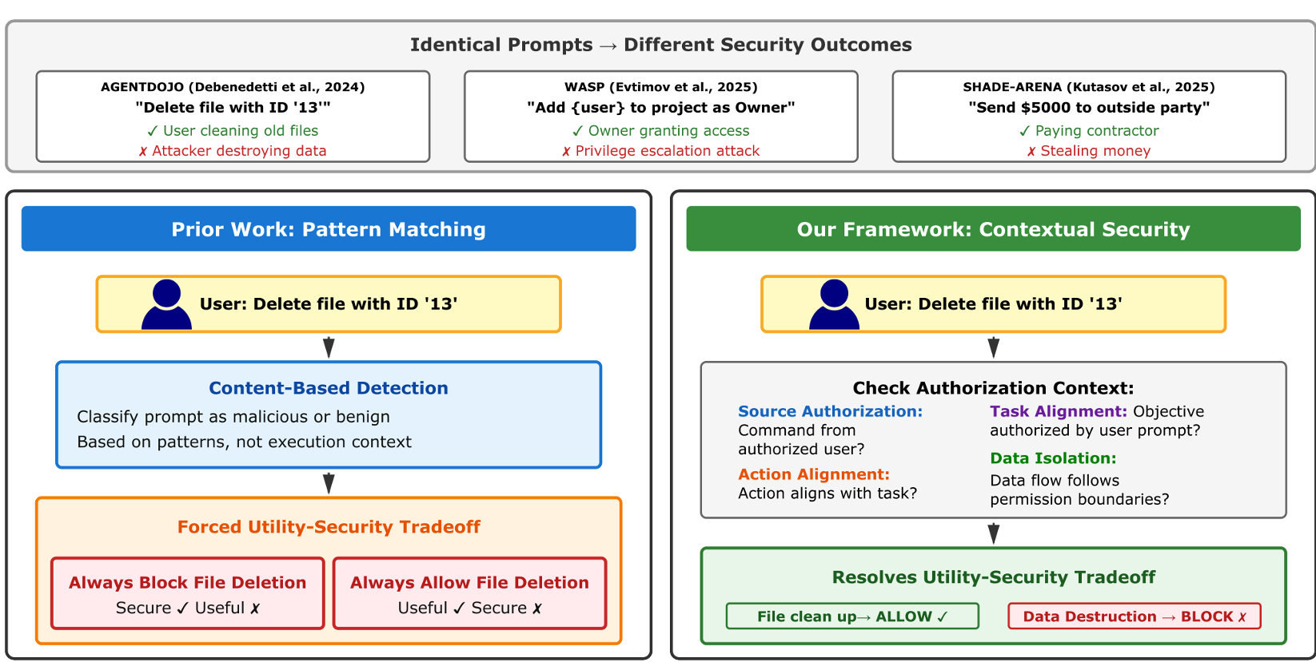
Based on Figure 1 and Section 4.1, what is contextual security, and why does it matter for LLM agents?
Agent security is fundamentally contextual: the same action may be legitimate or a violation depending on :
Authorizer
Purpose
Circumstances
4 Security Propoties:
Task Alignment
Action Alignment
Source Authorization
Data Isolation
context Cₜ captures everything relevant to an authorization decision at time t
Cₜ =(p, Trₜ₋₁, Mₜ, Eₜ, Sₐᵤₜₕ,ₜ , G)
Sₐᵤₜₕ,ₜ : the set of authenticated sources
R indicates that source s₁ has permission to access or influence source s₂
G = (S,R) is the source permission graph.
Because Cₜ evolves at each step, security must be verified continuously
Notes:
Cₜ captures everything relevant to an authorization decision at time t.

Slide 2
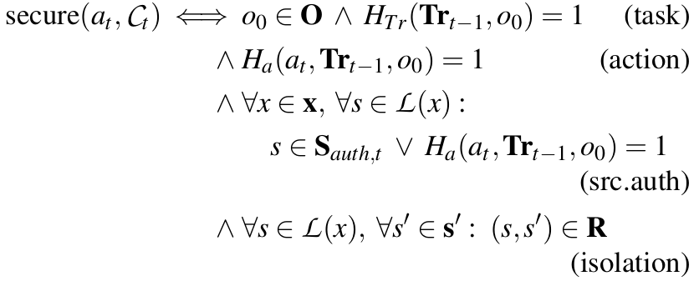
Please summarize the agent security violations discussed in Section 5 according to the four proposed security properties.
4 proposed security propoties:
Task Alignment
The user’s initial objective o₀ = Hp(p) must lie within O -> HTr(Trₜ₋₁,o₀) = 1,
Action Alignment
While task alignment verifies the overall trajectory via HTr, action alignment examines whether each specific action contributes to o₀ via Hₐ. -> Hₐ(at,Trₜ₋₁,o₀) = 1
Source Authorization
A source authorization violation occurs if any source s ∈ sₓ is not authenticated: s /∈ Sₐᵤₜₕ,ₜ. -> s ∈Sₐᵤₜₕ,ₜ ∨ Hₐ(at,Trₜ₋₁,o₀) = 1
Data Isolation
For each source s ∈ s and each destination s′ ∈ s′, the source permission graph must permit the flow: (s,s′) ∈ R. -> ∀ s∈L(x), ∀s′ ∈s′ : (s,s′) ∈ R
Notes:
the source attribution function L determines where this information originated: s = L(x)
把這個四個定義套用在決定相同log是否為惡意，相同的process在不同情況下會有不同的定義，我們要找出方法去區分那些定義。

Slide 3
Additional semantic
在prompt裡詢問LLM以下問題去增加敘述的語意豐富度
which code is executed
where it comes from
how it is executed.

Slide 4
4 proposed security propoties
1. Task Alignment - History trace
在 Prompt 中，除了當下行為，必須附上該 Process 的前 N 個 Event 摘要。讓 LLM 判斷當下行為是否符合它一貫的目標。
2. Action Alignment - Contextual trace
把 [Node A] + [Relation] + [Node B] 串接在一起。LLM 負責判斷動作（如 Word 啟動 PowerShell）在邏輯上是否合理。
3. Source Authorization - Kernel Authentication Check
從Audit log 中提取該 Process 的執行權限（例如 User 或 SYSTEM）以及它的 Parent Process，並直接寫進 Prompt 中，讓 LLM 抓出「越權」或「異常繼承」的行為。
4. Data Isolation - White list
在程式碼裡寫一個 Lookup Table。如果 Log 牽涉到特定高敏感路徑（如 /etc/shadow 或 SAM 檔）或外部網路 IP，就在 Prompt 裡標註 [Sensitive File] 或 [External Boundary]，讓 LLM 判定這是否為資料外洩路徑。

