Slide 1



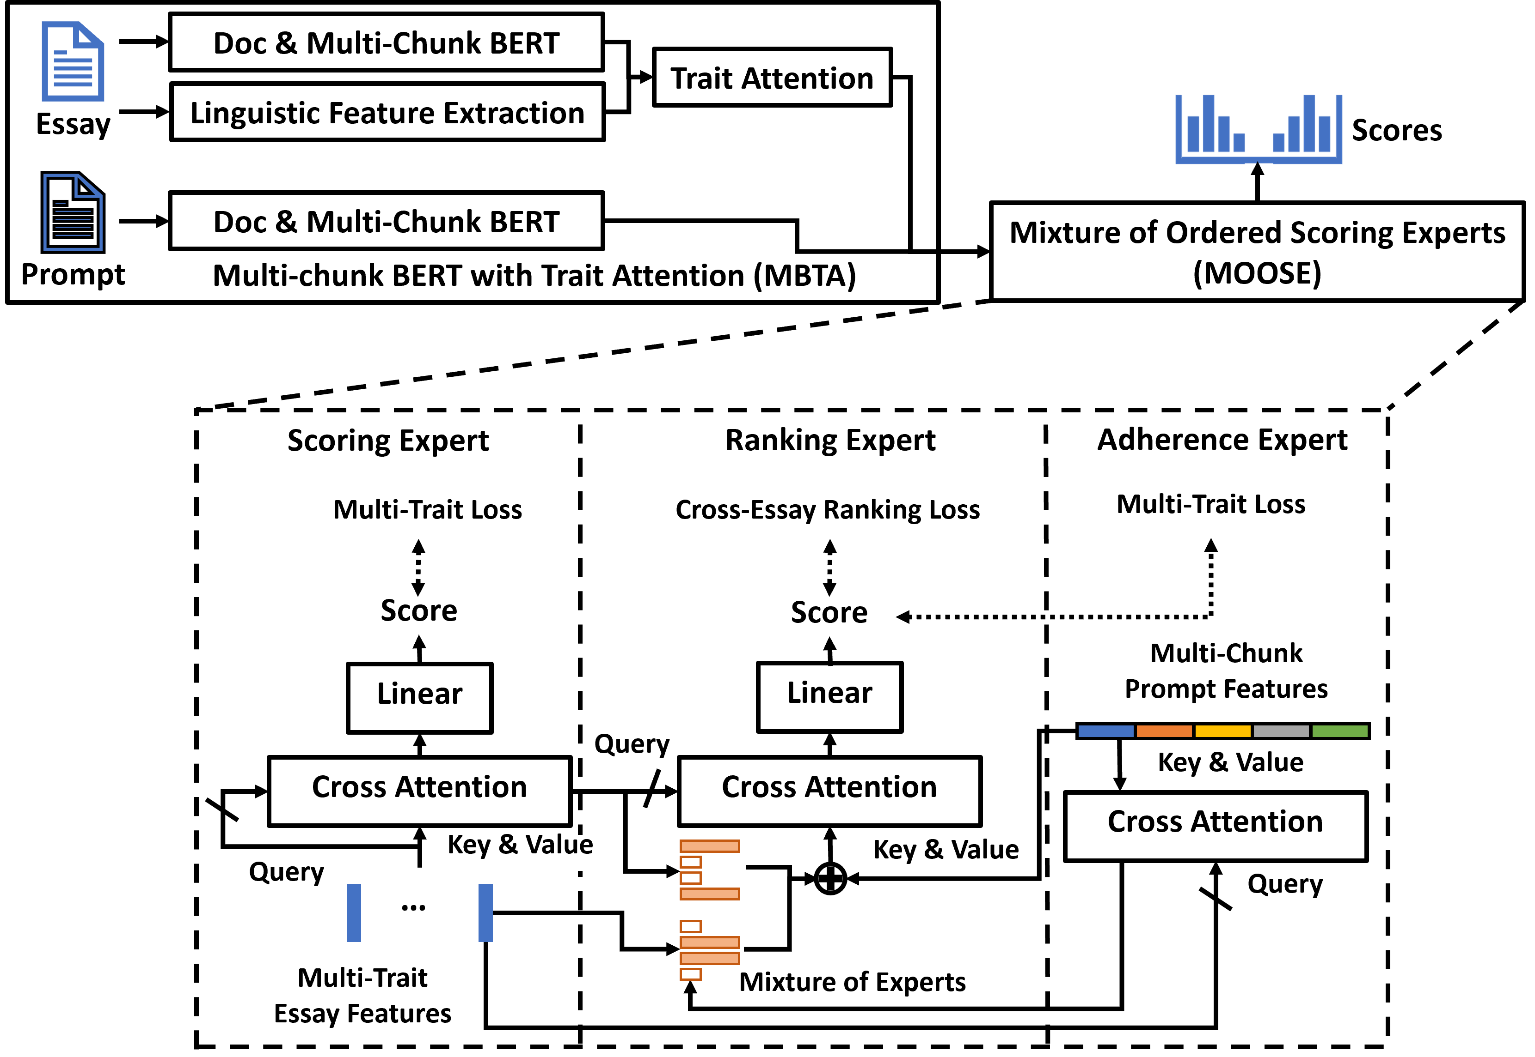
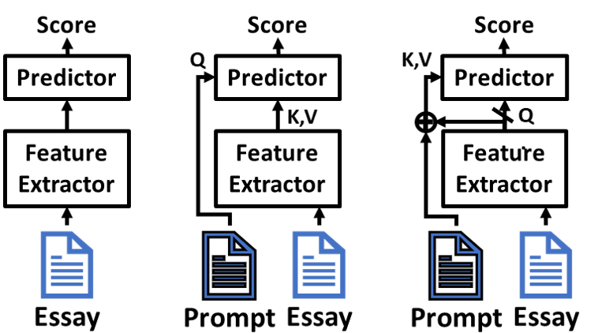
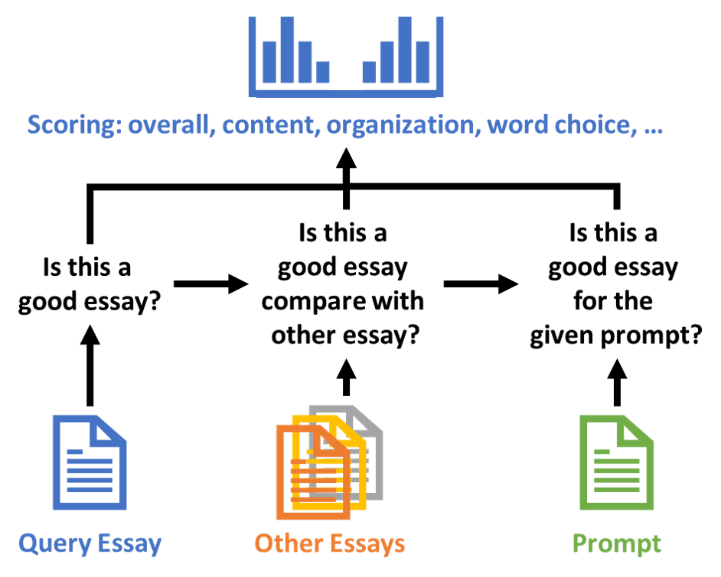


Mixture of Ordered Scoring Experts for Cross-prompt Essay Trait Scoring
Po-Kai Chen³, Bo-Wei Tsai³, Kuan-Wei Shao¹, Chien-Yao Wang², Jia-Ching Wang³, and Yi-Ting Huang^{1*}
¹National Taiwan University of Science and Technology, ²Institute of Information Science, Academia Sinica, ³National Central University
Abstract
Mixture of Ordered Scoring Experts (MOOSE)
Cross-Prompt QWK of Different Query Type
We propose the Mixture of Ordered Scoring Experts (MOOSE), a framework for essay trait scoring. It imitates the scoring process of professional human raters by integrating three specialized experts to evaluate: (1) the overall quality of an essay, (2) its relative quality compared to other essays, and (3) its relevance to the given prompt.
Furthermore, by reformulating essay trait scoring as a scoring cue retrieval problem and using the essay as the query, MOOSE achieves state-of-the-art performance in cross-prompt essay trait scoring on the ASAP++ dataset. It offers stable and trait-consistent results, surpassing previous models including LLM-based methods.
Model | QWK | STD
Prompt as query | 0.591 | 0.091
Essay as query | 0.624 | 0.057
Cross-Prompt QWK of Different Learning Goal
Model | QWK | STD
Learning to scoring | 0.589 | 0.058
Learning to retrieve scoring cues | 0.596 | 0.056
Cross-Prompt QWK of Different Scoring Experts
Model | QWK | STD
Scoring experts | 0.597 | 0.059
Ranking experts | 0.607 | 0.054
Ordered experts | 0.624 | 0.058
Methodology
Insights
Feature Extraction
Performance
Using essay as query strongly improves the performance via estimating distribution of essay over prompt & essay.
Reformulating learning goal to scoring cue retrieval makes the model more robust on the unseen prompt.
By imitating scoring process of human raters, ordered experts get outstanding performance on essay scoring.
Capturing hierarchical features of essay and prompt by Multi-Chunk BERT [1] and Trait Attention [2].
Extract 86 linguistic features (POS, readability, syntax, …).
Cross-Prompt QWK
(Avg. over 8 prompts)
Multi-Trait QWK
(Avg. over 9 traits)
Essay as Query
Model | QWK | STD
RDCTS [3] | 0.570 | 0.085
ProTACT [2] | 0.592 | 0.067
EPCTS [4] _{(LLM-based)} | 0.632 | 0.038
OSE (Ours) | 0.638 | 0.037
MOOSE (Ours) | 0.642 | 0.036
Model | QWK | STD
RDCTS [3] | 0.568 | 0.065
ProTACT [2] | 0.586 | 0.058
EPCTS [4] _{(LLM-based)} | 0.623 | 0.035
OSE (Ours) | 0.634 | 0.023
MOOSE (Ours) | 0.641 | 0.018
Prevents overfitting to seen prompts.
Enables generalized scoring cue retrieval.
Reference
[1] Yongjie Wang et al. “On the use of BERT for automated essay scoring: Joint learning of multi-scale essay representation.” NAACL, 2022.
[2] Heejin Do et al. “Prompt- and trait relation-aware cross-prompt essay trait scoring.” ACL Findings, 2023.
[3] Jingbo Sun et al. “Enhanced cross-prompt trait scoring via syntactic feature fusion and contrastive learning.” The Journal of Supercomputing, 2024.
[4] Jiangsong Xu et al. “EPCTS: Enhanced prompt-aware cross-prompt essay trait scoring.” Neurocomputing, 2025.
(Previous Approaches)
(Ours)
Ordered Scoring Experts (OSE)
Scoring Expert: Learn essay inherent scoring cues.
Ranking Expert: Compare relative quality across different essays.
Adherence Expert: Estimate the degree of prompt adherence.
Improvements
Code & Demo
Outperforms all SoTAs on cross-prompt essay trait scoring.
Achieves exceptionally stable performance across different prompts and traits.
Makes the prediction of the model be interpretable.
The code and the demo of the paper are publicly available at https://antslabtw.github.io/MOOSE

