Slide 1
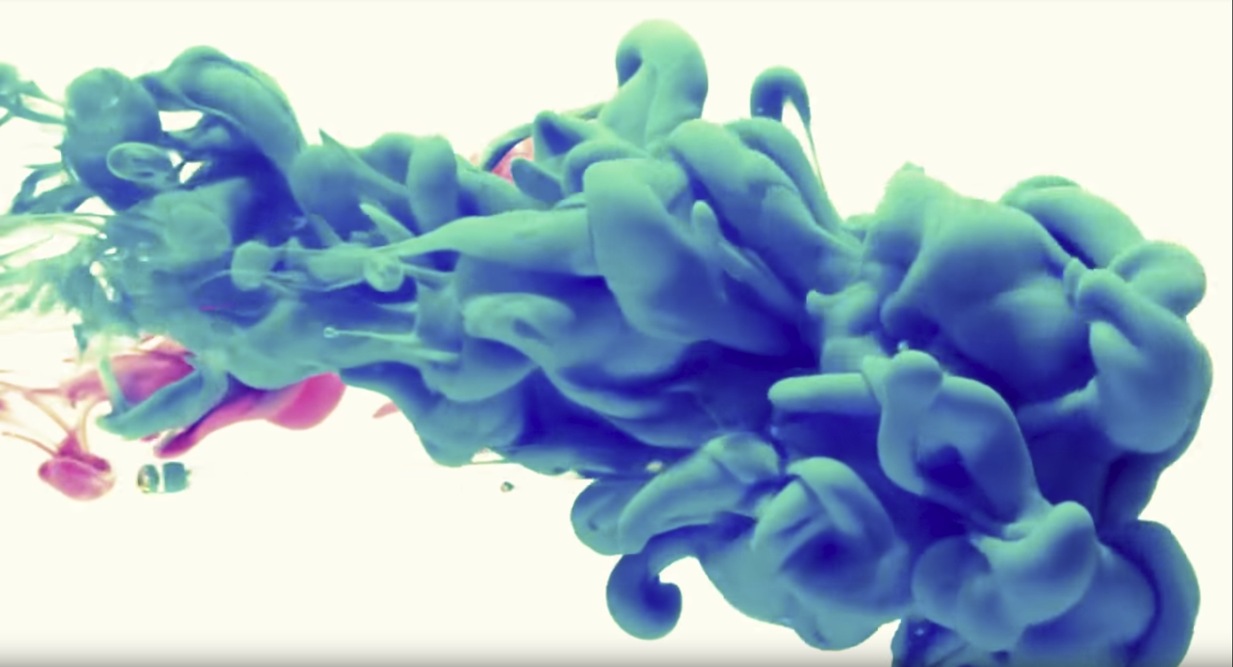
T
A
E
T
E
B
L
N
S
N
I

Slide 2

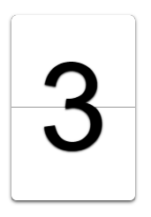
Player 1
Player 2

Slide 3
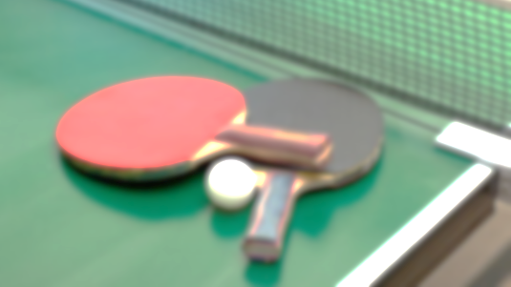
T
A
E
T
E
B
L
N
S
N
I

Slide 4

T
A
E
T
E
B
L
N
S
N
I

Slide 5
ANTTI
AAPO

Slide 6
ANTTI
AAPO

