Slide 1
Part - I
Auto Convolution

Slide 2

Raw Data
Date
2017-01-01
Tittle
উখিয়ার অনিবন্ধিত শিবিরের পাশে নতুন বসতি
News
স্ত্রী নুর জাহান ও আট সন্তানকে নিয়ে দুই মাস ধরে রাখাইনের বুড়াশিকদার পাড়ায় খালের ওপর মাচা বেঁধে দিন যাপন করছিলেন মোহাম্মদ হোসেন। কিন্তু গত তিন-চার দিনে ওই এলাকায় মিয়ানমারের সশস্ত্র বাহিনী ও নাডালা বাহিনীর নতুন অভিযান শুরুর পর প্রাণ বাঁচাতে তাঁরা বাংলাদেশে এসেছেন।……………...

Slide 3
Feature Procurement
Murder : "খুন","নিহত","ঘাত","আঘাত","হত্যা","গুলি","চাকু","বন্দুক","পিস্তল","আগ্নেয়াস্ত","ছুড়ি","অস্ত্র","সশস্ত্র","রক্তপাত","মার","মেরে","লাশ","মৃত","ঘাতক","পিটিয়ে"
Kidnap : "অপহরণ","হরণ","তুলে","গুম","ক্ষিপ্র","জোর","পাচার","দখল","পীড়ন","নিপীড়ন","শিকার","অত্যাচার","নির্যাতন","জুলুম","জবরদস্তি","বলাত্কার","নারীধর্ষণ","ধর্ষণ","ধর্ষিত","ধর্মনাশ"
Hassle : "মারামারি","হামলা","আহত","ধেয়ে","ধাওয়া","পাল্টা","আক্রমণ","হানা","ধোলাই","দ্বন্দ্ব","চক্রান্ত","ষড়যন্ত্র","ঝগড়া","সংঘর্ষ","দাঙ্গা","লড়াই","কলহ","সহিংস","সংঘাত","শত্রুতা"

Slide 4
Feature Procurement
Protest : "বিক্ষোভ","সভা","সমাবেশ","হরতাল","ছত্রভঙ্গ","হল্লা","বিবাদ","বিরোধ","গোলমাল","প্রতিদ্বন্দ্বিতা","সংগ্রাম্","আন্দোলন","মিছিল","অবরোধ","নাশকতা","ধর্মঘট","আলোড়ন","বিশৃঙ্খলা","ঝামেলা","প্রতিবাদ"
Accident : "দূর্ঘটনা","ভিড়","আকস্মিক","দুর্দশা","সংকট","বাগিয়ে","কবল","এলোপাতাড়ি","ক্ষত","ক্ষয়","বিপর্যয়","সর্বনাশ","আচমকা","হঠাৎ","অপ্রত্যাশিত","দৃঢ়ভাবে","দুর্বিপাক","বিপাক","আপদ","আর্তনাদ"
Terror : "আতঙ্ক","বিস্তার","হৈচৈ","ভয়","উত্তেজনা","রেশ","ক্রুদ্ধ","ক্রোধ","বিপদ","অশান্তি","অস্থির","উপদ্রব","অসাধুতা","নিয়মভঙ্গ","উপদ্রব","প্রভাব","চক্র","চাঁচল্য","আশঙ্কা","নালিশ"
Dhaka : "ঢাকা","নরসিংদী","গাজীপুর","শরীয়তপুর","নারায়ণগঞ্জ","টাঙ্গাইল","কিশোরগঞ্জ","মানিকগঞ্জ","মুন্সিগঞ্জ","রাজবাড়ী","মাদারীপুর","গোপালগঞ্জ","ফরিদপুর","বেলাবো","মনোহরদী","নরসিংদী","পলাশ","রায়পুরা","শিবপুর","কালীগঞ্জ"...............

Slide 5
Preparation 1
After procurement of the feature we isolated the dataset into two tables
News_Id | day | month | year | murder | kidnap | hassle | protest | accident | terror
0 | 8 | 5 | 2018 | 39 | 9 | 30 | 3 | 2 | 3
1 | 10 | 5 | 2018 | 7 | 1 | 22 | 3 | 5 | 1
2 | 24 | 5 | 2018 | 2 | 0 | 1 | 0 | 1 | 4
Table for time division : 1.0
News_Id | barishal | chittagong | dhaka | khulna | rajshahi | rangpur | sylhet | mymensingh
0 | 0 | 8 | 6 | 0 | 0 | 0 | 0 | 0
1 | 0 | 0 | 0 | 0 | 0 | 1 | 0 | 0
2 | 0 | 1 | 6 | 2 | 0 | 1 | 0 | 0
Table for area division : 1.1

Slide 6
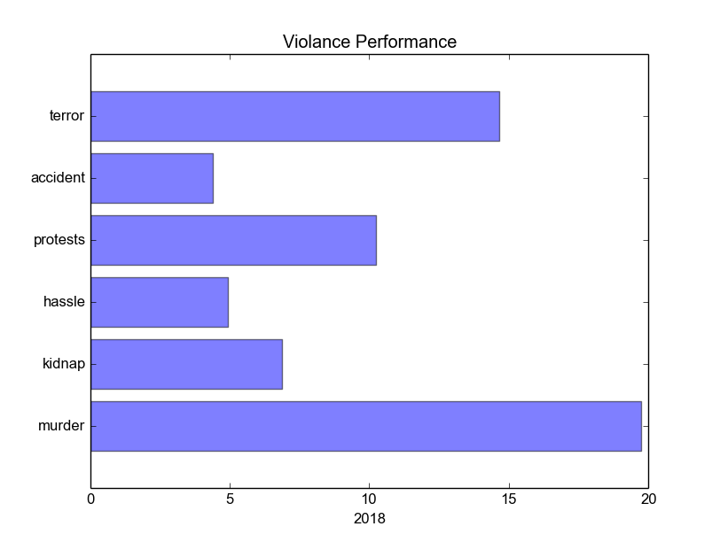
Visualization
Clustered by Year : 2018

Slide 7
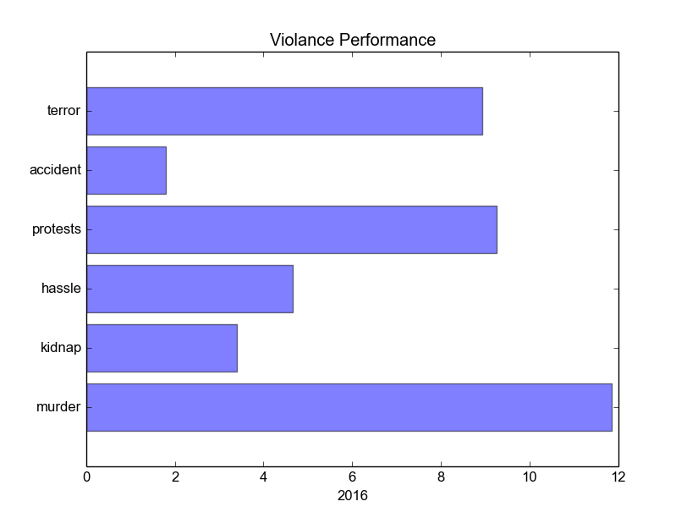
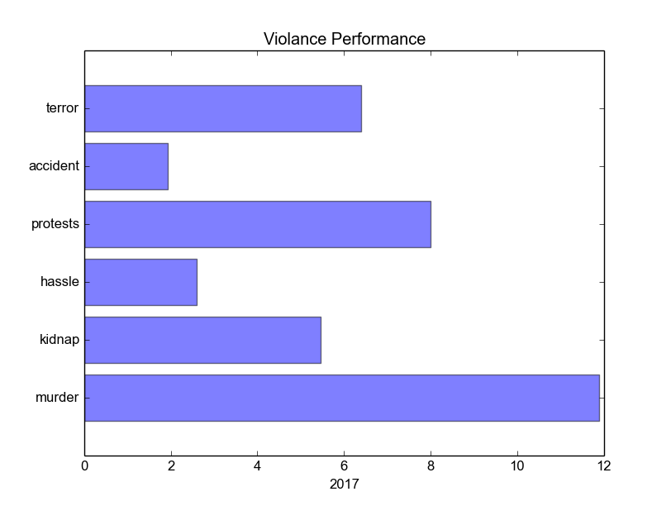
Visualization
Clustered by Year : 2016 & 2017

Slide 8
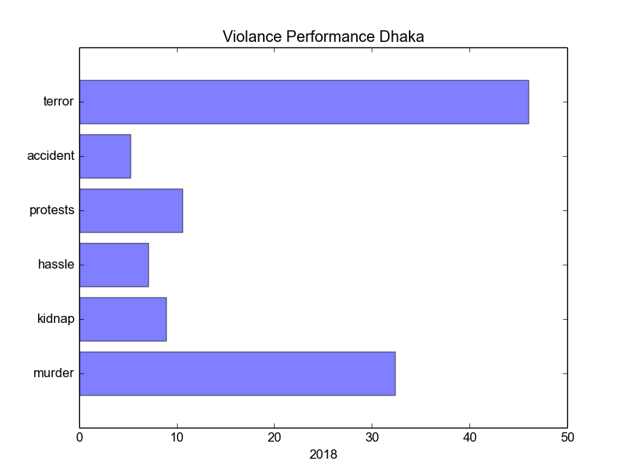
Visualization
Clustered By Area (Dhaka) & Year

Slide 9
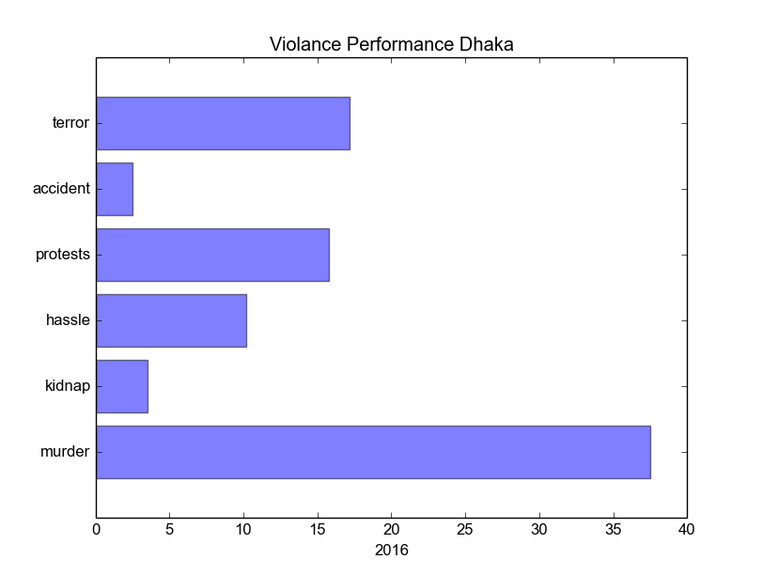
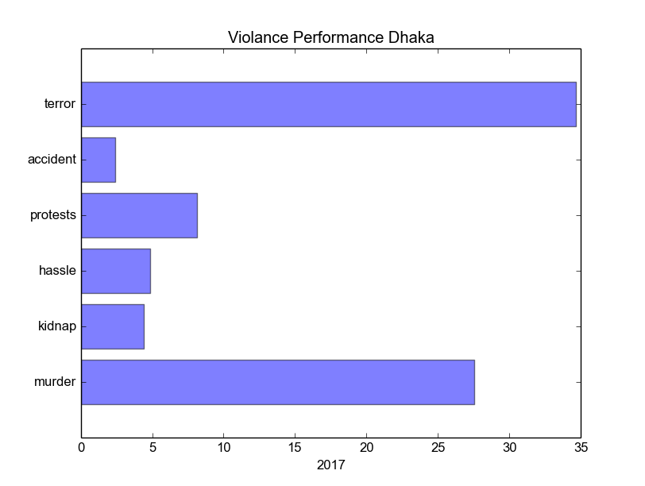
Visualization
Clustered By Area (Dhaka) & Year

Slide 10
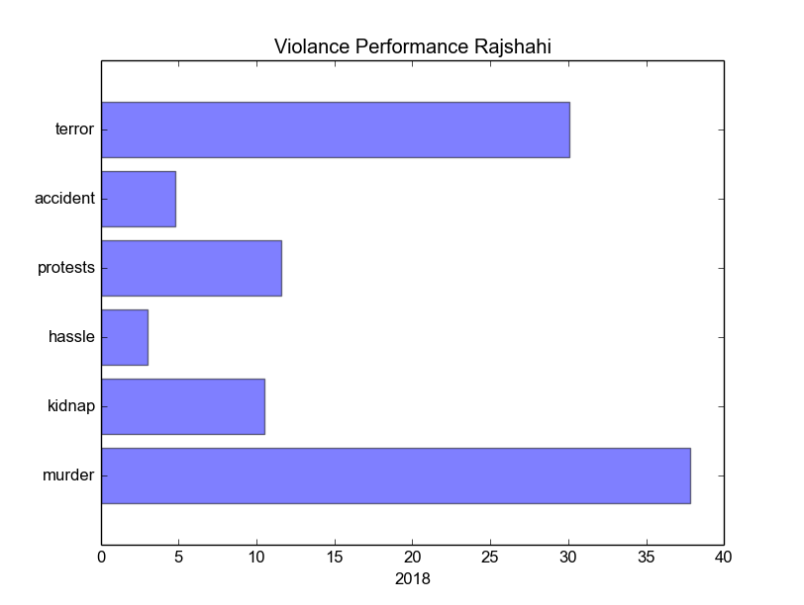
Visualization
Clustered By Area (Rajshahi) & Year

Slide 11
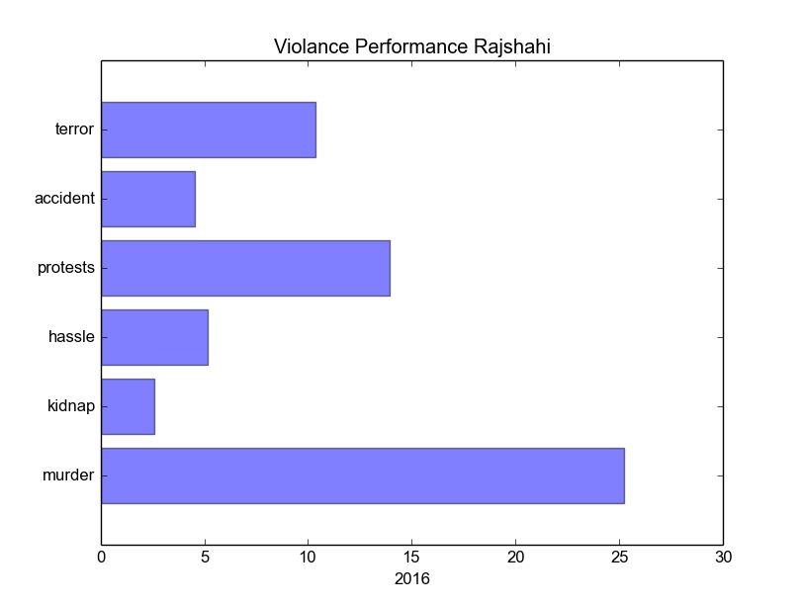
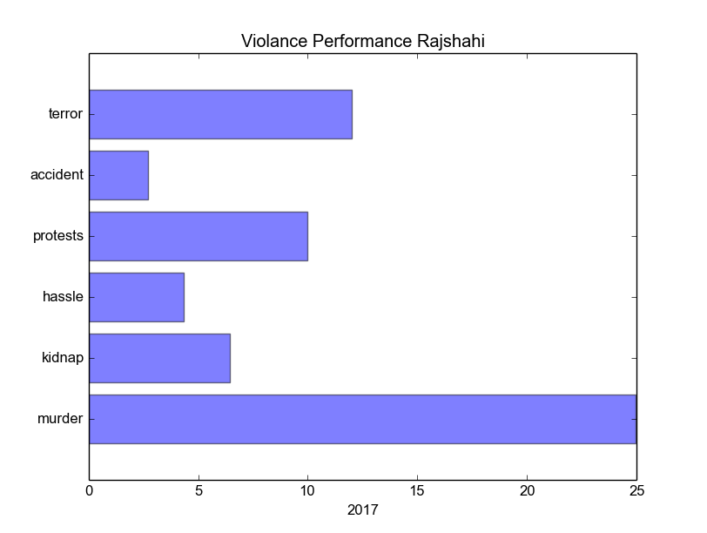
Visualization
Clustered By Area (Rajshahi) & Year

Slide 12
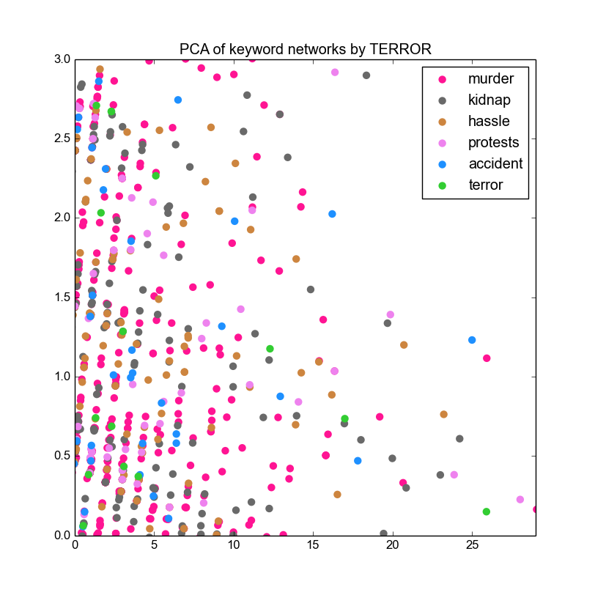
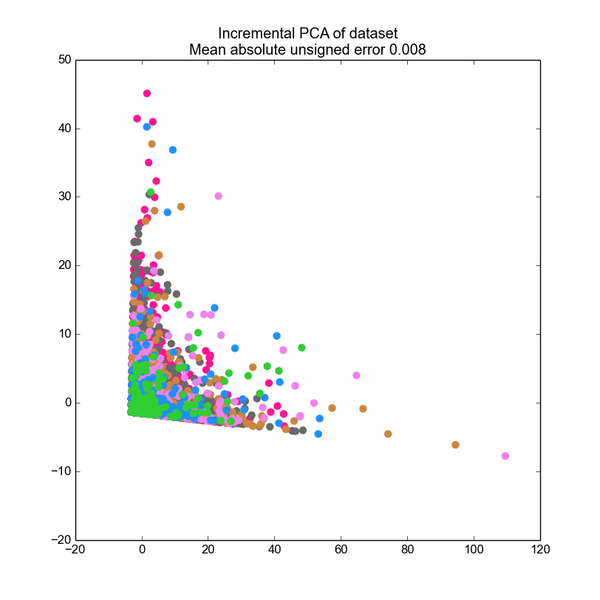
Visualization
Principal Component Analysis

Slide 13
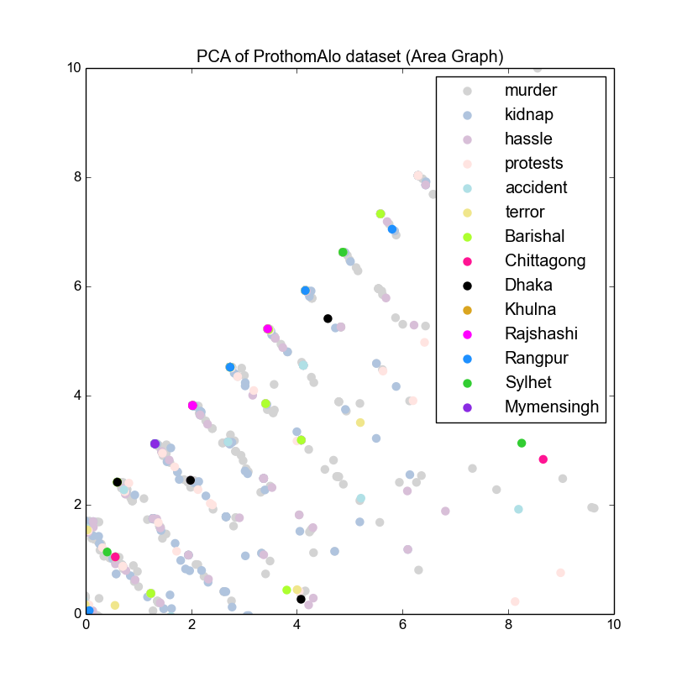
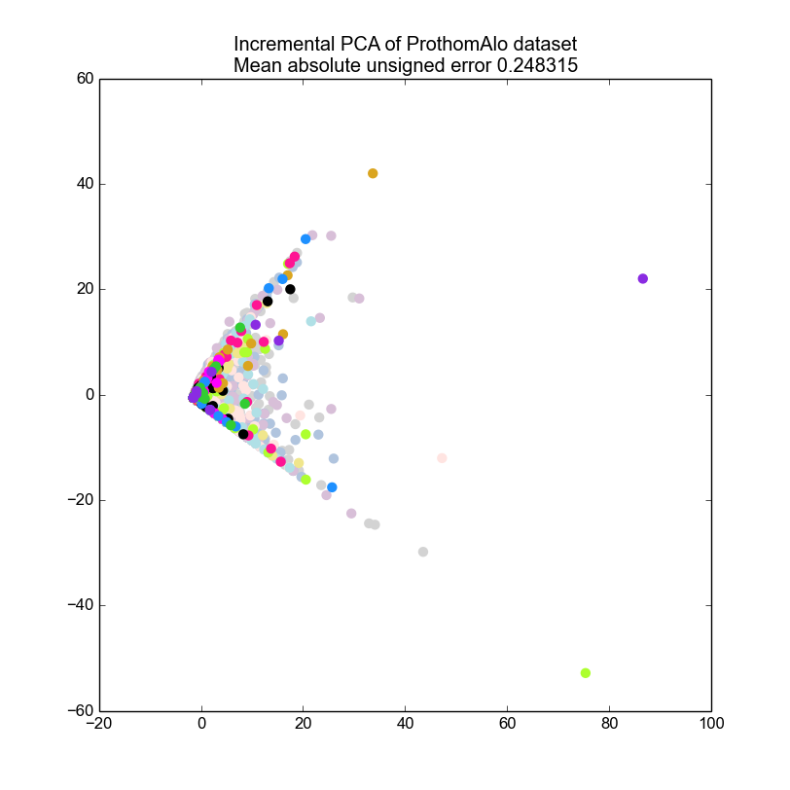
Visualization
Principal Component Analysis

Slide 14
Bottom Up Hierarchical
(BUH) Classifier
Why BUH classifier?
Prevents concept-drifting error.
Ensemble classifier; Supports the Decision Tree by weighting through the other classifiers.
Novel class detection.
Utilizes a supervised learning technique with a better tf–idf evidence.
Proper importance for each feature is established.

Slide 15
Forecasting
Methodology :
Auto Convolution
Its a mathematical operator which takes two functions x and h and produces a third function y, that represents the amount of overlap between x and a translated version of h.
Tf-Idf
Its a numerical statistic that is intended to reflect how important a word is to a document in a collection or corpus. Most of the time It is used as a weighting factor in searches of information retrieval, text mining, and user modeling.

Slide 16
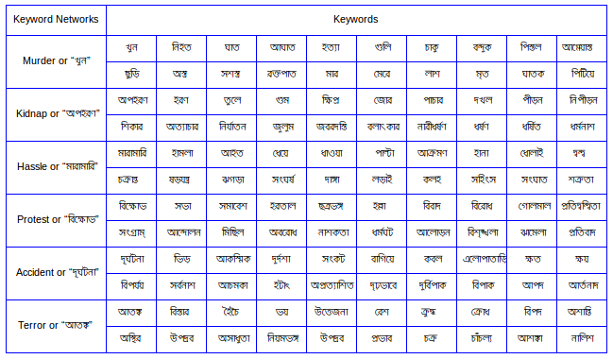
Bottom Up Hierarchical
(BUH) Classifier

Slide 17
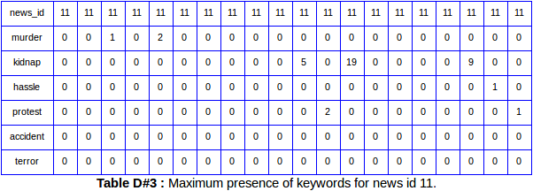
Bottom Up Hierarchical
(BUH) Classifier
Maximum Presence

Slide 18
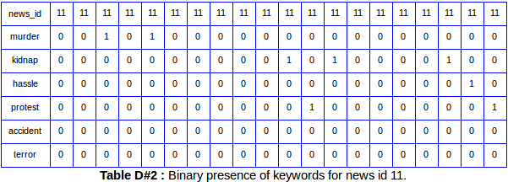
Bottom Up Hierarchical
(BUH) Classifier
Binary Presence

Slide 19
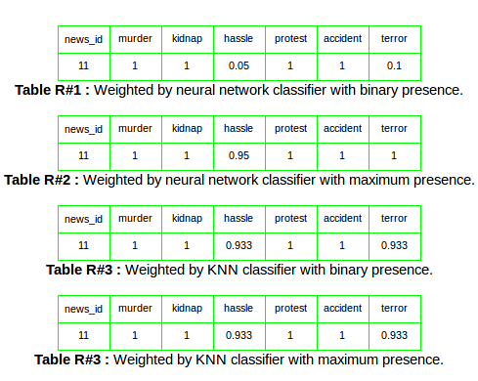
Bottom Up Hierarchical
(BUH) Classifier

Slide 20
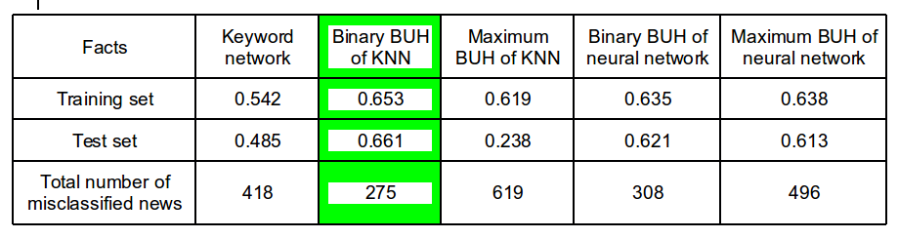
Analogy On
Decision Tree
Total Number of Instances : 2850
Training Set : 65% (1853)
Test Set : 35% (997)

Slide 21
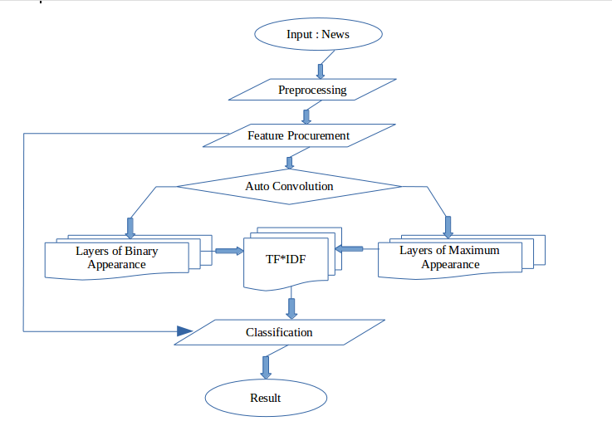
Flow Chart

