Slide 1
Thunder Detection & Damage Reduction System
A project by
Imtiaz Mamun
Mahmudul Hamid
Arpita Roy
Humaira Noor
* See slide notes for page directions
Notes:
When listing all project collaborators, either use commas or bullets

Slide 2

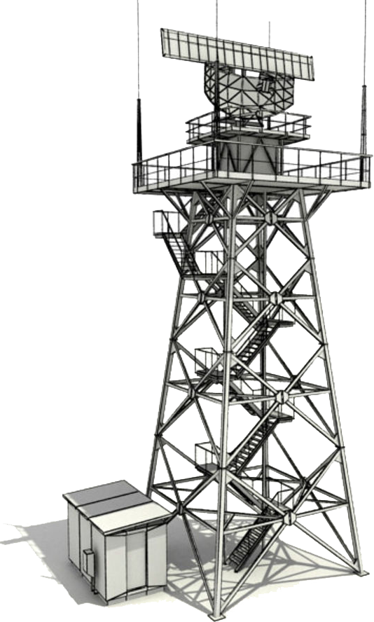
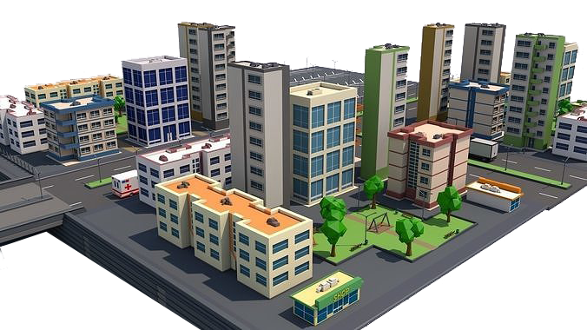
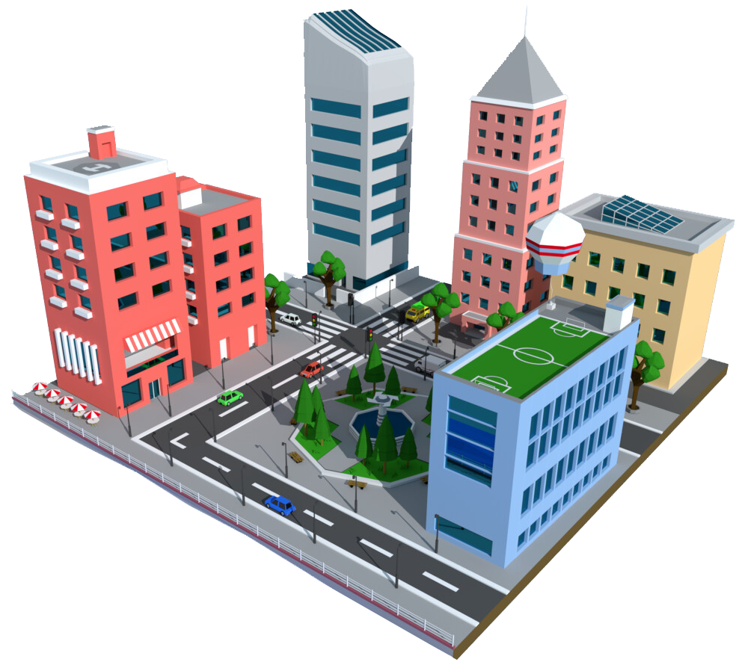
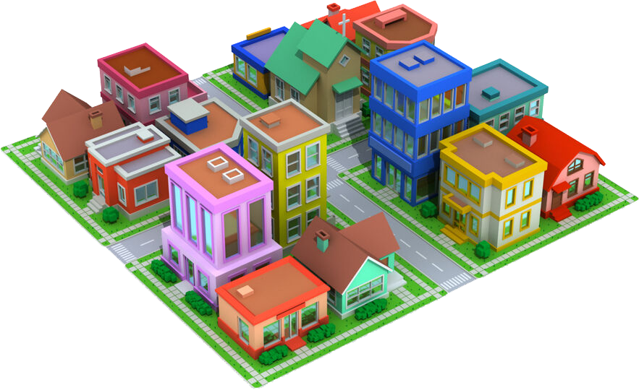
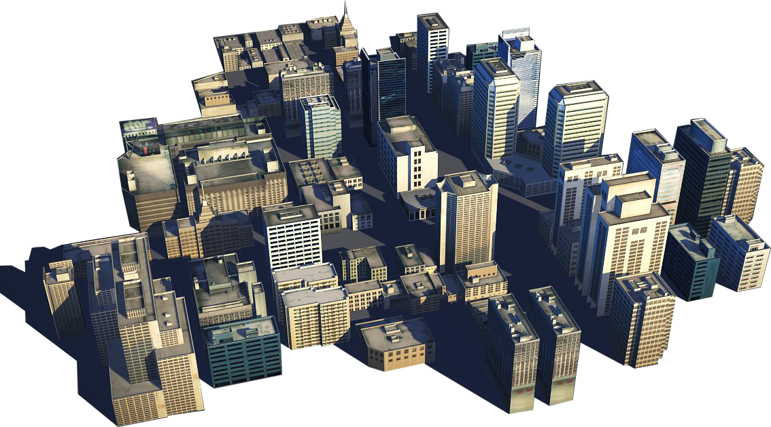
Implementation from Colony
Notes:
Insert a map of your colony (draw it, ink it, or create it in PPT- be creative!)
Insert -> Pictures for photos
Draw for digital inking
Insert -> Shapes if you want to create it in PPT
All mountains, towns/villages, bodies of water/waterways, landmarks, etc. should be clearly labeled

Slide 3
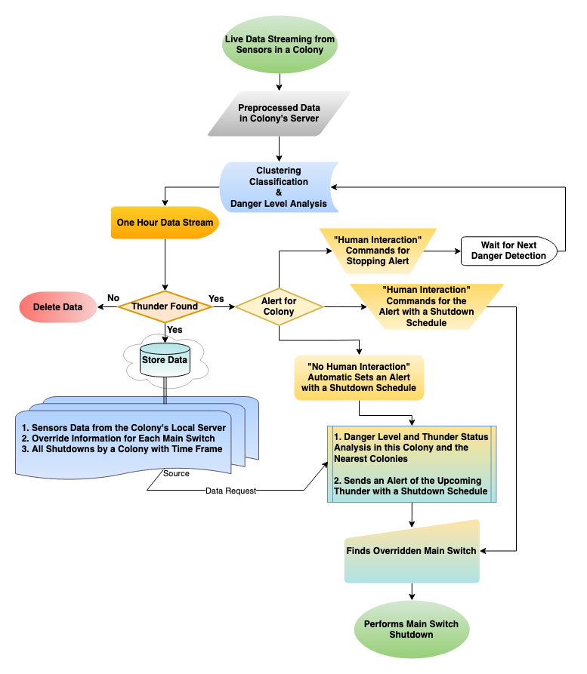
Flowchart
Notes:
What is the name of your colony song?
Write lyrics to the song and, if you are feeling creative, use a computer program or instruments to create the music that goes along with it!
To insert an audio file, click on Recording -> Audio -> Audio on My PC and choose your file

Slide 4
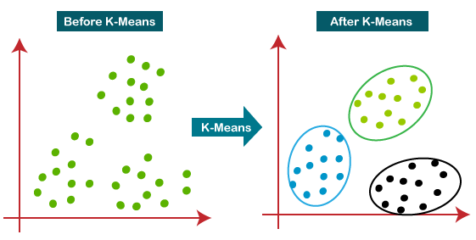
Flowchart
Notes:
What is the name of your colony song?
Write lyrics to the song and, if you are feeling creative, use a computer program or instruments to create the music that goes along with it!
To insert an audio file, click on Recording -> Audio -> Audio on My PC and choose your file

Slide 5
Classification
AS3935 | Distance (KM) | Wind Speed (KM/h) | Humidity (%) | Temperature (C) | Light Flashes (1,0) | Thunder Sound (1,0)
11111 | 31 | 0.644 | 0.73 | 16.18333333 | 0 | 0
11011 | 27 | 9.0965 | 0.84 | 13.83888889 | 0 | 0
11000 | 24 | 9.2092 | 0.93 | 13.77222222 | 0 | 0
10100 | 20 | 9.9015 | 0.82 | 13.28333333 | 0 | 0
10001 | 17 | 10.4006 | 0.95 | 12.75555556 | 0 | 0
1110 | 14 | 11.2056 | 0.89 | 12.16666667 | 0 | 0
1100 | 12 | 11.3344 | 0.83 | 11.25 | 1 | 1
1010 | 10 | 12.0106 | 0.93 | 11.18333333 | 0 | 1
1000 | 8 | 13.8299 | 0.79 | 11.11111111 | 0 | 0
110 | 6 | 14.3612 | 0.63 | 11.11111111 | 0 | 0
101 | 5 | 17.0982 | 0.6 | 10.69444444 | 1 | 0
1 | Storm | 22.0409 | 0.87 | 8.633333333 | 1 | 0

Slide 6
Social Groups
Colony Name | Main Switch IP | Used Port List | Overridden Ports | House Address
Colony A | 172.16.0.1 | 8801, 8802, 8808 | 8808 | 8th Floor, Ho. 88, Rd. 8
Colony A | 172.16.4.4 | 8401, 8404, 8484 | 8404, 8484 | 4th Floor, Ho. 88, Rd. 8
Colony B | 172.21.2.1 | 8202, 8433, 8424 | N/A | 2th Floor, Ho. 88, Rd. 8
Colony B | 172.18.8.4 | 8123, 8321 | N/A | 6th Floor, Ho. 88, Rd. 8
Colony C | 172.25.5.2 | 8989, 8899, 8889 | 8889 | 3th Floor, Ho. 88, Rd. 8
Colony C | 172.30.0.6 | 8765, 8567 | N/A | 5th Floor, Ho. 88, Rd. 8
Notes:
*OPTIONAL SLIDE* If you are interested in learning more about social groups, look up the caste or class system.

