Slide 1
Thunder Detection and Home Appliances Power Management
Group Members
Shubham Saha
Imtiaz Mamun
Mahmudul Hamid
Arpita Roy
Humaira Noor
IOT

Slide 2
Project Grounds
Safety of Home Appliances
Storm Alert for Preparedness: Warning Systems
Danger Level and Time and Space Distance of Upcoming Thunder

Slide 3
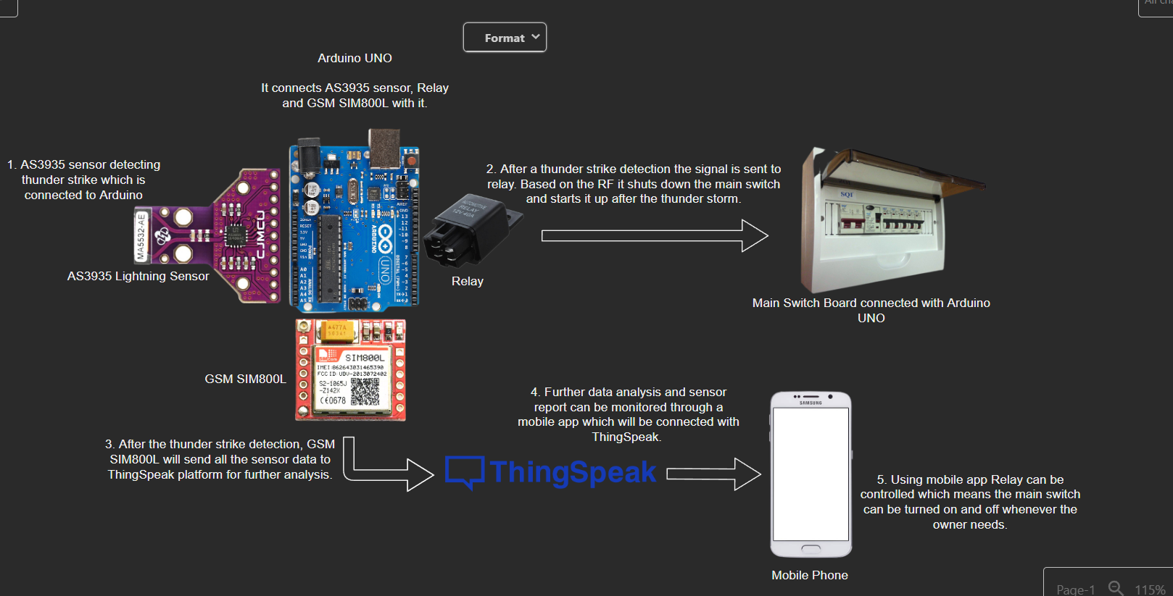
Dagram

Slide 4
Project Goal
Making a cheap device for each home with automated power control of desired switch for the safety of human and electronic device life.

