Slide 1


Privacy systems in the cloud
Pedro Antunes up201507254

Slide 2
CONTENTS
  Cloud system background
  What am i protecting against?
  HSM solution
  What guarantees is the hardware giving me?
  Validation

Slide 3
CLOUD SYSTEM BACKGROUND
Entities
  Hosts
  Clients
  Operators
Ensure privacy of client information by cryptographic operations
Who ensures keys safety?

Slide 4
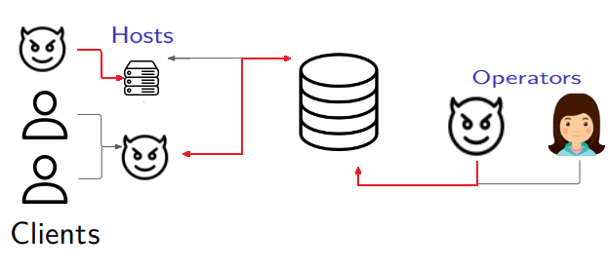
WHAT AM I PROTECTING AGAINST?
Should a host have one key per client? Is it realist scalable?

Slide 5
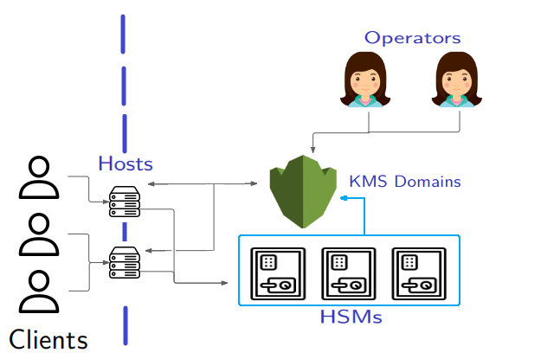
HSM SOLUTION
Encrypts customer crypto keys
Crypto operations over multiple HSMs using the same key
Number of keys
=
Number of hosts

Slide 6
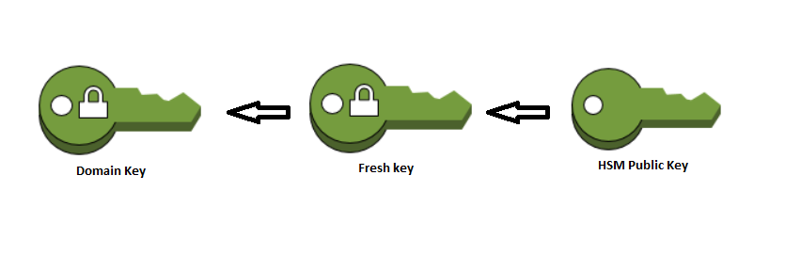
KMS DOMAINS
Domain Keys
  Encrypted domain key
  Key to decrypt domain key, encrypted for each HSM public key
Trust
  Domain ID
  Entities Public Keys in the domain (HSMs & Operators)
  Quorum (Trusted Operators)
  Hash of predecessor trust
HSM Signature
HSM Signature

Slide 7
WHAT GUARANTEES IS THE HARDWARE GIVING ME?
Domain creation and validation
Domain keys rotation
Domain keys can only be decrypted within an HSM that belongs to the domain.
High availability for cryptographic operations (encryption/signature)
Confidentiality and integrity over system stored keys
Assumptions
  Domain creation is decided and approved by a group of honest operators that will belong to the domain.
  Entities cannot be removed from a domain. Only added
  New entities must be attested with valid signatures. The number of valid signatures must be greater than or equal to quorum trust.

Slide 8
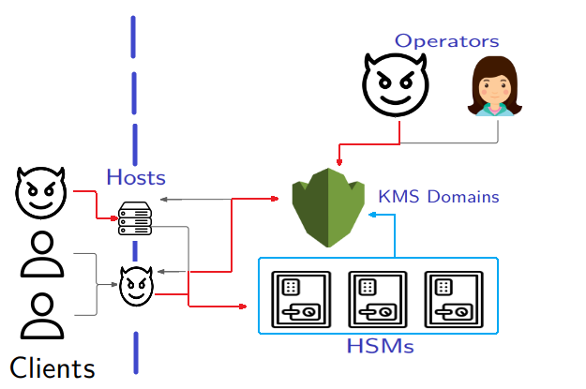
VALIDATION
An attacker can only recover the stored keys if he breaks the security of a cryptographic algorithm or if he can manipulate an HSM.
If the quorum is set correctly, even if the attacker tries to influence operators, the actions on a domain have to be validated by at least 1 honest operator.

Slide 9
PROOF OF CONCEPT

Slide 10
QUESTIONS
Pedro Antunes up201507254

