Slide 1
Term project: Sports Data Analytics
MET CS688 C1 – Web analytics and mining
Anthony valencia

Slide 2
An analysis of player statistics from the NBA 07-08 season
> nba0708 <- fetch_NBAPlayerStatistics("07-08")
> names(nba0708)
[1] "League" "Name" "Team" "Position"
[5] "GamesPlayed" "TotalMinutesPlayed" "FieldGoalsMade" "FieldGoalsAttempted"
[9] "ThreesMade" "ThreesAttempted" "FreeThrowsMade" "FreeThrowsAttempted"
[13] "OffensiveRebounds" "TotalRebounds" "Assists" "Steals"
[17] "Turnovers" "Blocks" "PersonalFouls" "Disqualifications"
[21] "TotalPoints" "Technicals" "Ejections" "FlagrantFouls"
[25] "GamesStarted"

Slide 3
Player analysis of the LA Lakers 07-08 season
> nba0708.lakers <- nba0708[nba0708$Team == 'LAL’,]
> nba0708.lakers$Name
[1] "Trevor Ariza" "Kwame Brown" "Kobe Bryant" "Andrew Bynum" "Jordan Farmar"
[6] "Derek Fisher" "Pau Gasol" "Coby Karl" "Dj Mbenga" "Chris Mihm"
[11] "Ira Newble" "Lamar Odom" "Vladi Radmanovic" "Ronny Turiaf" "Sasha Vujacic"
[16] "Luke Walton"

Slide 4
Best 3pt shooter on Lakers 08-07
> nba0708.lakers$ThreePercentage <- nba0708.lakers$ThreesMade/nba0708.lakers$ThreesAttempted
> three.percentage.lakers.not.na <- nba0708.lakers[!is.na(nba0708.lakers$ThreePercentage),]
> three.percentage.lakers.not.na[three.percentage.lakers.not.na[, "ThreePercentage"] == max(three.percentage.lakers.not.na$ThreePercentage, na.rm=TRUE),][,c("Name","ThreePercentage","ThreesMade","ThreesAttempted")]
Name ThreePercentage ThreesMade ThreesAttempted
410 Sasha Vujacic 0.437037 118 270

Slide 5
Player on court the most
> minutes.played.lakers.not.na <- nba0708.lakers[!is.na(nba0708.lakers$TotalMinutesPlayed),]
> minutes.played.lakers.not.na[minutes.played.lakers.not.na[, "TotalMinutesPlayed"] == max(minutes.played.lakers.not.na$TotalMinutesPlayed, na.rm=TRUE),][,c("Name","TotalMinutesPlayed")]
Name TotalMinutesPlayed
67 Kobe Bryant 3193

Slide 6
Player with the most steals
> steals.lakers.not.na <- nba0708.lakers[!is.na(nba0708.lakers$Steals),]
> steals.lakers.not.na[steals.lakers.not.na[, "Steals"] == max(steals.lakers.not.na$Steals, na.rm=TRUE),][,c("Name","Steals")]
Name Steals
67 Kobe Bryant 150

Slide 7
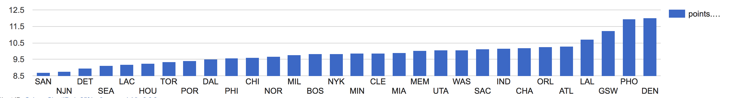
Points per player for each team

Slide 8
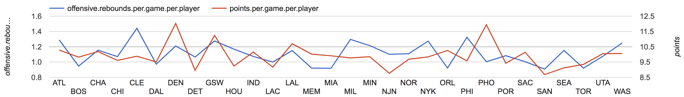
Points vs Rebounds per player

Slide 9
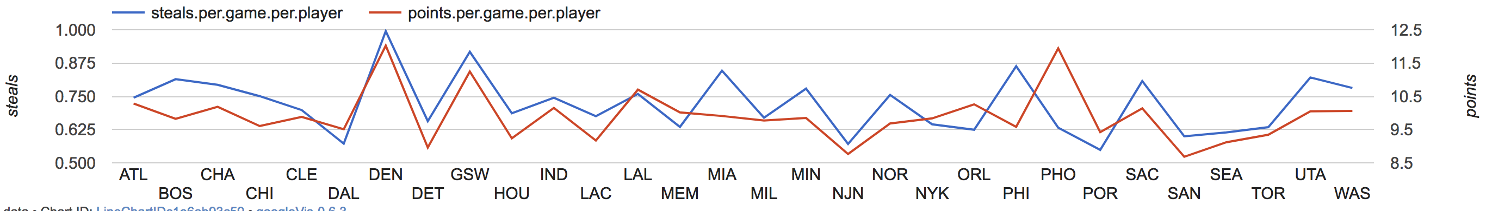
Points vs Steals per player

Slide 10
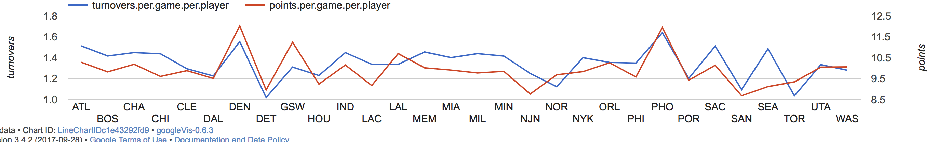
Points vs Turnovers per player

Slide 11
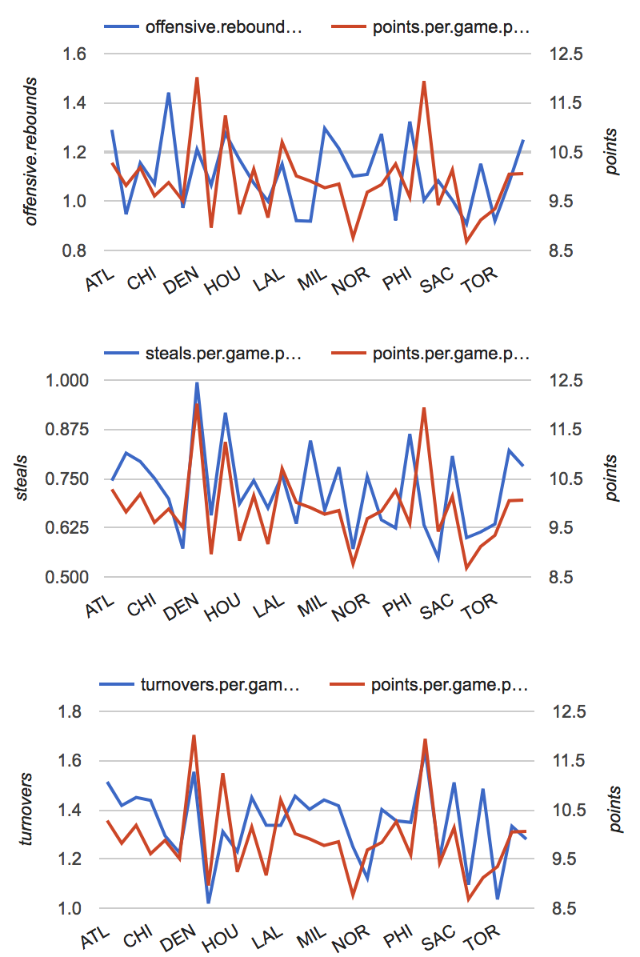
Points vs All (rebounds, steals, turnovers) per player

Slide 12
Winningest teams in NBA during 07-08 season

Slide 13
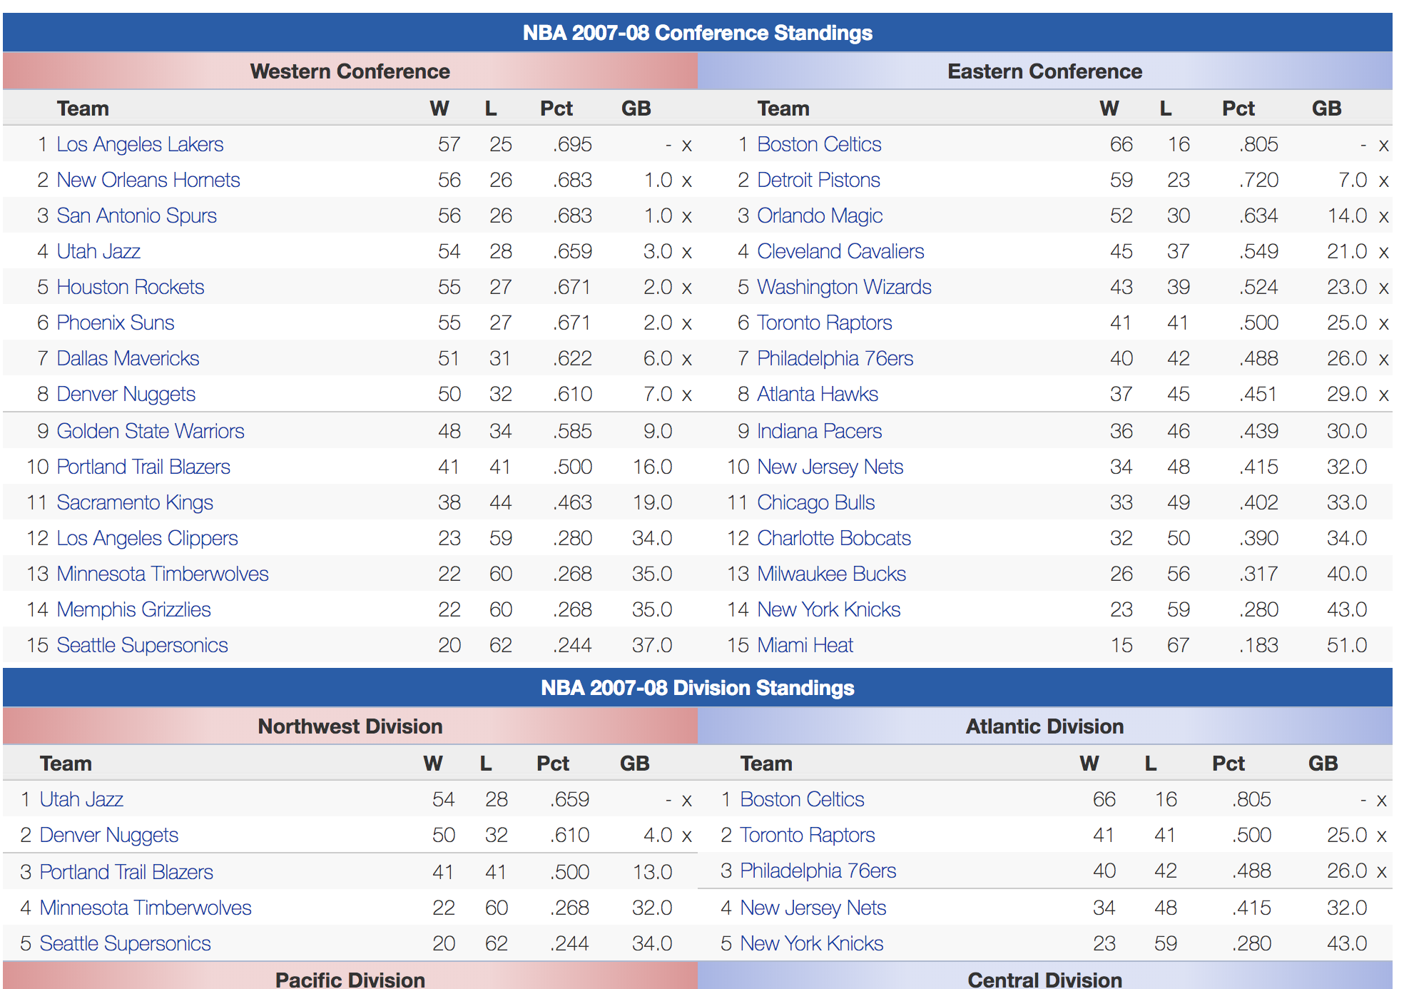
07-08 Team standings: LandOfBasketball.com

Slide 14
How to get that first table?
> webpage <- paste0("http://www.landofbasketball.com/", "yearbyyear/2007_2008_standings.htm")
> LoB.temp.data <- readHTMLTable(rawToChar(GET(webpage)$content), header = T, stringsAsFactors = F)
> LoB.temp.data[1]
$`NULL`
Team W L Pct GB
1 1 Los Angeles Lakers 57 25 .695 - x
2 2 New Orleans Hornets 56 26 .683 1.0 x
3 3 San Antonio Spurs 56 26 .683 1.0 x
4 4 Utah Jazz 54 28 .659 3.0 x
5 5 Houston Rockets 55 27 .671 2.0 x
6 6 Phoenix Suns 55 27 .671 2.0 x
7 7 Dallas Mavericks 51 31 .622 6.0 x
8 8 Denver Nuggets 50 32 .610 7.0 x
9 9 Golden State Warriors 48 34 .585 9.0
10 10 Portland Trail Blazers 41 41 .500 16.0
11 11 Sacramento Kings 38 44 .463 19.0
12 12 Los Angeles Clippers 23 59 .280 34.0
13 13 Minnesota Timberwolves 22 60 .268 35.0
14 14 Memphis Grizzlies 22 60 .268 35.0
15 15 Seattle Supersonics 20 62 .244 37.0

Slide 15
Preprocessing steps
Get West sub table: unlist
Turn list into dataframe
Rename columns
Do above steps for east
Concatenate east and west into single dataframe
Type conversion: factor to character, int and numeric

Slide 16
Top 5 teams
> head(team.summary.0708.df[order(team.summary.0708.df$w, decreasing = TRUE),], 5)[,c("team", "w")]
team w
1 Boston Celtics 66
2 Detroit Pistons 59
16 Los Angeles Lakers 57
17 New Orleans Hornets 56
18 San Antonio Spurs 56

Slide 17
Basketball by country analysis: World Cup
Data From landofbasketball.com

Slide 18
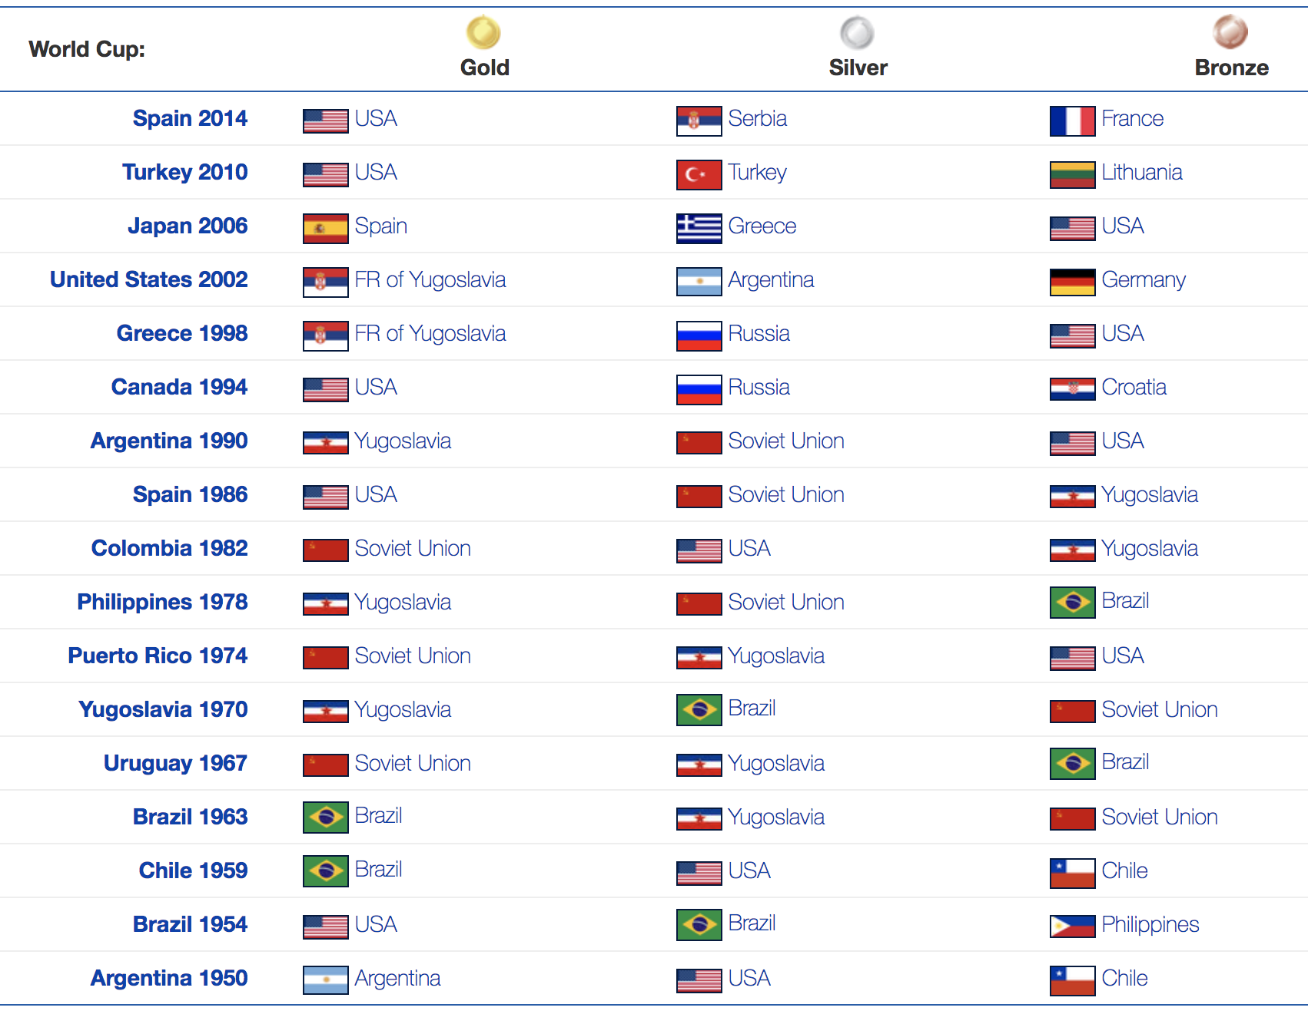
World Cup of Basketball raw content

Slide 19
Getting the table
> webpage <- paste0("http://www.landofbasketball.com/", "world_cup_stats/medals_by_year.htm")
> LoB.temp.data <- readHTMLTable(rawToChar(GET(webpage)$content), header = T, stringsAsFactors = F)
> LoB.temp.data
$`NULL`
V1 V2 V3 V4 V5
1 World Cup: Gold Silver Bronze
2 <NA> <NA> <NA> <NA>
3 Spain 2014 USA Serbia France
4 <NA> <NA> <NA> <NA>
5 Turkey 2010 USA Turkey Lithuania
6 <NA> <NA> <NA> <NA>
7 Japan 2006 Spain Greece USA
8 <NA> <NA> <NA> <NA>
9 United States 2002 FR of Yugoslavia Argentina Germany
<NA> <NA> <NA> <NA>
.
.

Slide 20
Preprocessing steps
Import as dataframe
Drop first NULL row
Remove NA rows
Correct country names to match googleVis geo chart identifiers
Convert type from factor to character

Slide 21
Plotting champion countries
> gold.medals.country.freq.df <- as.data.frame(table(medals.by.year.df$Gold))
> names(gold.medals.country.freq.df) <- c("country", "golds")
> gold.medals.country.freq.df$country <- as.character(gold.medals.country.freq.df$country)
# plot data
> geo.gold <- gvisGeoChart(
gold.medals.country.freq.df,
locationvar="country",
colorvar="golds"
)
> plot(geo.gold)

Slide 22
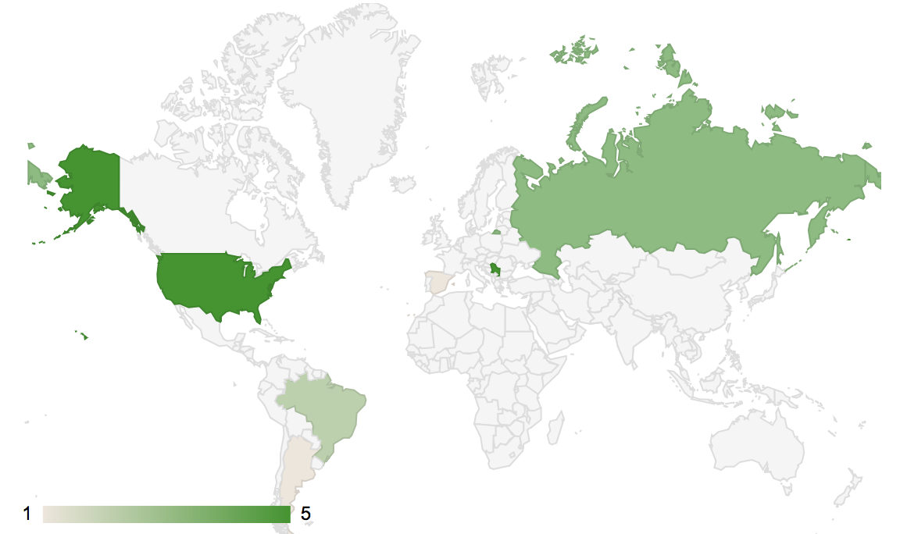
Gold Countries

Slide 23
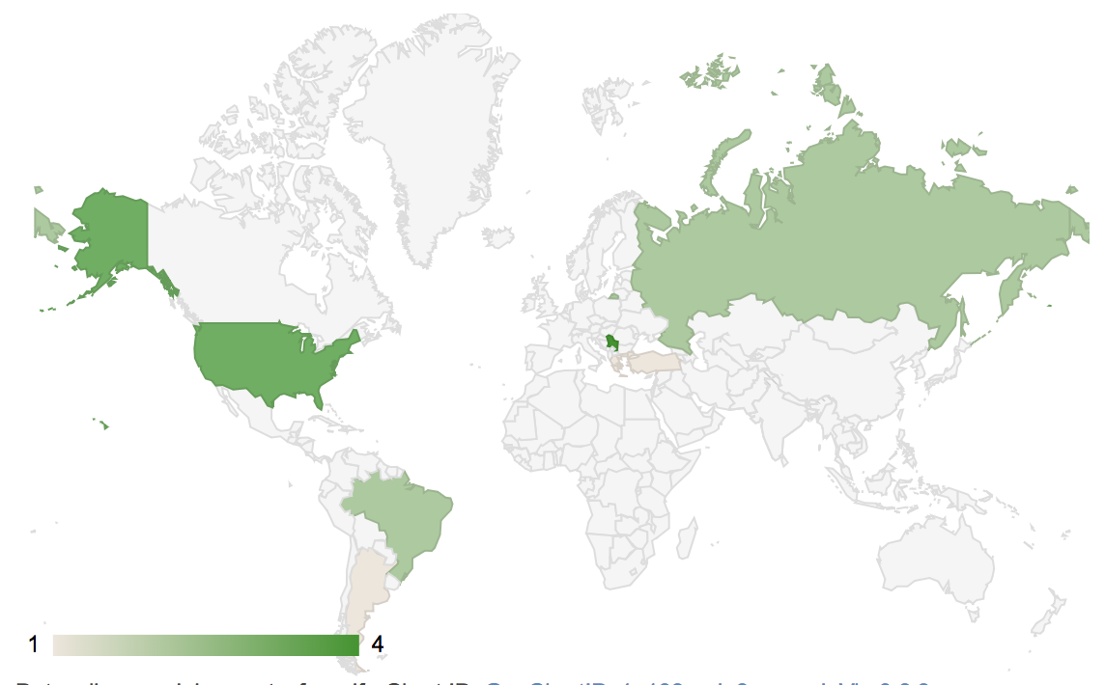
Silver Countries

Slide 24
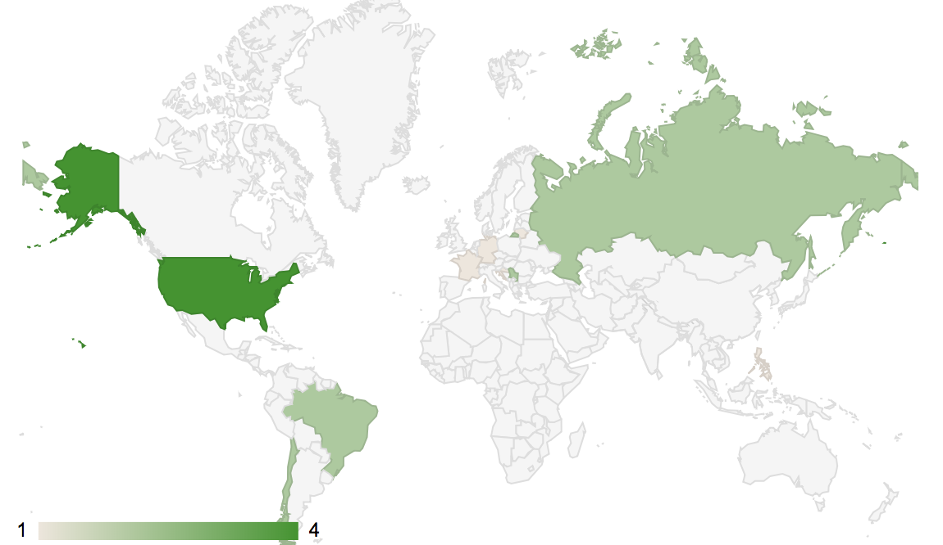
Bronze Countries

