Slide 1
Final Project: An Analysis of MLB Data (2010-2016)
CS544 Foundations of analytics (Fall 2017)
Anthony Valencia

Slide 2

Retrosheet:
play by play Major League Baseball event files
Player, manager, coach, umpire index
Roster files
Ballpark files
Franchise files
Software tools (Windows compatible)
BEVENT.EXE: creates play-by-play files
BOX.EXE: generates box scores
BGAME.EXE: game summary files (containing date, day/night, weather, score)

Slide 3
Data prep: Creating play-by-play files w/BEVENT.EXE on EC2
Launch Win Svr 2016 on t2.micro AWS EC2
Organize event files by decade/year
Write/Exec python script to call bevent.exe creating all CSVs
Upload to AWS S3
Launch Ubuntu 16.04 on t2.micro AWS EC2
Create decade-present CSVs using bash
SCP locally
Convert to Rdata files
Use 2010-present-event.Rdata (15 MB; 1970 is 90.4 MB)

Slide 4
Data prep cont.: Additional Rdata files
player_manager_coach.Rdata: full names, and time active
parkcode.Rdata: historical ball park data
current_names.Rdata: current team names
event_types.Rdata: play event types including codes
positions.Rdata: field positions)
park_details.Rdata: additional ballpark detail including distance to center field

Slide 5
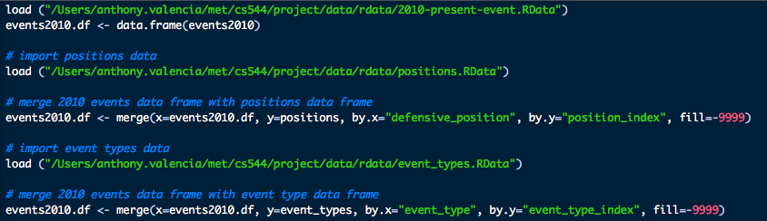
Create 2010 events merged with event types and positions
position_index | position
1 | pitcher
2 | catcher
3 | 1b
4 | 2b
5 | 3b
6 | ss
7 | lf
8 | cf
9 | rf
10 | designated hitter
11 | pinch hitter

Slide 6
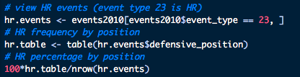
HR by position

Slide 7
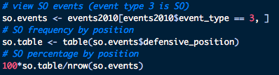
SO by position

Slide 8
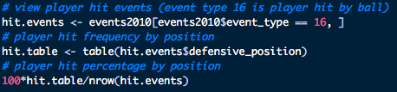
Hits by position

Slide 9
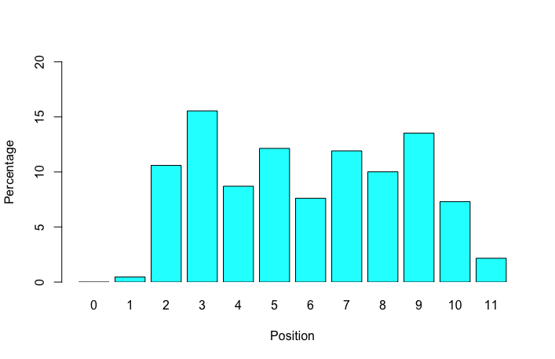
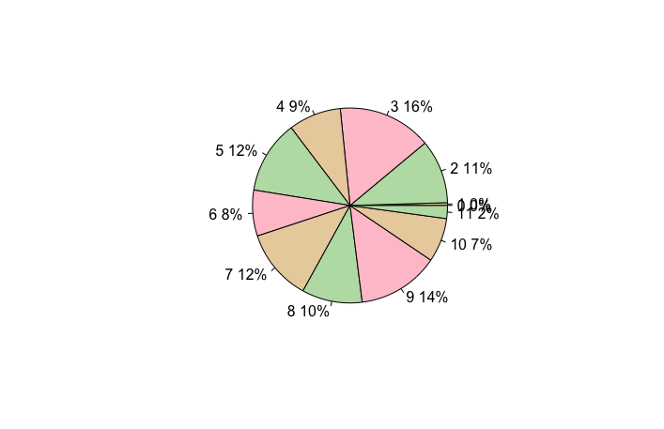
HR by position historgram & pie chart

Slide 10
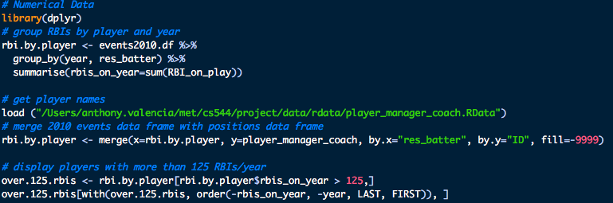
More than RBI/year
res_batter | year | RBI/Y | LAST | FIRST | DEBUT
cabrm001 | 2012 | 139 | Cabrera | Miguel | 6/20/03
davic003 | 2013 | 138 | Davis | Chris | 6/26/08
cabrm001 | 2013 | 137 | Cabrera | Miguel | 6/20/03
arenn001 | 2016 | 133 | Arenado | Nolan | 4/28/13
arenn001 | 2015 | 130 | Arenado | Nolan | 4/28/13
hamij003 | 2012 | 128 | Hamilton | Josh | 4/2/07
encae001 | 2016 | 127 | Encarnacion | Edwin | 6/24/05
ortid001 | 2016 | 127 | Ortiz | David | 9/2/97
kempm001 | 2011 | 126 | Kemp | Matt | 5/28/06
cabrm001 | 2010 | 126 | Cabrera | Miguel | 6/20/03

Slide 11
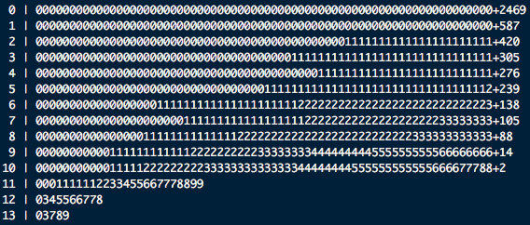
Remove players w/10 games or less
RBI/Year stats:
Mean: 24.85745
Variance: 822.0773
Standard deviation: 28.67189
Quantiles: 0%: 0; 25%: 2;
50%: 13; 75%: 41; 100%: 139

Slide 12
Central Limit Theorem
The distribution of the sample means for a given sample size of the population has the shape of the normal distribution

Slide 13
Central Limit Theorem
Measuring home field advantage

Slide 14
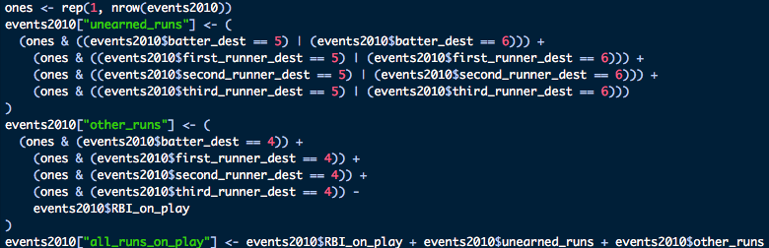
Capturing play run total

Slide 15
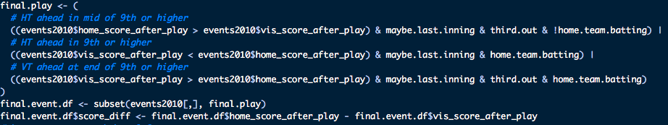
Set each team’s score after play
Set the final score difference

Slide 16

Did we get all games
44 games ended early.
Trust me. I checked every one of them.

Slide 17
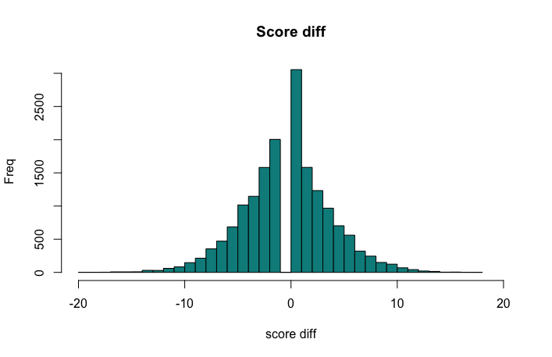
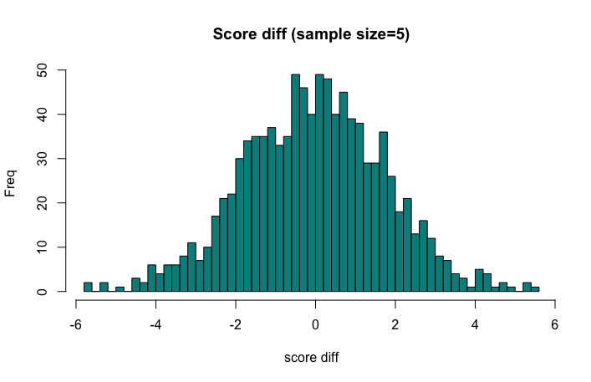
Visualizing home field advantage
Median: 1
Mean: 0.1293993
SD: 4.195234
Median: 0
Mean: 0.058
SD: 1.77828

Slide 18
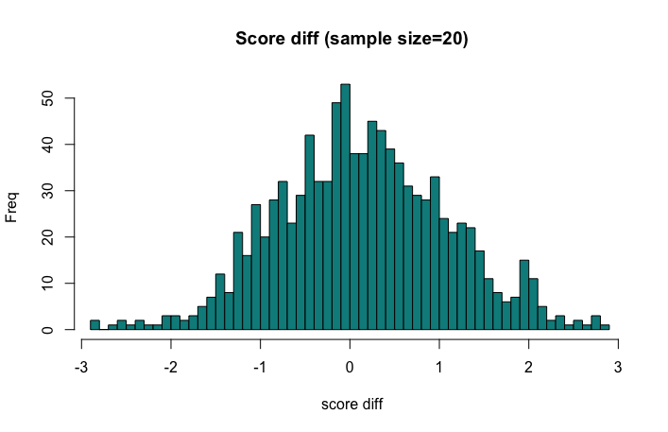
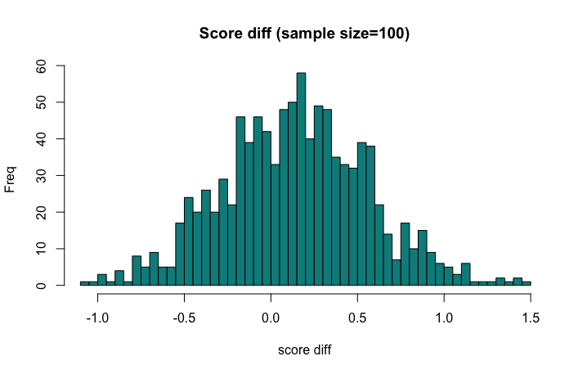
Median: 0.15
Mean: 0.16335
SD: 0.9516275
Median: 0.15
Mean: 0.14457
SD: 0.422206

Slide 19
Sampling Methods
Home Runs: ball park advantage

Slide 20
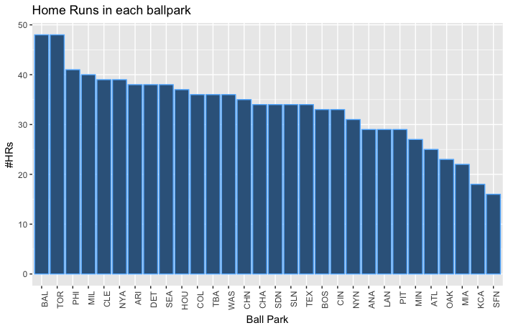
srswor size=1000 on all HR events

Slide 21
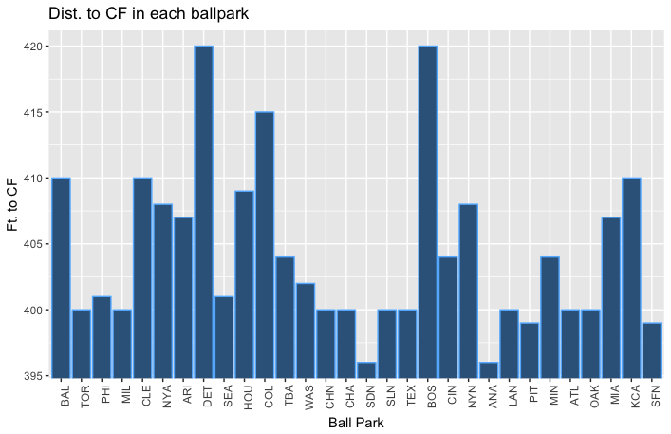
Distance to CF in each ballpark
No apparent relationship

Slide 22
Confidence Levels
Home field advantage

Slide 23
80% Conf Level (alpha = 0.20), z: -1.28, 1.28
90% Conf Level (alpha = 0.10), z: -1.64, 1.64
Final score SD: 4.195234
Sample size=10, Mean: -1.9
80% Conf Level (alpha = 0.20), CI = (-3.60, -0.20), Precision = 3.40
90% Conf Level (alpha = 0.10), CI = (-4.08, 0.28), Precision = 4.36
Sample size=100, Mean: 0.13
80% Conf Level (alpha = 0.20), CI = (-0.41, 0.67), Precision = 1.08
90% Conf Level (alpha = 0.10), CI = (-0.56, 0.82), Precision = 1.38
Sample size=1000, Mean: 0.278
80% Conf Level (alpha = 0.20), CI = (0.11, 0.45), Precision = 0.34
90% Conf Level (alpha = 0.10), CI = (0.06, 0.50), Precision = 0.44

Slide 24
Further Analysis
Measuring batter performance with On Base Percentage and Slugging Average

Slide 25
On Base Percentage
OBP = (H + BB + HBP)/(AB + BB + HBP + SF)

Slide 26
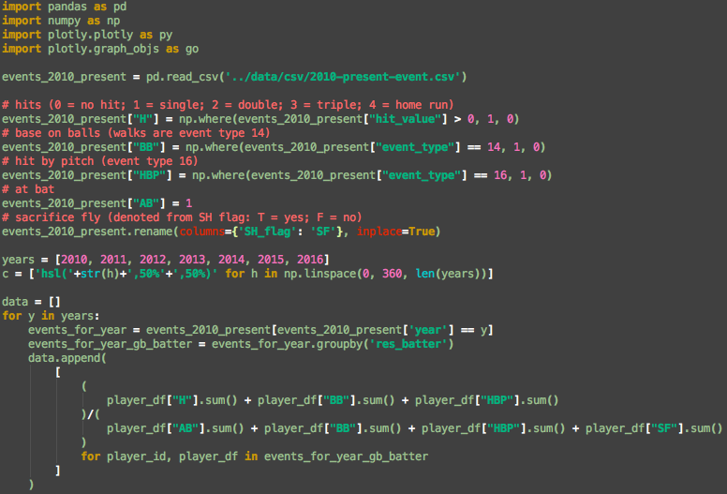
H: hits; BB: base on balls; HBP: hit by pitch; AB: at bat; SF: sacrifice fly

Slide 27
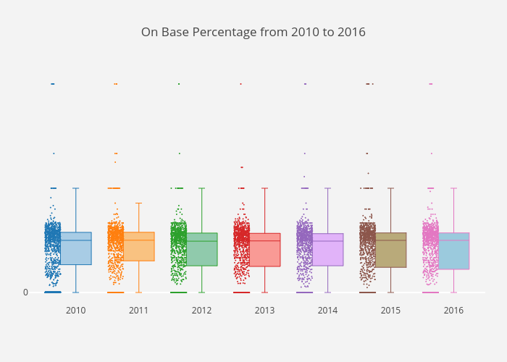
Plotly box plots by year of OBP

Slide 28
Slugger Average
TB = 1B + 2*2B + 3*3B + 4*HR SLG = TB/AB

Slide 29
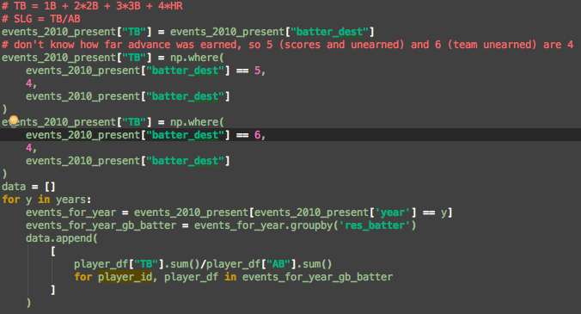
5 if scores and unearned, 6 if team unearned. Not sure how far advance was earned, so we set to home plate.

Slide 30
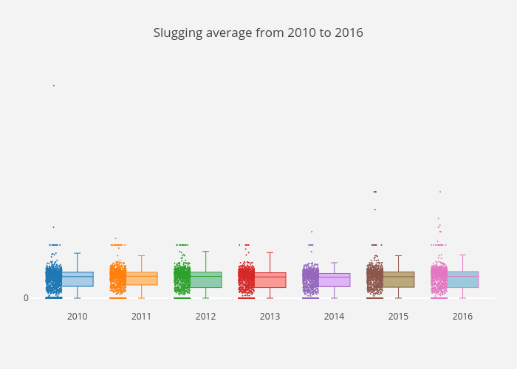
Plotly box plots by year of SLG

