Slide 1

GE Aerospace
Electrical Engineering Task 1

Slide 2
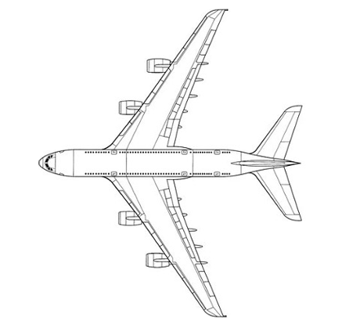
Design Your Power Distribution
To design your power distribution system in PowerPoint, consider the following guidelines on how to use shapes to represent different components:
Lines and Arrows: Use these to depict electrical connections between components. For example, a solid line could represent primary power connections, while a dashed line might indicate secondary or backup connections.
Rectangles and Squares: Ideal for representing distribution panels and circuit breakers. You can use labels or different colors to differentiate between primary and secondary panels.
Circles or Ellipses: These could symbolize generators or other power sources. Position them at the beginning of your power flow diagram to indicate where the power originates. Engine 1 generator, engine 4 generator, and the main battery are common power sources, shown on the following diagram.
Triangles or Diamonds: Use these shapes to denote electrical and avionics systems that require reliable power from the distribution panels. Common systems are shown on the following diagram.
Remember, each shape's size, color, and placement should help clarify the system's layout and operation, making it intuitive for someone else to understand your design rationale.
Use the aircraft diagram on the next slide to design your power distribution system.

Slide 3
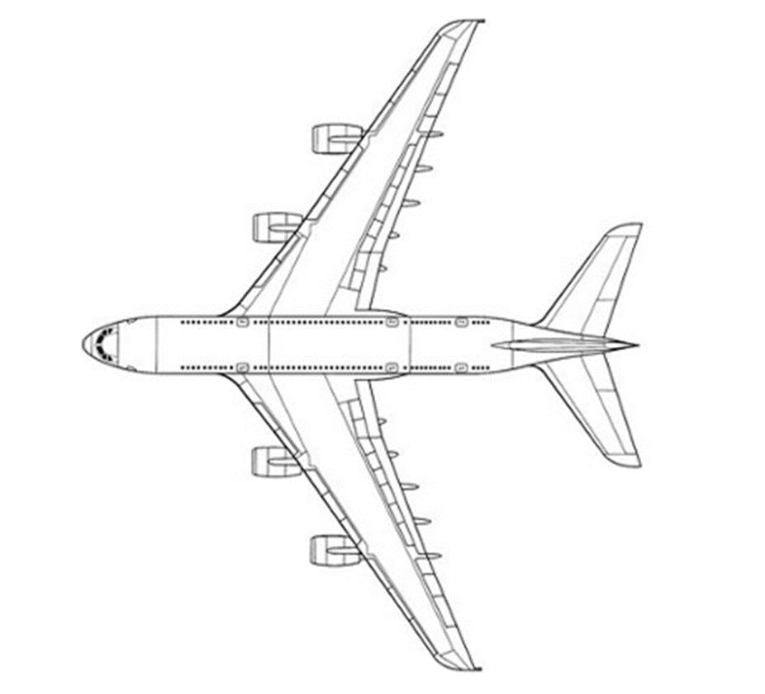
Engine 4 Generator
Navigation Memory
Bleed Air Control
Pilot Windshield Anti-Ice
Secondary Panels
Pitch Trim
Yaw Damper
Main Battery
Primary panels
Air Conditioner
Strobe Light
Fire Extinguisher
Engine 1 Generator

Slide 4
Design Rationale
System Architecture
Split-Bus & Dual Redundancy: Engine 1 and 4 Generators power isolated Primary Distribution Panels to isolate faults.
Secondary Panel Segregation: Primary buses step down power to Secondary Panels, separating critical flight loads (Pitch Trim, Yaw Damper) from non-critical loads (Cabin Air Conditioner).
Emergency Battery Backup: Main Battery links directly to essential buses for immediate emergency takeover during total generator loss.
Circuit Breaker Selection
Thermal-Magnetic Breakers: Selected for primary panels to handle high surge currents while protecting against prolonged overloads.
Solid-State Power Controllers (SSPCs): Used in secondary avionics panels for fast, wear-free electronic tripping and real-time status telemetry.
Critical Path Isolation: Individual breakers assigned to each load to prevent single-point failures from dropping entire sub-systems.
Compliance with Industry Standards
FAA / EASA Part 25 Alignment: Meets transport category safety rules for electrical isolation and dual-redundancy.
DO-160 Environmental Compliance: Formulated to meet rigorous standards for temperature, moisture ingress, and vibration tolerance.
System Safety Assessment (ARP4761): Architecture eliminates common-cause failures across flight-critical controls.

Slide 5
Verification Procedure Outline
Testing Objectives
Redundancy Validation: Verify automatic failover to secondary panels and main battery if an engine generator fails.
Environmental Survival: Ensure panels and breakers endure flight-level thermal and mechanical stress.
Isolation Control: Confirm circuit breakers trip locally before power surge cascades across main buses.
Test Methods & Stress Simulations
Temperature: Cycle panels from $-55^\circ\text{C}$ (high altitude) to $+70^\circ\text{C}$ (engine bay) under max load.
Humidity: Expose sub-panels to $95\%$ RH cycling to test insulation and prevent short circuits.
Vibration: Mount breakers on a 3-axis shaker table simulating engine noise and severe turbulence to prevent false trips.
Expected Outcomes
Zero Power Loss: Continuous operation of critical flight systems (Yaw Damper, Pitch Trim) during generator failure.
Structural Integrity: Zero trip failures under peak vibration and zero moisture ingress during humidity tests

