Slide 1
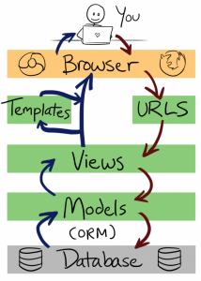
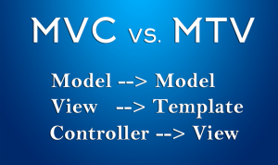
Model-View-Template in Django is an alternative to Model-View-Controller in RoR.
Django view performs a role of a MVC controller as well as template of a Django is a MVC view.

Slide 2
Rails makes building REST web services a breeze and routes are expressed in terms of HTTP verbs.
Django does not use the HTTP verb to route. Instead it is more verbose and uses regular expressions to match URLs to controllers.
Django doesn’t have any convention when naming controller actions, so Django does not have any cool helpers like Rails’ resource and every route has to be explicitly defined. This results in each controller requiring several routing rules.
from django.conf.urls import url
from . import views
app_name = 'polls'
urlpatterns = [
url(r'^$', views.IndexView.as_view(), name='index'),
url(r'^(?P<pk>[0-9]+)/$', views.DetailView.as_view(), name='detail'),
url(r'^(?P<pk>[0-9]+)/$', views.ResultsView.as_view(), name='results'),
url(r'^(?P<pk>[0-9]+)/$', views.vote, name='vote'),
]

Slide 3
from django.shortcuts import get_object_or_404, render
from django.http import HttpResponseRedirect
from django.core.urlresolvers import reverse
from django.views import generic
from django.utils import timezone
from .models import Choice, Question
# Create your views here.
class IndexView(generic.ListView):
template_name = 'polls/index.html'
context_object_name = 'latest_question_list'
def get_queryset(self):
# return Question.objects.order_by('-pub_date')[:5]
return Question.objects.filter(
pub_date__lte=timezone.now()
).order_by('-pub_date')[:5]
class DetailView(generic.DetailView):
model = Question
template_name = 'polls/detail.html'
def get_queryset(self):
return Question.objects.filter(pub_date__lte=timezone.now())

Slide 4
DJANGO EXAMPLE PROJECT STRUCTURE
README
manage.py
fabfile.py
site/settings.py
site/wsgi.py
site/urls.py
site/app/models.py
site/app/forms.py
site/app/views.py
site/app/urls.py
site/app/middleware.py
site/app/templates/template.html

Slide 5
Rails views uses the Embedded Ruby template system which allows you to write arbitrary Ruby code inside your templates. This means it is extremely powerful and fast, but with great power comes great responsibility.

