Slide 1
Exercise 1 : ex1.java
Thread Creation and Execution (sleep() and join())
class C extends Thread {
int i;
C(int i) { this.i = i; }
public void run() {
System.out.println("Thread " + i + " says hi");
try {
sleep(500);
} catch (InterruptedException e) {}
System.out.println("Thread " + i + " says bye");
}
}
class ex1 {
private static final int NUM_THREAD = 10;
public static void main(String[] args) {
System.out.println("main thread start!");
C[] c = new C[NUM_THREAD];
for(int i=0; i < NUM_THREAD; ++i) {
c[i] = new C(i);
c[i].start();
}
System.out.println("main thread calls join()!");
for(int i=0; i < NUM_THREAD; ++i) {
try {
c[i].join();
} catch (InterruptedException e) {}
}
System.out.println("main thread ends!");
}
}

Slide 2
Exercise 2 : parallel summation
Write a single-threaded and multi-threaded java program that computes the sum of integer numbers 1,2,…,NUM_END where NUM_THREAD is the number of threads. For multi-threaded programming, use (i) naïve approach, and (ii) devide-and-conquer (recursive) approach.
class SumThread extends Thread {
int lo, hi; // fields for communicating inputs
int[] arr;
int ans = 0; // for communicating result
SumThread(int[] a, int l, int h) {
lo=l; hi=h; arr=a;
}
public void run() {
// insert your code here
}
}
class ex2 {
private static int NUM_END = 10000;
private static int NUM_THREAD = 4; // assume NUM_END is divisible by NUM_THREAD
public static void main(String[] args) {
if (args.length==2) {
NUM_THREAD = Integer.parseInt(args[0]);
NUM_END = Integer.parseInt(args[1]);
}
int[] int_arr = new int [NUM_END];
int i,s;
for (i=0;i<NUM_END;i++) int_arr[i]=i+1;
s=sum(int_arr);
System.out.println("sum=" + s) ;
}
static int sum(int[] arr) {
// insert your code here
}
}

Slide 3
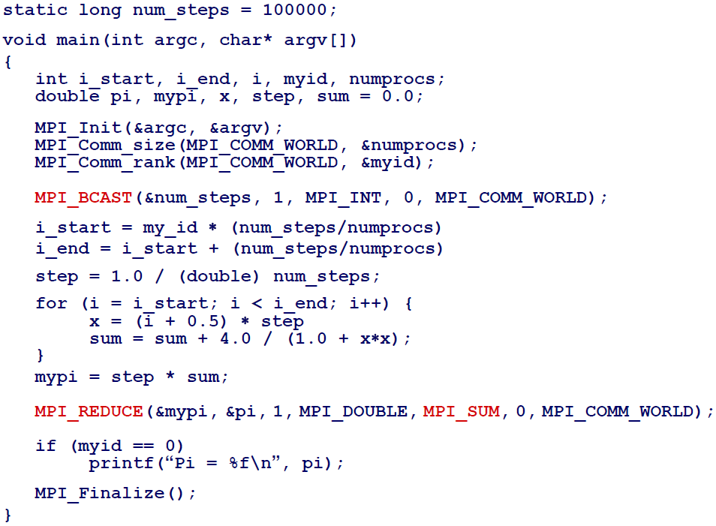
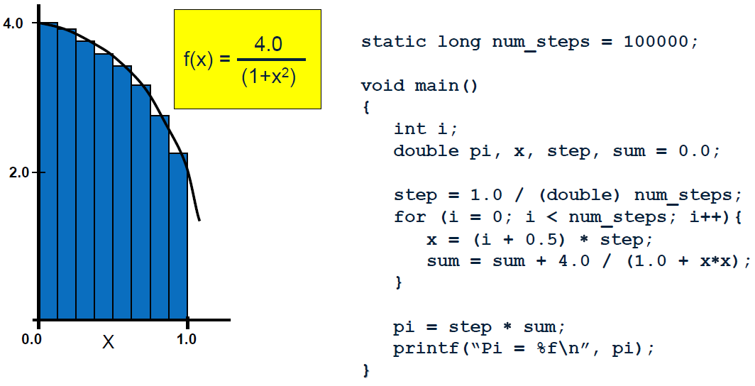
Exercise 3 : parallel integration
Write a single threaded and multithreaded java programs that compute following numerical integration where the variable NUM_THREAD is # of threads and the variable NUM_STEP is # of steps.
See the C/MPI codes below and rewrite them with JAVA language.

Slide 4
Exercise 3 : parallel integration
// ex3_serial.java (single threaded)
// ex3.java (multithreaded)

Slide 5
Exercise 4 : Prime numbers
Write a multithreaded java program that shows how many prime numbers between 1 and NUM_END where NUM_THREAD is the number of threads
Use static load balancing approach
For your programming, you can consider following single threaded code.
Also, measure the execution time and compare the results
class ex4_serial {
private static final int NUM_END = 200000;
public static void main(String[] args) {
int counter=0;
int i;
long startTime = System.currentTimeMillis();
for (i=0;i<NUM_END;i++) {
if (isPrime(i)) counter++;
}
long endTime = System.currentTimeMillis();
long timeDiff = endTime - startTime;
System.out.println("Execution Time : "+timeDiff+"ms");
System.out.println("1..."+(NUM_END-1)+" prime# counter=" + counter +"\n");
}
private static boolean isPrime(int x) {
int i;
if (x<=1) return false;
for (i=2;i<x;i++) {
if ((x%i == 0) && (i!=x)) return false;
}
return true;
}
}

