Slide 1

Senior Business Intelligence Analyst Main Assessment
Alexandros Ntzoufas (antzoufas@gmail.com)

Slide 2
Agenda
Efood sales during Jan 2021
Customers Segmentation with K-Means
Total sales and average frequency per customer category
Customer targeting for Marketing campaigns
Focusing on specific cities with low breakfast sales
2

Slide 3



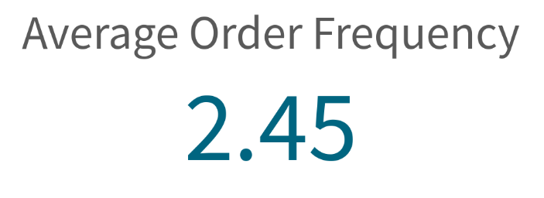


Main KPIs of efood sales in January 2021
3

Slide 4
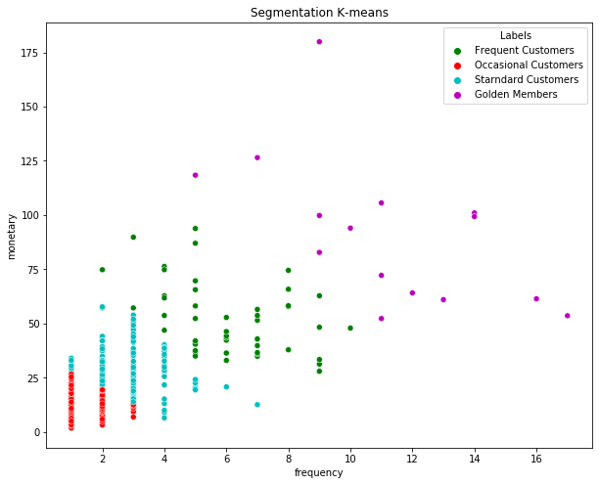
Segmentation of efood customers with K-Means
4 Clusters of customers are defined with regards the frequency and the basket (€)
Golden members
Frequent Customers
Standard Customers
Occasional Customers
(€)
4

Slide 5
Segmentation of efood customers with K-Means
Segment | Frequency | Monetary | N Obs | Prop Obs
Occasional Customers | 1.26 | 10.50 | 98580 | 60.49%
Starndard Customers | 2.97 | 27.98 | 43799 | 26.87%
Frequent Customers | 6.04 | 51.43 | 16705 | 10.25%
Golden Members | 11.43 | 95.39 | 3870 | 2.37%
The majority (60.5%) of the customers are occasional with low frequency and basket value
Standard customers buy every ten days on average with a total basket of 28 €
Frequent customers almost twice per week with a total basket of 51.5€
Golden members are 2.37% of the total customers, buying three times per week with a total basket of 95€
5

Slide 6
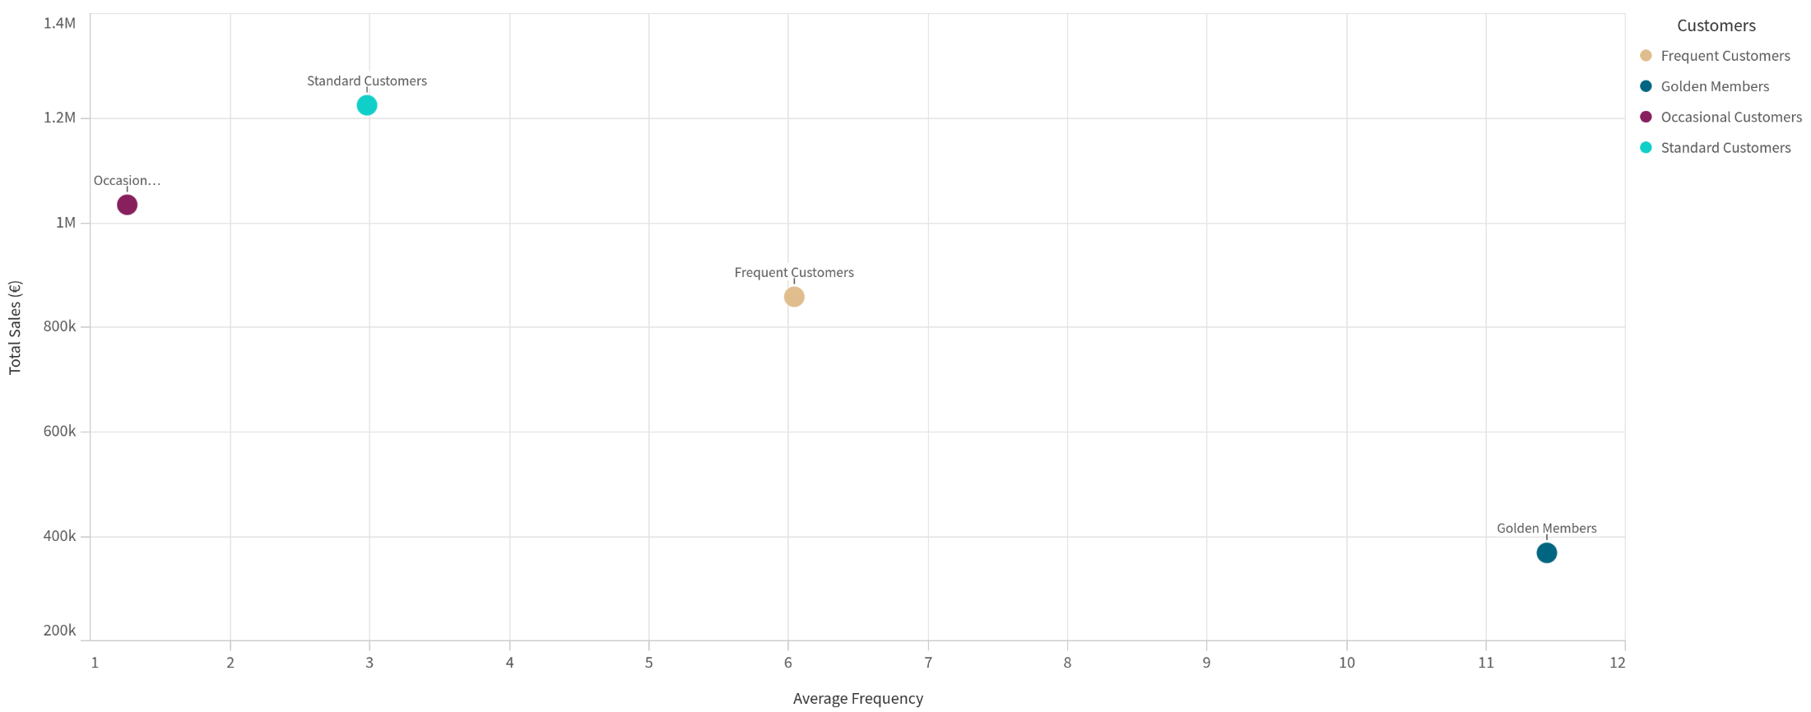
Total sales and Average Frequency for Customers Categories
Golden Members have the higher Average Frequency
Frequent Customers have both high Total Sales and Frequency
Standard and Occasional Customers have high Total Sales due to the high number of customers of each group
6

Slide 7
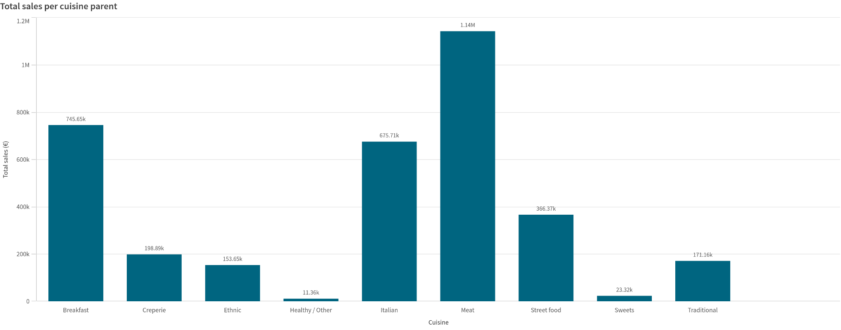
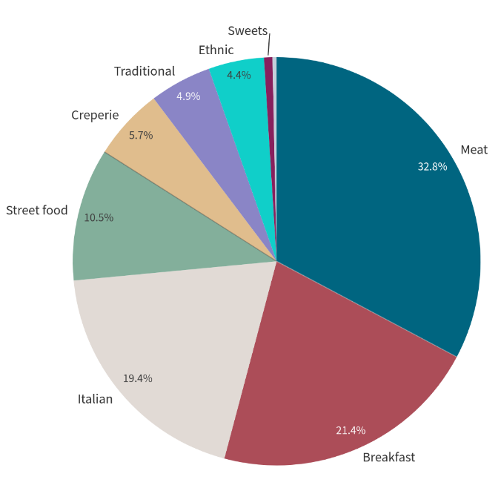

Total sales allocation per Cuisine Parent
Breakfast is 21.4% of the total sales with a total amount of € 745K
7

Slide 8
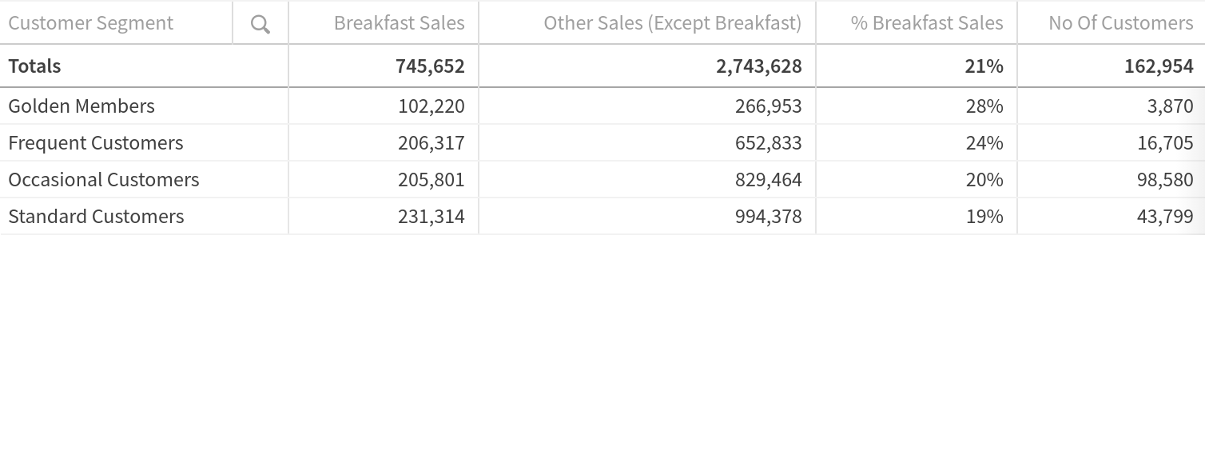
Focusing on specific customer categories – Marketing Mix
Marketing Focus Campaign
Frequent Customers is a loyal category of customers where a campaign could focus to increase the consumption of this group in order to upgrade to Golden Members
Standard Customers is significant target group for the Marketing Team to. It includes 27% of the total customers and its sales in Breakfast are 19% of the total sales.
This proportion is lower than the average and the other customer groups, so, a campaign can be released for increasing breakfast sales of Standard Customer and upgrade them to more loyal customers (Frequent)
8

Slide 9
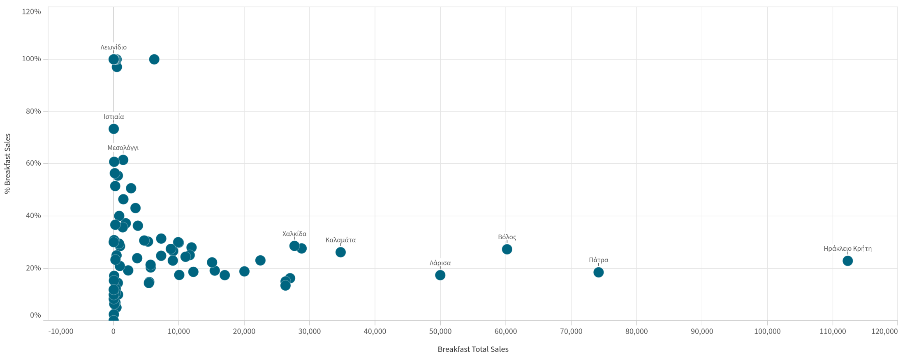
Breakfast Total Sales and % Breakfast Sales per City
Higher Breakfast Total Sales
Higher % Breakfast Total Sales
The marketing mix can also include City oriented actions in order to increase the breakfast sales
The cities in the red circle have low total and percentage sales in Breakfast, so targeted campaigns could focus on these areas.
9

