Slide 1
LOAN PREDICTION
PRESENTED BY--
ANUSHKA KUMARI
SONAM SAHU
TAMANNA MUKHI

Slide 2
Introduction
This project predicts whether a loan applicant is risky or safe using machine learning techniques in SPSS Modeler.

Slide 3
Objective
To predict loan risk
Classify applicants into:
Risky (1)
Non-Risky (0)
Improve decision-making process

Slide 4
Dataset Description
Dataset contains 252000 records
Includes Age, Income, Experience, Profession, etc.
Target variable: Risk_Flag

Slide 5
Data Audit
Performed using Data Audit Node
No missing values
Both categorical and continuous data present

Slide 6
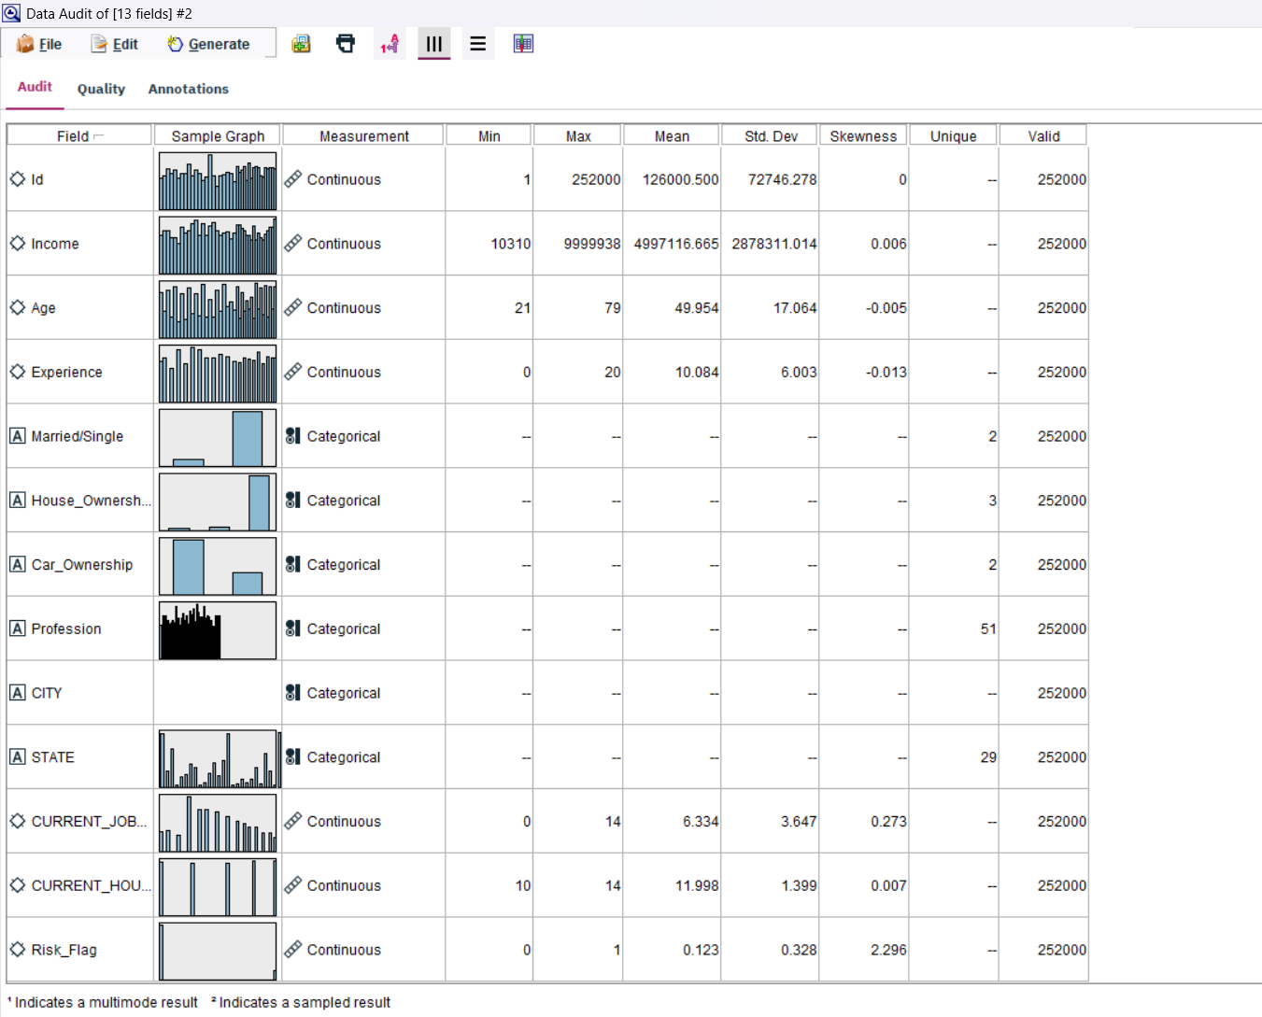
DATA AUDIT

Slide 7
Important Features
Income
Age
Experience
House Ownership
Profession
City & State

Slide 8
Data Preprocessing
Set roles using Type Node
Removed unnecessary fields (Id)
Handled categorical data
Checked distributions.

Slide 9
Data Partition
Training: 70%
Testing: 30%
Helps avoid overfitting

Slide 10
Modeling Techniques
Decision Tree (C5.0)
Logistic Regression
Neural Network

Slide 11
Model Evaluation
Used Evaluation Node
Compared accuracy
Used ROC Curve and Confusion Matrix

Slide 12
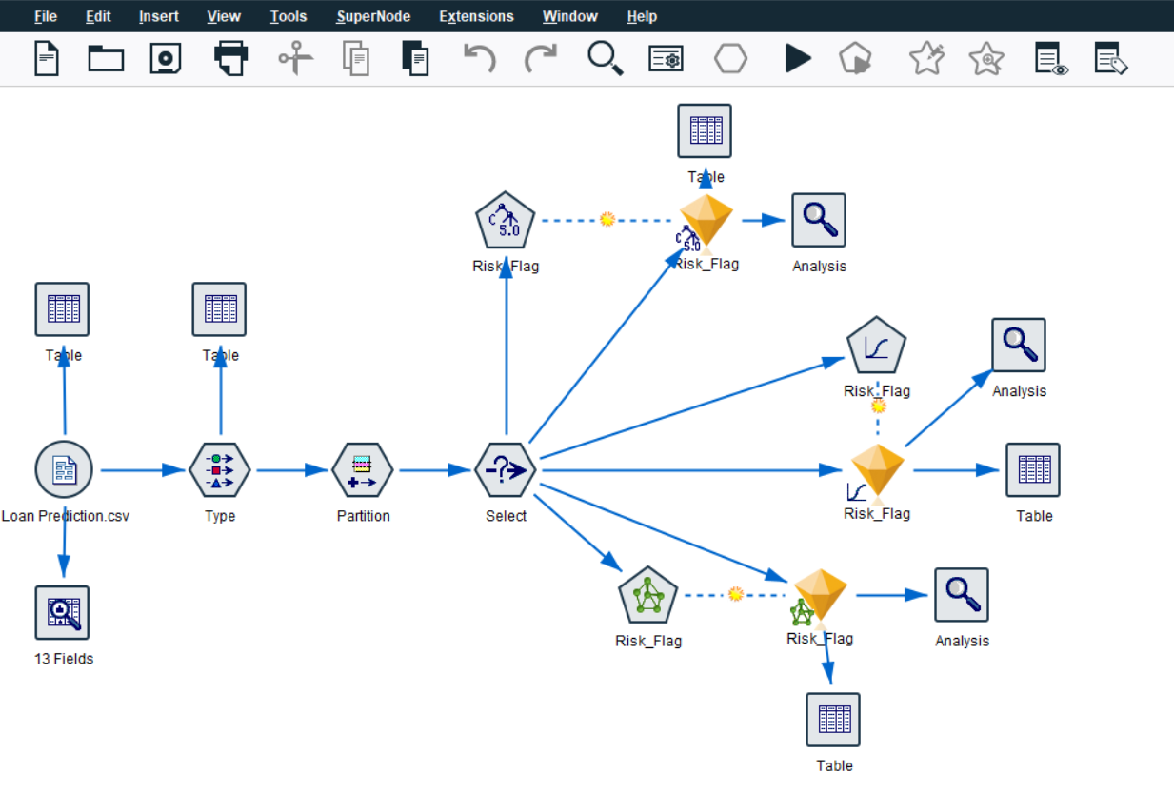

Slide 13
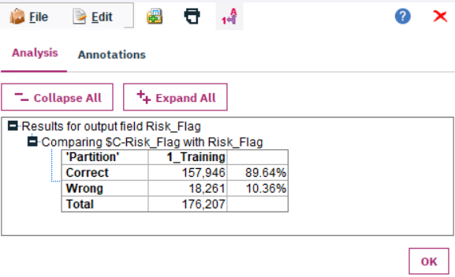
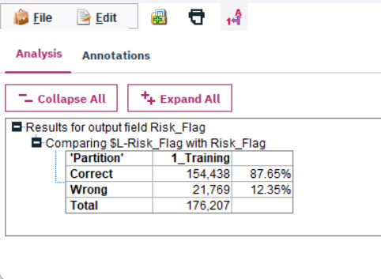
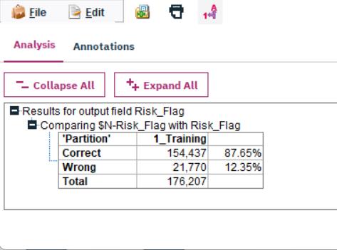
Results of Analysis
C5.0 Modeling
Logistic Regression
Neural Network

Slide 14
Results
Decision Tree performed best
Good accuracy achieved
Model successfully predicts loan risk

Slide 15
Conclusion
SPSS Modeler helps build models easily
Loan prediction improves decision making
Useful in banking sector

Slide 16
Thank You
Questions?

