Slide 1
UNIT 3 CLIQUES, CLUSTERS AND COMPONENTS 9 Hrs.
Components and Subgraphs: Sub graphs - Ego Networks, Triads, Cliques, Hierarchical Clustering, Triads, Network Density and conflict. Density: Egocentric and Sociocentric - Digression on Absolute Density - Community structure and Density, Centrality : Local and Global - Centralization and Graph Centres, Cliques and their intersections, Components and Citation Circles - Positions, Sets and Clusters.

Slide 2

Components and Subgraphs:
A subgraph is a subset of the nodes of a network, and all of the edges linking these nodes.
Component subgraphs (or simply components) are portions of the network that are disconnected from each other.

Slide 3
Ego Net
The ego-net approach to social network analysis, which takes discrete individual actors and their contacts as its starting point, is one of the most widely used approaches.

Slide 4
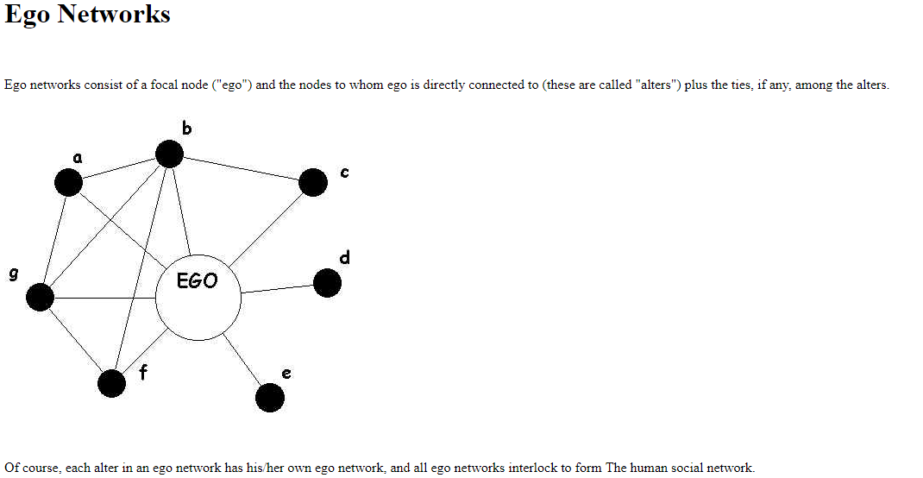

Slide 5
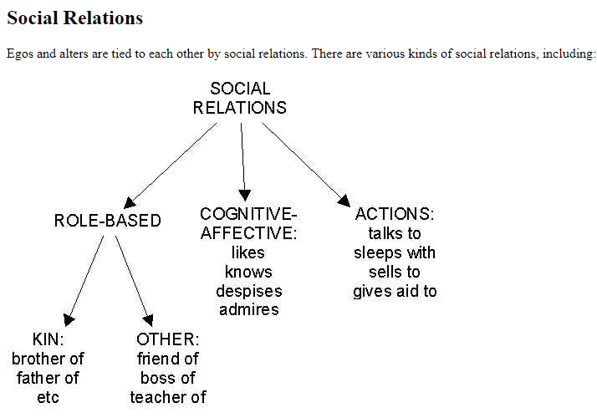

Slide 6
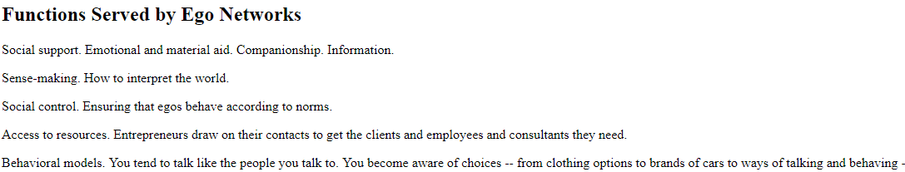

Slide 7
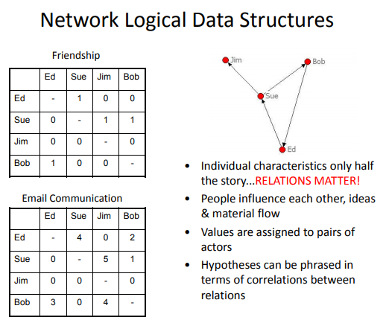

Slide 8
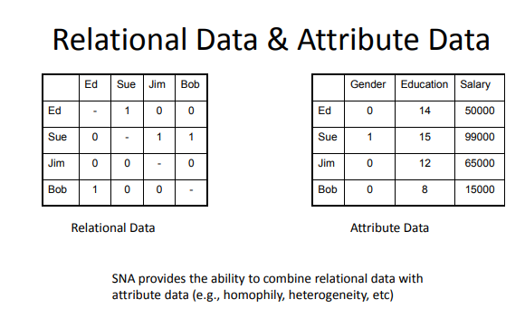

Slide 9
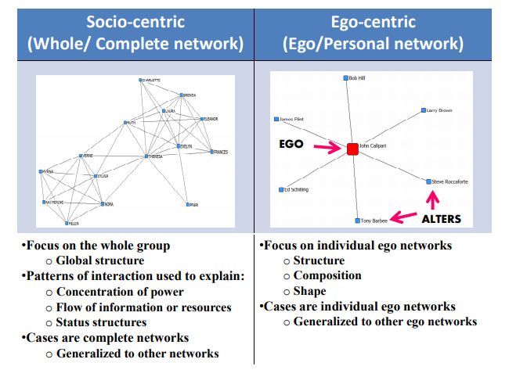

Slide 10
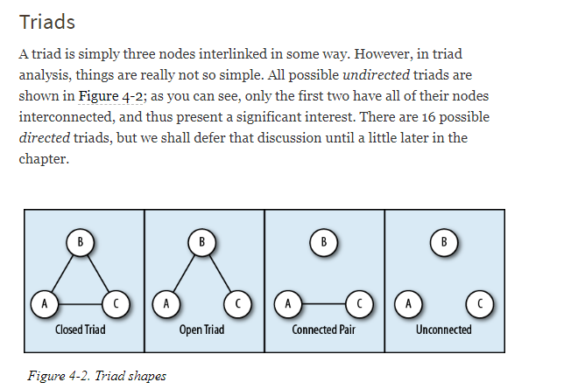

Slide 11
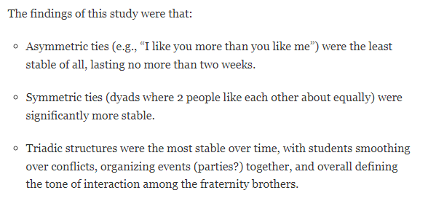

Slide 12
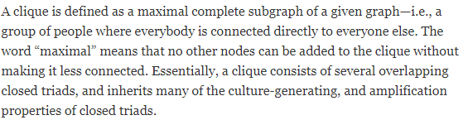
Cliques

Slide 13
Hierarchical Clustering Algorithm
Hierarchical clustering, also known as hierarchical cluster analysis, is an algorithm that groups similar objects into groups called clusters. The endpoint is a set of clusters, where each cluster is distinct from each other cluster, and the objects within each cluster are broadly similar to each other. Hierarchical clustering can be performed with either a distance matrix or raw data. When raw data is provided, the software will automatically compute a distance matrix in the background
How hierarchical clustering works
Hierarchical clustering starts by treating each observation as a separate cluster. Then, it repeatedly executes the following two steps: (1) identify the two clusters that are closest together, and (2) merge the two most similar clusters. This iterative process continues until all the clusters are merged together.

Slide 14
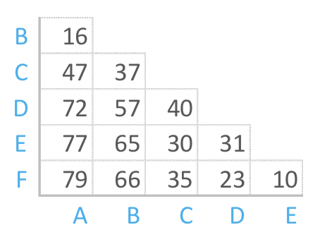
The distance matrix below shows the distance between six objects.

Slide 15
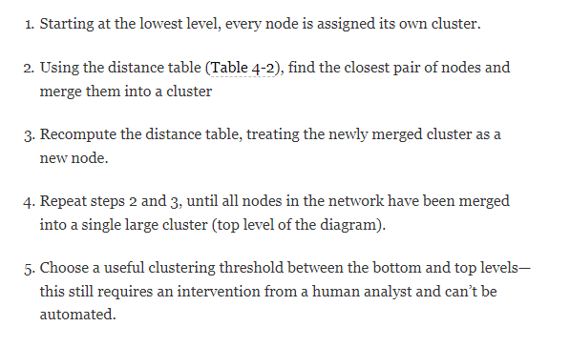
Hierarchical Clustering Algorithm

Slide 16
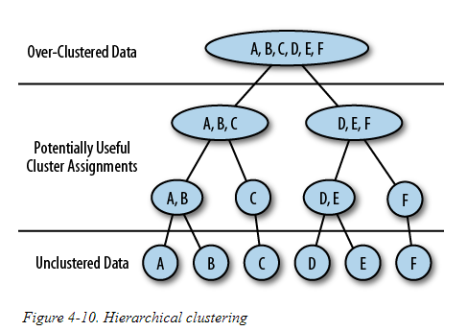
Hierarchical Clustering

Slide 17
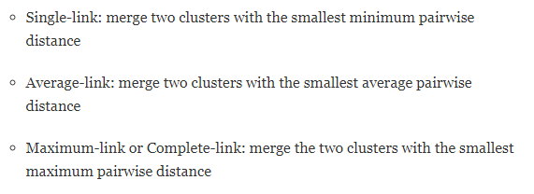

Slide 18
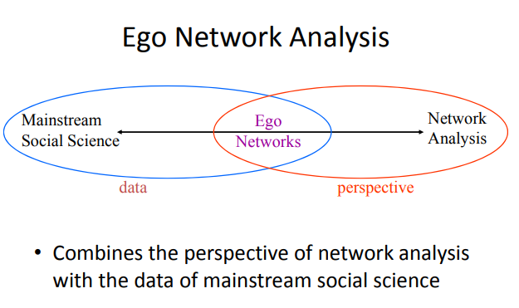

Slide 19
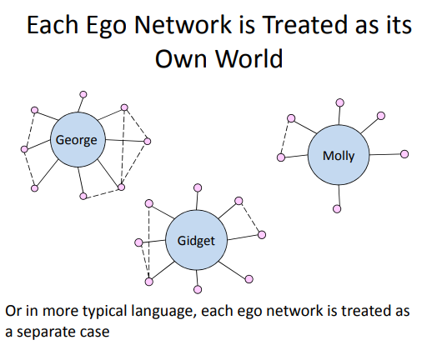

Slide 20
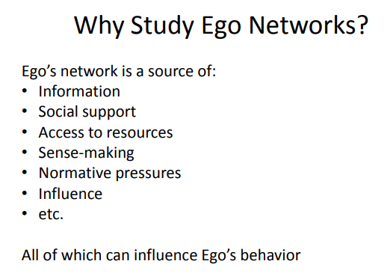

Slide 21
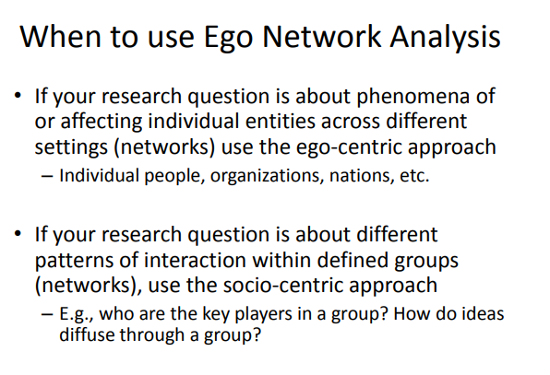

Slide 22
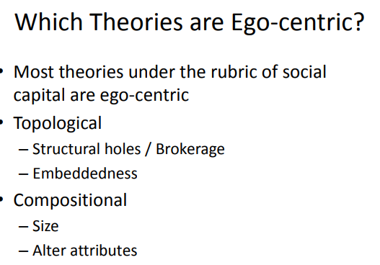

Slide 23
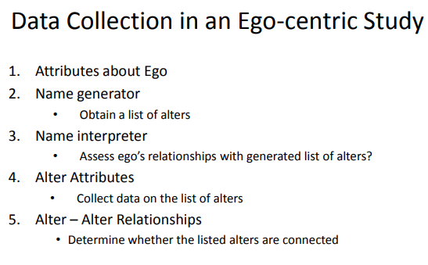

Slide 24
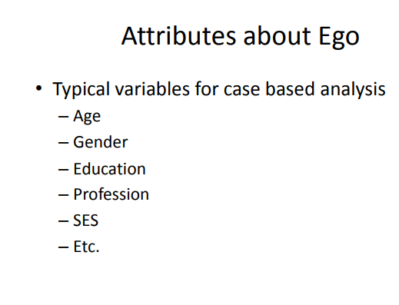

Slide 25
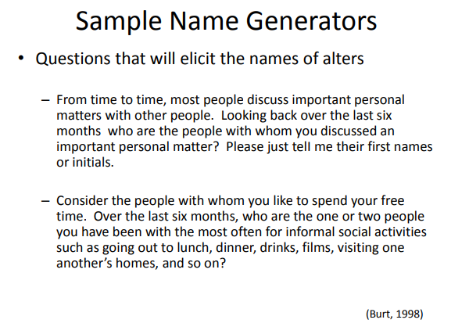

Slide 26
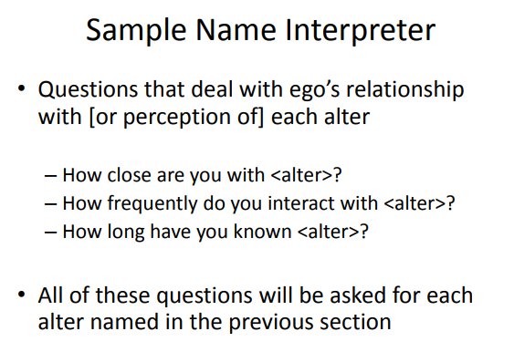

Slide 27
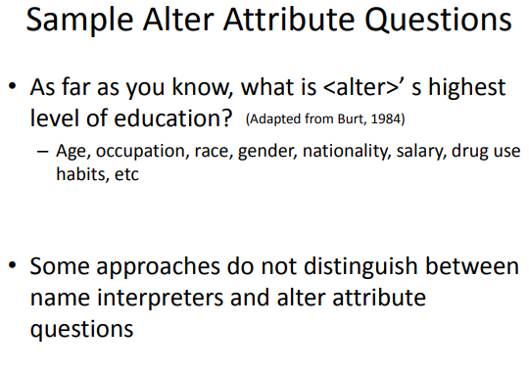

Slide 28
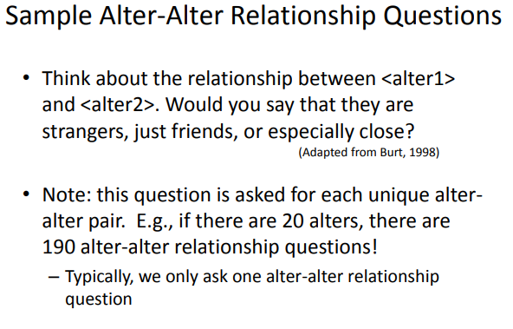

Slide 29
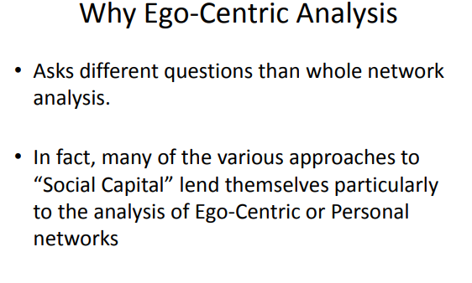

Slide 30
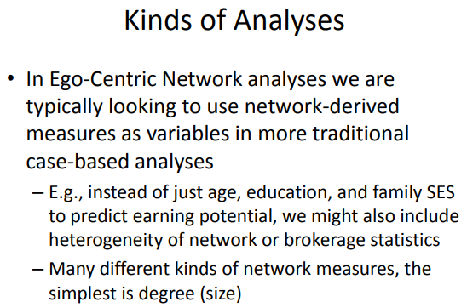

Slide 31
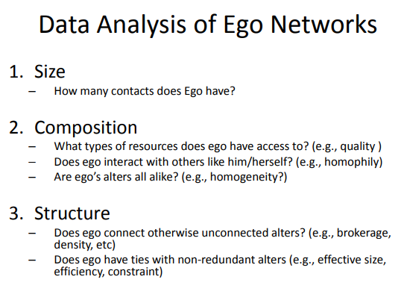

Slide 32
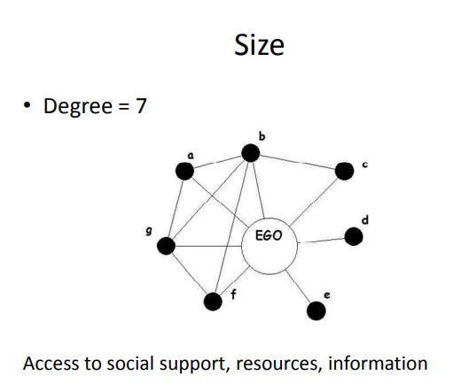

Slide 33
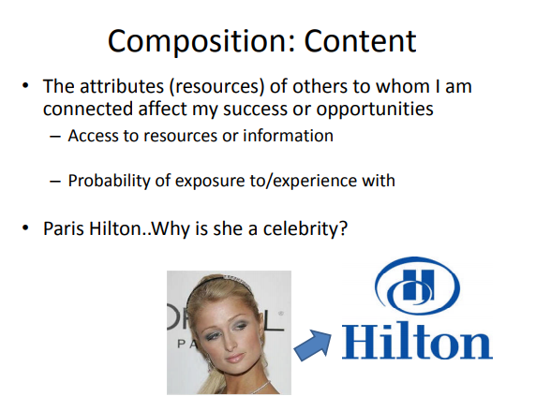

Slide 34
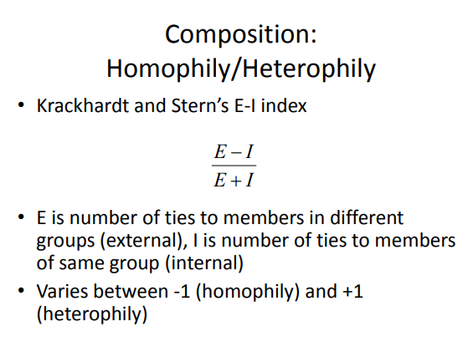

Slide 35
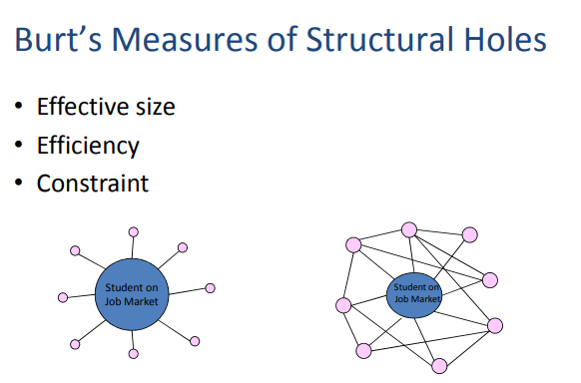

Slide 36
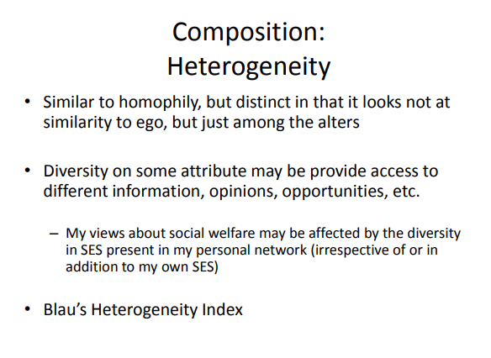

Slide 37
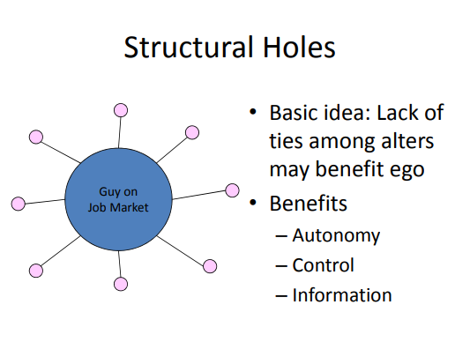

Slide 38
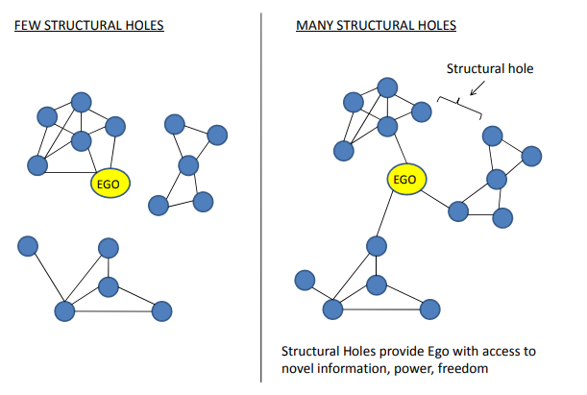

Slide 39
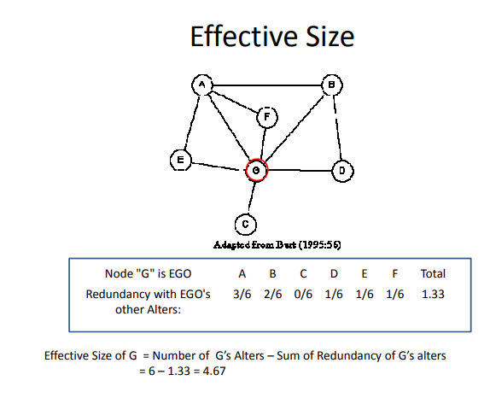

Slide 40
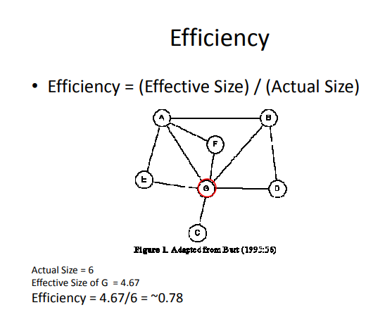

Slide 41
