Slide 1
Introduction to
Git and GitHub
What is a Version Control
Basic CLI Commands
Introduction to Git
Setting up VS Code
Introduction to GitHub

Slide 2
What is a Version Control System?
Version Control System manages the entire process
of version and keeps the track of the changes made.

Slide 3
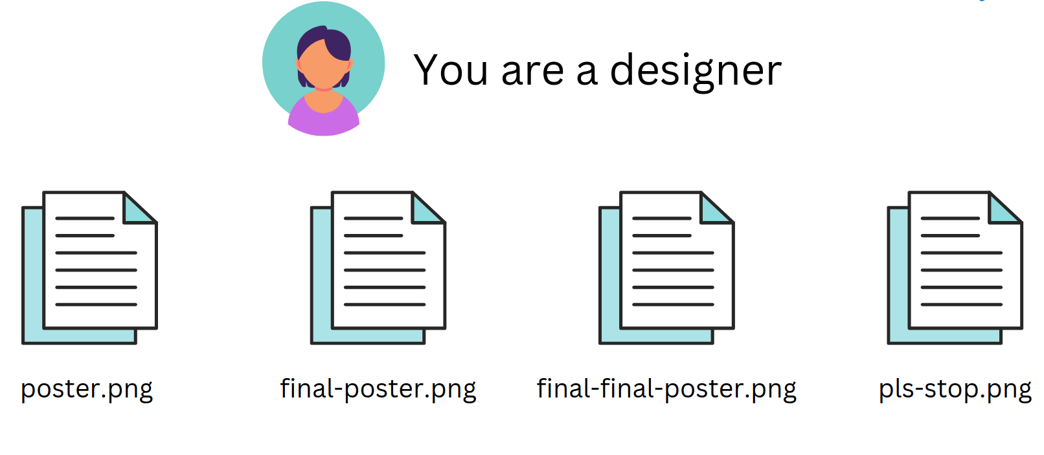
What is a Version Control System?

Slide 4
What is Git?
Git is a free and open source distributed version control system designed to handle everything from small to very large projects with speed and efficiency.

Slide 5
Git Features
Distributed version control → Every developer has a full copy of the repository (not just the latest snapshot).
Branching and merging → Easy to create branches for features, fixes, experiments, and merge them back.
History tracking → Keeps a complete record of changes (commits).
Collaboration → Multiple developers can work together, sync via push/pull.
Staging area → Allows selective commits.
Speed and efficiency → Optimized for performance even with large projects..

Slide 6
Git 3-Tree Architecture
In Git, your files can be in one of three main states. Understanding this is key to understanding how Git works:
Working Directory: This is your project folder with all the files you are currently working on. Any changes you make here are not yet tracked by Git.
Staging Area (or Index): This is an intermediate area where you list the specific changes you want to include in your next "snapshot" or commit. You use the git add command to move changes from your working directory to the staging area.
Repository (.git directory): This is where Git permanently stores the snapshots (commits) of your project. You use the git commit command to save the staged changes into the repository.

Slide 7
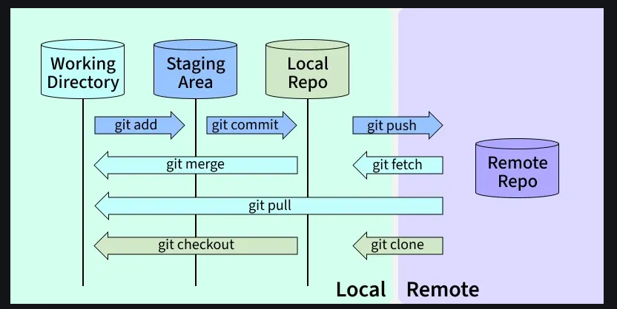
Git 3-Tree Architecture

Slide 8
Git Commands: Clone / Commit / Push
Clone = download project.
Commit = save changes locally.
Push = upload changes to GitHub.

Slide 9
Clone
Purpose: Download an existing repository from GitHub (or another remote) to your local machine.
Command:
bash

