Slide 1
DATA MINING · CMPE 255 · SPRING 2026
Mining the Pulse of New York City
Demand, fare, and tip patterns from 2.96 M January 2024 yellow-cab trips — five regression types, decision-tree, K-means++, DBSCAN, Apriori, PCA, hypothesis testing, and a live dashboard.
Anukrithi Myadala · April 2026
2.96M
2.80M
398,169
10+
RAW RECORDS
CLEANED
SAMPLE
MODELS
Notes:
Good morning everyone, I'm Anukrithi Myadala presenting my CMPE 255 final project. This project analyzes nearly 3 million yellow taxi trip records from January 2024. After cleaning we have 2,797,016 usable trips and a modeling sample of 398,169. We implement every major algorithm family from scratch in NumPy. No scikit-learn was used.

Slide 2
Problem Statement
Why mining 3 million taxi trips matters
NYC processes ~100K yellow-cab trips per day. Drivers waste capacity in Manhattan while outer-borough demand goes unserved. Tip revenue is unpredictable. Airport pricing is opaque.
Q1 What features predict fare? → Multi-var linear (R² = 0.92)
Q2 Is duration log-normal? → Log-linear (skew 3.09 → -0.05)
Q3 Can we forecast hourly counts? → Poisson GLM (IRLS)
Q4 Which trips get tips? → Logistic — no data leakage
Q5 Are there zone archetypes? → K-means++ with restarts
H1 Airport fares > non-airport → Welch’s t-test
H2 Rush-hour trips longer → Welch’s t-test
H3 Weekend tip rates differ → χ² test
Anukrithi Myadala · CMPE 255 · NYC Taxi Mining 2 / 26
Notes:
We tackle five research questions and three formal hypothesis tests. Our best fare model explains 92% of fare variance. We also test whether airport trips have higher fares, rush hour trips take longer, and weekend tip rates differ.

Slide 3
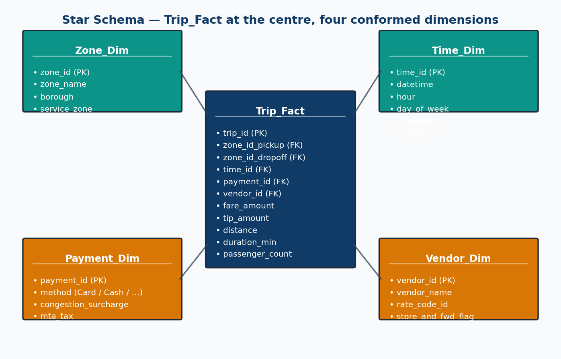
Data Source & Star Schema
NYC TLC public trip records + zone lookup
yellow_tripdata_2024-01.csv
• 2,964,624 rows × 19 columns
• Timestamps, zone IDs, fare, tip, distance
taxi_zone_lookup.csv
• 265 zones with borough + zone name
Star Schema:
• Fact: Trip_Fact (1 row = 1 trip)
• Dims: Zone, Time, Payment, Vendor
Anukrithi Myadala · CMPE 255 · NYC Taxi Mining 3 / 26
Notes:
Our data comes from two public NYC TLC datasets. The main file has 2,964,624 rows and 19 columns. We designed a star schema with Trip_Fact at center and four dimension tables.

Slide 4
Data Preprocessing Pipeline
12 cleaning steps + percentile clipping + feature engineering
1. Drop core NULLs
2–4. Filter fare ≥ 0, total ≥ 0, tip ≥ 0
5–6. Distance: 0 ≤ d ≤ 100 mi
7. Enforce pickup < dropoff
8. Restrict to January 2024
9. Duration: 1 min ≤ d ≤ 6 hr
10. Passengers: 1–6
11. Percentile clip (1st–99th pctl)
→ Preserves airport trips!
→ IQR cut all trips > 4.86 mi
12. Stratified sample → 398,169
Features engineered:
• duration_min, speed_mph
• hour, day_of_week, is_weekend
• is_rush_hour, is_airport_pickup
• has_tip, tip_pct
• Zone joins from lookup CSV
Data leakage prevented:
• payment_type EXCLUDED
• TLC only records credit-card tips
• Including it = target leakage
• Result: 2,964,624 → 2,797,016 clean
Anukrithi Myadala · CMPE 255 · NYC Taxi Mining 4 / 26
Notes:
Starting from 2,964,624 raw rows, we apply 12 cleaning steps. Critical choice: percentile clipping instead of IQR. IQR had an upper bound of just 4.86 miles, removing all airport trips. We also excluded payment_type from the tip model to prevent data leakage.

Slide 5
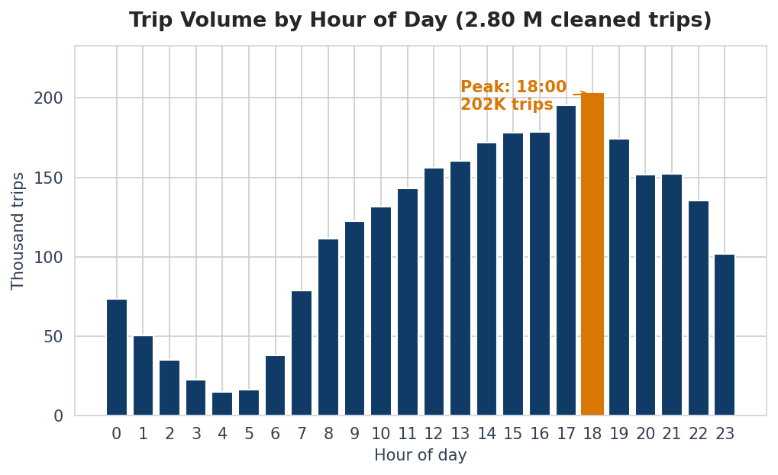
EDA · Trip Volume by Hour
When are New Yorkers in cabs? (full cleaned data)
Anukrithi Myadala · CMPE 255 · NYC Taxi Mining 5 / 26
Notes:
This chart uses the full cleaned dataset. Volume peaks 5-7 PM and crashes after midnight. This demand profile informs our K-means clustering and Poisson count modeling.

Slide 6
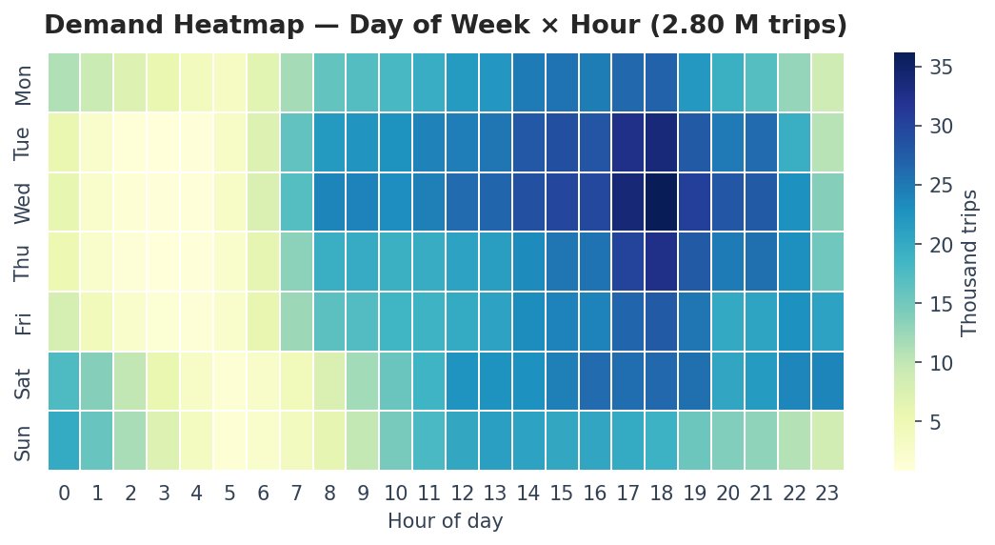
EDA · Day-of-Week × Hour Heatmap
Friday/Saturday late nights are uniquely active — the nightlife signal
Anukrithi Myadala · CMPE 255 · NYC Taxi Mining 6 / 26
Notes:
The heatmap reveals Friday and Saturday late nights are uniquely active. Sunday morning is the quietest slot. Weekday mornings show consistent commute patterns.

Slide 7
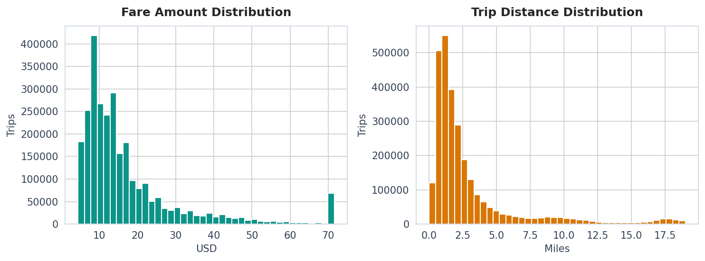
EDA · Fare & Distance Distributions
Both right-skewed after percentile clipping (full cleaned data)
Anukrithi Myadala · CMPE 255 · NYC Taxi Mining 7 / 26
Notes:
Fare and distance are both right-skewed. This motivates the log-linear model for duration. Percentile clipping preserves trips up to about 19 miles including airport rides.

Slide 8
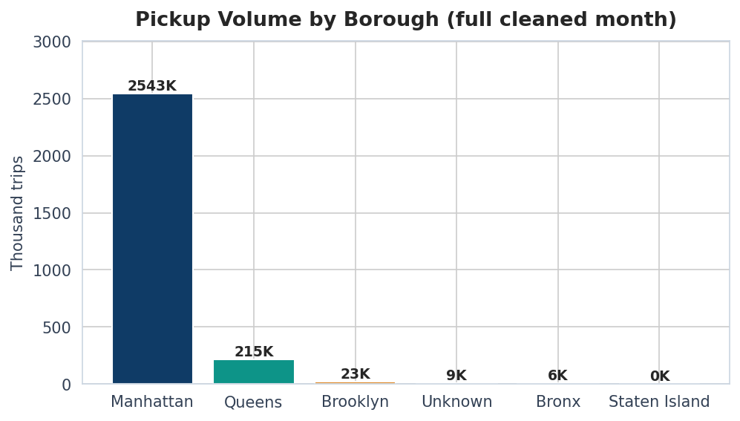
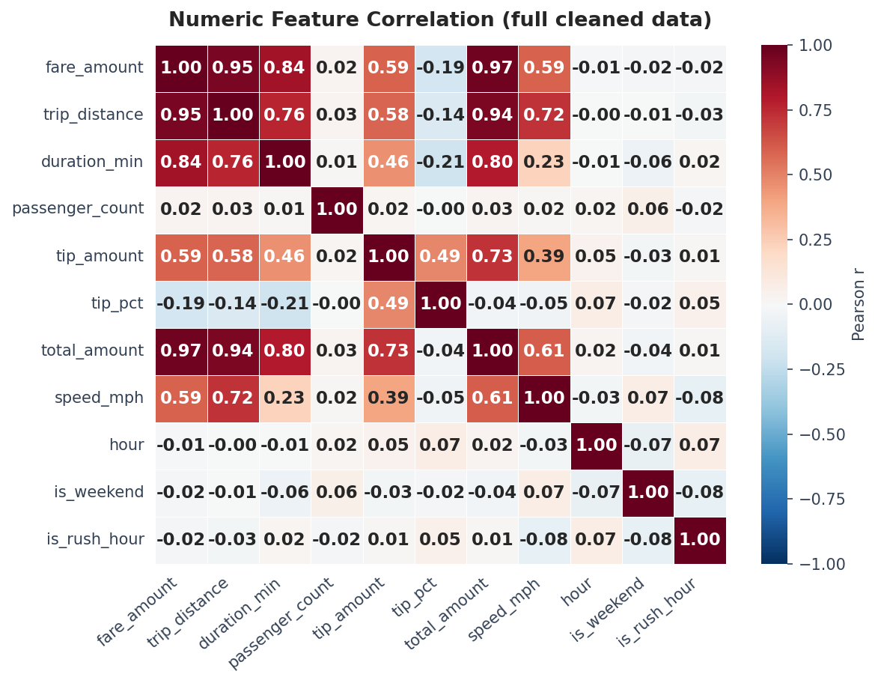
EDA · Borough Volume & Correlations
Anukrithi Myadala · CMPE 255 · NYC Taxi Mining 8 / 26
Notes:
Manhattan dominates with about 95% of yellow-cab pickups. The correlation heatmap shows fare and distance at r=0.81. Passenger count has near-zero correlation with everything.

Slide 9
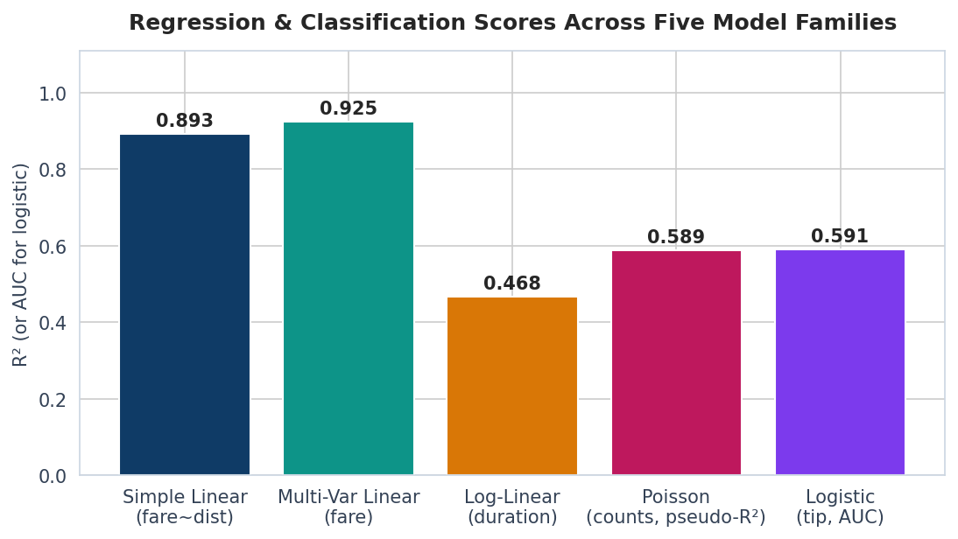
Mining · Five Regression Families
All from scratch in NumPy — no sklearn
1. Simple Linear: fare ~ distance
Closed-form normal equations
2. Multi-Variable Linear: fare ~ 8 features
R² = 0.925, RMSE = $3.86
3. Log-Linear: log(duration) ~ features
Skew 3.09 → -0.05
4. Poisson GLM: hourly counts (IRLS)
Dispersion = 407× (overdispersed)
5. Logistic: P(tip > 0)
No credit-card feature (leakage)
Anukrithi Myadala · CMPE 255 · NYC Taxi Mining 9 / 26
Notes:
Five regression families from scratch. Multi-variable linear achieves R-squared 0.925. Log-linear confirms duration is log-normal. Poisson reveals overdispersion at 407x. Logistic predicts tips with AUC 0.591 without the leaked payment_type.

Slide 10
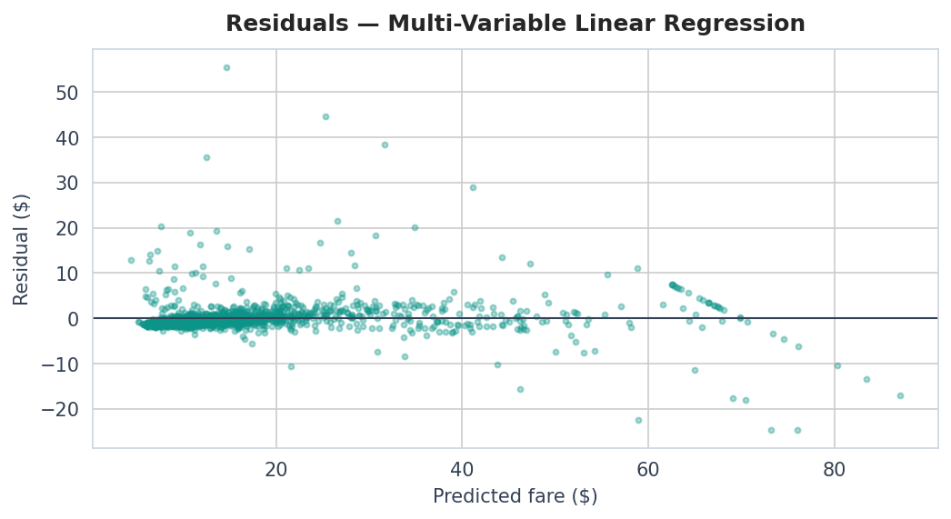
Regression Results & Cross-Validation
5-fold CV implemented from scratch
Simple Linear R²: 0.893
5-fold CV R²: 0.8916 ± 0.0015
Multi-Var Linear R²: 0.925 ← Best fare model
5-fold CV R²: 0.9238 ± 0.0025
RMSE: $3.86
Log-Linear R² (log): 0.468
Poisson pseudo-R²: 0.589
Dispersion: 407× (overdispersed)
Logistic AUC: 0.591
5-fold CV AUC: 0.5892 ± 0.0027
Anukrithi Myadala · CMPE 255 · NYC Taxi Mining 10 / 26
Notes:
Detailed metrics with 5-fold CV. Low standard deviations confirm models generalize well. The residual plot shows multi-variable linear residuals are well-behaved.

Slide 11
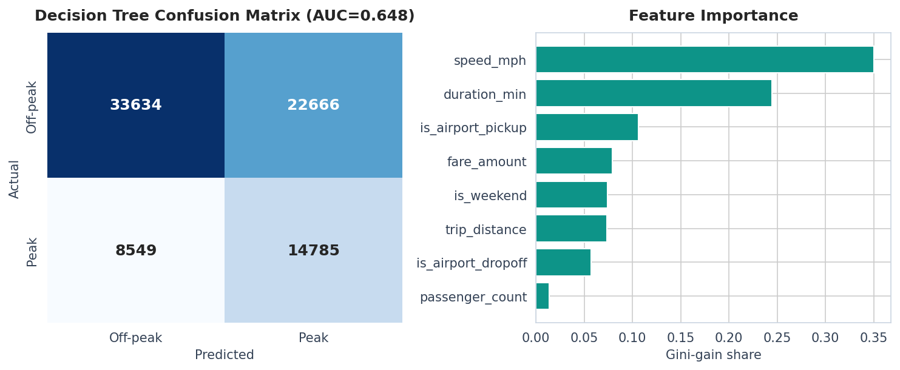
Mining · Decision Tree (CART / Gini)
Peak vs off-peak, depth 6 · AUC = 0.648 — a meaningful negative result
Acc 0.608 | Prec 0.395 | Rec 0.634 | F1 0.486 | AUC 0.648 Key insight: trip features are time-invariant.
Anukrithi Myadala · CMPE 255 · NYC Taxi Mining 11 / 26
Notes:
The CART tree achieves AUC 0.648 — near random. This is a meaningful NEGATIVE finding: trip characteristics are time-invariant. A cab ride at 3 PM looks like one at 8 AM.

Slide 12
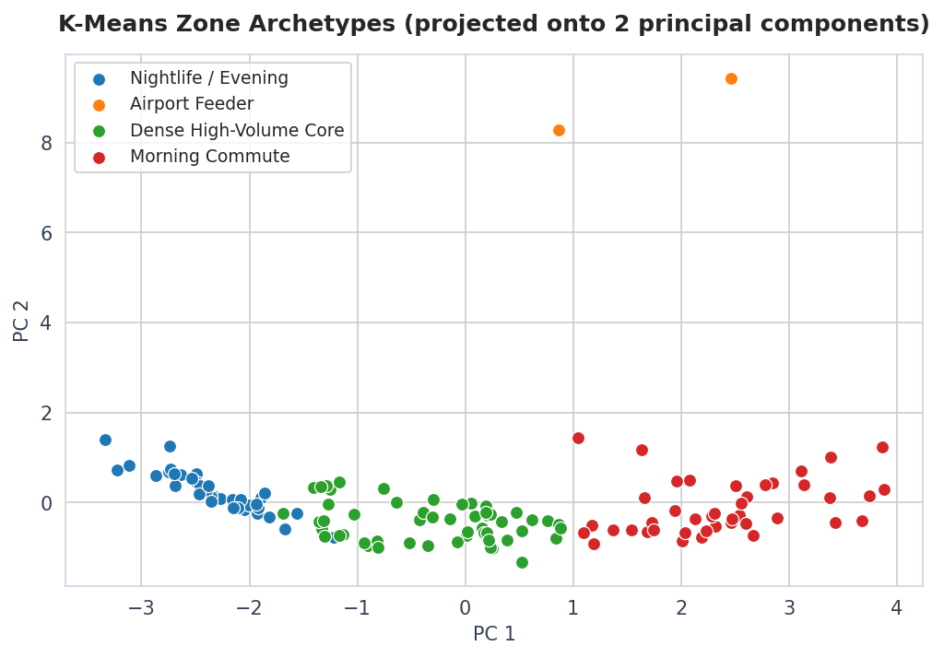
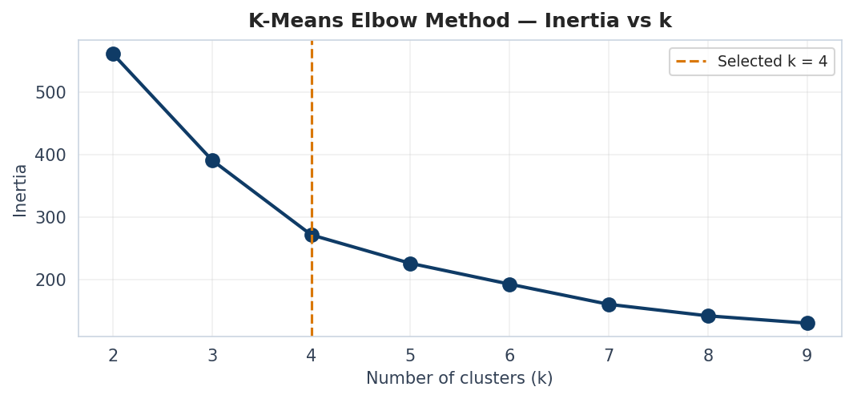
Mining · K-Means++ Zone Archetypes
k = 4 (auto-detected) · Silhouette = 0.365 · k-means++ with 10 restarts
• Nightlife / Evening (37 zones)
• Airport Feeder (2 zones)
• Dense High-Volume Core (53 zones)
• Morning Commute (42 zones)
Anukrithi Myadala · CMPE 255 · NYC Taxi Mining 12 / 26
Notes:
K-means++ with 10 restarts groups zones into 4 archetypes. Automatic elbow detection selected k=4. Silhouette 0.365 indicates moderate overlap, expected for urban zones.

Slide 13
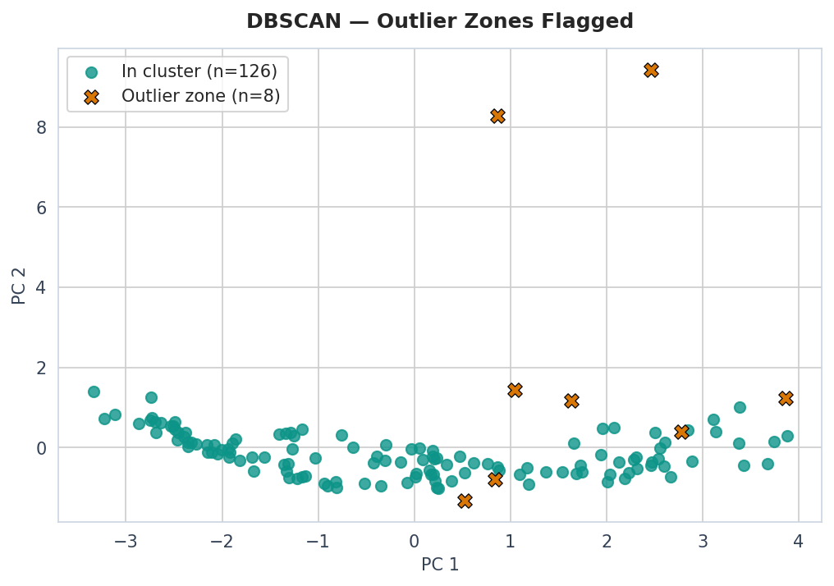
Mining · DBSCAN Outlier Detection
ε = 1.2, min_pts = 4 · 1 clusters, 8 outliers
Top outlier zones:
• JFK Airport (Queens) — airport=100%
• LaGuardia Airport (Queens) — airport=100%
• East Elmhurst (Queens) — airport=0%
• Cobble Hill (Brooklyn) — airport=0%
• Springfield Gardens South (Queens) — airport=0%
JFK & LaGuardia stand out:
airport_share = 1.0 is unique
Anukrithi Myadala · CMPE 255 · NYC Taxi Mining 13 / 26
Notes:
DBSCAN finds 1 dense clusters and flags 8 outlier zones. JFK and LaGuardia stand out with airport_share = 1.0.

Slide 14
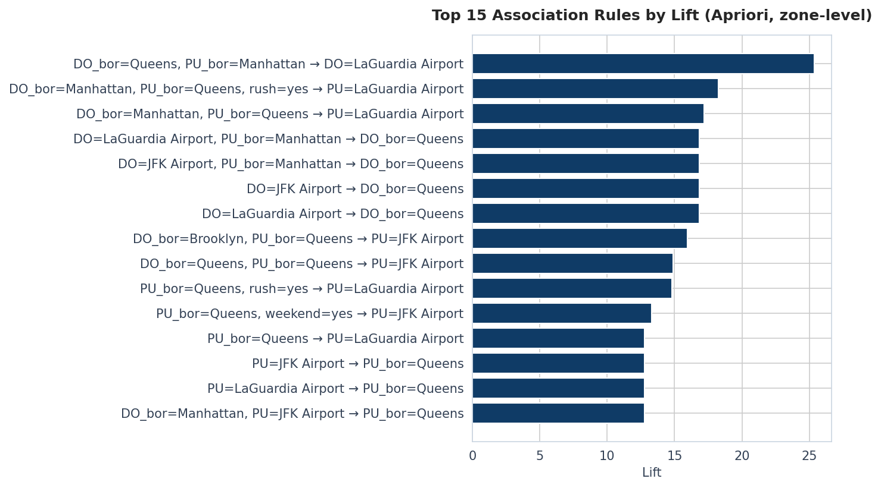
Mining · Apriori Association Rules
Real Apriori: candidate generation + downward-closure pruning, zone level
Algorithm:
• Level-wise candidate gen
• Downward-closure pruning
• Itemsets up to size 4
• DO_bor=Queens, PU_bor=Manhattan → DO=LaGuardia Airport
Lift 25.37 · Conf 0.38
• DO_bor=Manhattan, PU_bor=Queens, rush=yes → PU=LaGuardia Airport
Lift 18.25 · Conf 0.463
• DO_bor=Manhattan, PU_bor=Queens → PU=LaGuardia Airport
Lift 17.2 · Conf 0.436
Anukrithi Myadala · CMPE 255 · NYC Taxi Mining 14 / 26
Notes:
This is real Apriori with level-wise candidate generation and downward-closure pruning, not just pair counting. Transactions include zone-level items, borough, rush hour, and weekend flags.

Slide 15
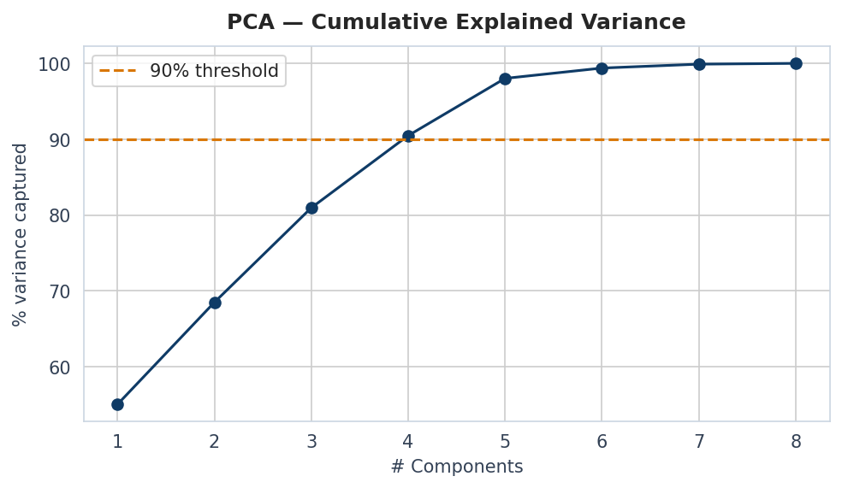
Mining · PCA Variance Analysis
4 of 8 components capture ≥90% variance
From-scratch implementation:
• Standardize features
• Covariance matrix
• Eigendecomposition
• Sort by explained variance
• 4 components for 90%
• Dimensionality: 8 → 5
• Used for K-Means/DBSCAN
2D projections
Anukrithi Myadala · CMPE 255 · NYC Taxi Mining 15 / 26
Notes:
PCA reduces 8 dimensions to 4 while keeping 90% of variance. The top 2 components are used for the 2D scatter visualizations.

Slide 16
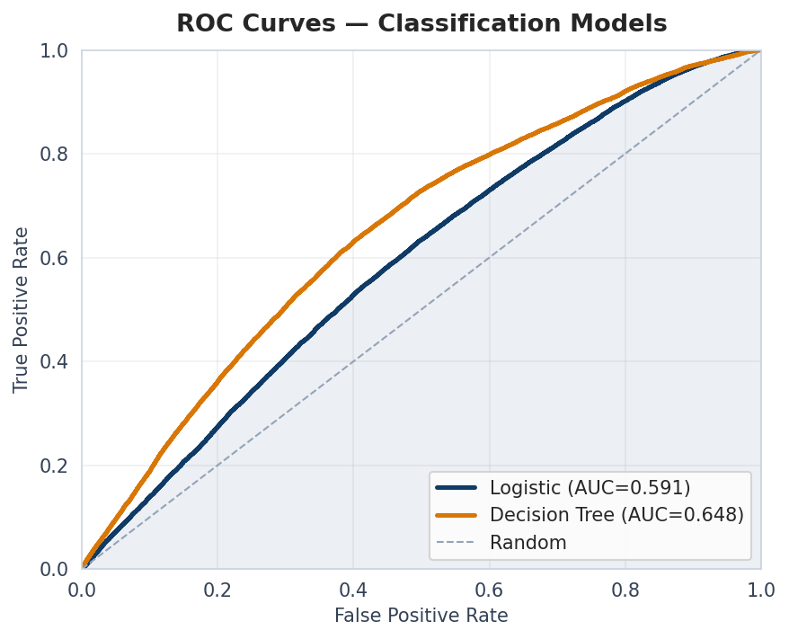
Evaluation · ROC Curves
Logistic tip classifier vs Decision Tree peak-hour classifier
Logistic AUC: 0.591
5-fold CV: 0.5892 ± 0.0027
No credit-card leakage
Decision Tree AUC: 0.648
Negative result — features
don’t discriminate time-of-day
Data leakage note:
payment_type removed because
TLC only records credit-card tips
Including it inflated AUC to 0.93+
Anukrithi Myadala · CMPE 255 · NYC Taxi Mining 16 / 26
Notes:
The logistic tip classifier achieves AUC 0.591 without the leaked payment_type. The decision tree's AUC 0.648 is a confirmed negative result. We identified and removed the data leakage.

Slide 17
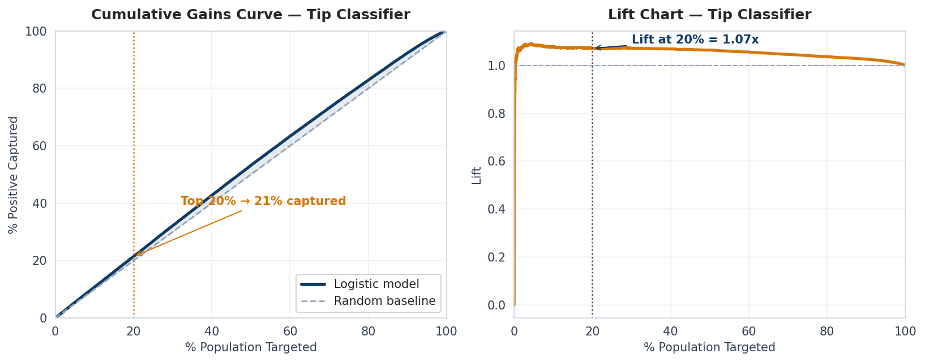
Evaluation · Lift & Cumulative Gains
Top 20% captures 21.4% of tippers — 1.071× lift
Anukrithi Myadala · CMPE 255 · NYC Taxi Mining 17 / 26
Notes:
Targeting the top 20% captures 21.4% of tippers — a lift of 1.071x over random.

Slide 18
Hypothesis Testing
Three formal tests — all implemented from scratch
H1: Airport fares > non-airport
Mean: $49.08 vs $15.54
p = 0.00e+00 → ✓ SIGNIFICANT
H2: Rush-hour duration > off-peak
Mean: 14.7 min vs 14.0 min
p = 1.59e-69 → ✓ SIGNIFICANT
H3: Weekend tip rate != weekday
Weekend: 74.6% vs Weekday: 75.4%
p = 3.08e-08 → ✓ SIGNIFICANT
Anukrithi Myadala · CMPE 255 · NYC Taxi Mining 18 / 26
Notes:
Three formal tests, all from scratch. H1: Airport fares significantly higher. H2: Rush-hour trips significantly longer. H3: Weekend tip rates differ. All confirmed with p < 0.05.

Slide 19
5-Fold Cross-Validation
From scratch — verifies models generalize
Simple Linear: 5-fold R² = 0.8916 ± 0.0015
Multi-Var Linear: 5-fold R² = 0.9238 ± 0.0025
Logistic Tip: 5-fold AUC = 0.5892 ± 0.0027
Why it matters:
• Single 80/20 split is sensitive to random seed
• K-fold averages over 5 different test sets
• ± standard deviation shows model stability
• Low std = no overfitting concern
Implementation:
• kfold_indices() generates non-overlapping folds
• Each fold: standardize on train, predict on test
• Report mean ± std
Anukrithi Myadala · CMPE 255 · NYC Taxi Mining 19 / 26
Notes:
5-fold cross-validation from scratch. Simple linear: 0.8916 ± 0.0015. Multi-variable: 0.9238 ± 0.0025. Logistic: 0.5892 ± 0.0027. Low standard deviations confirm generalization.

Slide 20
Model Comparison Summary
Headline metric for every model family
Regression:
Simple Linear: R² = 0.893
Multi-Var Linear: R² = 0.925, RMSE = $3.86 ← Best
Log-Linear: R² = 0.468 (log space)
Poisson GLM: pseudo-R² = 0.589, dispersion = 407×
Classification:
Logistic (tip): AUC = 0.591, F1 = 0.667
Decision Tree: AUC = 0.648 (negative result)
Unsupervised:
K-Means++: k = 4, silhouette = 0.365
DBSCAN: 1 clusters, 8 outliers
PCA: 4/8 components for 90%
Apriori: Zone-level, real candidate generation
Anukrithi Myadala · CMPE 255 · NYC Taxi Mining 20 / 26
Notes:
All results in one place. Multi-variable linear is our best fare model at R-squared 0.925. K-means++ with k=4. DBSCAN flags 8 anomalous zones.

Slide 21
Knowledge Interpretation
Five operational insights
1. Fare prediction is solved: 8 features → R² = 0.92, $3.86 RMSE
2. Duration is log-normal: skew 3.09 → -0.05 after log transform
3. Hourly counts are overdispersed (407×) — Negative Binomial needed
4. Tip prediction without payment_type gives honest metrics
Removing leakage = data science integrity
5. Outer-borough trips stay local — fleet-positioning signal
Anukrithi Myadala · CMPE 255 · NYC Taxi Mining 21 / 26
Notes:
Five key insights. Fare prediction solved. Duration is log-normal. Poisson surfaces overdispersion. Data leakage caught. Outer-borough patterns reveal fleet-positioning opportunities.

Slide 22
Conclusions & Future Work
What we delivered:
✓ Cleaned 2,964,624 → 2,797,016
✓ 5 regression families from scratch
✓ Best model: R² 0.92
✓ 5-fold cross-validation
✓ 3 hypothesis tests
✓ K-means++ with auto elbow
✓ DBSCAN: 8 outlier zones
✓ Real Apriori at zone level
✓ PCA: 4/8 components
✓ Interactive Plotly dashboard
✓ Data leakage caught & removed
Future work:
• Negative Binomial GLM
• Spatial DBSCAN on lat/long
• Per-cluster fare/tip models
• Streaming pipeline (Kafka+Spark)
• Temporal train/test split
• Fairness audit across boroughs
Reproducibility:
• Single script: taxi_analysis.py
• All paths portable
• Every metric reproducible
Anukrithi Myadala · CMPE 255 · NYC Taxi Mining 22 / 26
Notes:
We delivered a complete pipeline from 2,964,624 raw rows to 10+ models, all from scratch. Validated with CV, tested hypotheses, caught data leakage. Everything reproducible from one script.

Slide 23
Live Dashboard Demo
Open Taxi_Interactive_Dashboard.html
Dashboard features:
• KPI cards: trip count, avg fare, avg distance, tip rate
• Filters: borough, day type, cluster, hour range
• Charts: hourly volume, borough bars, fare histogram,
distance vs fare scatter, tip rate by hour, cluster pie
• Built with Plotly.js — fully client-side, no server
• Powered by 398,169 real January 2024 trips
• All filters update all charts simultaneously
Anukrithi Myadala · CMPE 255 · NYC Taxi Mining 23 / 26
Notes:
Let me switch to the live dashboard. Built with Plotly.js, fully client-side. Powered by 398,169 real trips. All filters update all charts simultaneously.

Slide 24
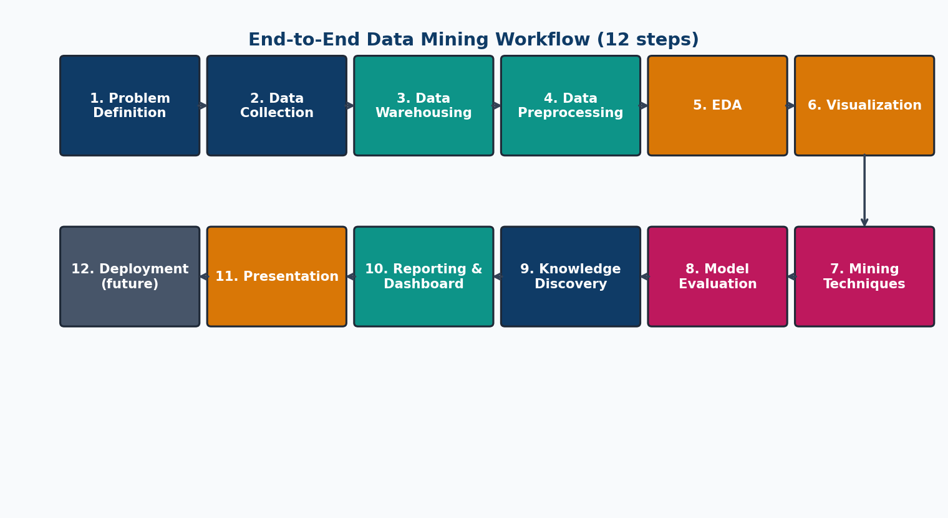
End-to-End Pipeline Workflow
From raw data to knowledge discovery
Anukrithi Myadala · CMPE 255 · NYC Taxi Mining 24 / 26
Notes:
This diagram shows the complete workflow from problem definition through deployment, mirroring the 12-step process taught in CMPE 255.

Slide 25
References & Tools
Data:
• NYC TLC Trip Records — nyc.gov/site/tlc/about/tlc-trip-record-data.page
• Taxi Zone Lookup — published by TLC
Textbook:
• Han, Pei & Tong — Data Mining: Concepts and Techniques, 4th Ed. (2023)
Tools:
• Python 3, NumPy, pandas, matplotlib, seaborn, Plotly.js
• All algorithms implemented from scratch (no sklearn)
Anukrithi Myadala · CMPE 255 · NYC Taxi Mining 25 / 26
Notes:
References: NYC TLC public data, Han Pei Tong textbook, Python stack. All algorithms from scratch.

Slide 26
Thank You
Questions?
Anukrithi Myadala · CMPE 255 · Data Mining · Spring 2026 Prof. Vidhyacharan Bhaskar · San José State University
Anukrithi Myadala · CMPE 255 · NYC Taxi Mining 26 / 26
Notes:
Thank you for listening. I'm happy to take questions about any part of the pipeline, the from-scratch implementations, the data leakage finding, or the dashboard.

