Slide 1
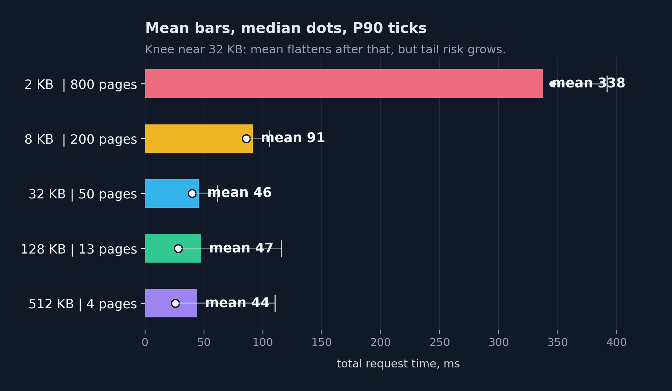
THE 32 KB KNEE
Why 50 pages at 32 KB almost tied 4 pages at 512 KB?
CMPE 275 Anukrithi + Asim
NYC 311 2020-present | 80k returned rows | 20-byte records | A-F host1, G/H/I host2 | 30 runs/chunk
Scatter-gather fan-in
Total time components
Client only calls A
first page gathers B-I once
scatter-gather
B-I fan-in over Wi-Fi
Client
A
+
cache materialization
A assembles 1.6 MB
+
Chunk size
B
H
G
I
amortized page cost
N QueryOnce calls
+
C
D
E
serialization/copy
protobuf bytes + slices
F
32 KB has mostly paid off the page-count penalty.
A materializes/cache-builds the 1.6 MB result
Page overhead multiplies
Fairness: equal turns, not identical latency
7.7x
338 ms -> 44 ms
2 KB
800 pages
~0.42 ms/page, but 800x
cli1
A
2 KB to 512 KB total mean
32 KB
50 pages
~0.91 ms/page, knee
cli2
cli3
queue
32 KB
512 KB
512 KB
4 pages
~11 ms/page, few but bigger
cli4
45.7 ms / P90 61
44.0 ms / P90 110
Each client received 50 chunks; finish spread was 4.3% (116.8-121.8 ms).
At 32 KB, page-count cost is mostly amortized. Key takeaway is that 32 KB is the best balance, since below it repeated paging dominates, and above it fixed costs and tail latency dominate.
338 ms is all 800 pages, not one chunk.
Takeaway: first page gathers/cache-builds once; chunk size controls how many later client-to-A page costs are repeated.
Notes:
Anu: For our mini 2, We used NYC 311 service requests, converted a 80,000 row subset into compact 20-byte typed binary records, and returned 80,000 of those records through a nine-node gRPC tree spread across two laptops on Wi-Fi. A through F on one machine, G, H, and our Python node I on the other. The only variable we changed across runs was chunk size. Everything else stayed the same — same data, same tree, same two laptops, 30 runs per chunk size.
At the extremes, the result looks obvious. 2 KB chunks averaged 338 ms. 512 KB chunks averaged 44 ms. 7.7x faster, bigger chunks win, done. But that's not the finding.
the part we found more interesting is what happens in the middle. At 32 KB, we needed 50 pages to return the full result. At 512 KB, we needed only 4. That's going from 50 round trips down to 4 — and the means are 45.7 versus 44.0 milliseconds. 1.7 ms apart. So cutting 46 pages out of the request barely moved the number at all, and that needs an explanation.
To understand it, you have to look at the tree. The client only ever talks to A — A is the sole public entry point and owns the scatter-gather fan-in. On the very first page of any request, A fans out and gathers from B, H, G, and I, which recursively gather their own children. Once those payloads return, A assembles the full 1.6 MB result and caches it under that request ID. That first page is the only one that pays the distributed gather cost. Every page after that is just A slicing the cached payload and returning the next chunk — the tree doesn't get touched again.
That is why total time is not only bandwidth. The cost has four pieces: scatter-gather fan-in over Wi-Fi, cache materialization at A, amortized page cost for each QueryOnce call, and serialization/copy work for the protobuf bytes. Small chunks help on page size but multiply the page count. Large chunks reduce the number of page calls, but each response is larger and the tail latency becomes more visible.
Asim: The bottom-left diagram is there to avoid a common misunderstanding. The 338 ms at 2 KB is not one chunk response. It is all 800 page responses combined. Each 2 KB page is cheap, about 0.42 ms on average, but 800 cheap operations still add up. At 32 KB, the client only needs 50 pages, so most of the repeated paging overhead has already been amortized. So the total time is page count multiplied by per-page cost, plus the first gather/cache cost. Going from 50 pages down to 4 pages still helps a little, but now the fixed gather/cache floor and payload movement dominate. That is why 32 KB and 512 KB have almost the same mean even though 512 KB uses far fewer pages.
The fairness box shows why we did not just say 512 KB is the answer. At the 32 KB knee, four clients each got exactly 50 chunks through A's queue. Their finish times were not identical, but they were close: 116.8 to 121.8 ms, a 4.3 percent spread. So this is opportunity fairness. A gives clients equal turns, but network timing still creates slightly different wall-clock completion times. 512 KB would make this worse: fewer, heavier pages mean one client's slow gather blocks the queue for longer.
So the actual design decision here isn't just "which chunk size is fastest." It's: what are you optimizing for? If it's raw mean speed, 512 KB wins by about 1.7 ms. If it's robustness, tail behavior, and concurrent client fairness, 32 KB is the better operating point — it's already past most of the page-count penalty and it keeps tail risk manageable.
The takeaway at the bottom of the slide says it cleanly: the first page gathers and cache-builds once. Chunk size controls how many times you repeat the client-to-A page cost after that. Below 32 KB, repeated pages dominate. Above 32 KB, the fixed gather floor and tail variance dominate. The useful discovery isn't that bigger chunks are faster — it's where the bottleneck shifts and why.

