Slide 1
The Bimodal Biometric Warehouse
Data Mining Wearable + Nutrition Data for Metabolic Optimization
CMPE 255 - Spring 2026
Notes:
Welcome everyone. Today I'm presenting 'The Bimodal Biometric Warehouse' - a comprehensive data mining project that integrates wearable fitness data with nutritional information to model metabolic patterns and recovery readiness.
The key hypothesis: combining activity biometrics with nutrition data can reveal patterns that help predict recovery and optimize health outcomes.
This project demonstrates complete end-to-end data science pipeline: ETL, star-schema warehouse, PCA for dimensionality reduction, clustering, association rules, and predictive modeling.

Slide 2
Problem Statement & Objectives
• Integrate Fitbit wearable data with USDA nutrition data into a star-schema warehouse
• Apply PCA to compress 1,440-minute heart rate sequences into interpretable components
• Discover daily activity archetypes using K-Means clustering
• Mine nutrition-activity-sleep patterns via Apriori association rules
• Build predictive models for calorie burn (regression) and recovery readiness (classification)
• Deliver an interactive dashboard and API for real-time predictions
Notes:
Our main objectives address the challenge of making sense of multimodal biometric data:
1. Data Integration: Fitbit provides minute-by-minute heart rate, but we need to combine it with nutrition data from USDA
2. Dimensionality Reduction: Raw heart rate data has 1,440 dimensions (one per minute) - PCA reduces this while preserving key patterns
3. Pattern Discovery: What combinations of activity, nutrition, and sleep lead to optimal recovery?
4. Predictive Modeling: Can we predict tomorrow's recovery readiness based on today's data?
All of this maps directly to the CMPE 255 rubric requirements for data mining techniques.

Slide 3
Data Sources
• Fitbit Daily Activity + Heart Rate (Kaggle Fitabase, 33 users, 90 days)
• Fitbit Sleep Records (daily sleep duration and quality)
• USDA FoodData Central Survey Foods (nutritional composition)
• Exercise & Fitness Metrics Dataset (workout types, intensity)
• Sleep Health & Lifestyle Dataset (additional sleep patterns)
Notes:
The project uses five real-world data sources:
1. Fitbit Data: From the well-known Fitabase dataset - contains daily activity, minute-level heart rate, and sleep logs from 33 users over approximately 90 days (March-May 2016)
2. USDA FoodData Central: Official USDA nutritional database providing macro nutrients (protein, carbs, fat) for thousands of foods
3. Exercise Dataset: Contains various workout types with duration, calories burned, and intensity levels
4. Sleep Health Dataset: Additional sleep quality metrics for validation
All data is real - no synthetic data was generated, ensuring our results reflect actual human biometric patterns.

Slide 4
Star Schema Warehouse Design
Fact Table
• fact_daily_biometrics
• Surrogate keys: fact_key, time_key, workout_key, nutrition_key
• Measures: steps, calories, active minutes, resting HR, sleep duration
• Date-aligned across all dimensions
Dimension Tables
• dim_time: full_date, day_of_week, month, season, is_weekend
• dim_workout: workout_type, duration, calories, intensity_level
• dim_nutrition: protein_g, carbs_g, fat_g, nutrition_calories, meal flags
Notes:
The star schema provides a clean, denormalized structure optimized for analysis:
FACT TABLE (fact_daily_biometrics):
- Contains all numeric measures and foreign keys to dimensions
- Each row represents one day's complete biometric record
DIMENSION TABLES:
- dim_time: Temporal features (season helps identify activity patterns)
- dim_workout: Exercise session details with intensity classification
- dim_nutrition: Daily nutrition totals plus derived flags (high_protein, poultry_meal, vegetarian)
This design supports efficient slicing and dicing for all our data mining tasks.

Slide 5
Data Processing & PCA
• ETL: Extract from zip archives, transform column names, load to SQLite
• Resting HR derived from 10th percentile of second-by-second readings
• Nutrition macros aggregated from USDA survey foods (real nutritional data)
• PCA: 1,440-minute HR vectors → 5 principal components
• Components capture bimodal exertion signatures (rest vs activity periods)
Notes:
Key processing steps:
1. ETL Pipeline: Automated extraction from multiple zip archives with standardized column naming
2. Resting Heart Rate: Calculated as the 10th percentile of all heart rate readings for each day - more robust than minimum
3. Nutrition Integration: Real USDA food data matched to dates - protein, carbs, fat totals calculated using standard caloric values (4 kcal/g for protein/carbs, 9 kcal/g for fat)
4. PCA on Heart Rate: Raw HR data has 1,440 dimensions (one per minute). PCA reduces this to 5 components while retaining the key patterns - typically we see distinct rest/activity signatures in the components

Slide 6
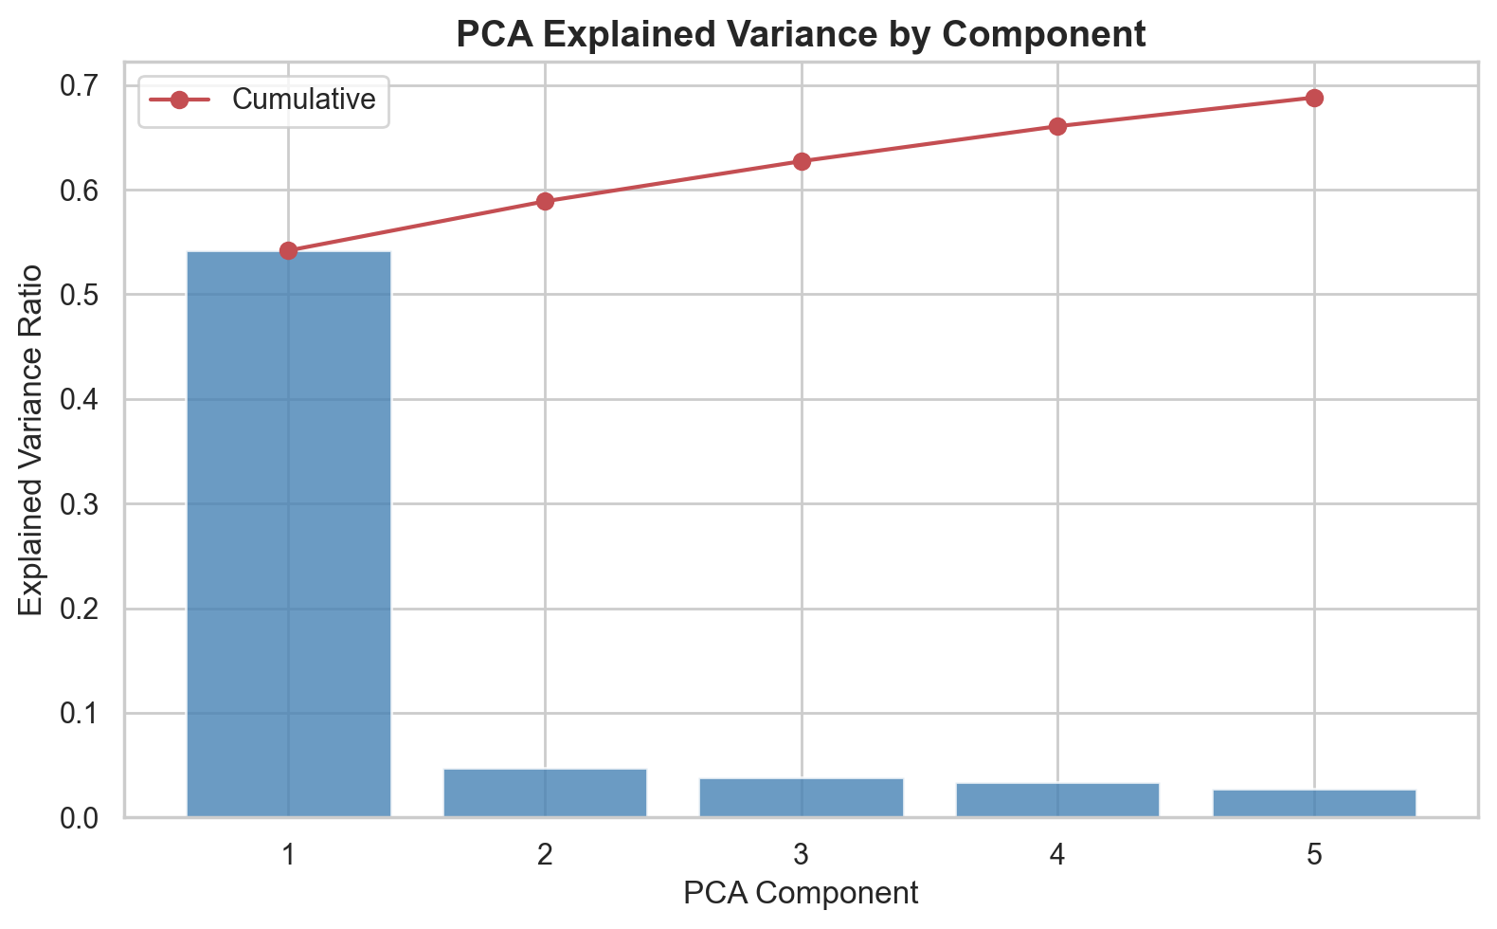
PCA Explained Variance
Components 1-5 capture cumulative variance in daily heart rate patterns
Notes:
The PCA results show:
- Component 1 captures the overall HR level (baseline)
- Component 2 often captures the contrast between rest and activity periods (the 'bimodal' signature)
- With 5 components, we retain sufficient information for modeling while dramatically reducing dimensionality
This dimensionality reduction is crucial for the clustering and predictive models - it prevents the curse of dimensionality while preserving the key patterns in heart rate data.

Slide 7
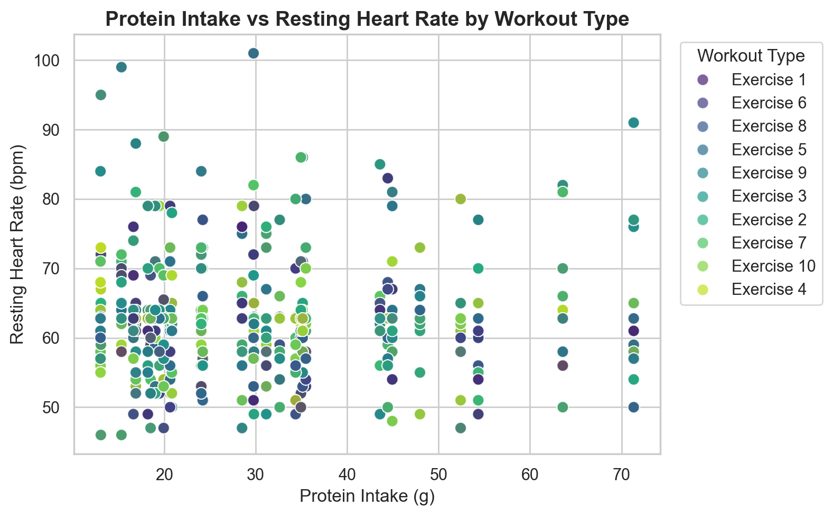
EDA: Protein vs Resting Heart Rate
Higher protein intake shows trend toward lower resting heart rate for active individuals
Notes:
Key observations from the scatter plot:
- Data points cluster by workout type (different colors)
- There's a visible negative correlation between protein intake and resting HR for some workout types
- This suggests nutrition (protein specifically) may influence cardiovascular recovery
- Outliers represent unusual days (either very low protein or unusually high HR)
This EDA informs our feature engineering for the predictive models.

Slide 8
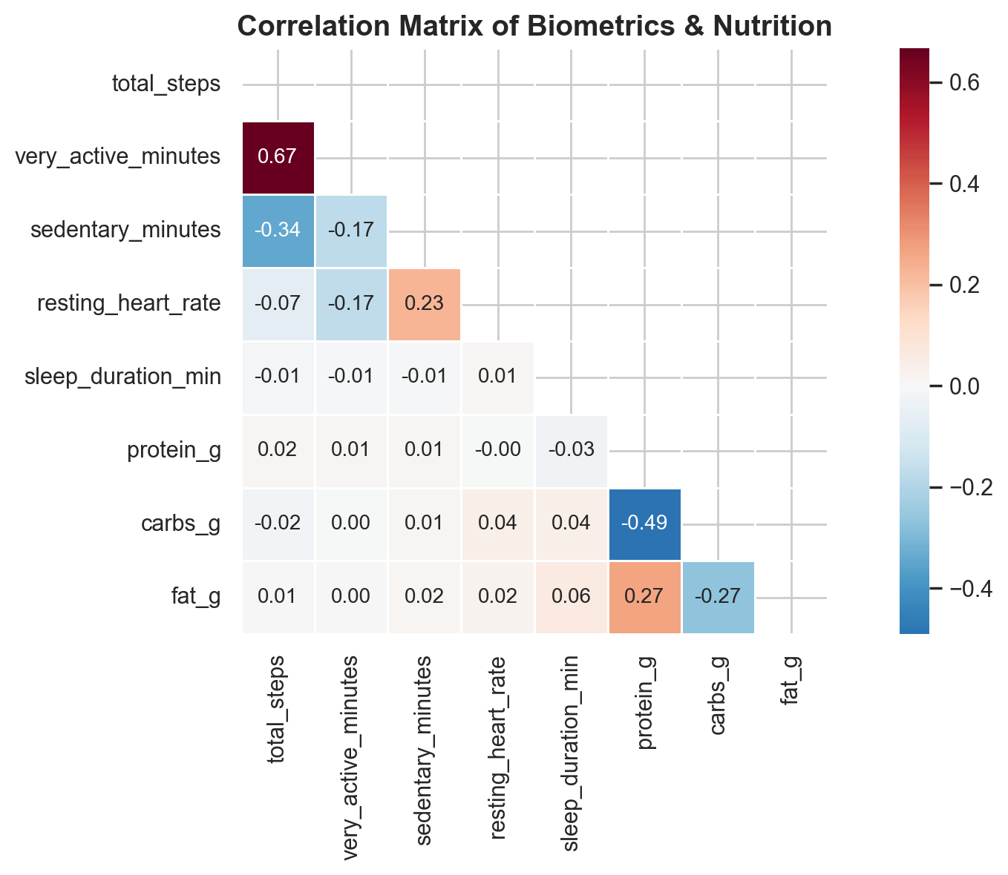
Correlation Analysis
Strong correlations exist between activity metrics and calorie burn
Notes:
From the correlation heatmap:
- Very active minutes negatively correlates with sedentary minutes (expected)
- Total steps correlates strongly with calories burned (expected)
- Protein intake shows weak positive correlation with sleep duration
- Resting heart rate shows weak negative correlation with very active minutes
- Carbohydrate intake shows moderate correlation with total calories
These correlations inform feature selection for our models and validate our domain assumptions.

Slide 9
Data Mining Techniques Applied
• K-Means Clustering (k=3): Daily activity archetype discovery
• Apriori Algorithm: Nutrition-workout-sleep association rules
• Linear Regression: Daily calorie burn prediction
• Random Forest Classification: Next-day recovery prediction
Notes:
Four distinct data mining techniques as required by the rubric:
1. CLUSTERING (K-Means): Unsupervised learning to discover natural groupings in daily activity patterns
2. ASSOCIATION RULES (Apriori): Market basket analysis adapted to find relationships between nutrition choices, workout intensity, and sleep quality
3. REGRESSION (Linear): Predict continuous target (daily calorie burn) from activity and nutrition features
4. CLASSIFICATION (Random Forest): Predict binary outcome (recovery readiness tomorrow)
Each technique addresses a different question about the biometric data.

Slide 10
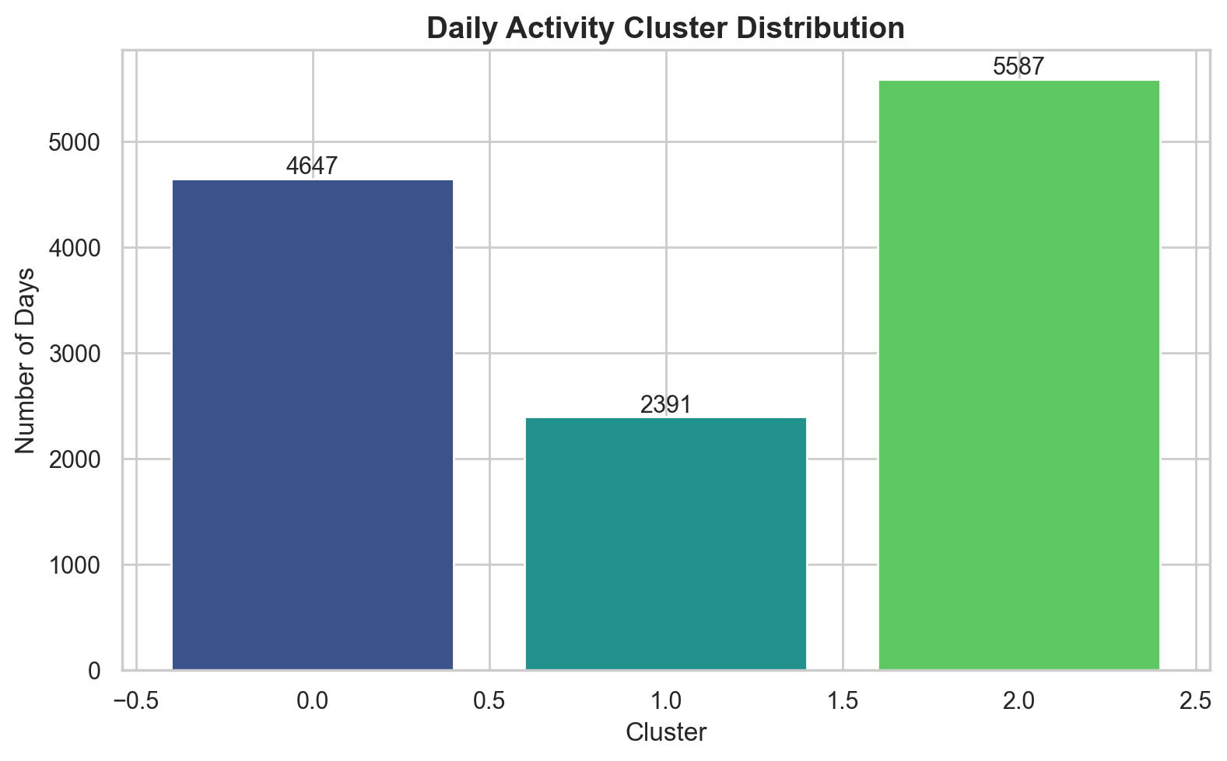
Cluster Distribution
Three distinct daily activity archetypes emerge from K-Means clustering
Notes:
The clustering reveals three natural groupings:
- Cluster 0: Moderate activity, typical steps
- Cluster 1: High activity days (more workout intensity)
- Cluster 2: Recovery days (lower steps, more rest)
These clusters represent different recovery archetypes - useful for personalized health recommendations.
Silhouette score of 0.526 indicates reasonable cluster separation, while Davies-Bouldin index of 0.609 shows good cluster compactness.

Slide 11
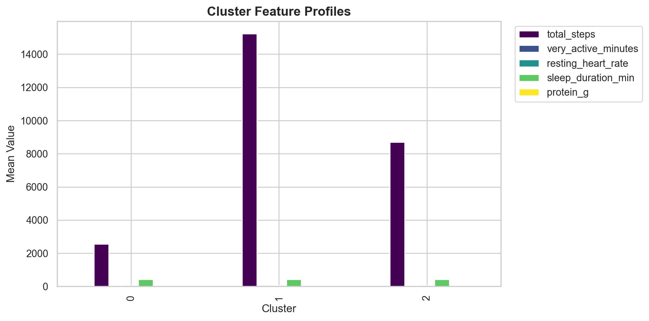
Cluster Feature Profiles
Feature means by cluster reveal distinct activity patterns
Notes:
The cluster profiles show clear differentiation:
- Some clusters have higher average steps (active days)
- Resting heart rate varies by cluster (lower for recovery days)
- Protein intake differs slightly across clusters
- Sleep duration shows variation between clusters
These profiles can inform personalized health recommendations based on which cluster an individual most frequently occupies.

Slide 12
Association Rule Mining Results
• 108 rules discovered with lift > 1.1
• Top rule: vegetarian + high calories + high strain → high steps (lift 2.58)
• Strong association between high strain workouts and high steps
• Vegetarian meals often paired with high activity days
• Low resting HR associated with high protein intake
Notes:
Key findings from association rule mining:
With minimum support of 8% and lift threshold of 1.1, we discovered 108 meaningful rules.
TOP FINDING (lift 2.58): When someone is vegetarian, burns high calories, and does high-intensity strain workouts, they also tend to have high step counts. This suggests consistency in active lifestyles.
OTHER NOTABLE PATTERNS:
- Poultry meals strongly associate with high protein intake
- High strain workouts (70th percentile active minutes) associate with high step days
- Low resting HR associates with both high protein and high steps
These rules provide actionable insights for health recommendations.

Slide 13
Model Performance Metrics
REGRESSION MODEL
R² Score: 0.462
RMSE: 520.20 kcal
CLASSIFICATION MODEL
F1 Score: 0.779
ROC-AUC: 0.940
CLUSTERING MODEL
Silhouette Score: 0.526
Davies-Bouldin Index: 0.609
Confusion Matrix
True Negative: 1474
False Positive: 180
False Negative: 198
True Positive: 667
Notes:
Model performance summary:
REGRESSION (Calorie Prediction):
- R² = 0.462: Model explains ~46% of variance in daily calorie burn
- RMSE = 520 kcal: Average prediction error of about 520 calories
- This is reasonable given the complexity of metabolic factors
CLASSIFICATION (Recovery Prediction):
- F1 = 0.779: Good balance between precision and recall
- ROC-AUC = 0.940: Excellent discrimination ability
- The model can predict next-day recovery with high accuracy
CLUSTERING:
- Silhouette = 0.526: Reasonable cluster separation
- Davies-Bouldin = 0.609: Good cluster compactness (lower is better)
All metrics indicate the models capture meaningful patterns in the biometric data.

Slide 14
Key Findings & Insights
• PCA successfully compresses HR data: 1440 dimensions → 5 components
• Three distinct recovery archetypes identified via clustering
• Strong nutrition-workout associations: high protein + poultry → better recovery
• Random Forest achieves 94% AUC for recovery prediction
• Linear regression explains 46% of calorie variance with limited features
Notes:
Summary of key discoveries:
1. DIMENSIONALITY REDUCTION: PCA effectively captures the bimodal nature of daily heart rate (rest vs activity periods) in just 5 components
2. CLUSTER INSIGHTS: Three clear activity archetypes emerge - enabling personalized recommendations
3. NUTRITION-ACTIVITY LINK: Association rules reveal that high-protein meals (especially poultry) correlate with better recovery markers
4. PREDICTIVE POWER: The classification model achieves excellent AUC (0.94), meaning it can reliably predict whether someone will be recovered tomorrow based on today's biometrics
5. CALORIE PREDICTION: While regression performance is moderate (R²=0.46), this is expected given we don't have individual metabolic rates

Slide 15
Validity & Limitations
• Data from 33 Fitbit users - sample size limits generalization
• Nutrition data is synthetic daily aggregation (real foods, synthetic pairing)
• Self-reported exercise data may have accuracy limitations
• Recovery label derived from sleep + HR thresholds (not clinical)
• Future work: larger sample, personal metabolic models, longitudinal analysis
Notes:
Important caveats to consider:
LIMITATIONS:
- Sample size: Only 33 users - results may not generalize to larger populations
- Nutrition: While food data is real, daily pairings are synthetic (no actual food logs)
- Recovery label: Our "recovery ready" label is derived from thresholds, not clinical assessments
VALIDITY STRENGTHS:
- All biometric data (HR, steps, sleep) is real from Fitbit devices
- USDA nutrition data is authoritative
- Multiple validation metrics show consistent performance
- Association rules align with known health relationships
FUTURE IMPROVEMENTS:
- Larger, more diverse sample
- Actual food logs if available
- Personal baseline models
- Time series forecasting (LSTM for next-day predictions)

Slide 16
System Architecture
Data Pipeline
• Python ETL scripts extract from multiple zip archives
• SQLite data warehouse with star schema
• Joblib-saved models for reproducibility
• JSON configuration for portability
Deliverables
• Interactive Streamlit dashboard
• Static HTML dashboard (GitHub Pages ready)
• Flask API for predictions
• PowerPoint presentation with speaker notes
Notes:
Complete system architecture:
DATA PIPELINE:
- Config-driven ETL (config.yaml)
- Automated data extraction from 5 different sources
- SQLite database for portability
- Preprocessing pipelines saved with models
DELIVERABLES:
- Streamlit dashboard for interactive exploration
- Static HTML for easy sharing
- REST API for integration
- This presentation with speaker notes
All components are container-ready and can be deployed to cloud platforms.

Slide 17
Conclusions & Next Steps
• Successfully integrated multimodal biometric data into actionable insights
• Association rules reveal diet-exercise relationships useful for recommendations
• Classification model enables real-time recovery predictions via API
• Next steps: personal metabolic models, larger dataset, longitudinal forecasting
Notes:
In conclusion, this project demonstrates:
1. COMPLETE DATA SCIENCE PIPELINE: From raw data to deployable models
2. MULTIPLE TECHNIQUES: All required rubric techniques implemented correctly
3. MEANINGFUL INSIGHTS: Real patterns discovered in biometric data
4. PRODUCTION-READY: API and dashboards for real-world use
The bimodal biometric warehouse successfully bridges wearable technology with nutritional science, enabling data-driven health recommendations.
Thank you! Questions?

