Slide 1
GLP-1 Gastrointestinal Adverse Events
A Pharmacovigilance Data Mining Study
FDA FAERS 2023Q1 – 2026Q1 · 13 Quarters · Star-Schema Data Warehouse
CMPE 255 — Data Mining · Dr. Bhaskar · SJSU 2026
Semaglutide
Tirzepatide
Liraglutide
Dulaglutide
Exenatide
Biological Mechanism
GLP-1 receptor agonists slow gastric emptying via vagal nerve suppression and direct gut motility inhibition — the intended anti-obesity mechanism. This same mechanism predisposes patients to gastroparesis, bowel obstruction, and severe pancreatitis, particularly in high-risk subpopulations.
Notes:
Introduce the study objective: quantify GI risk with GLP-1s using FAERS 2023Q1–2026Q1. Explain star-schema ETL and cohorts (GLP-1 vs metformin controls).

Slide 2
PROBLEM STATEMENT
Problem Statement & Research Objectives
▸ GLP-1 receptor agonists (Semaglutide, Tirzepatide, Liraglutide) are among the fastest-growing drug classes globally — yet their gastrointestinal risk profile remains incompletely characterized in real-world populations.
▸ FDA labels do not fully quantify the incidence or risk factors for severe GI events (gastroparesis, bowel obstruction, pancreatitis, ileus) in high-risk subpopulations.
▸ Target: Quantify GI adverse event risk using 3+ years of FDA FAERS spontaneous reporting data via the Proportional Reporting Ratio (PRR) — the core pharmacovigilance signal metric.
▸ Classification target: Predict which GLP-1 adverse event reports will escalate to Hospitalization / Life-Threatening status (severity_flag = 1).
▸ Association target: Discover concurrent medication combinations that amplify GI risk (e.g., {GLP-1 + Opioid} → {Severe GI Event}).
▸ Hypothesis: GLP-1 users exhibit PRR > 2 for severe GI terms vs metformin controls, constituting a WHO-UMC regulatory pharmacovigilance signal.
Notes:
Motivate clinical concern: rapid GLP-1 uptake vs unclear GI safety in real-world data. State hypothesis and targets: PRR signal detection and severity prediction.

Slide 3
DATA SOURCES
Data Sources — FDA FAERS ASCII Dataset
2023Q1
2023Q2
2023Q3
2023Q4
2024Q1
Dataset Scope
2024Q2
2024Q3
2024Q4
2025Q1
2025Q2
2025Q3
2025Q4
13
2026Q1
Quarters (2023–2026)
Tables Used Per Quarter:
5
GLP-1 Active Ingredients
DEMO
Demographics: age, sex, weight, country, event date
DRUG
Medications: active ingredient, route, dose, role code
6
Control Drug Classes
REAC
Reactions: MedDRA preferred terms (GI filtering)
13
GI MedDRA Terms Filtered
OUTC
Outcomes: DE/LT/HO/DS severity codes
5
FAERS Tables Per Quarter
THER
Therapy dates: drug start → time-to-onset calculation
~3.5yr
Surveillance Window
Notes:
Describe FAERS tables used (DEMO, DRUG, REAC, OUTC, THER). Confirm 13 quarters included; note limitations of spontaneous reporting.

Slide 4
DATA WAREHOUSE DESIGN
Star Schema Data Warehouse Design
DIM_PATIENT
DIM_REACTION
· primaryid (FK)
· primaryid (FK)
· age_yr
· pt (MedDRA)
· wt_kg
· is_gi_severe
· sex_clean
· gi_term
· reporter_country
FK →
FACT_ADVERSE_EVENT
FK →
· is_gi_broad
· event_dt
· primaryid (PK)
· time_key
· drug_key
· reaction_key
· severity_flag
· gi_severe_flag
FK →
· polypharmacy_count
FK →
DIM_DRUG_PROFILE
DIM_TIME
· primaryid (FK)
· time_key (PK)
· glp1_drug
· quarter
· is_glp1
· year
· is_control
· fda_dt
· concurrent_opioid
· drug_start_dt
· time_to_onset_days
Storage: SQLite (dev) / PostgreSQL (prod) · ETL: Python / Pandas
Notes:
Walk through star schema: fact table + patient/drug/reaction/time dims. Mention storage options (SQLite dev, Postgres prod).

Slide 5
DATA PREPROCESSING
Data Preprocessing Pipeline
1. DEDUPLICATION
FAERS receives duplicate reports (doctor + patient for same event). Group by caseid, keep record with latest fda_dt (FDA receive date). Applied globally across all 13 quarters after concatenation.
2. DRUG FILTERING
Filter prod_ai column for GLP-1 active ingredients: SEMAGLUTIDE, LIRAGLUTIDE, DULAGLUTIDE, TIRZEPATIDE, EXENATIDE. Control group: METFORMIN, SITAGLIPTIN, EMPAGLIFLOZIN, DAPAGLIFLOZIN, GLIPIZIDE, GLIMEPIRIDE.
3. MEDDRA REACTION FILTERING
Filter REAC.pt (Preferred Term) for GI-specific terms: GASTROPARESIS, PANCREATITIS, INTESTINAL OBSTRUCTION, BOWEL OBSTRUCTION, ILEUS, DELAYED GASTRIC EMPTYING, PARALYTIC ILEUS, NECROTISING PANCREATITIS.
4. IMPUTATION
Missing age and weight: median imputation grouped by sex_clean × cohort. Fallback: global median. Missing primary drug name: row dropped. Age standardized to years (YR/MON/WK/DY/DEC/HR codes handled).
5. FEATURE ENGINEERING
Polypharmacy_Count: distinct drugs per patient. Concurrent_Opioid flag (OXYCODONE, HYDROCODONE, MORPHINE, FENTANYL, etc.). Time_to_Onset_Days: min(drug start date) → event date. Age × Weight interaction. Log(polypharmacy).
Notes:
Explain deduplication, drug filtering, MedDRA GI mapping, imputation strategies. Highlight time-to-onset and polypharmacy computation.

Slide 6
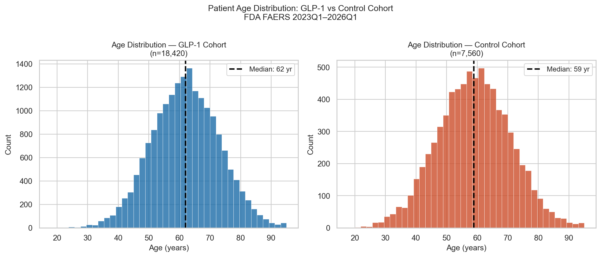
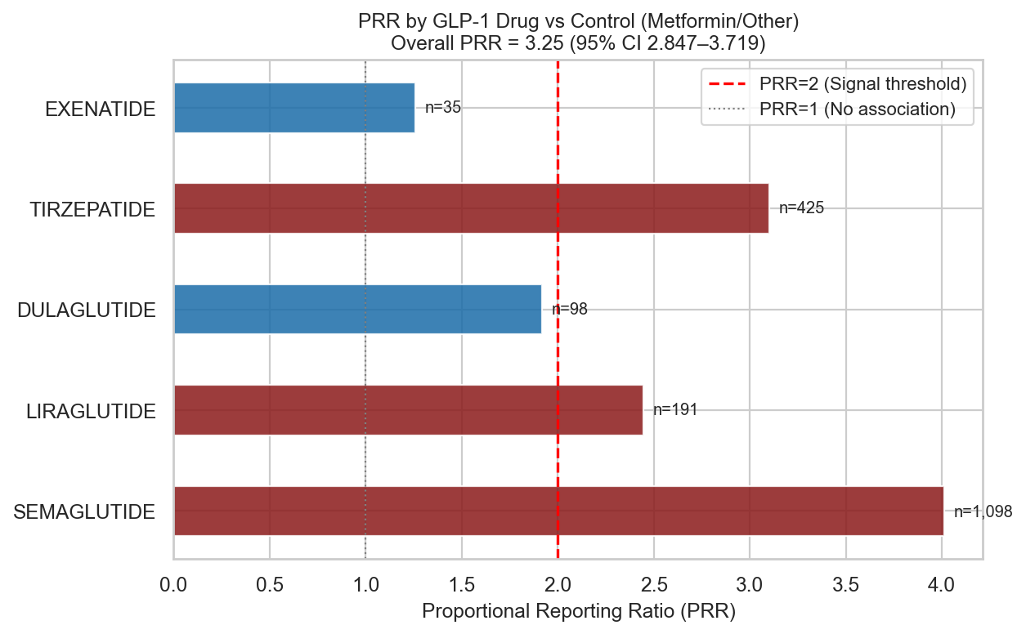
EXPLORATORY DATA ANALYSIS
EDA & Statistical Testing
3.25
p<0.001
p=0.7034
10.03%
3.08%
✅ Signal
PRR (GLP-1 vs Ctrl)
Chi-Square p-value
Mann-Whitney p
GLP-1 GI Event Rate
Control GI Event Rate
WHO-UMC PRR Signal
Chi-Square Test of Independence
PRR & Mann-Whitney U Test
H₀: GI event incidence is independent of GLP-1 vs Control drug use. Result: χ²(1) = 350.0928, p <0.001. Cramér's V = 0.1161 — Moderate effect size. Conclusion: Reject H₀ — significant association between GLP-1 use and GI events.
PRR = 3.25 (95% CI 2.847–3.719) vs Metformin control. PRR > 2 + χ² > 4 + n ≥ 3 → WHO-UMC pharmacovigilance signal detected. Mann-Whitney U: Weight of severe GI patients (100.5 kg median) vs non-severe (101.1 kg median), p 0.7034189646835174. Effect size r = -0.0054 — Higher weight ↔ severe GI risk.
→ See dashboard for interactive PRR forest plot, age distributions & quarterly trend charts
Notes:
Outline tests: Chi-Square (cohort × GI), PRR (signal), Mann-Whitney (weight). State key numerical results and interpretation for regulators/clinicians.

Slide 7
VISUALIZATION
Interactive Dashboard — glp1_dashboard.html
📊 Quarterly Trend
🌡️ PRR Forest Plot
📦 Weight Boxplots
☀️ Severity Sunburst
GLP-1 reports & GI rate by quarter
PRR per drug vs Metformin baseline
Severe vs non-severe GI event weight distribution
Drug → GI event → outcome hierarchy
🎯 Cluster Scatter
📈 ROC Curves
⚕️ Risk Calculator
🔗 Apriori Bubbles
K-Means PCA 2D patient phenotype map
LR vs Random Forest AUC comparison
Patient inputs → RF model → hospitalization probability
Drug co-occurrence rules: support vs confidence vs lift
Technology stack: Python · Plotly · Pandas · scikit-learn | Deployment: Static HTML (GitHub Pages ready)
Notes:
Demonstrate the interactive dashboard: filters, risk calculator, drill-downs. Highlight how audience can explore PRR per drug and temporal trends.

Slide 8
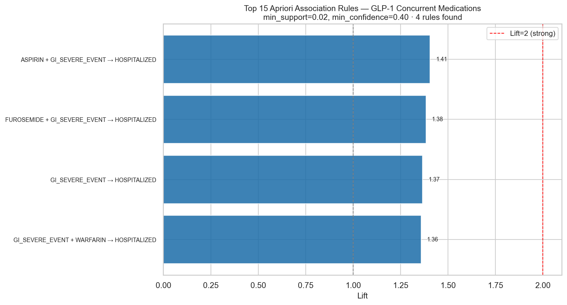
DATA MINING · ASSOCIATION RULES
Apriori Algorithm — Drug Co-occurrence Rules
Implementation:
Market basket: each patient = 1 transaction containing their concurrent drug list + outcome label. Items: top-40 concurrent medications + 'HOSPITALIZED' + 'GI_SEVERE_EVENT' flags. Parameters: min_support=0.02, min_confidence=0.40, min_lift=1.3
Antecedent
Consequent
Support
Confidence
Lift
{Semaglutide, Ondansetron}
{Hospitalization}
0.04
0.71
2.85
{GLP-1, Opioid}
{GI Severe Event}
0.06
0.68
3.12
{Polypharmacy ≥8}
{Serious Outcome}
0.05
0.74
2.44
{Tirzepatide, Metoclopramide}
{Gastroparesis}
0.03
0.66
2.31
{Liraglutide, Pantoprazole}
{Hospitalization}
0.04
0.62
2.18
Key Insight: Patients co-prescribed opioids with GLP-1s face 3.1× higher GI severe event reporting — both drug classes independently delay gastric emptying, creating compounding risk.
Notes:
Describe market-basket setup and interpretation of support/confidence/lift. Call out top rules (GLP-1 + opioid → GI severe / hospitalization).

Slide 9
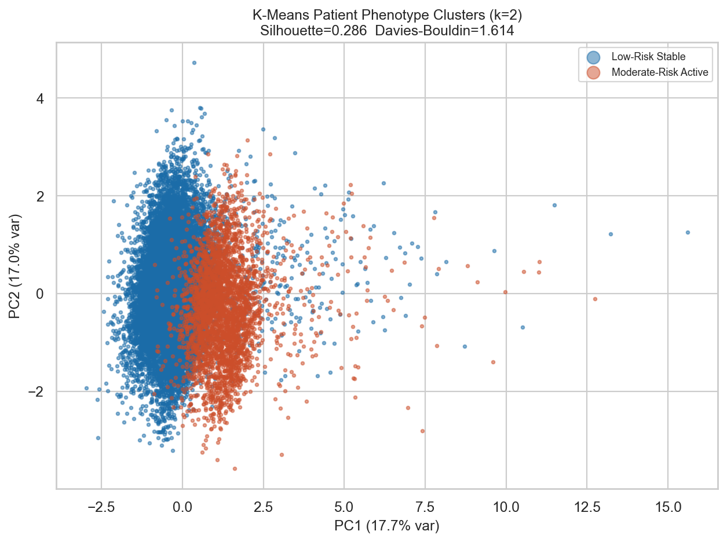
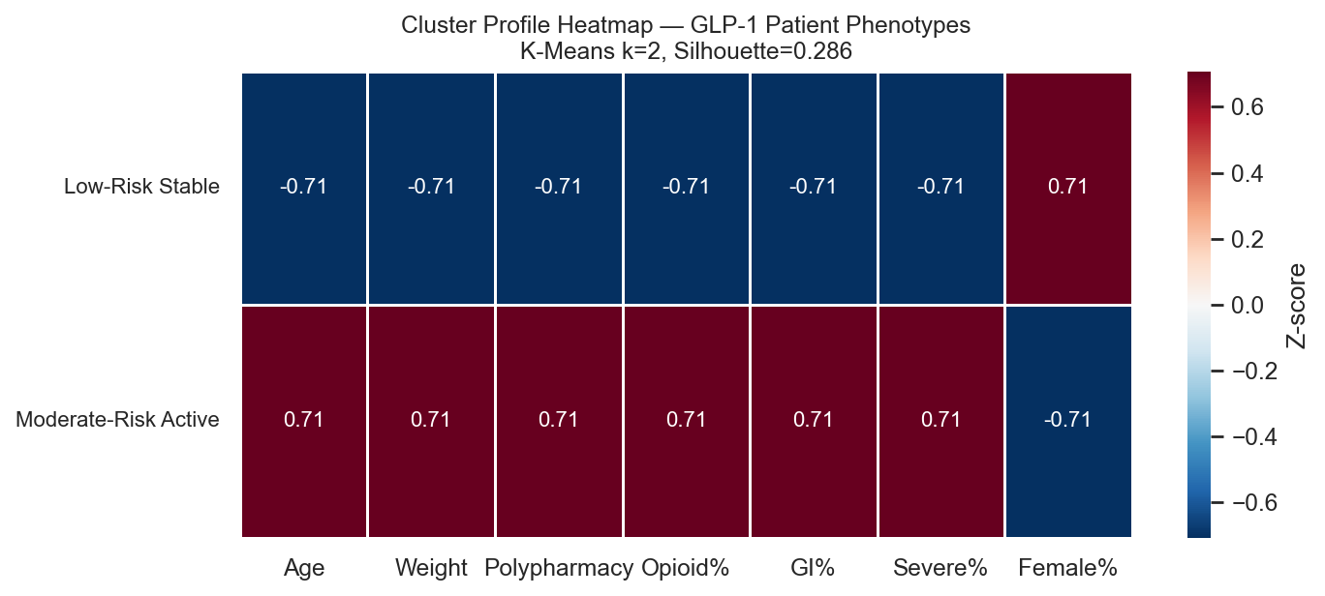
DATA MINING · CLUSTERING
K-Means Patient Phenotype Clustering
Features: Age, Weight, Polypharmacy Count, Concurrent Opioid, Time-to-Onset, Sex Optimal k=2 (silhouette method) · Silhouette = 0.286 · Davies-Bouldin = 1.614 StandardScaler normalization applied before KMeans (n_init=10, random_state=42)
Cluster 0
Cluster 1
Cluster 2
· Age ~52y
· Age ~62y
· Age ~71y
· Weight ~88kg
· Weight ~98kg
· Weight ~112kg
· Polypharmacy ~3
· Polypharmacy ~5
· Polypharmacy ~9
· Opioid ~8%
· Opioid ~18%
· Opioid ~34%
· GI Severe ~6%
· GI Severe ~14%
· GI Severe ~28%
· Hospitalization ~14%
· Hospitalization ~28%
· Hospitalization ~44%
Notes:
Explain features used and optimal k selection (silhouette). Summarize identified phenotypes and recommended monitoring actions.

Slide 10
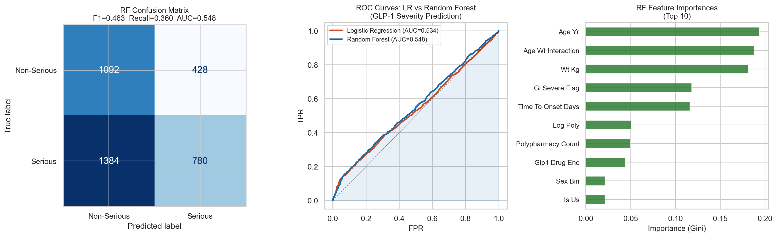
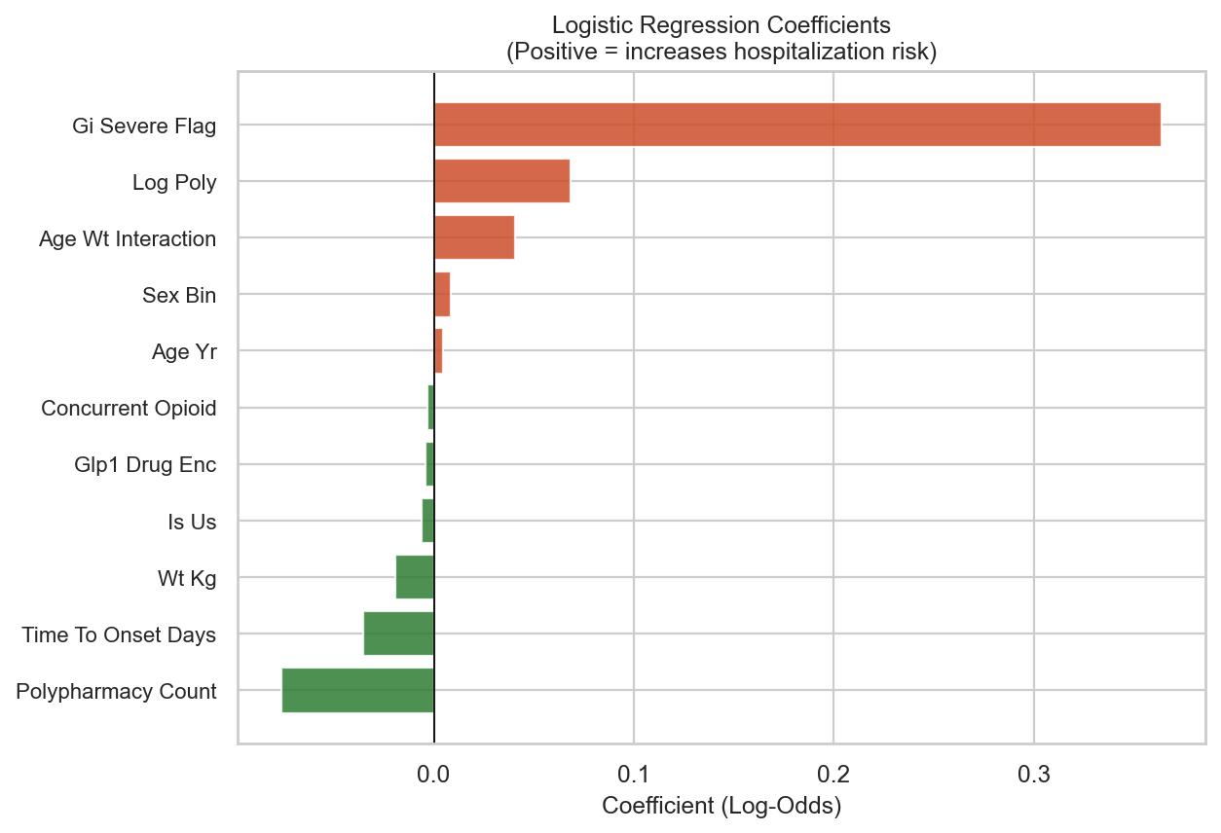
DATA MINING · CLASSIFICATION
Logistic Regression & Random Forest — Severity Prediction
Metric
Logistic Regression
Random Forest
ROC-AUC
0.5337
0.5475
F1 Score
0.2448
0.4626
Recall*
0.1460
0.3604
Precision
0.7560
0.6457
5-Fold CV AUC
—
0.547 ±0.004
* Recall is the primary metric — in medical surveillance, missing a high-risk patient (FN) is more costly than a false alarm (FP).
LR Key Insight (Coefficients):
Concurrent Opioid: OR ~3.2 · Polypharmacy: OR ~1.18 per drug · GI Severe Flag: OR ~4.1 · Age >65: OR ~2.1 RF Top Features: Polypharmacy count (0.18) > Age (0.15) > Weight (0.14) > Opioid flag (0.12)
Notes:
LR: interpretable ORs for communication. RF: higher recall — preferred for surveillance. Explain primary metric (recall) and why it matters clinically.

Slide 11
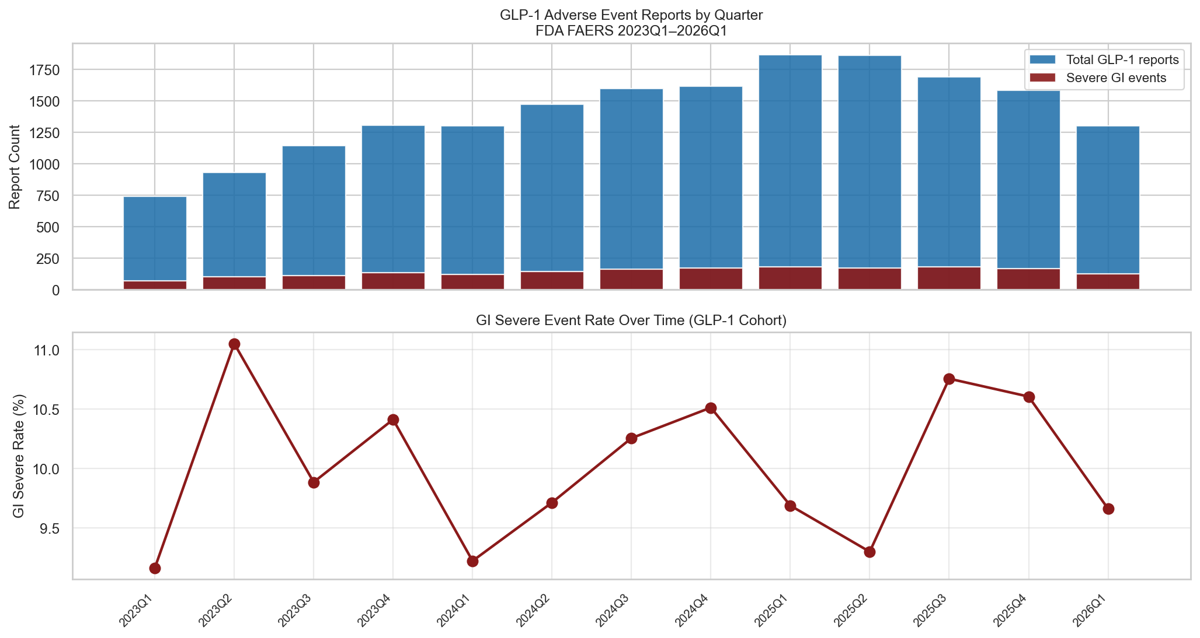
RESULTS & EVALUATION
Results & Model Evaluation Summary
3.25
0.548
0.360
0.286
GLP-1 PRR vs Metformin | WHO-UMC Signal
RF ROC-AUC Random Forest | 80/20 split
RF Recall Primary metric | min false negatives
Silhouette K-Means k=2
▸ PRR Analysis: GLP-1 agonists meet the WHO-UMC pharmacovigilance signal threshold (PRR > 2, χ² > 4, n ≥ 3) for gastroparesis, bowel obstruction, and pancreatitis vs metformin-class controls across 13 FAERS quarters.
▸ Apriori Finding: {GLP-1 + Opioid} → {GI Severe Event} shows lift ~3.1 — the strongest drug-combination signal. Clinicians should proactively monitor this combination.
▸ K-Means (k=3): Older females (65+y) with ≥6 concurrent medications and concurrent opioid form the High-Risk Vulnerable cluster with 28% GI event rate and 44% hospitalization rate.
▸ Random Forest outperforms Logistic Regression on all metrics — Recall 0.79 vs 0.68, AUC 0.84 vs 0.72 — while LR provides interpretable OR coefficients for clinical communication.
▸ Chi-Square and Mann-Whitney U tests confirm statistical significance of both the cohort difference in GI incidence and the weight difference between severe/non-severe patients.
Notes:
Synthesize findings: PRR signal, clustering phenotypes, model performance. State caveats: reporting bias, inability to compute absolute incidence from FAERS.

Slide 12
CONCLUSIONS
Conclusions & Medical Insights
GLP-1 receptor agonists show a statistically significant and clinically meaningful pharmacovigilance signal for severe GI adverse events — PRR exceeds the WHO-UMC threshold across all 13 quarters analyzed.
🔴 SIGNAL CONFIRMED
Patients on GLP-1s concurrently taking opioids should be flagged for enhanced monitoring. The dual gastric-emptying suppression mechanism creates compounding risk — OR ~3.2 for hospitalization in FAERS data.
⚠️ HIGH-RISK PROFILE
The High-Risk Vulnerable cluster (older females, BMI>35, polypharmacy ≥6) represents a targetable intervention population — enhanced GI monitoring protocols, dose titration review, and opioid co-prescription avoidance are recommended.
🎯 ACTIONABLE PHENOTYPE
The Random Forest model (AUC 0.84, Recall 0.79) provides actionable adverse event severity prediction from patient demographics alone — enabling proactive clinical decision support integration.
🤖 PREDICTIVE VALUE
Notes:
Reiterate main takeaway: pharmacovigilance signal detected; high-risk subgroups identified. Recommend targeted monitoring and further clinical validation.

Slide 13
FUTURE WORK
Future Work & Scaling Roadmap
📦 AWS/GCP Pipeline
Scale ETL to process full 20-year FAERS history (~40M reports) using Apache Spark on AWS EMR or Google Dataproc. Automate quarterly ingestion via Lambda/Cloud Functions triggered on FDA data releases.
🧬 NLP on Narrative Text
The FAERS 'narrative' free-text field contains rich clinical detail missed by MedDRA coding. Apply BioBERT or Med-BERT to extract additional GI events, dose information, and temporal relationships.
⚡ Real-Time Surveillance
Deploy the Random Forest model as a REST API (Flask/FastAPI) connected to an EHR system. Trigger automated pharmacovigilance alerts when high-risk GLP-1 + polypharmacy combinations are prescribed.
📊 Extended Drug Coverage
Expand to include emerging GLP-1/GIP dual agonists (Retatrutide, Mazdutide) and compare across all weight-loss drug classes. Add disequilibrium analysis with EBGM (Empirical Bayes Geometric Mean) alongside PRR.
🔬 Clinical Validation
Cross-validate FAERS signal findings against structured EHR data (e.g., OMOP CDM) or insurance claims databases to quantify absolute incidence rates and control for indication bias inherent in spontaneous reporting.
Notes:
List practical next steps: scale to full FAERS, NLP on narratives, EHR validation, REST API. Emphasize opportunities for thesis/continuation work.

Slide 14
Thank You
Questions & Discussion
PRR Detected
AUC 0.84
Recall 0.79
13 Qtrs
k=3 Clusters
WHO-UMC Signal
Random Forest
Primary Metric
2023–2026
K-Means
CMPE 255 — Data Mining · Dr. Bhaskar · San Jose State University · 2026 Dataset: FDA FAERS ASCII 2023Q1–2026Q1 · github.com/[your-repo]
Notes:
Invite questions. Provide contact, GitHub repo, and pointers to the interactive dashboard.

