Slide 1

Smart Irrigation
System
Class Project
Environmental Impact Analysis
Group Members:
Arshan Khan • Anurag Sharma • Gaurav Rawat • Sahil Bora • Jay Manral

Slide 2

The Problem: Water Crisis in Agriculture
70%
60%
40%
of freshwater used
in agriculture
water wasted by
traditional methods
of India's agriculture
rain-dependent
Key Issues:
Manual watering leads to over/under irrigation — crop losses increase
Flood irrigation wastes up to 50% more water than needed
Farmers lack real-time soil moisture data — guesswork is the norm
Groundwater depletion is accelerating due to inefficient irrigation
Climate change makes rainfall unpredictable — smart systems needed urgently

Slide 3






Why Smart Irrigation?
Water Savings
Better Crop Health
Cost Efficient
Reduces water usage by 30–50% using soil moisture sensing
Plants get water only when needed — prevents root rot & wilting
Reduces electricity & water bills for farmers in the long run
Automated Control
Saves Groundwater
Eco-Friendly
No manual effort — pump runs only when soil is dry
Prevents over-extraction of underground water sources
Reduces agricultural carbon footprint & water runoff pollution

Slide 4
System Overview: How It Works
Soil Moisture
Sensor (YL-69)
Arduino
Uno
Relay
Module
Water
Pump (5V)
Reads soil wetness
Processes data
Switches pump
Irrigates crop
How the Logic Works:
IF soil moisture < threshold (dry soil)
  → Arduino sends signal to relay → Relay turns ON pump → Water flows to crop
IF soil moisture ≥ threshold (wet soil)
→ Arduino sends OFF signal → Relay turns OFF pump → No water wasted

Slide 5

Components Required
# | Component | Qty | Role
1 | Arduino Uno | 1 | Brain of the system — reads sensor & controls relay
2 | Soil Moisture Sensor (YL-69) | 1 | Detects soil wetness — analog & digital output
3 | 5V Relay Module | 1 | Acts as a switch to turn the pump ON/OFF
4 | Mini Water Pump (5V DC) | 1 | Pumps water from container to crop
5 | Plastic Pipe / Tube | 1m | Carries water from pump to plant
6 | 9V Battery + Connector | 1 | Power supply for Arduino
7 | Jumper Wires | 20+ | For all circuit connections
8 | Breadboard | 1 | For prototyping without soldering
9 | Small Water Container | 1 | Acts as water reservoir (bucket/bottle)

Slide 6
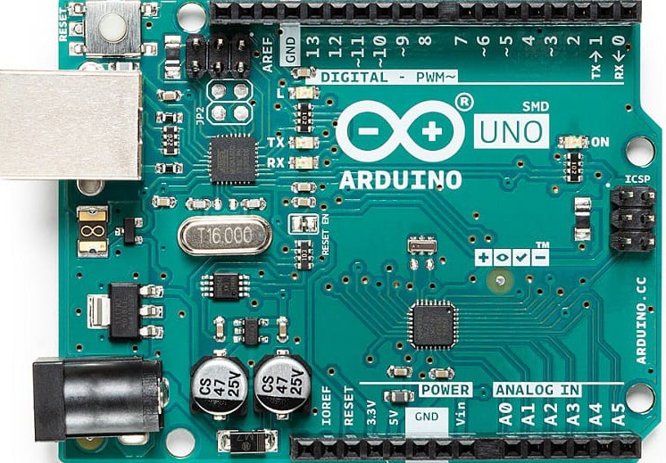
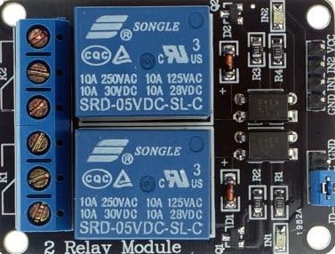
1. Connect Soil Sensor output to Arduino A0 pin
2. Connect Relay module IN to Arduino D8 pin
3. Connect Relay COM to battery (+) and NO to pump
4. Place soil sensor probes in soil near plant roots
5. Place pump in water container
6. Connect pipe from pump outlet to plant
7. Power Arduino with 9V battery
8. Upload code and test dry/wet conditions
Circuit Connections
Arduino Uno
Assembly Steps
A0 (Analog In) → Sensor AOUT
D7 (Digital In) → Sensor DOUT
5V → Sensor VCC + Relay VCC
GND → Sensor GND + Relay GND
D8 (Digital Out) → Relay IN
Relay NO/COM → Pump (+) wire

Slide 7
Arduino Code (Simple & Explained)
int sensorPin = A0;
int pumpPin = 8;
int threshold = 500;
void setup() {
Serial.begin(9600);
pinMode(pumpPin, OUTPUT);
}
void loop() {
int val = analogRead(sensorPin);
Serial.println(val);
if (val < threshold) {
// Soil dry - pump ON
digitalWrite(pumpPin, HIGH);
} else {
// Soil wet - pump OFF
digitalWrite(pumpPin, LOW);
}
delay(1000);
}
Code Explanation
sensorPin
Reads soil moisture value (0–1023)
pumpPin
Controls relay for pump ON/OFF
threshold
500 = moisture cutoff point (adjust for soil type)
analogRead()
Gets current soil moisture value
if (val<500)
Soil is too dry → turn pump ON
else
Soil is moist enough → pump stays OFF
delay(1000)
Checks every 1 second

Slide 8
Real-Life Implementation
1
Phase 1: Prototype (This Project)
1 plant pot, Arduino + sensor + pump. Test indoor or in school lab.
Phase 2: Small Farm Scale
2
Multiple sensors, a larger pump & pipes for a kitchen garden or small farm.
3
Phase 3: Full Field Deployment
Solar-powered, multiple zones, WiFi monitoring via mobile app (IoT).
📌 Our project is Phase 1 — a working proof-of-concept that demonstrates the core logic. It can be scaled with minimal changes!

Slide 9
Environmental Impact Analysis
✅ Positive Impacts
⚠️ Challenges / Limitations
Reduces freshwater consumption by 30–50%
Prevents over-irrigation → less waterlogging & soil erosion
Lowers energy use compared to flood irrigation
Improves soil health over time
Reduces chemical runoff from over-watered soils
Supports sustainable farming practices
E-waste if sensors not recycled properly
Initial electronic waste from failed prototypes
Battery disposal needs responsible handling
Not solar-powered at this stage
Sensor accuracy may vary in different soils
Mitigation:
Use rechargeable batteries → add solar panel in Phase 2 → recycle old sensors at e-waste centers

Slide 10
Traditional vs Smart Irrigation
Feature | Traditional Irrigation | Smart Irrigation (Ours)
Water Usage | Very High (flood/manual) | Optimized (sensor-based)
Automation | Manual labor required | Fully automated
Cost (Long-term) | High water & energy bills | Significantly lower
Crop Health | Risk of over/under watering | Consistent moisture
Monitoring | No monitoring | Real-time data via Serial
Scalability | Difficult to expand | Easy to scale up
Eco Impact | High water waste, runoff | Reduced waste, eco-friendly

Slide 11

Complete Bill Breakdown (Budget: ₹1000)
S.No | Item | Source | Qty | Cost (₹) | Note
1 | Arduino Uno (Clone) | Amazon / Local Shop | 1 | ₹280 | Branded = ₹550; Clone works fine
2 | Soil Moisture Sensor (YL-69) | Amazon / Robu.in | 1 | ₹50 | Includes comparator module
3 | 5V Single Channel Relay Module | Amazon / Robu.in | 1 | ₹45 | Controls pump ON/OFF
4 | Mini Submersible DC Pump (5V) | Amazon / Local | 1 | ₹85 | Can also use 3V–6V pump
5 | Jumper Wires (M-M & M-F set) | Amazon / Robu.in | 20 pcs | ₹60 | Needed for all connections
6 | Breadboard (Mini/Half size) | Amazon / Local | 1 | ₹45 | No soldering needed
7 | 9V Battery + Snap Connector | Any hardware shop | 1 | ₹30 | Powers Arduino
8 | Plastic Pipe / Silicone Tube (1m) | Local hardware store | 1m | ₹30 | Carries water to plant
9 | Small Plastic Container (1L) | Home / Market | 1 | Free | Water reservoir (can reuse)
10 | USB Cable (for programming) | Already available | 1 | Free | Use existing cable
 | TOTAL |  |  | ₹625

Slide 12

Conclusion
1
Smart irrigation is the need of the hour for sustainable farming
2
Our system costs only ₹625 — accessible for every student & farmer
3
Simple components + Arduino logic = powerful automated solution
4
Reduces water waste by up to 50% — huge environmental benefit
5
Scalable from a school project to real farm deployment
6
Addresses water scarcity — one of India's biggest challenges
Thank You! | Group: Arshan • Anurag • Gaurav • Sahil • Jay

