Slide 1
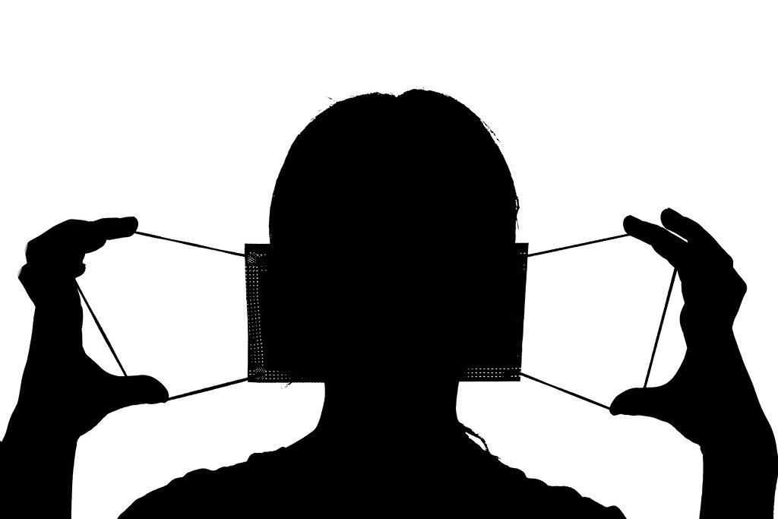
REAL TIME FACE MASK
DETECTION

Slide 2
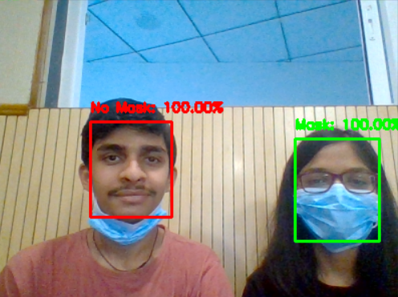
BY :-
Sarvagya Kanungo (200005040)
Anushka Nile (200001006)

Slide 3
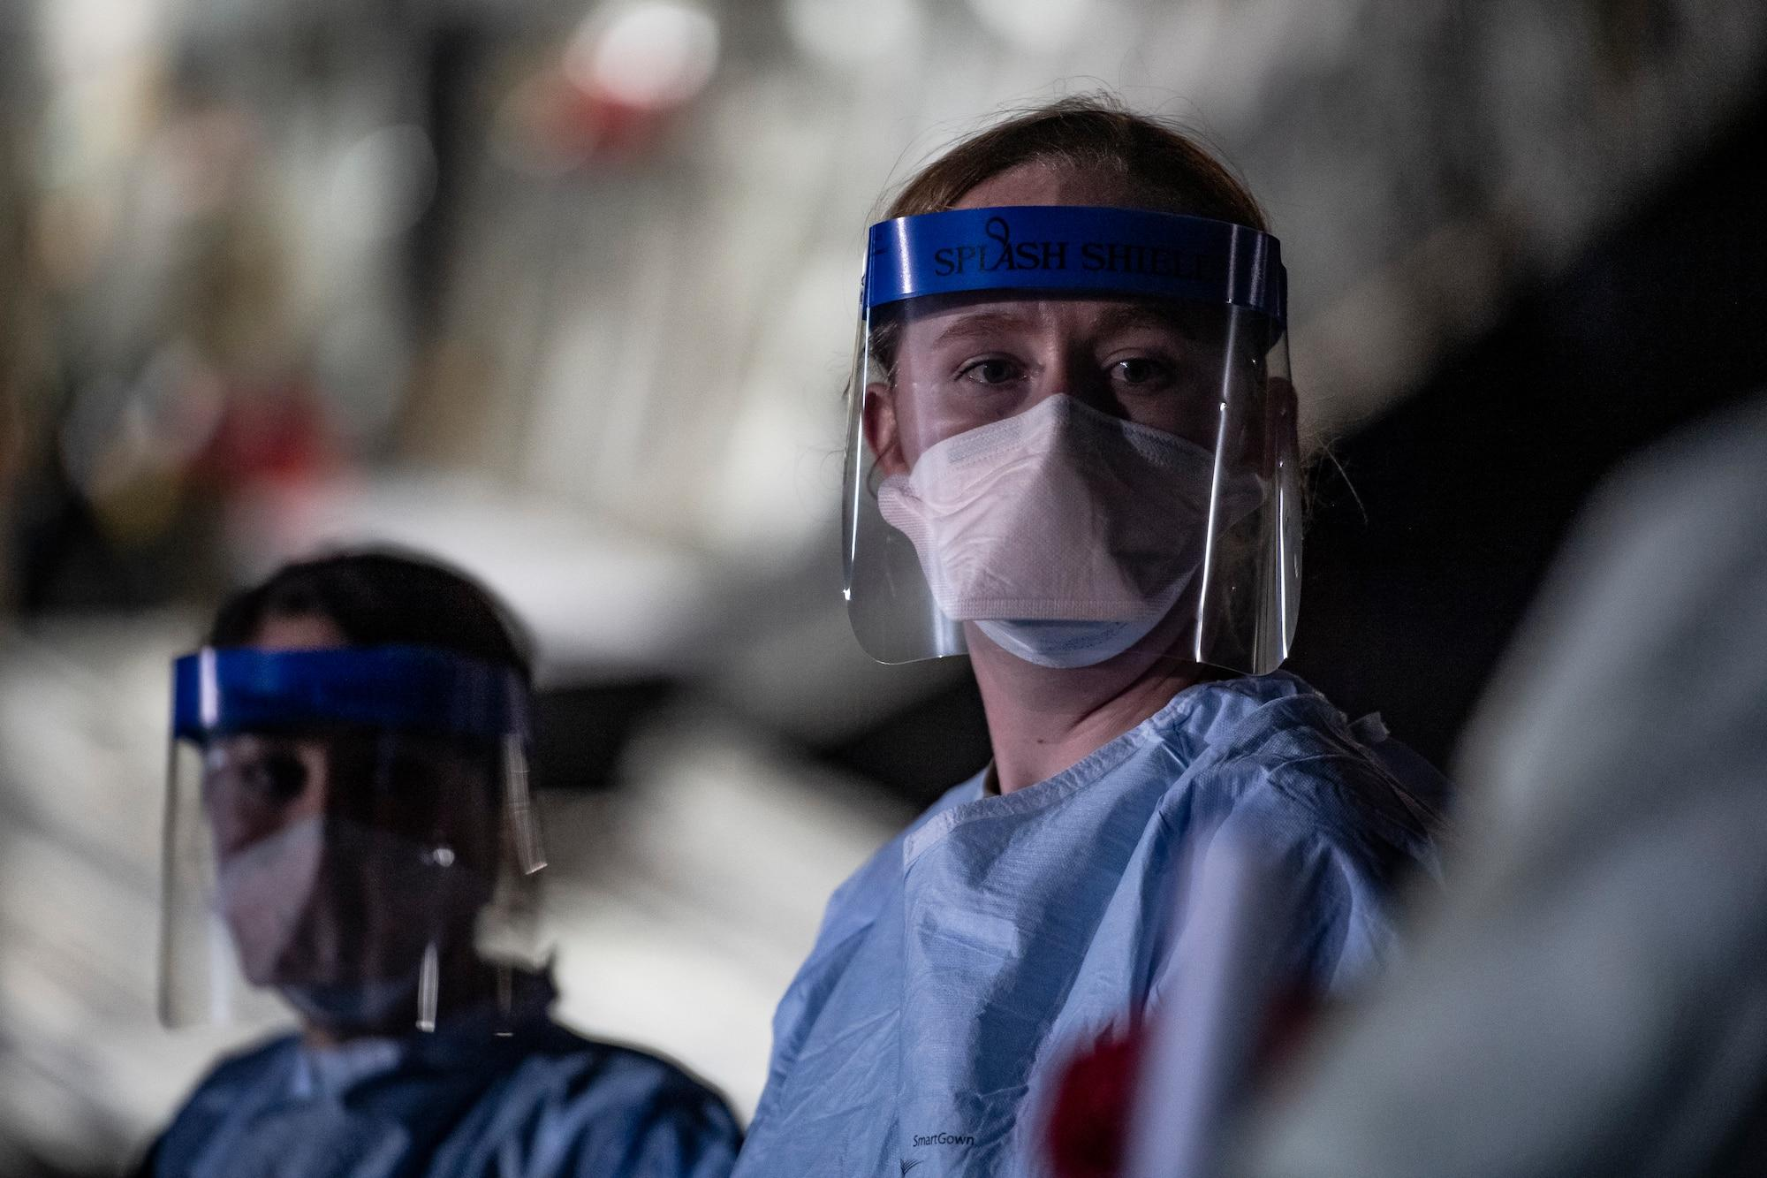
INTRODUCTION
In this post pandemic world, Wearing face mask has become an essential aspect of our daily lives. However, enforcing the proper use of mask in public spaces has been challenging. Our solution here uses computer vision techniques to detect if a person is wearing a mask in real time.

Slide 4
PROBLEM STATEMENT
The main objective of the face mask detection problem is to accurately detect whether a person is wearing a face mask or not. It should provide alerts or notifications when a person is detected not wearing a face mask regardless the lighting conditions around the person or the type of face mask, he/she is wearing.

Slide 5
DATA SET
●We used Face-mask-detection-4k-images dataset for training and testing.
●It is a standard dataset which includes 4,000 images.
●It is equally divided into ‘Mask’ and ‘No Mask’ categories.
●The images are of various sizes, the faces are real as well as animated and the pictures are taken at different angles.

Slide 6
DATA PREPROCESSING
● Resizing the images to 224x224 pixels.
● Conversion to array format.
● Scaling the pixel intensities in the input image to the range [-1, 1].

Slide 7
ONE HOT ENCODING
● Our data is mainly divided in two classes With_Mask and Without_Mask .
● Label Binarization is used to convert the categorical data into binary vectors with each class represented as a binary vector.
● Fit_Transform function fits the label binarizer to the labels and then transforms the labels into binary form.
● the to_categorical function is used to convert the binary vectors into one-hot encoded labels.
● In one hot encoded matrix there is only 1 non-zero value in each row representing
Class or label that it belongs to.
Example : 01 for masked / 10 for unmasked

Slide 8
WHY ONE HOT ENCODING
● In our problem we have to categorize our data into two classes (masked , unmasked)
● Label Encoding is generally used for ordinal data, where there is a natural ordering of the classes and ranks categories in order which is not the case here. We have nominal data here.
● Count Encoding replaces each category with its count in data that is not the case here.

Slide 9
DATA AUGMENTATION
● Used to artificially expand the training dataset.
● By Applying :- Rotation, Zoom-in, Zoom-out, Horizontal/Vertical shift, Flipping Images, Nearest Fill (used to fill the pixels lost during augmentation)

Slide 10
MODEL
● MobileNetV2 network is used and we add our own custom Fully Connected layer to it for perform binary classification on our dataset (masked and unmasked).
● MobileNetV2 is a lightweight architecture that is highly efficient in terms of memory usage and computational speed, making it well-suited for real-time applications and allows us to achieve high accuracy with minimal computational resources.

Slide 11
● YOLO is primarily designed for object detection tasks in complex scenes, YOLO is a heavier and more complex model compared to MobileNetV2, and it requires more computational resources and training time.
● DenseNet is a good model architecture for many computer vision tasks, it may not be the best choice for real-time face mask detection due to its computational complexity and large number of parameters as compared to MobileNetV2.
● We Design the head of the model that is to be placed on the top of the base model.

Slide 12
●Average pooling Layer :
This results in a smaller feature map that preserves the important information from the original image and helps in reducing computational complexity. We have used pool size 7x7 pixels.
● Flatten Layer :
Transforms the 2D feature maps generated by Average pooling layer into a 1D feature vector. This is necessary because the fully connected (Dense) layer requires a 1D input.

Slide 13
● Dense layer :
Dense layer 128 units and a ReLU activation function. This is a fully connected layer that performs a linear transformation on the input and applies the ReLU activation function element-wise.
● Dropout layer :
A dropout layer with dropout rate of 0.5 is used , which randomly sets 50% of the layer's outputs to zero during training. This is a regularization technique that helps prevent overfitting by forcing the network to learn more robust features.

Slide 14
● Final Dense layer :
Dense layer with 2 units (We have 2 classes) and a softmax activation function. This is the output layer of the model, which produces a probability distribution over the two classes (masked and unmasked ) based on the input image. The softmax activation ensures that the output values sum up to 1, allowing us to interpret them as probabilities and take the class with a higher probability as the final prediction.

Slide 15
ADAM Optimizer
Adam optimizer can adapt the learning rate for each parameter of the model based on the past gradient values and it also uses the moving average of the gradient instead of the gradient itself. This helps to achieve faster convergence and better accuracy, especially when dealing with large datasets or complex models.

Slide 16
Adaptive Gradient algo adapts the learning rate for each parameter based on the historical gradient information, it scales the learning rate based on the sum of the squares of the historical gradients for each parameter. learning rate keeps decreasing as training progresses, which can lead to slow convergence and squared gradients make algo inefficient.
RMSprop tries to solve this by using an exponentially weighted moving average of the squared gradients to scale the learning rate.

Slide 17
ADAM combines the benefits of two other extensions of stochastic gradient descent (SGD), namely, Adaptive Gradient Algorithm (AdaGrad) and Root Mean Square Propagation (RMSProp). it computes adaptive learning rates for each parameter and stores exponentially decaying average of past gradients and squared gradients.

Slide 18
TRAINING AND TESTING
The model is trained on the head of the network using the fit() method of the model. The model is evaluated on the testing data using the predict() method and the classification report is printed to show the performance of the model.
The fit method trains the model using backpropagation to minimize the loss between the predicted output of the model and the actual output and evaluates its performance on the validation data after each epoch

Slide 19
The predict method returns an array of predicted probabilities for each input in the testing dataset.
Accuracy is set as the evaluation metric to be used during training and testing.
Binary cross-entropy loss function calculates the difference between the predicted probabilities and the true labels, and minimizes this difference during training.

Slide 20
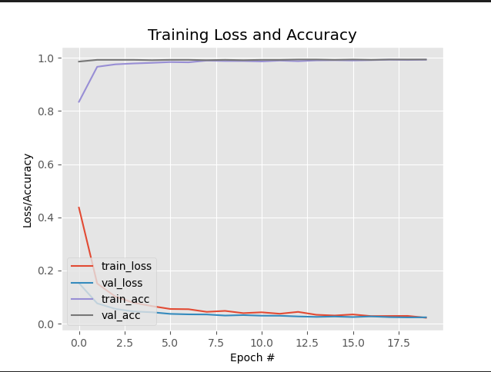
TRAINING LOSS AND ACCURACY

Slide 21
Detection and Prediction
Our Function take an input frame, a face detection network and a face mask detection network and returns a list of face locations and their corresponding predictions of wearing a mask.

Slide 22
BOUNDING BOXES AND LABELS
For each frame, we call our function to detect the face locations and mask predictions and then draws bounding boxes and labels on the frame based on the predictions.
Finally it displays the output frame in a window.

Slide 23
Social Distancing
An Interesting add-on to our project

Slide 24
THANK YOU

