Slide 1
IR based home automation system with password
Name :- Anushuya Patra
Course :- Robotics

Slide 2
Content :
SL. No. | Topic | Slide no.
1 | Problem Statement | 3
2 | Description | 4
3 | Material Requirement | 5
4 | Material Description | 6-11
5 | Module Description | 12-17
6 | Logic diagram | 18
7 | Logic definition | 19-20
8 | Test circuits | 21-26
9 | Error detection | 27-28
10 | Final project | 29-32
11 | Observation | 33

Slide 3
Problem Statement :-
Build an i2c based IR remote system using a relay, PIR sensor, and buzzer. The microcontroller will take input from IR remote and send it to another microcontroller according to its value PIR sensor and buzzer will work also use a relay.

Slide 4
Description :
In my project is used as a locking password in front of any room. Through IR remote we need to press password if the password is correct then it checks that person is in front of the room if a person gives the correct password and he/she is in front of the room the light is got automatically turned on in the room. If her/his password is wrong or that person is not in front of the room but tries to put the password, then one alarming sound rings. When once the light is on its means you are already entered into the room so the light is turned on if u need to turn off the light then press the power switch(red switch on top). That can repeat infinite times.

Slide 5
Material Requirement:
1. Arduino UNO (2)
2. IR remote and IR sensor
3. Buzzer (Piezo)
4. PIR sensor
5. Relay SPDT
6. Power Supply
7. Bulb

Slide 6


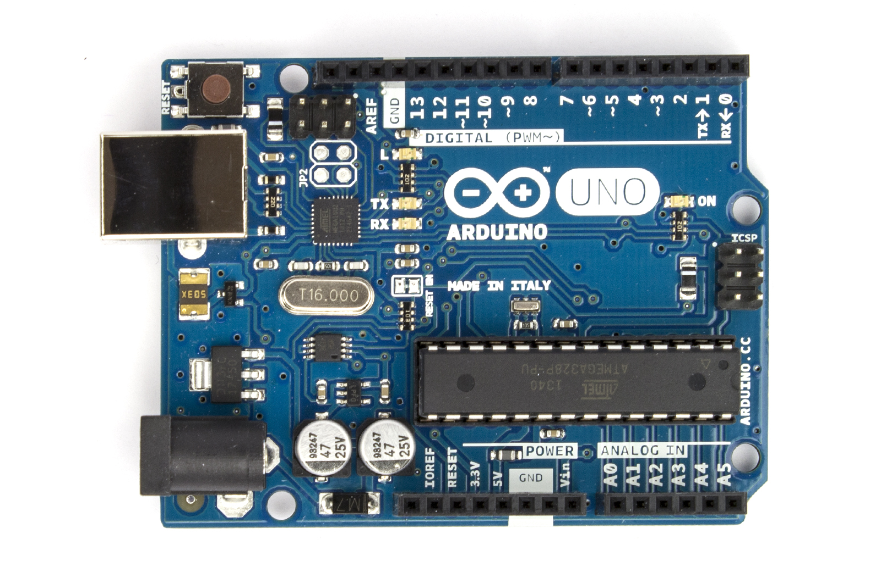
Arduino uno:
Arduino Uno is a microcontroller board based on the ATmega328P . It has 14 digital input/output pins (of which 6 can be used as PWM outputs), 6 analog inputs, a 16 MHz quartz crystal, a USB connection, a power jack, an ICSP header and a reset button. It contains everything needed to support the microcontroller ,simply connect it to a computer with a USB cable or power it with an AC-to-DC adapter or battery to get started.
It is best choice for beginner's.

Slide 7
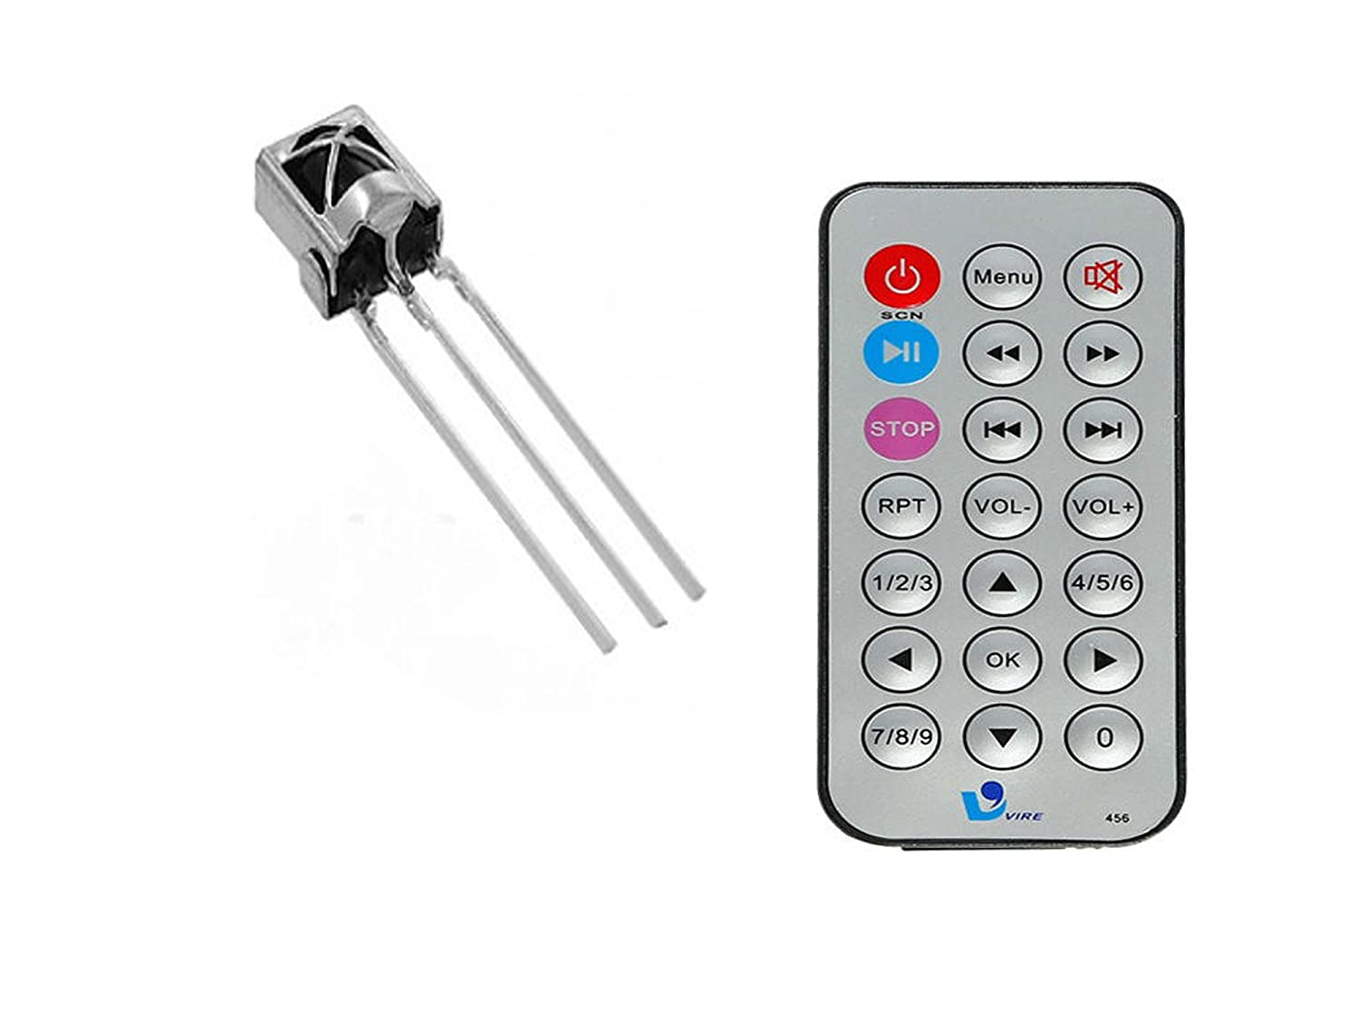
Ir remote and ir sensor :
Infrared (IR) communication is a widely used and easy to implement wireless technology that has many useful applications. The most prominent examples in day-to-day life are TV/video remote controls, motion sensors, and infrared thermometers.
Ir sensor has 3 pins one is connected to ground(middle one), another is for power(left one) and last one is for input/output pins(right one ).

Slide 8
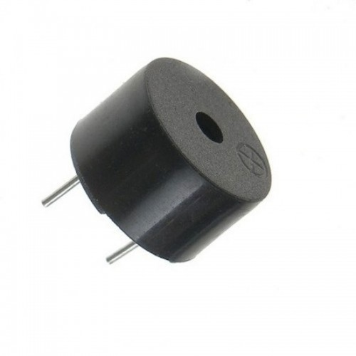
Buzzer (Piezo)
A piezo buzzer is a type of electronic device that's used to produce a tone, alarm or sound .
It has 2 pins . One is connected to ground, and another is connected to any digital pin in the Arduino UNO board.
We can make any melodious music by tone() function with their nots.

Slide 9
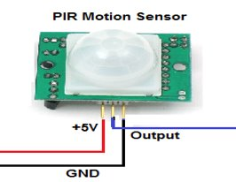
PIR SENSOR
A passive infrared sensor (PIR sensor) is an electronic sensor that measures infrared (IR) light radiating from objects in its field of view. They are most often used in PIR-based motion detectors. PIR sensors are commonly used in security alarms and automatic lighting applications.
​ Here in this picture we see that it has 3 pins.
Already mentioned in picture that one is connected to ground pin, another is connected with power of +5V and another is digital pin use for input.

Slide 10
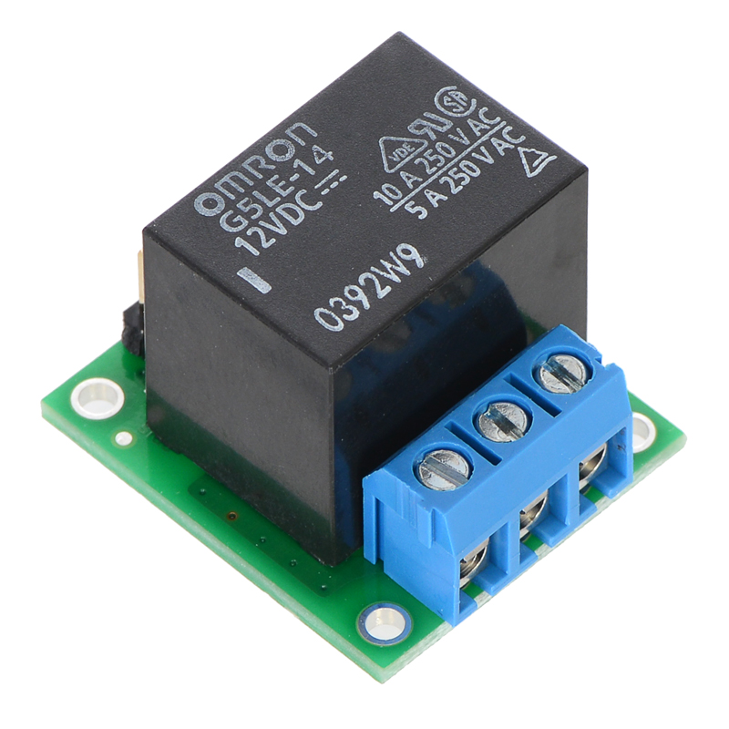
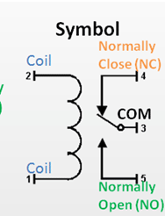
Relay:
Relays are used to provide time delay functions. They are used to time the delay open and delay close of contacts. Relays are used to control high voltage circuits with the help of low voltage signals.
It has 5pins but in our project we use only 4 pins.
1. Connected to ground(Terminal 8).
2. Connected to bulb(Terminal 7).
3. Connected to power Supply(Terminal 1).
4. Connected to digital pin(Terminal 5).

Slide 11
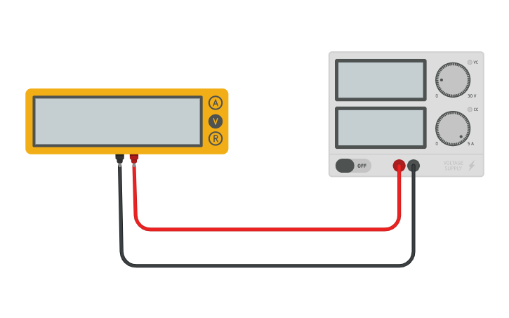

POWER SUPPLY
It has two pins one is connected to relay and another is with bulb.
BULB​
It has two pins one is connected to power supply and another is with relay.

Slide 12
Module description:
I divide my project into three paths
1. Made circuit in Arduino uno 1
2. Made Circuit in Arduino uno 2
3. Connect Arduino uno 1 and 2

Slide 13
1. ARDUINO UNO 1:
Arduino IR remote Library is used in the project to make and check passwords from the data received from the transmitter. IRremote library can transmit and receive infrared signals. For this project, we are only going to receive the signal transmitted by an infrared source. For operate IR sensor we need to use
#include <IRremote.h> - It include all library function which are use for run IR sensor.
IRrecv irrecv(RECV_PIN) - Specifying the pin that is connected to receiver module output.
“irrecv. enableIRIn” is a call to a function (also called a method) in the IRrecv class called “enableIRIn” which probably enables the IR input to be detected. It is used in setup function.
decode_results is Class Reference this is defiend in IRremote.h . Results returned from the decoder.
The irrecv.blink13(true) function will blink the Arduino’s on board LED every time the receiver gets a signal from the remote control, which is useful for debugging.
irrecv.decode(&results) - by this function it results return one value that input by user.

Slide 14
2. Arduino UNO 2:
The passive infrared sensor does not radiate energy to space. It receives the infrared radiation from the human body to make an alarm. If the human infrared radiation is directly irradiated on the detector, it will, of course, cause a temperature change to output a signal.
Range of pir sensor is
Indoor passive infrared: Detection distances range from 25 cm to 20 m.
Indoor curtain type: The detection distance ranges from 25 cm to 20 m.
Outdoor passive infrared: The detection distance ranges from 10 meters to 150 meters.
Outdoor passive infrared curtain detector: distance from 10 meters to 150 meter.
In my project under this range output value is high and bulb will be glow. If that person is not in this range then buzzer will make noise and in serial monitor one information is printed for come closer.

Slide 15
3.Connect Arduino uno 1 and 2(i2c circuit):
The I2C Bus consists of two wires called the Serial Data (SDA) and the Serial Clock (SCL). Data is transmitted through the SDA line while the SCL line is used to synchronize the devices with the clock signal. Both these bus lines are open-drain drivers and hence you have to use pull-up resistors to keep them HIGH.
We use such a MASTER-SLAVE connection to decrease the work load on one Arduino, or to connect more sensors to project etc like in my project I used.
Connections :
These steps to connect two Arduino UNOs using I2C:
Connect digital pins 0 and 1 on one Arduino to the different pins on the different one like D0 with D1 and D1 with D0 on another Arduino. Rather than this we can also connect A4 and A5 with same pins on another Arduino.
The GND line has to be common for both Arduinos. Connect it with a jumper.

Slide 16
Connection with Digital serial pins(0 & 1) | Connection with Analog pins(A4 & A5)
For master : int x=0; void setup() { Serial.begin(9600); } void loop() { Serial.write(x);/// sends x } | For master : #include<Wire.h>// Include the required Wire library for I2C int x = 0; void setup() { Wire.begin(); // Start the I2C Bus as Master } void loop() { Wire.beginTransmission(9); // transmit to device Wire.write(x); // sends x Wire.endTransmission(); // stop transmitting }
For Slave : int v = Serial.read(); // read the value | For Slave : Wire.onReceive(receiveEvent);//in void setup() for join int x = Wire.read(); // read the value

Slide 17
Wire.available() : It is a function if we connect circuits by analog pins. By this function, we can detect that the transmitted value is fulfill our required bytes if not then we can store it as a char value.
In my project, I use digital pins for communication as I need to store all the input values and all the values should be stored for making a password.

Slide 18
Logic diagram/flow chart
Arduino 1
F
Arduino 2
Void loop
T
t>0
t=t-1
Start
i=i+1
F
T
i<n
F
ch=
password
F
t!=-1
Receive value from IR
Sending value
T
T
v!=-1
F
senor state
F
state
T
T – Condition true
F – Condition false
switch(v)
T
goto
v=
-1
T
t=3
n=password length
i=0
state=false
String ch
207
F
247
F
F
167
F
So on for other cases....
v=
255
T
T
T
T
ch=ch+'0'
ch=ch+'1'
ch=ch+'9'
break

Slide 19
Logic Description
Here I use t to check the number of times password entered by the person so it is restricted only for 3 times one person can try so I take t=3 and decreases its value by 1 after completing one loop. So I take it under a while loop.
Here I use i for taking input from the person till the person's password length becomes equal to the owner password length and store that string value in ch as a temporary password. Initially, the value of i is 0.
Here v is an integer value that stores the value received from another Arduino.
If any value doesn't send from the master, then I use the continue statement which directly goes to loop main statement.
In switch, I check the value of v with a key code of 0-9 store it in ch, and make a temporary password.
Now after password checking, if the password is correct then I take the sensor value in sensorstate if the value is high means the person is close to the sensor, then the light is on, and once the light is turned on state value is true.
Once the state value is true then the person can enter the room then that person can turn off the light by the power switch.
And once the light turn on I change ch to null and t=-1 and use the continue statement to go to the main loop
You can continue this for infinite times.

Slide 20
In my project through Arduino UNO 1 value is passed and sent to Arduino UNO 2 through communication digital pins (D0 & D1). I take the password as a string. At 1st password is already set by the admin. Any person can try a password only 3 times if a password is wrong then one alarm rings continuously till that person doesn't put the correct password. As we know the transmitted value is an int so for making a password I use a switch case for every int value that has a char value that is input in the temporary password string.
1st inner while loop I use to control void loop() function because we know that loop function is called multiple times with milliseconds. For control and continue loop I use the continue function (this function leaves the rest part and again goes to the starting point of the loop) so if any value is input from IR remote then the value of it is increased by one up to the length of password loop will continue. For checking, value is the input I use irrecv.blink13(true) function by this when we press any key on IR remote led will be a blink. If you want to turn of light then you have to press power (red switch) switch in ir remote and light turn off.

Slide 21
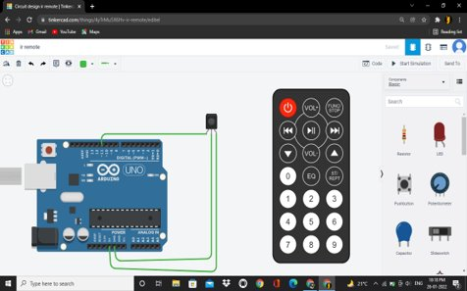
Test:
1st test circuit :

Slide 22
Code:
void loop() {
if (irrecv.decode(&results)) {
unsigned int value = results.value;
Serial.println(value);
switch (value) {
case 12495:
Serial.println('0'); break;
case 2295:
Serial.println('1'); break;
case 34935:
Serial.println('2'); break;
case 18615:
Serial.println('3'); break;
case 10455:
Serial.println('4'); break;
case 43095:
Serial.println('5'); break;
case 26775:
Serial.println('6'); break;
case 6375:
Serial.println('7'); break;
case 39015:
Serial.println('8'); break;
case 22695:
Serial.println('9'); break;
}
irrecv.resume(); // Receive the next value
}
}
#include <IRremote.h>
#include<string.h>
int RECV_PIN = 11;
IRrecv irrecv(RECV_PIN);
decode_results results;
void setup()
{//Enable serial usage and IR signal in
Serial.begin(9600);
Serial.println("Enabling IRin");
irrecv.enableIRIn();
irrecv.blink13(true);
Serial.println("Enabled IRin");
}

Slide 23
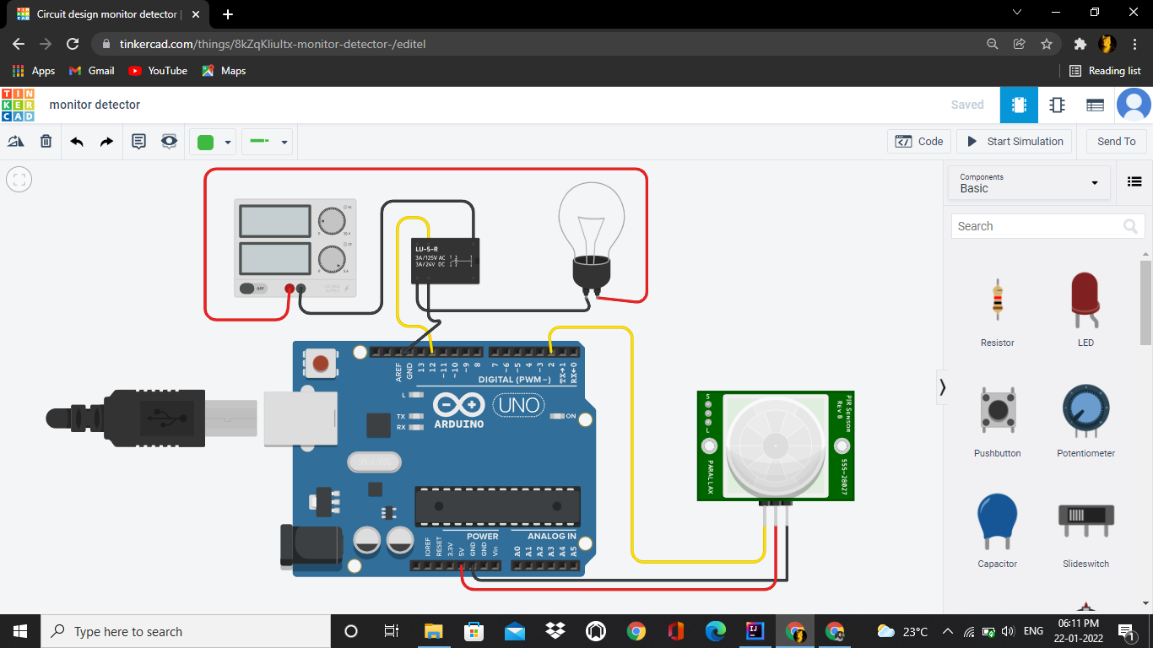
Arduino UNO test 2:

Slide 24
Code:
unsigned int s=Serial.read();
Serial.println(s);
sensorState = digitalRead(sp);
if (sensorState == LOW)
{ // LED on.
digitalWrite(bulb, HIGH);
Serial.println(sensorState);
}
else {
digitalWrite(bulb, LOW);
}
delay(10); // Delay a little bit to improve
}
int sensorState = 0;
int sp=2;
int bulb=12;
void setup()
{
pinMode(sp, INPUT);
pinMode(bulb, OUTPUT);
Serial.begin(9600);
}
void loop()
{

Slide 25
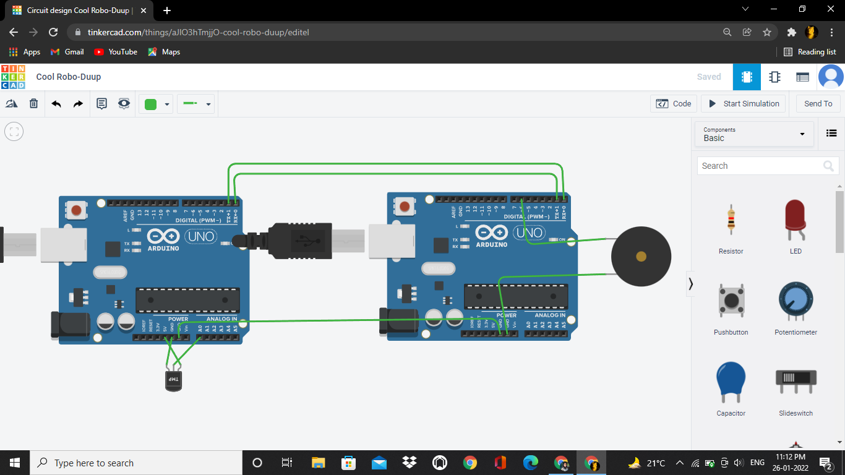
Arduino UNO test 3:

Slide 26
Arduino UNO 1 | Arduino UNO 2
int val; void setup() { pinMode(A0,INPUT); Serial.begin(9600); } void loop() { val = analogRead(A0); Serial.write(val); delay(500); //Serial.println(val); } | void setup() { Serial.begin(9600); pinMode(6,OUTPUT); digitalWrite(6,LOW); } void loop(){ int v = Serial.read(); Serial.println(v); delay(500); if (v > 90){ tone(6,1000); } else{ noTone(6); } }

Slide 27
Error
For 1st circuit, I was confused to get stuck in the values of each key button in IR remote each key has a different specific value it was different for int, unsigned int, or for hexadecimal numbers. Except for power key int and unsigned int value is same.
No.s | Unsigned int | int
0 | 12495 | 207
1 | 2295 | 247
2 | 34935 | 119
3 | 18615 | 183
4 | 10455 | 215
5 | 43095 | 87
6 | 26775 | 151
7 | 6375 | 231
8 | 39015 | 103
9 | 22695 | 167
Power | 255 | 255

Slide 28
In the second circuit I face a lot deficulties and error in making password by controling void loop().
For removing string error I littile bit study on string funtion and use string.length() this is for calculate length of string we can also add header file string.h .
For controlling loop I used various while loop and I use goto x, it is a also a type of loop.
goto x :- It skip all segment between x : to goto x; without any condition it act as loop.
And in communication between master and slave I got stuck and it from you tube.

Slide 29
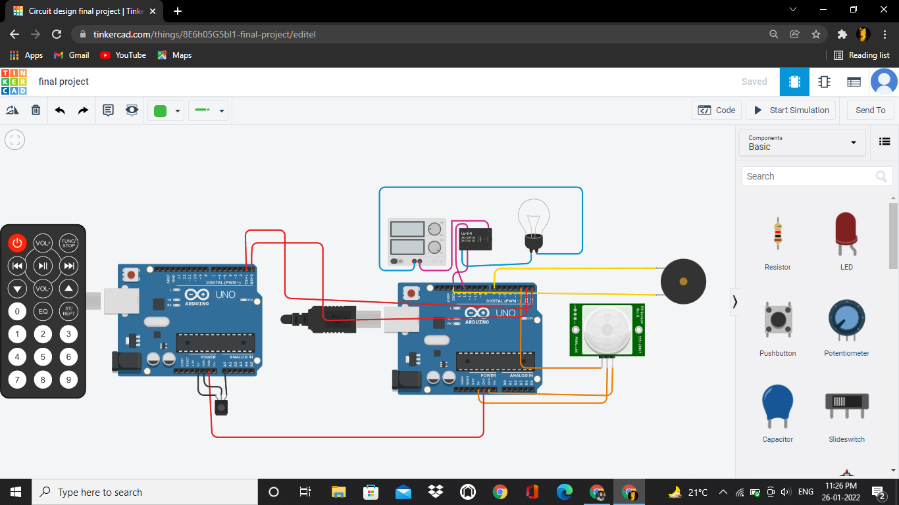
Final circuit:

Slide 30
Code: Arduino 1 :
irrecv.enableIRIn();
irrecv.blink13(true);
}
void loop()
{
if (irrecv.decode(&results))
{
value=results.value;
Serial.write(value);
irrecv.resume();
}
}
#include <IRremote.h>
int RECV_PIN = A0;
IRrecv irrecv(RECV_PIN);
decode_results results;
int value;
void setup()
{
Serial.begin(9600);

Slide 31
Arduino 2:
void loop(){
t=3;
digitalWrite(bulb, HIGH);
while(t>0){
i=0;
String ch;
while(i<password.length())
{
v = Serial.read();
Serial.println(v);
if(v==-1)
continue;
switch (v) {
case 207:
ch=String(ch+'0'); break;
case 247:
ch=String(ch+'1'); break;
case 119:
ch=String(ch+'2'); break;
case 183:
ch=String(ch+'3'); break;
case 215:
ch=String(ch+'4'); break;
case 87:
ch=String(ch+'5'); break;
case 151:
ch=String(ch+'6'); break;
case 231:
ch=String(ch+'7'); break;
case 103:
ch=String(ch+'8'); break;
case 167:
ch=String(ch+'9'); break;
}
i++;
delay(500);
}///1st inner while
Serial.println(ch);
delay(500);
int t,i=0;
int v;
int sensorState = 0;
int sp=2;
int bulb=12;
int buzzerpin=7;
String password="1234";
bool state;
void setup(){
pinMode(buzzerpin,OUTPUT);
pinMode(sp, INPUT);
pinMode(bulb, OUTPUT);
digitalWrite(bulb, HIGH);
Serial.begin(9600);
}//setup

Slide 32
while(ch==password){
//delay(1000);
sensorState = digitalRead(sp);
if (sensorState == HIGH){
noTone(buzzerpin);
digitalWrite(bulb, LOW);
Serial.println("Welcome");
state=true;
x:
v = Serial.read();
Serial.println(v);
if(v==-1)
goto x;
if(v==255){
digitalWrite(bulb, HIGH);
t=-1;
ch="";
continue;
}
}//if
else {
tone(buzzerpin,500);
digitalWrite(bulb, HIGH);
Serial.println("Come close to sensor");
}//else
delay(500);
}//2nd inner while
if(t!=-1)
tone(buzzerpin,500);
t--;
}//outer while
} //void loop

Slide 33
observation
In my point of view, this is a very good project I know that it is already available in the market but we can make this at a very low price. This is a very flexible project like it can implement not only for bulbs but also for other home appliances and by making connecting more Arduino we can control all the things from any place inside the home. This is a very useful project.

Slide 34

Thank you

