Slide 1
Json-rules-engine vs Nools
Use Cases
Json-rules-engine
Overview
Suitable for projects where ease of use and maintainability are priorities
Ideal for dynamic rule evaluations with straightforward JSON definitions
Good for applications requiring asynchronous rule processing.
Json-rules-engine
Rules defined in a JSON format, enhancing readability and manageability
Supports complex conditional logic, including all, any, and none conditions for rule execution
Allows chaining of rules, custom operators, and asynchronous event-driven actions.
Nools
Suitable for projects needing high performance and handling complex rule sets
Ideal for scenarios requiring detailed control over rule definitions and efficient pattern matching.
Nools
A JavaScript rule engine based on the Rete algorithm.
Provides a specialized language tailored for writing rules in a more programmatic way than the JSON-based format
Allows chaining of rules, custom operators, and asynchronous event-driven actions.
Designed for complex rule evaluation with high performance.
Rete algorithm
Checking each rule against each fact one by one would take a long time if you have many rules and facts. The Rete algorithm helps speed this up by organizing the rules and facts into a network, kind of like a flowchart.
Flowchart Setup: First, it creates a flowchart where each node represents a small part of rule
Fact Checking: When a new fact comes in, it goes through the flowchart. Each node checks if the fact matches its small part of rule.
Combination of Checks: If the fact matches at each step, it keeps moving through the flowchart. If it doesn’t match, it stops.
Efficient Matching: Because the flowchart is shared by all rules, the algorithm can quickly see which facts match which rules without repeating checks.

Slide 2
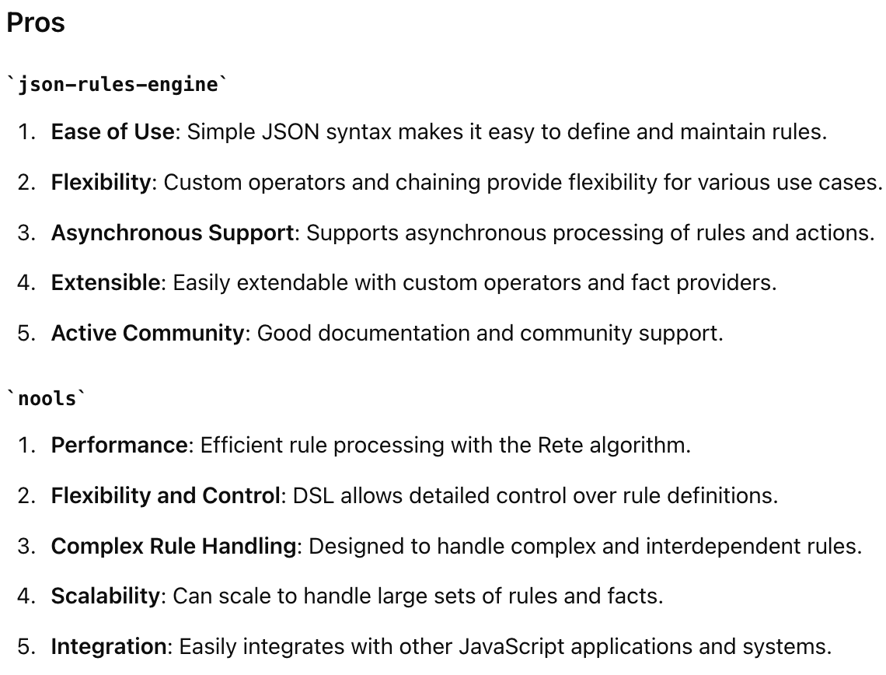
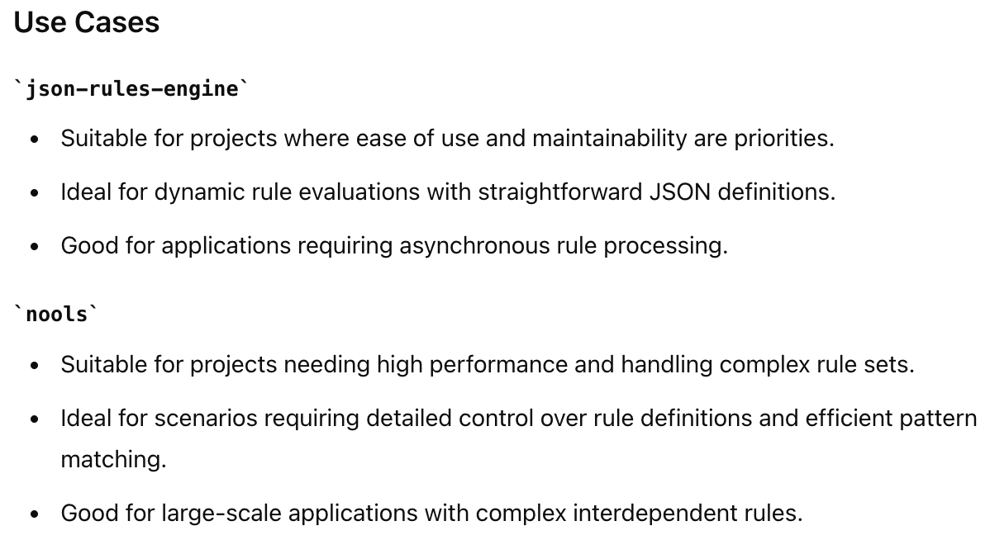
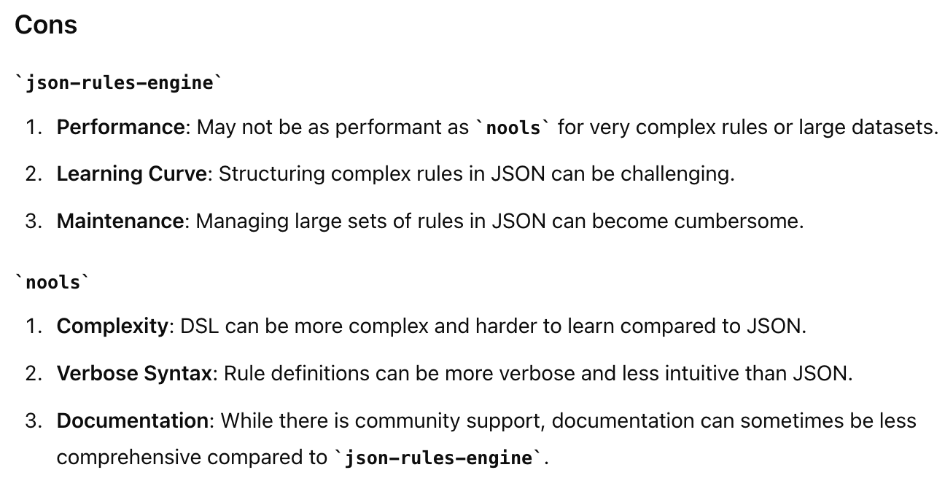

Slide 3
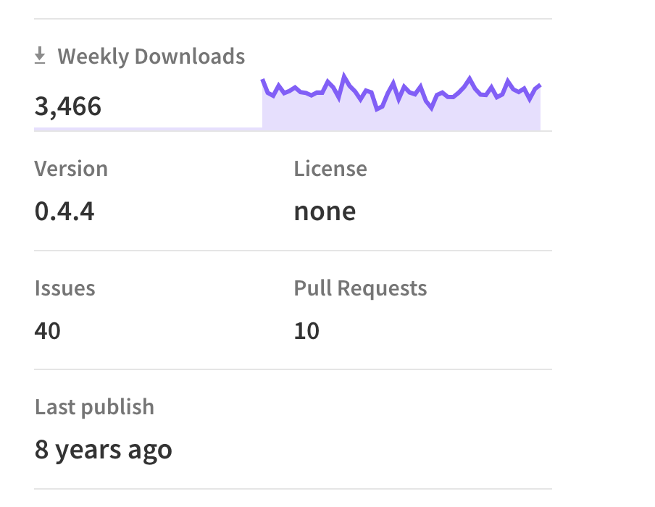
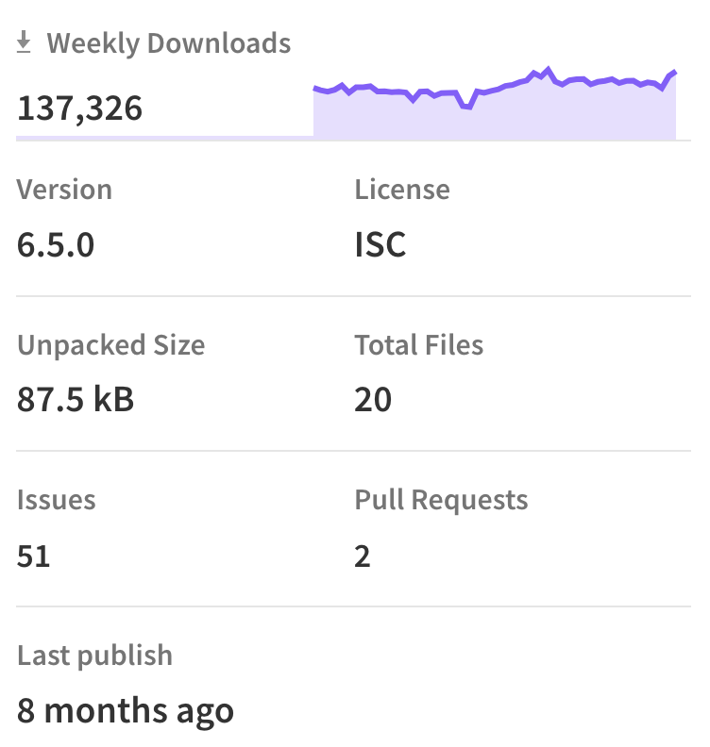
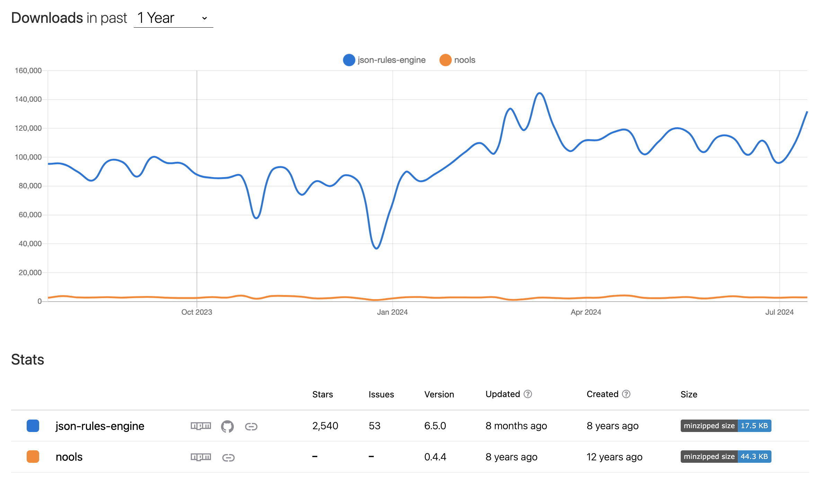
Json-rules-engine vs Nools: Popularity
Nools
Json-rule-engine

Slide 4
Feature/Engine | json-rules-engine | Nools | Sift | RuleJS | SimpleRuleEngine | Drools | RulesEngineJS
Syntax | JSON | DSL (Domain-Specific Language) | Python | JavaScript functions | Simple | DSL (Java-based) | JavaScript
Custom Operators | Yes | Yes | Yes | Yes | No | Yes | Yes
Event-Driven | Yes | Yes | No | No | No | No | No
Chaining Rules | Yes | Yes | Yes | Yes | No | Yes (inference) | Yes
Asynchronous | Yes | No | No | No | No | No | No
Flexibility | High | Medium | High | High | Low | Very High | High
Performance | Moderate | Good | High | Good | Good | High | Good
Complex Rule Sets | Moderate | Medium | High | Moderate | Low | High | Moderate
Documentation | Extensive | Moderate | Good | Moderate | Basic | Extensive | Moderate
Ease of Use | Easy | Medium | Moderate | Easy | Very Easy | Complex | Easy
Integration | Good | Moderate | Good | Excellent | Good | Complex | Good
Community Support | Active | Smaller community | Growing | Moderate | Limited | Strong | Moderate
Setup Complexity | Low | Medium to High | Moderate | Low | Very Low | High | Low
Unpacked Size | 87.5 kB | -- | 372 kB | 32.5 kB | 27.3 kB | -- | --
License | ISC | None | MIT | ISC | MIT | -- | MIT
Last publish | 8 months ago | 8 years ago | 3 months ago | 5 Years ago | 4 years ago | -- | 7 years ago
weekly download | 1,37,326 | 3466 | 2930086 | 59 | 35 | -- | 0
Notes:
Sift = Simple Implementation for Flexible Testing. Open source
Sift is a tiny library for using MongoDB queries in Javascript

Slide 5
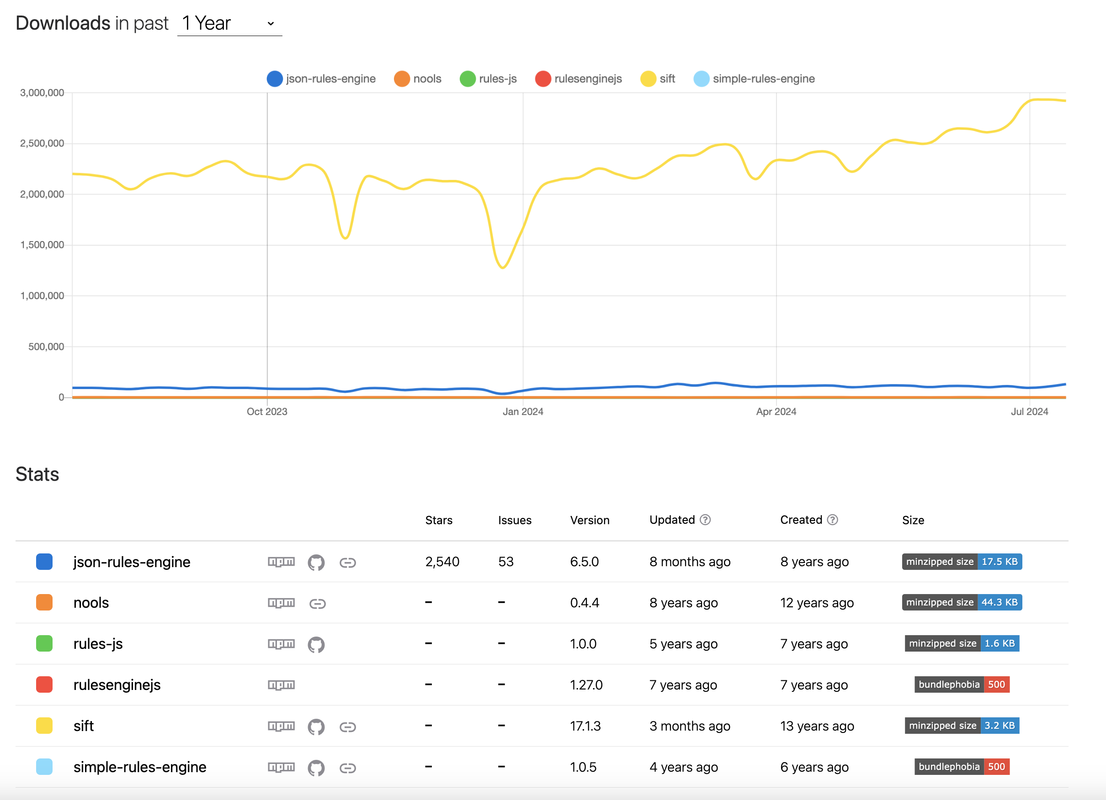

Slide 6
Json-rule-engine vs Sift
Overview
json-rules-engine
A rules engine written in JavaScript for both Node.js and the browser.
Designed to allow business logic to be specified in a declarative format.
Sift
A lightweight and simple rule engine for JavaScript.
Focuses on filtering and querying nested JSON data.
Key Features
json-rules-engine
Event-driven architecture.
Supports complex rule chaining and nested conditions.
Custom operators and facts.
Declarative rule definitions.
Asynchronous rule evaluation.
Extensive documentation and examples.
Sift
Lightweight and easy to integrate.
Simplifies filtering and querying of nested JSON objects.
Supports basic logical operations and conditions.
Quick setup and minimal configuration.
Pros and Cons
json-rules-engine
Pros: Powerful, flexible, supports complex rule sets, good documentation, active community.
Cons: Can be overkill for simple filtering, larger size, steeper learning curve.
Sift
Pros: Lightweight, simple syntax, easy to use, quick to integrate.
Cons: Limited in handling complex rule sets, less flexibility, smaller community.

