Slide 1


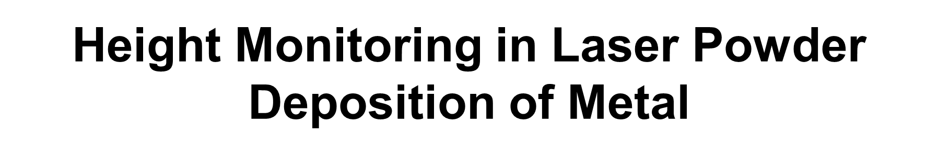
Instructor: Ravi K.R.
Presented by: Anamika Choudhary (B21MT004)

Slide 2
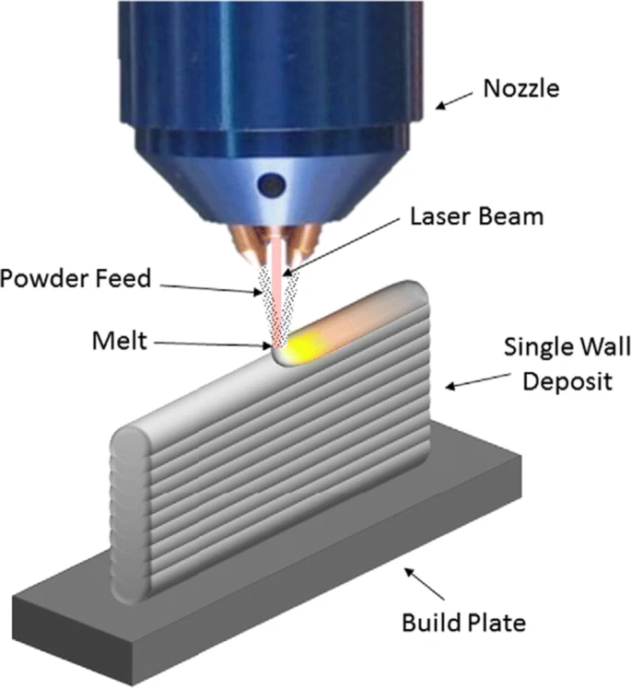
Laser Powder Deposition
Laser powder–based directed energy deposition (DED) is a specific additive manufacturing process that offers an effective way to fabricate parts where a deposition head delivers metal powder into the melt pool generated by a focused laser beam.
Powder is injected from a coaxial or multi-jet nozzle onto the focus region with the aid of carrier or shielding gas to enhance deposition efficiency and to minimize potential oxidation.

Slide 3
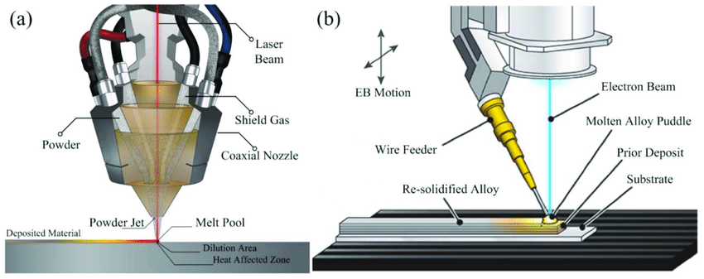
Due to the localized thermal energy and the rapid movement of the laser, almost instantaneous solidification of the molten material is obtained.
The characteristics of the deposited part depend on a large number of parameters. Such as, laser power, laser beam diameter, spatial distribution, shielding gas flow rate, carrier gas flow rate, travel speed, powder flow rate, powder, and building platform material properties, powder characteristics, powder feeding method, layer thickness, overlap percentage deposition strategy.
The three main mechanisms that can be identified are
(i) laser irradiation and material addition
(ii) melt pool generation
(iii) the solidification process.

Slide 4
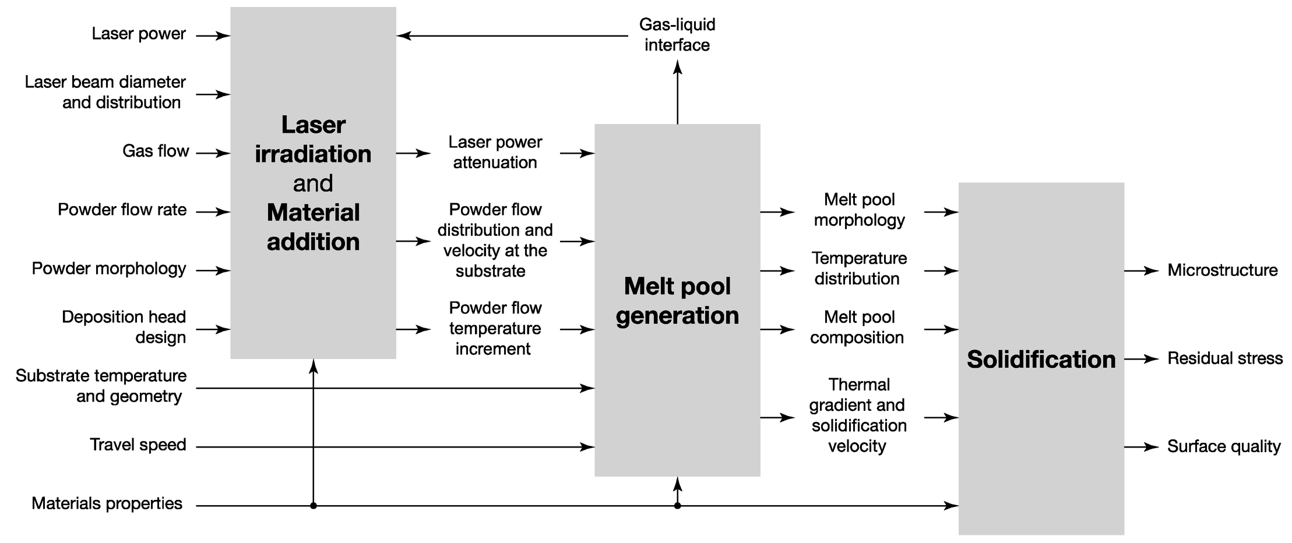

Slide 5
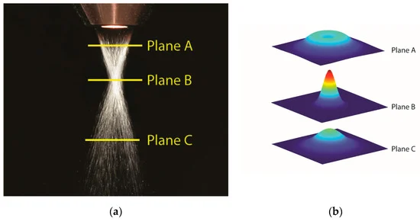
Powder Distribution
The powder flow is influenced by factors such as particle size, surface morphology, and rheological properties.
Powder distribution is influenced by parameters like nozzle design, powder velocity, and gas flow rate.
For instance, different nozzle configurations affect powder concentration and focal point position. Substrate position also influences powder distribution, with closer substrates yielding higher concentrations.
Additionally, powder velocity varies due to gas-powder interactions and laser irradiation. Optimal working areas for powder deposition have been identified around the powder focus plane. Material density also affects powder focus plane position.

Slide 6
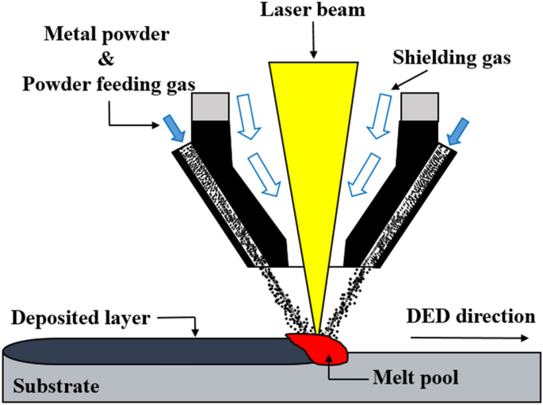
Powder and Laser Fusion
The powder and laser converges and interact with each other at the focal point to melt the maximum concentrated powder.
The laser makes a spot of 3.1mm diameter when the powder interacts with it on the substrate to form the melt pool.
The convergence distance from the nozzle is 13 mm and therefore this distance is maintained between the nozzle and substrate. So that powder and laser fusion happens near the substrate and avoids the wastage and spattering of powder material.

Slide 7
Process Parameters
1. | Laser Power | 2000 Watt
2. | Scan speed of laser | 12mm per second
3. | Laser spot (Diameter) | 3.1mm
4. | Shielding gas (flow rate) | argon gas (12 ltr/min)
5. | Powder flow rate | 21 g/min
6. | carrier gas flow (to carry the powder) | 5 ltr/min
7. | Metal powder | steel SS316L
8. | Powder size | 45-100 microns

Slide 8
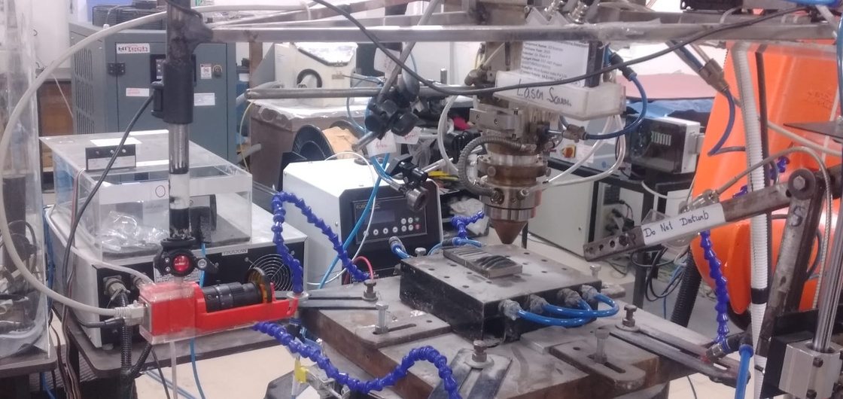
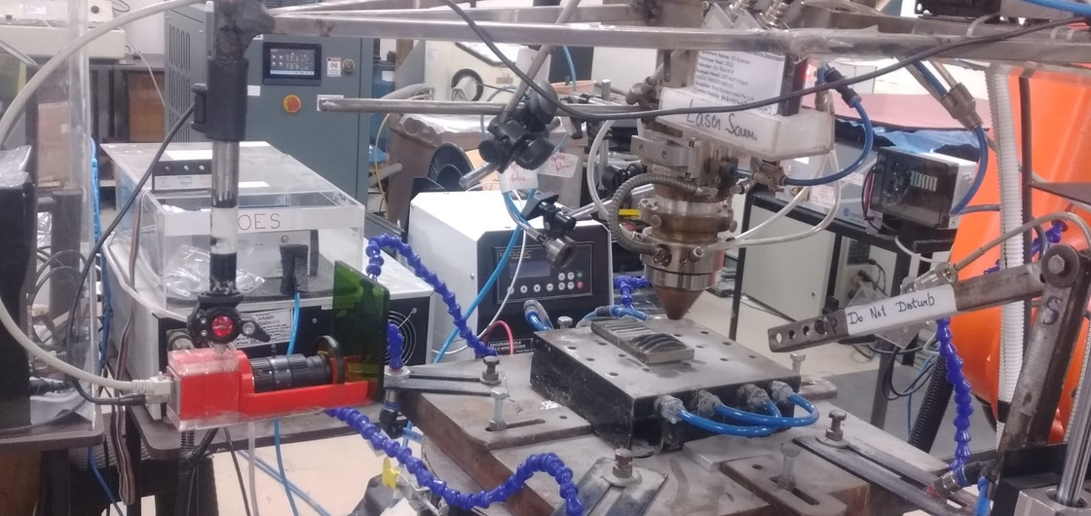
Camera Setup
The CCD camera is strategically positioned at the center of the substrate, ensuring optimal focus on the printed metal part for clear imaging, while remaining stationary throughout the observation process.

Slide 9
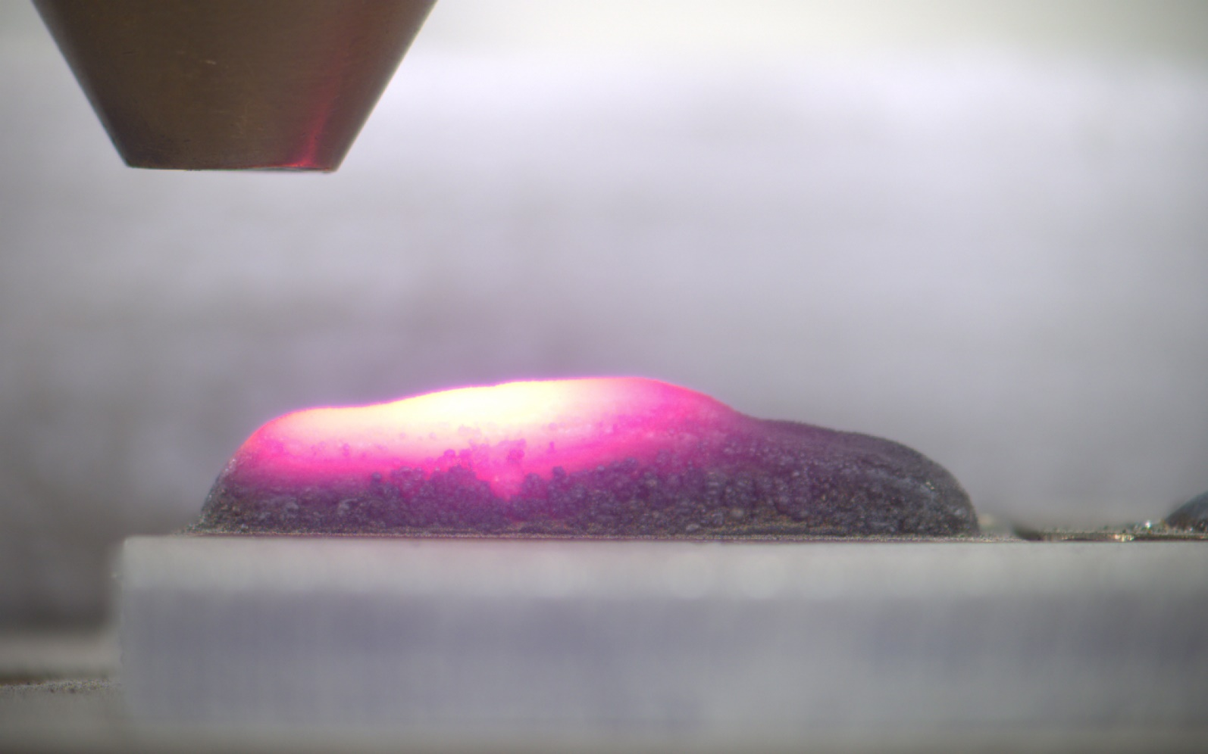
Differentiate while Printing and Not-Printing during Process
Image while printing the metal layer
Image when the printing process stops

Slide 10
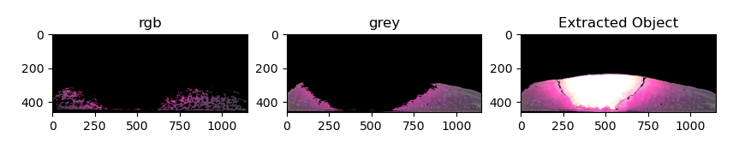
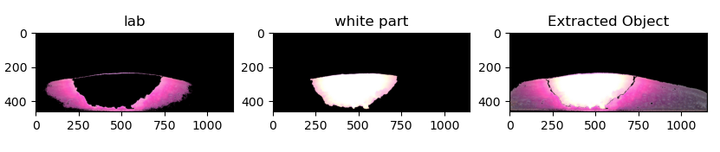
Metal Extraction
The metal has been extracted from the image taken by the CCD camera while printing, by using machine learning algorithms. The algorithm extracts the metal based on the color difference between metal and its surrounding.
Various color patterns are visualized during the printing. So, different color mask (such as rgb, grey, lab and white contour) were used to extract different colors of the printed metal and combined together to form the overall printed metal part.

Slide 11
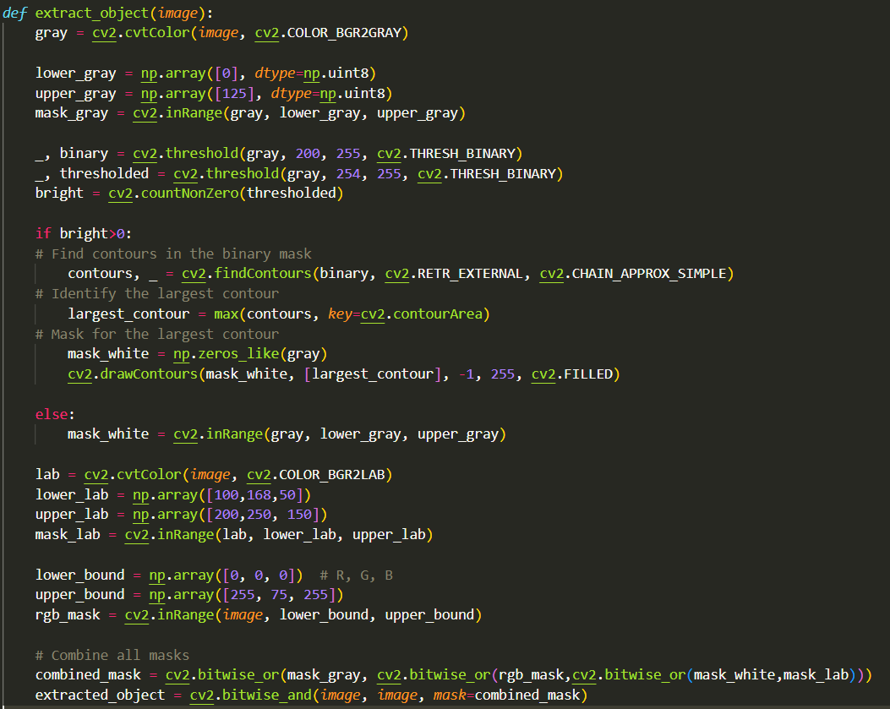
ML Algorithm
Different masks used to filter out different color from the image.
Combined all the masked images together to get the printed metal part from the image

Slide 12
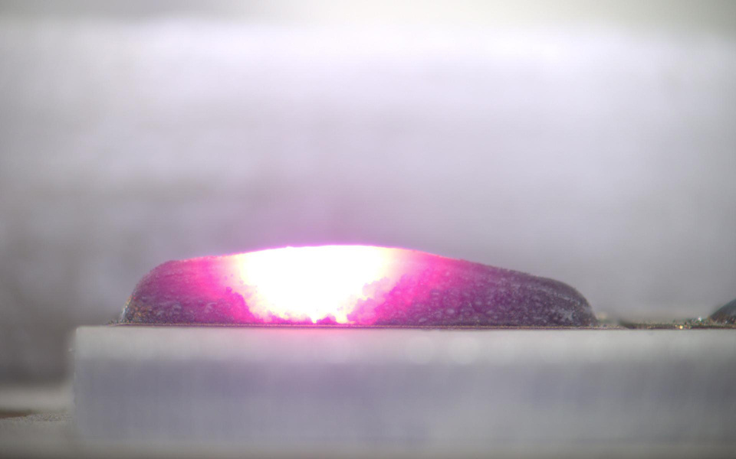
Results for Extracted Metal
Image taken by CCD camera while printing
Extracted image of printed metal

Slide 13
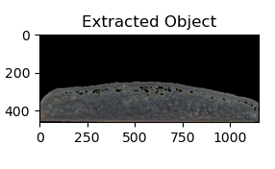
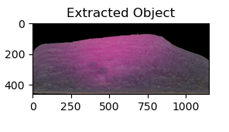
Height Variations at Different Points
While printing, excessive flow of the powder at various points can lead to the formation of different heights in the metal. Also, we require to maintain a specific distance between the nozzle and the metal printing part, to get the required properties of the printed metal. So, the height monitoring is helpful in doing so.

Slide 14
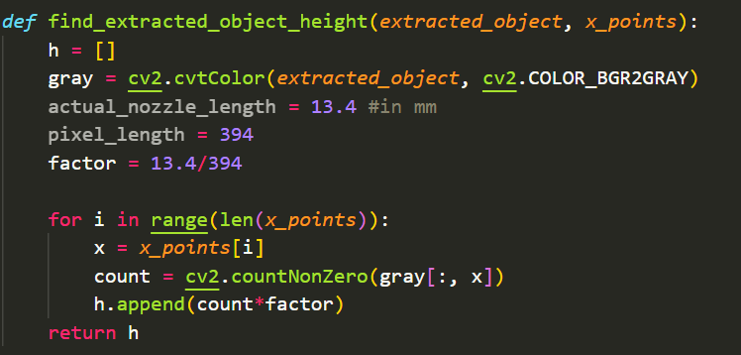
Height Calculation
To find the heights on the n number of points differently. After extraction of printed metal part from the image, it counts the number of pixels which have color values (>0 value) to get the height.

Slide 15
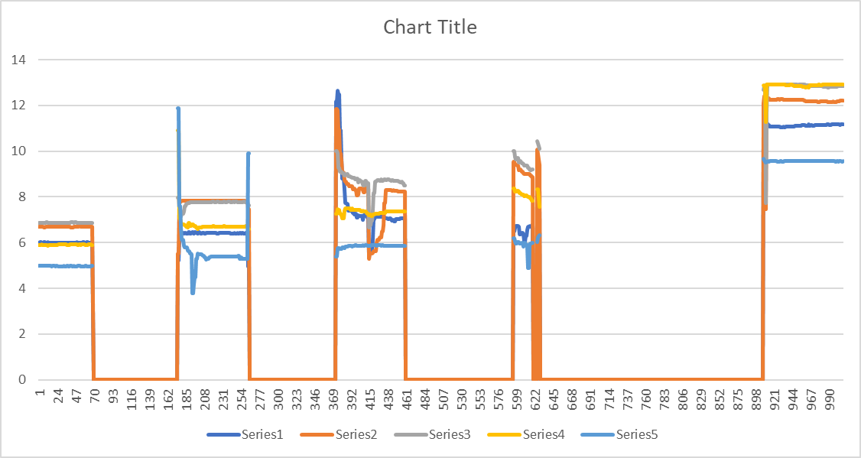
Heights at Different Points
Points taken in
graph:
x1 = 200
x2 = 400
x3 = 600
x4 = 800
x5 = 1000
The zero in the x-axis represents the images while printing

Slide 16
Conclusion
Why the height monitoring is required?
By monitoring the height of printed metal, we can observe the distance between the nozzle and the printing part. The nozzle moves 0.4mm in upward direction after printing each layer. And there is not always a uniform printing during the process. We can adjust the nozzle according to our requirements by height monitoring at different points.
As it is required to maintain a specific distance (13mm) between the nozzle and the substrate such that the focal point of powder distribution is near the melting part. Placing the substrate relatively close to the focal point can lead to higher capture efficiency of powder concentration into the melt pool. This leads to less wasted powder and faster deposition rates. Maintaining the right distance ensures uniform deposition and desired material properties in the final product. Prevents defects like porosity, incomplete fusion, and excessive heat input, ensuring mechanical integrity and reducing processing costs. Also controls laser energy input, preventing substrate overheating, and enhances surface finish, minimizing post-processing requirements.

Slide 17
THANK YOU!

