Slide 1



AI-Powered Multimodal Communication
(Bridging Communication Barriers for Disabled Users)
7th Semester Project | Department of Computer Science & Engineering
RVS College of Engineering and Technology, Jamshedpur
Dayanand Kr Gupta (CSE/057/22)
Ayush Kr Sinha (CSE/060/22)
Akash Rana (CSE/061/22)
Anu Kumari (CSE/062/22)
Under the guidance of Prof. Momita Kundu
Notes:
1

Slide 2
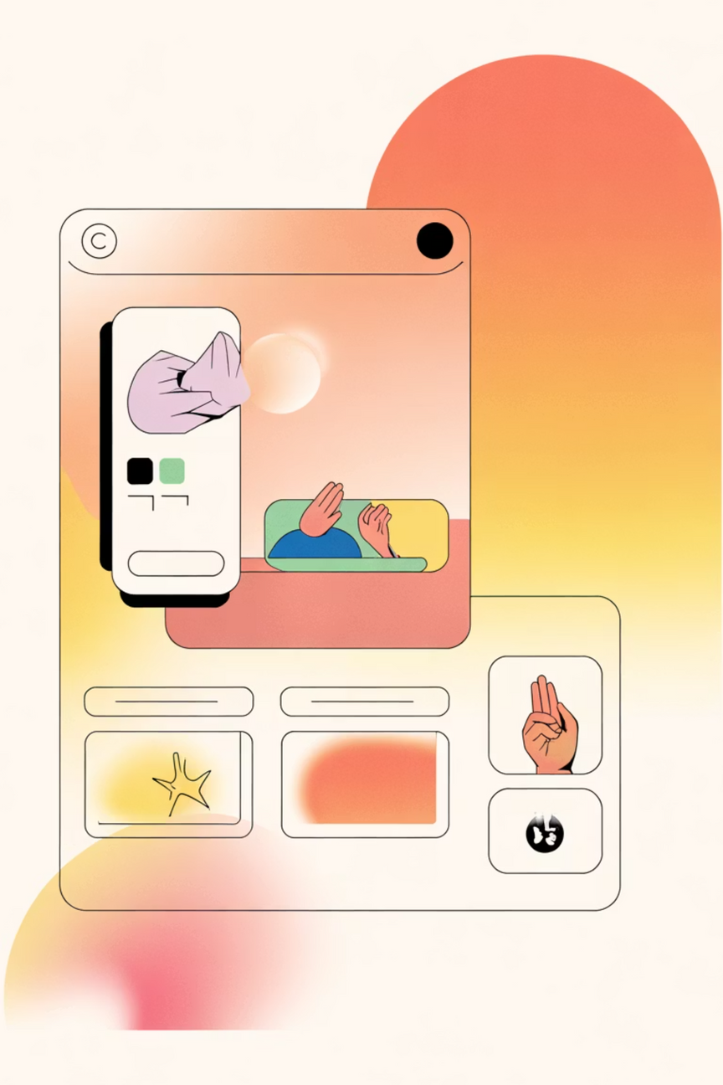
Project Vision
This platform empowers people with disabilities through AI-driven communication. We integrate speech, text, and sign language into a unified, intelligent system that promotes inclusive learning and meaningful social interaction.
Multimodal AI Tutor
Intelligent Chat System
Interactive learning across speech, text, and sign language modes.
Real-time collaboration and peer-to-peer communication.
AI Assistant
Instant, responsive support available whenever needed.
Notes:
2

Slide 3

The Problem We Solve
Communication Challenges
Current System Gaps
Disabled individuals struggle with digital participation
No unified, multimodal learning platform
Hearing, speech, and physical impairments create barriers
Lack of interactive education tools
Limited AI-driven accessibility solutions
Existing systems support only single modes
Notes:
3

Slide 4
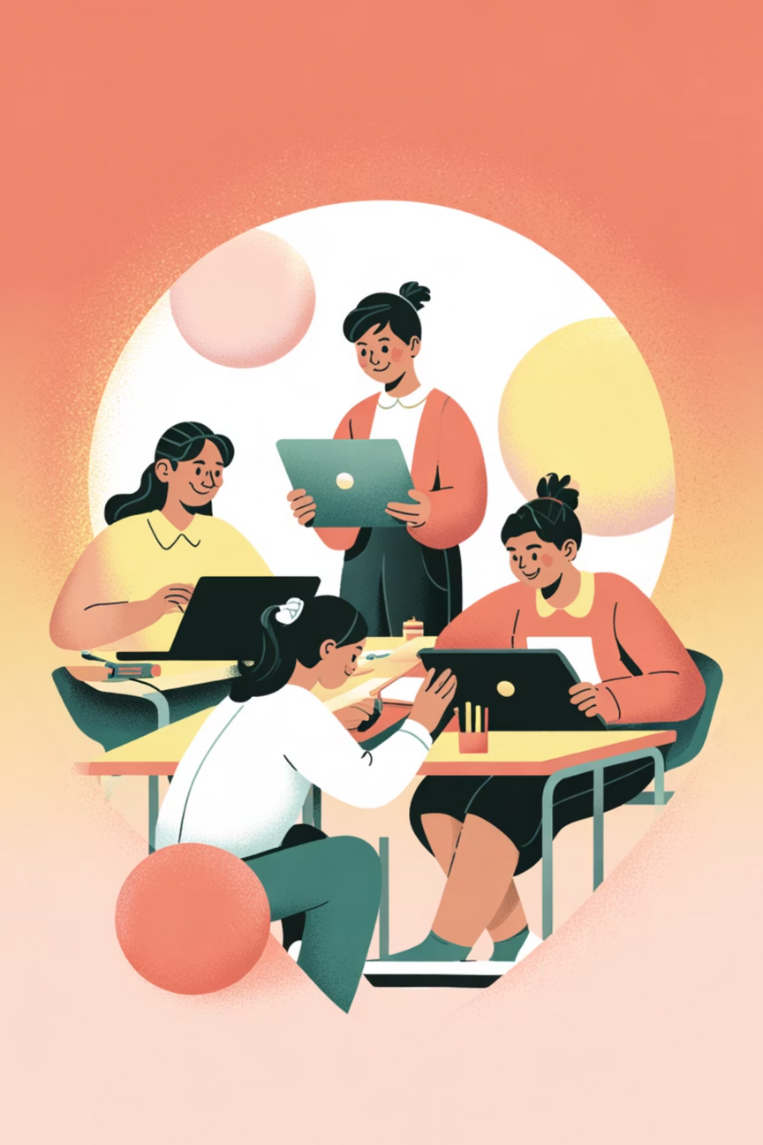
Why This Matters
Digital Equality
Inclusive Education
Removes barriers for users with hearing, speech, or physical impairments, ensuring equal access to education and communication.
Adapts to individual needs with flexible interaction modes, making learning accessible and engaging for everyone.
AI-Driven Accessibility
Leverages cutting-edge AI to create innovative, human-centered solutions that respect and empower differently-abled learners.
Notes:
4

Slide 5
What We're Building
1
AI Tutor with Multimodal Support
2
Collaborative Chat System
Intelligent educational system that understands and responds through text, speech, and sign language seamlessly.
Enables user-to-user and user-to-AI conversations with real-time translation across communication modes.
3
24/7 AI Assistance
4
User-Friendly Interface
Responsive chatbot providing instant support, learning help, and accessibility guidance whenever users need it.
Intuitive design with adaptable modes, ensuring accessibility and comfort for all users regardless of ability.
Notes:
5

Slide 6
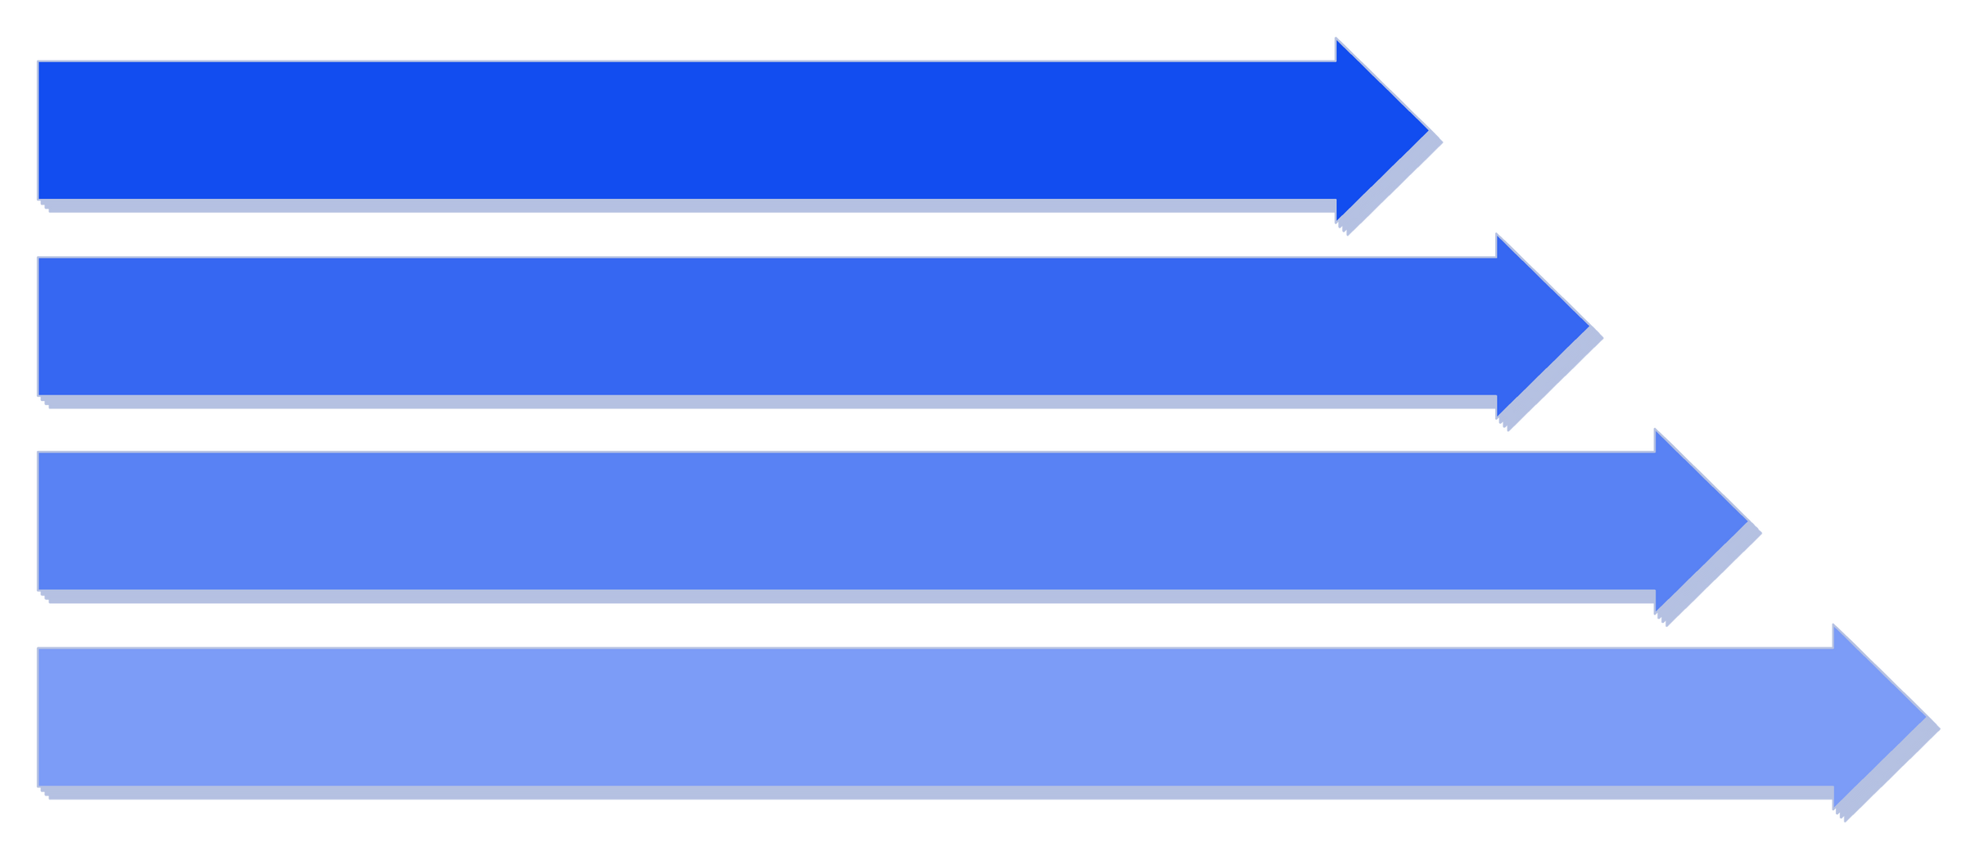
How It Works
User Input
Processing
AI Tutor
Output
Our architecture creates a seamless flow: users input information in their preferred mode, advanced AI processes it, the tutor responds intelligently, and output is delivered back in the chosen format - creating truly accessible communication.
Notes:
6

Slide 7
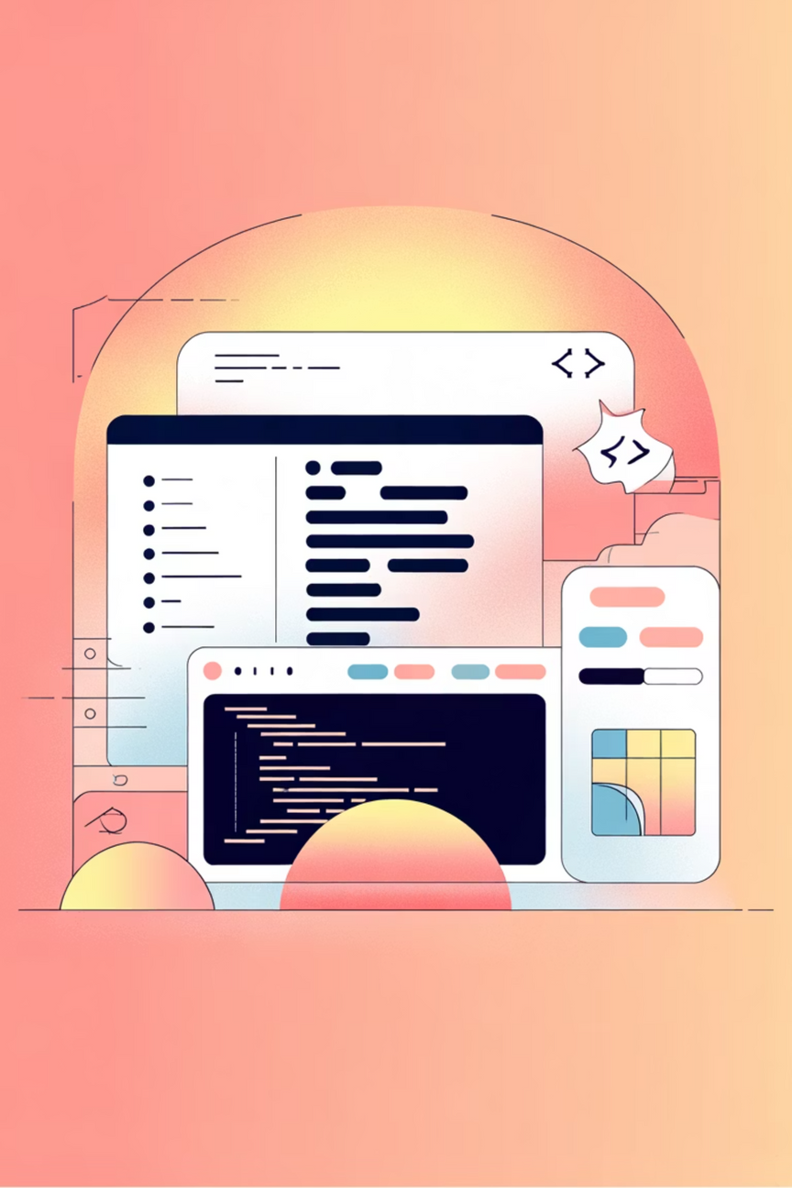
Technology Stack
Frontend
AI & Processing
React.js for dynamic interfaces
Whisper for speech recognition
HTML5 for structure
TailwindCSS for responsive design
MediaPipe for sign language detection
OpenCV for computer vision
Backend
Transformers for NLP
Flask for server logic
Hardware Requirements
MongoDB for secure data storage
Laptop/PC with microphone & camera
8GB RAM minimum
Intel i5 processor
Notes:
7

Slide 8
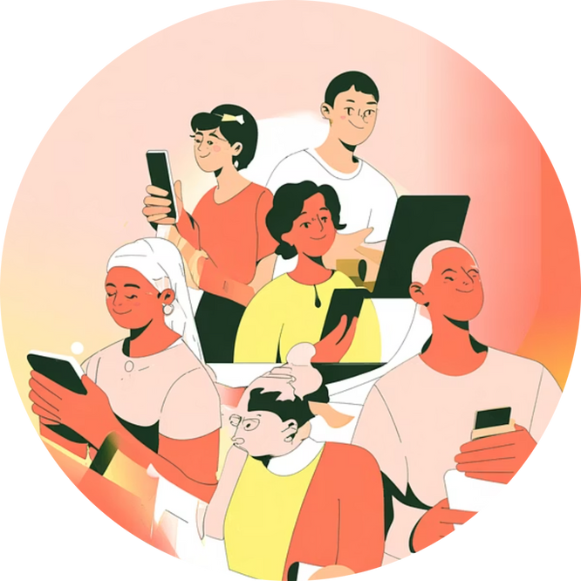
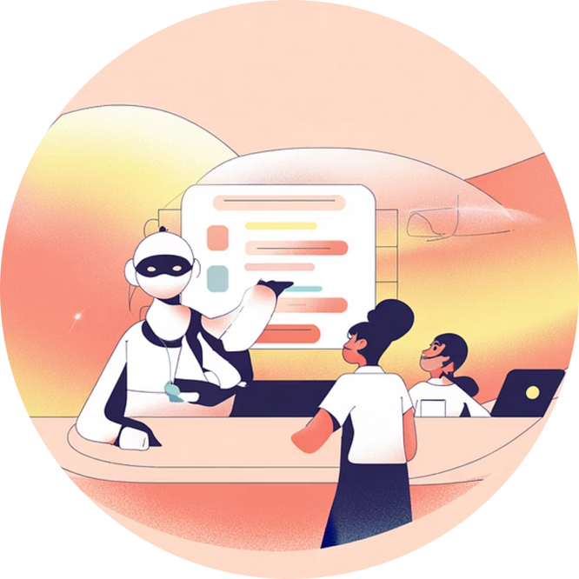
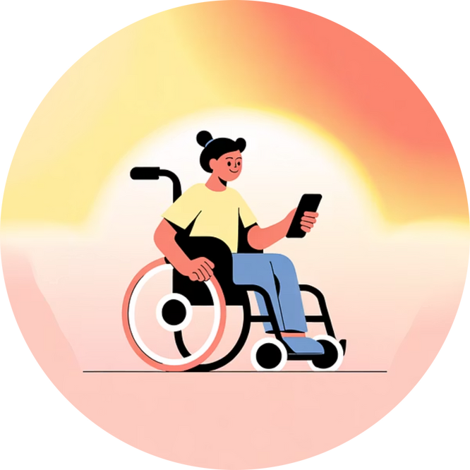
Our Key Contributions
Digital Inclusion
Integrated AI Learning
Empowerment Through Technology
Breaks down communication barriers, ensuring disabled users can participate fully in education and digital spaces.
Combines intelligent tutoring with community chat for comprehensive, accessible education tailored to individual needs.
Enhances independence and confidence among differently-abled learners, fostering long-term social and educational growth.
Notes:
8

Slide 9










Impact & Applications
Community Building
Assistive Education
Foster connections and collaboration among users.
Accessible learning for students with various disabilities.
Accessibility Standards
Sets new benchmarks for inclusive technology design.
Social Impact
Empowers millions facing communication barriers globally.
Innovation Model
Demonstrates AI's potential for human-centered solutions.
Notes:
9

Slide 10
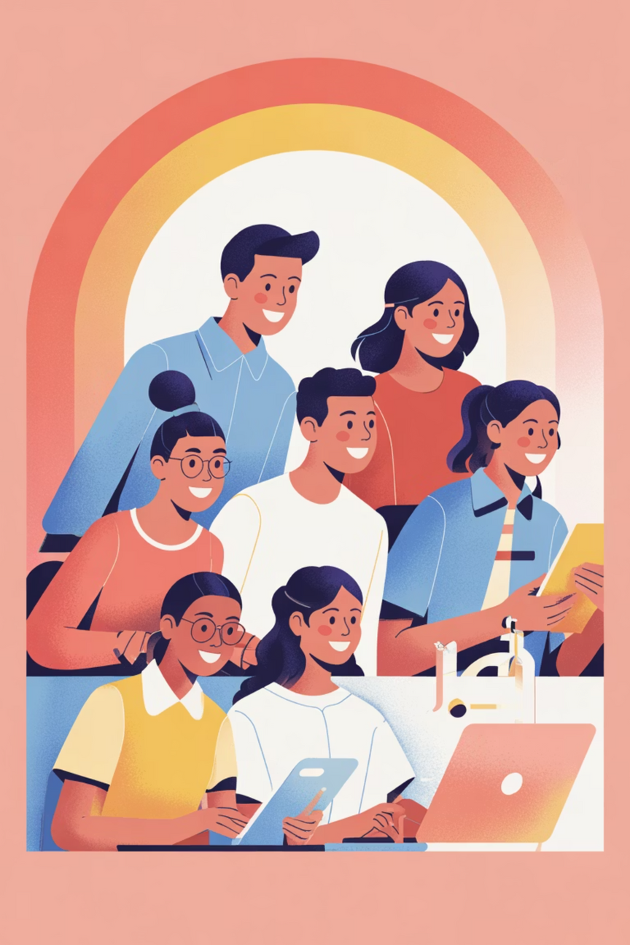
Bringing Accessibility to Life
This platform demonstrates AI's transformative power in creating inclusive, human-centered technologies. By integrating speech, sign language, and text, we break communication barriers and unlock equal opportunities for differently-abled learners.
Removes Barriers
Enables Learning
Builds Confidence
Creates Equality
Notes:
10

Slide 11
THANKYOU
Notes:
10

