Slide 1
Smart Building IoT: Detecting Room
Occupancy Using Environmental Sensors
Anu Bhukya
University of Hertfordshire
MSc Data Science | January 2026
github.com/anu-bhukya

Slide 2
Introduction & Motivation
Background & Context
Research Questions
Smart buildings rely on IoT sensors to optimise energy use — HVAC systems account for ~40% of commercial building energy. Accurate occupancy detection enables demand-driven climate control, reducing energy waste in unoccupied spaces.
This project investigates whether environmental sensor data (temperature, humidity, light, CO2, humidity ratio) can reliably predict room occupancy using machine learning, achieving production-ready accuracy for automated building management systems.
RQ1: Which ML algorithm most effectively predicts room occupancy from environmental sensor data?
RQ2: Can models trained on daytime data generalise effectively to nighttime occupancy patterns?
RQ3: How do environmental sensors contribute to occupancy prediction through non-linear relationships? (SHAP analysis)
Goal: Develop a production-ready occupancy detection system using IoT sensor fusion with >99% accuracy, interpretable via SHAP, and robust to temporal shifts and sensor failures.
Smart Building Occupancy Detection | Anu Bhukya | University of Hertfordshire

Slide 3
Previous Work & Literature Review
Occupancy Detection Literature
Key Methodological Foundations
Candanedo and Feldheim (2016) established the benchmark UCI Occupancy dataset, demonstrating that Light and CO2 are dominant occupancy indicators using statistical learning models.
Subsequent studies validated ensemble methods (Random Forest, Gradient Boosting) as superior to linear classifiers for multi-sensor occupancy prediction in smart buildings.
• Friedman (2001) — Gradient Boosting Machines for sequential error correction in classification tasks
• Lundberg and Lee (2017) — SHAP framework for unified model interpretability and feature attribution
• Pedregosa et al. (2011) — scikit-learn ecosystem for standardised ML pipeline development
• Cover and Hart (1967) — KNN theory for instance-based non-parametric classification
Research Gap & This Project's Contribution
Most existing studies focus on single-building, daytime-only evaluation. This project extends the analysis to: (1) temporal generalisation — testing daytime-trained models on nighttime data, (2) sensor failure resilience — evaluating model robustness when the dominant Light sensor is removed, and (3) SHAP-based non-linear relationship analysis to understand how individual sensors contribute to occupancy prediction through complex interactions.
Smart Building Occupancy Detection | Anu Bhukya | University of Hertfordshire

Slide 4
Methodology & Approach Comparison
Logistic Regression
Gradient Boosting ★
K-Nearest Neighbors
Type: Linear probabilistic classifier
Role: Baseline model
Strengths:
• Fast training (0.11s)
• Highly interpretable
• Strong recall (99.32%)
Limitations:
• Cannot capture non-linear sensor interactions
• Lower precision (94.98%)
Type: Ensemble tree-based boosting
Role: Primary non-linear model
Strengths:
• Best F1 score (98.43%)
• Captures non-linearity
• Interpretable via SHAP
• Excellent precision (98.11%)
Limitations:
• Longer training (3.87s)
Type: Instance-based non-parametric
Role: Comparative non-linear model
Strengths:
• Highest accuracy (99.39%)
• Fast inference (0.02s)
• Simple algorithm
Limitations:
• Less interpretable
• Memory-intensive at scale
• Lower F1 than GB (98.56%)
Pipeline: Data Loading → Cleaning → Feature Engineering (hour, day_of_week, is_weekend) → StandardScaler → 80/20 Stratified Split → GridSearchCV (5-fold, F1 scoring) → Model Evaluation → SHAP Explainability
Smart Building Occupancy Detection | Anu Bhukya | University of Hertfordshire

Slide 5
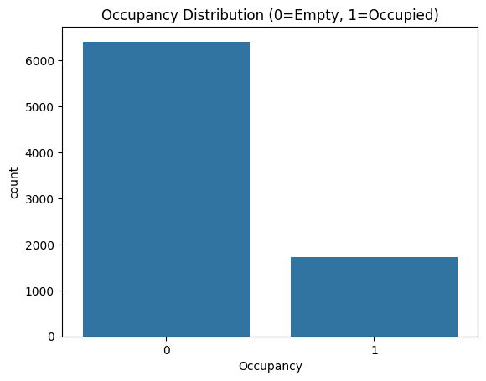
Dataset Overview
Dataset Specifications
Class Distribution
Property | Value
Source | UCI ML Repository — Occupancy Detection
Training Records | 8,143 (80/20 → 6,514 train / 1,629 test)
Sensor Features | Temperature, Humidity, Light, CO2, HumidityRatio
Engineered Features | Hour, Day_of_Week, Is_Weekend (3 temporal)
Total Features | 8 (5 sensor + 3 temporal)
Target | Occupancy (Binary: 0=Empty, 1=Occupied)
Date Range | February 2015 (minute-level readings)
Missing Values | 0 (complete dataset)
Sensor Data Description
IoT sensors record minute-level environmental readings: Temperature (°C), Humidity (% RH), Light (Lux), CO2 (ppm), and HumidityRatio. Light and CO2 show strongest class separation — occupied rooms have ~400-500 Lux and ~700-800 ppm CO2 vs ~100-200 Lux and ~400-500 ppm when empty. Moderate class imbalance addressed via stratified sampling. Three temporal features engineered from timestamps for temporal pattern capture.
Smart Building Occupancy Detection | Anu Bhukya | University of Hertfordshire

Slide 6
Ethical Implications
Privacy & Surveillance Concerns
Recommended Mitigations
• Occupancy detection could reveal sensitive work patterns and location tracking
• Real-time sensor data collection requires informed consent
• Historical occupancy data may expose personal routines
• Risk of function creep — monitoring expanding beyond energy management
• Data anonymisation — no linking sensor data to individuals
• Access controls — restrict occupancy data to authorised personnel
• Time-based retention policies for historical data deletion
• Transparent communication to building occupants
• Opt-out mechanisms for individuals
Model Fairness
Energy Efficiency Benefits
• Different building types may yield varying model performance
• Seasonal variations could cause model degradation
• Cross-building and cross-user-group validation recommended
• Differential privacy and federated learning for enhanced protection
Positive ethical outcome: Accurate occupancy detection enables smart HVAC control, reducing energy consumption and carbon footprint. Low error rates (Type I: 1.89%, Type II: 1.20%) minimise discomfort. Manual override capability recommended as failsafe for occupants.
Smart Building Occupancy Detection | Anu Bhukya | University of Hertfordshire

Slide 7
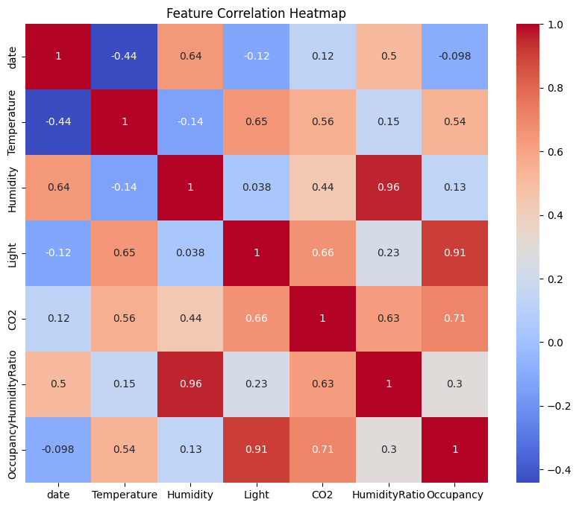
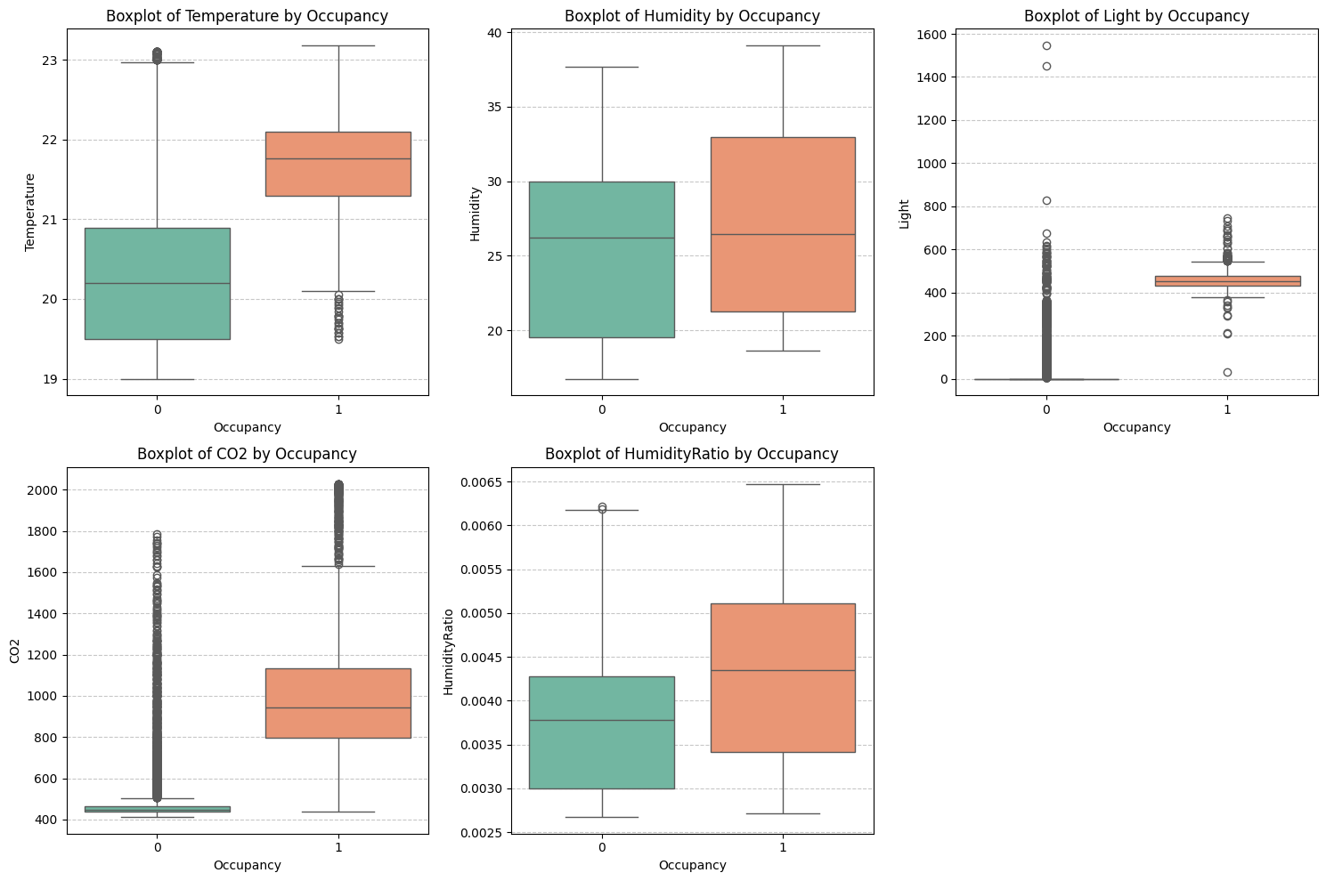
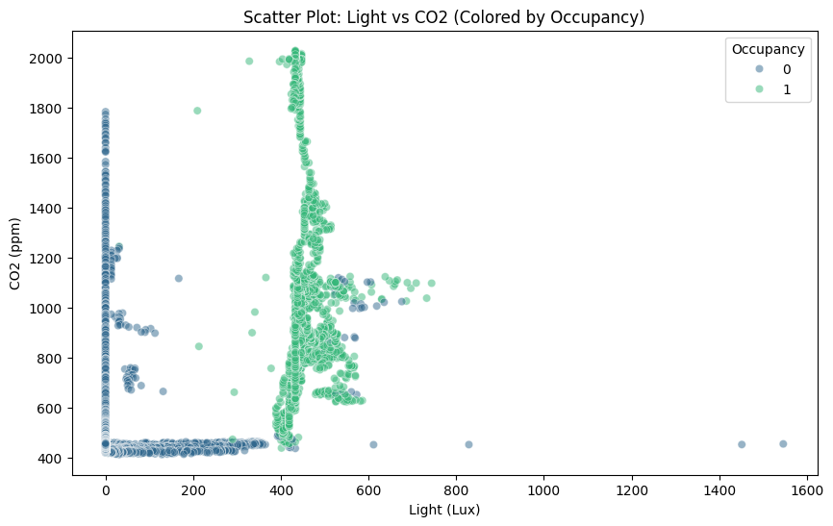
Exploratory Data Analysis
Occupancy Distribution
Box Plots by Occupancy
Light vs CO2 Scatter
Key EDA Insights
• Light & CO2 are dominant class separators — clear clustering between occupied and unoccupied
• Occupied: ~400-500 Lux, ~700-800 ppm CO2
• Unoccupied: ~100-200 Lux, ~400-500 ppm CO2
• Moderate class imbalance present
• Non-linear relationships evident in scatter plots
• Temperature & Humidity show weak discrimination
Smart Building Occupancy Detection | Anu Bhukya | University of Hertfordshire

Slide 8
Data Pre-processing
Processing Pipeline
Train-Test Split
1. Data Loading — 3 CSV files (training + 2 test sets)
2. Cleaning — Dropped unnamed index columns, converted date strings to datetime, confirmed 0 missing values
3. Feature Engineering:
• Hour (0-23) from datetime
• Day_of_Week (0-6)
• Is_Weekend (binary: 1 if Sat/Sun)
4. Feature Scaling — StandardScaler (z-score)
• Fitted on training data ONLY
• Applied to both train and test
• Columns: Temp, Humidity, Light, CO2, HumidityRatio
5. No imputation needed (complete dataset)
Parameter | Value
Split Ratio | 80% train / 20% test
Training Samples | 6,514
Test Samples | 1,629
Stratification | Yes (maintains class ratio)
Random State | 42 (reproducibility)
Data Leakage Prevention
StandardScaler fitted ONLY on training data; test data transformed using training statistics. Ensures realistic evaluation on unseen data.
Final Feature Set: 8 features — Temperature (scaled), Humidity (scaled), Light (scaled), CO2 (scaled), HumidityRatio (scaled), Hour (0-23), Day_of_Week (0-6), Is_Weekend (0/1)
Smart Building Occupancy Detection | Anu Bhukya | University of Hertfordshire

Slide 9
Models Used & Configuration
Logistic Regression
Gradient Boosting ★
K-Nearest Neighbors
Linear probabilistic classifier serving as the baseline model.
Grid Search Space:
• C: [0.1, 1, 10]
• solver: ['lbfgs', 'liblinear']
• Total: 6 combos × 5 folds = 30 fits
Best: C=0.1, solver=lbfgs
Rationale: Strong regularisation (low C) reduces overfitting and provides generalisable baseline.
Ensemble tree-based boosting — selected as primary model.
Grid Search Space:
• n_estimators: [50, 100]
• learning_rate: [0.05, 0.1]
• max_depth: [3, 5]
• Total: 8 combos × 5 folds = 40 fits
Best: n_est=50, lr=0.05, depth=5
Rationale: Slow learning with moderate tree complexity; captures non-linear sensor interactions.
Instance-based non-parametric classifier.
Grid Search Space:
• n_neighbors: [3, 5, 11]
• weights: ['uniform', 'distance']
• Total: 6 combos × 5 folds = 30 fits
Best: n_neighbors=3, weights=distance
Rationale: 3 neighbours provides local approximation; distance weighting emphasises closer neighbours.
All models optimised via GridSearchCV with 5-fold stratified CV and F1 scoring metric. Parallel processing (n_jobs=-1) enabled for faster search. Total: 100 model fits across all algorithms.
Smart Building Occupancy Detection | Anu Bhukya | University of Hertfordshire

Slide 10
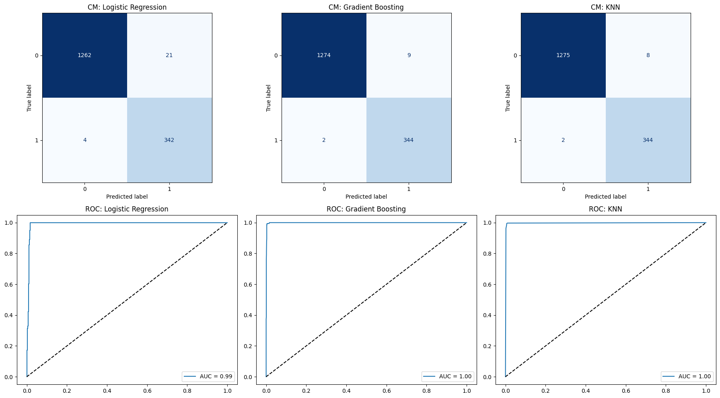
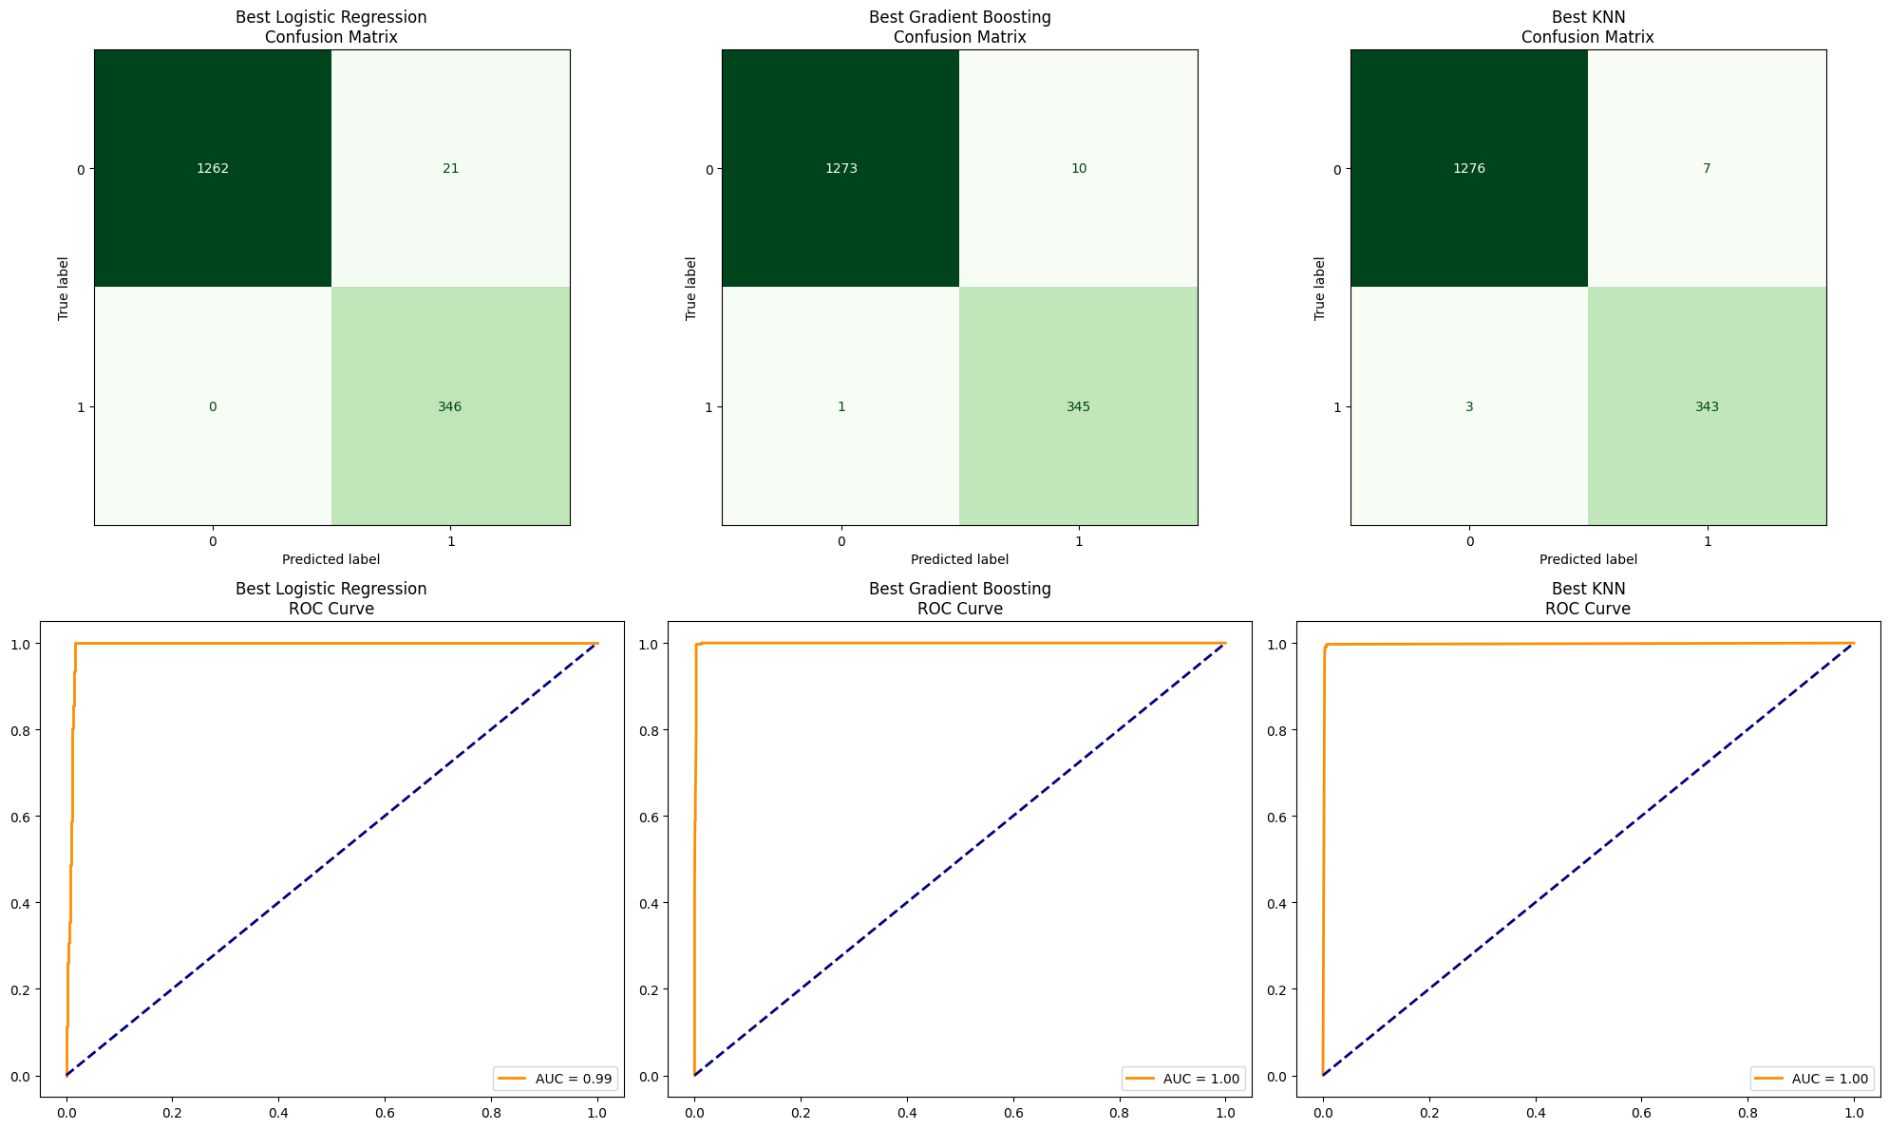
Model Results & Performance
Final Model Comparison (After Tuning)
Confusion Matrix / ROC
Model | Accuracy | Precision | Recall | F1 Score
Logistic Regression | 0.9871 | 0.9498 | 0.9932 | 0.9705
Gradient Boosting ★ | 0.9932 | 0.9811 | 0.9880 | 0.9843
KNN | 0.9939 | 0.9689 | 0.9827 | 0.9758
ROC Curve
Winner: Gradient Boosting
• Accuracy: 99.32% | F1: 98.43%
• Precision: 98.11% (only 1.89% false alarms)
• Recall: 98.80% (misses only 1.20%)
• ROC-AUC: ~0.99 (exceptional)
• Best precision-recall balance of all models
• Selected for SHAP interpretability
Smart Building Occupancy Detection | Anu Bhukya | University of Hertfordshire

Slide 11
Hyperparameter Tuning & Cross-Validation
Grid Search Best Results
5-Fold CV: Gradient Boosting
Model | Best F1 | Best Params
LogReg | 0.9705 | C=0.1, solver=lbfgs
GB ★ | 0.9843 | n_est=50, lr=0.05, depth=5
KNN | 0.9856 | k=3, weights=distance
Metric | Mean | Std Dev
Accuracy | 0.9934 | ±0.0022
Precision | 0.9811 | ±0.0061
Recall | 0.9880 | ±0.0058
F1 Score | 0.9845 | ±0.0046
Training Time: LR 4.23s | GB 3.87s | KNN 5.12s
5-Fold CV Comparison — All Models
Model | CV Acc | CV Prec | CV Recall | CV F1 | Stability
LogReg | 0.9875±0.0015 | 0.9498±0.0113 | 0.9932±0.0049 | 0.9709±0.0048 | Good
GB ★ | 0.9934±0.0022 | 0.9811±0.0061 | 0.9880±0.0058 | 0.9845±0.0046 | Best ★
KNN | 0.9897±0.0022 | 0.9689±0.0056 | 0.9827±0.0081 | 0.9758±0.0054 | Good
Smart Building Occupancy Detection | Anu Bhukya | University of Hertfordshire

Slide 12
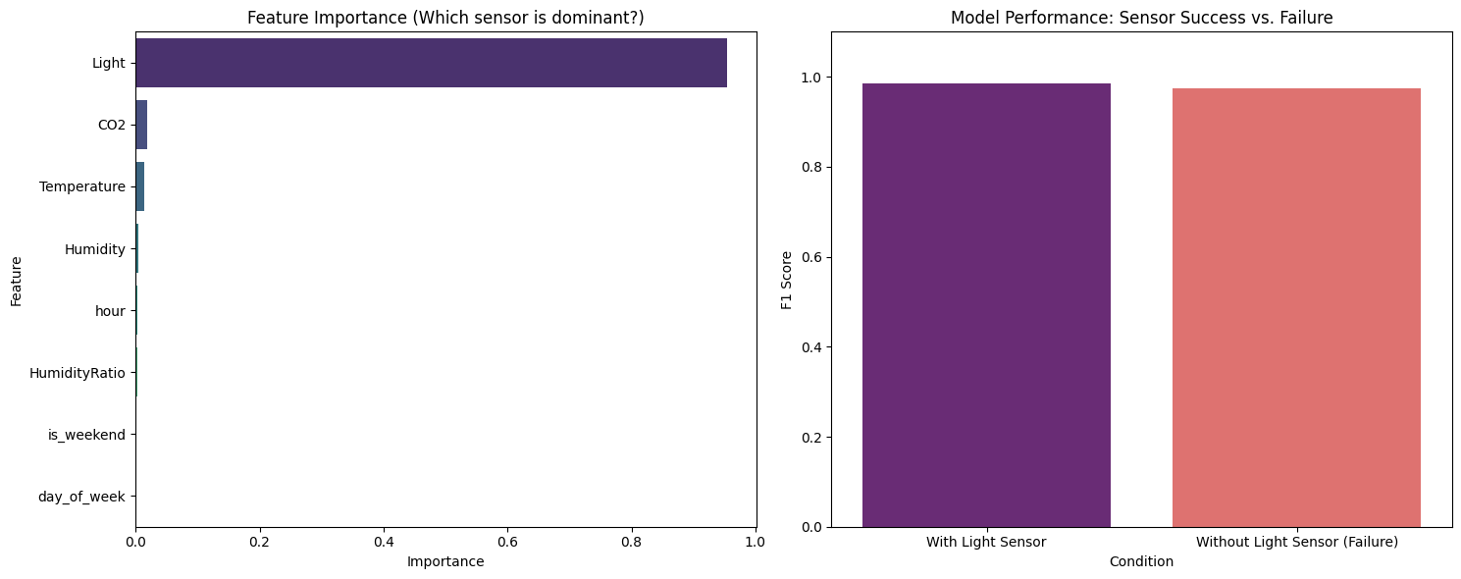
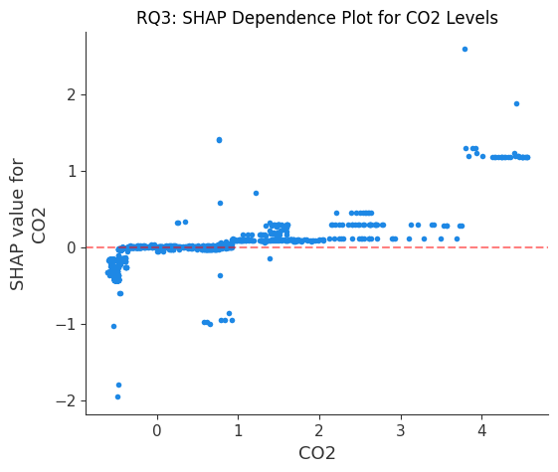
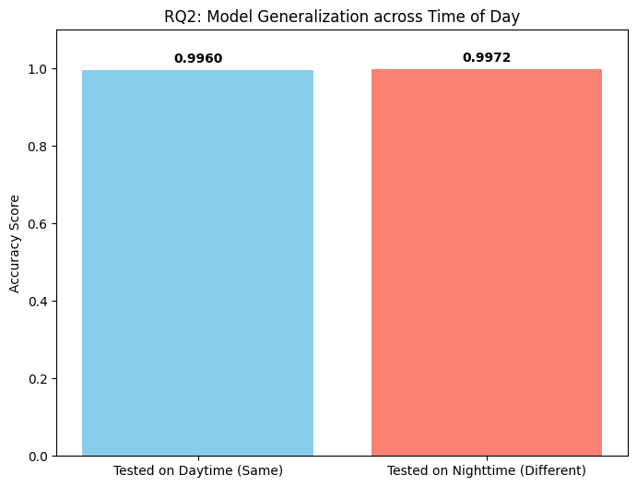
Analysis & Feature Importance
Feature Importance (GB)
SHAP Dependence — CO2
Temporal Generalisation (RQ2)
Key Analysis Findings
Feature Dominance:
• Light: 55-60% importance (primary)
• CO2: 25-30% (secondary)
• HumidityRatio: 8-12%
• Temp/Humidity/Temporal: <5% each
Sensor Failure Resilience:
• Without Light: F1 drops only 1.02% (0.9843→0.9743)
• CO2 compensates effectively
Temporal (RQ2):
• Day accuracy: 99.60%
• Night accuracy: 99.72% (generalises well!)
Smart Building Occupancy Detection | Anu Bhukya | University of Hertfordshire

Slide 13
Summary & Conclusions
Key Findings
Limitations & Future Work
• Gradient Boosting achieves 99.32% accuracy and 98.43% F1 — production-ready performance
• Light sensor dominates (55-60% importance) with CO2 as effective backup (25-30%)
• Model generalises from daytime to nighttime with 99.72% accuracy — no retraining needed
• SHAP confirms non-linear CO2 dependence (RQ3) — validates tree-based approach over linear models
• System resilient to Light sensor failure (only 1.02% F1 drop)
Limitations:
• Single building type (office, Feb 2015)
• No seasonal variation tested
• Binary occupancy only (no count estimation)
• Limited sensor types (no motion/WiFi)
Future Directions:
• LSTM/GRU for sequential temporal patterns
• Multi-building transfer learning
• Sensor fusion (motion, door, WiFi presence)
• Edge deployment for real-time IoT inference
• Differential privacy for occupant protection
• Occupancy count prediction (multi-class)
Research Questions Answered
RQ1: Gradient Boosting is the most effective model (F1=0.9843, best precision-recall balance, CV stability ±0.0046).
RQ2: Daytime-trained model generalises to nighttime with 99.72% accuracy — sensor signals are time-invariant for occupancy.
RQ3: SHAP reveals non-linear CO2 dependence and confirms Light as dominant sensor through feature interaction analysis.
Smart Building Occupancy Detection | Anu Bhukya | University of Hertfordshire

Slide 14
References
Candanedo, L.M. and Feldheim, V. (2016) 'Accurate occupancy detection of an office room from light, temperature, humidity and CO2 measurements using statistical learning models', Energy and Buildings, 112, pp. 28–39.
Friedman, J.H. (2001) 'Greedy function approximation: A gradient boosting machine', Annals of Statistics, 29(5), pp. 1189–1232.
Cover, T. and Hart, P. (1967) 'Nearest neighbor pattern classification', IEEE Transactions on Information Theory, 13(1), pp. 21–27.
Lundberg, S.M. and Lee, S.I. (2017) 'A unified approach to interpreting model predictions', Advances in Neural Information Processing Systems, 30, pp. 4765–4774.
Pedregosa, F. et al. (2011) 'Scikit-learn: Machine Learning in Python', Journal of Machine Learning Research, 12, pp. 2825–2830.
Hosmer, D.W., Lemeshow, S. and Sturdivant, R.X. (2013) Applied Logistic Regression. 3rd edn. Hoboken: John Wiley & Sons.
UCI Machine Learning Repository (2015) Occupancy Detection Data Set. Available at: https://archive.ics.uci.edu/ml/datasets/Occupancy+Detection (Accessed: January 2026).
Dua, D. and Graff, C. (2019) UCI Machine Learning Repository. Irvine, CA: University of California, School of Information and Computer Science.
Smart Building Occupancy Detection | Anu Bhukya | University of Hertfordshire

