Slide 1

The Database of Genomic Variants
A curated collection of structural variation in the human genome

Slide 2
Content
History
Data structure
Position in the DB ecosystem

Slide 3

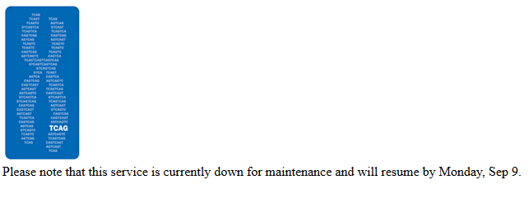

Slide 4
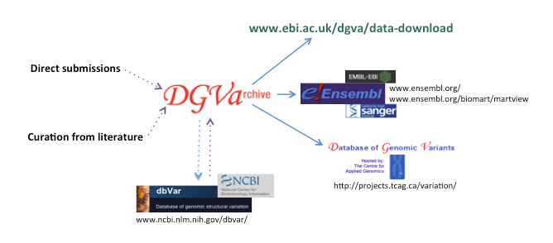
In 2008, a collaboration with DGVa and dbVar was established to create an archive, which allowed for the implementation of standardized terminology and assignment of formal accession numbers ensuring seamless access to SV data.
A pipeline was developed to exchange data between the DGVa and dbVar archives, and from the archives all data sets describing SV in healthy human control samples are sent to DGV for curation, interpretation and display.

Slide 5
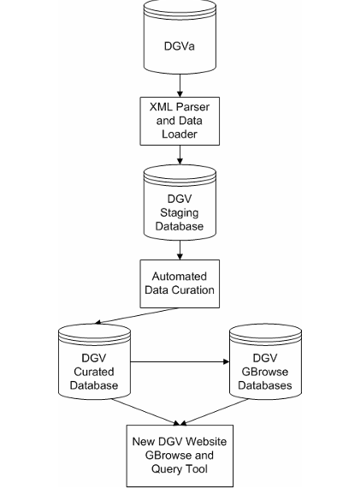
Overview of the process
Datasets are extracted from DGVa and processed through the DGV pipeline.
Relevant data is extracted by the XML parser from each study and loaded into the initial database.
Several automated quality control filters are applied, before the data is migrated into the final database tables and loaded into gbrowse.

Slide 6
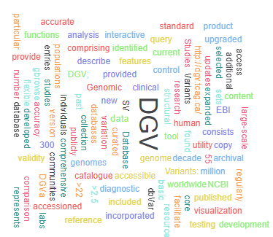
General Information
URL: http://dgv.tcag.ca/dgv/app/home
Full Name: Database of Genomic Variants
Year Founded: 2014
Last Update: 2020
Version: v2.0
Country: Canada
University: University of Toronto
PI/Team: Stephen W. Scherer

Slide 7
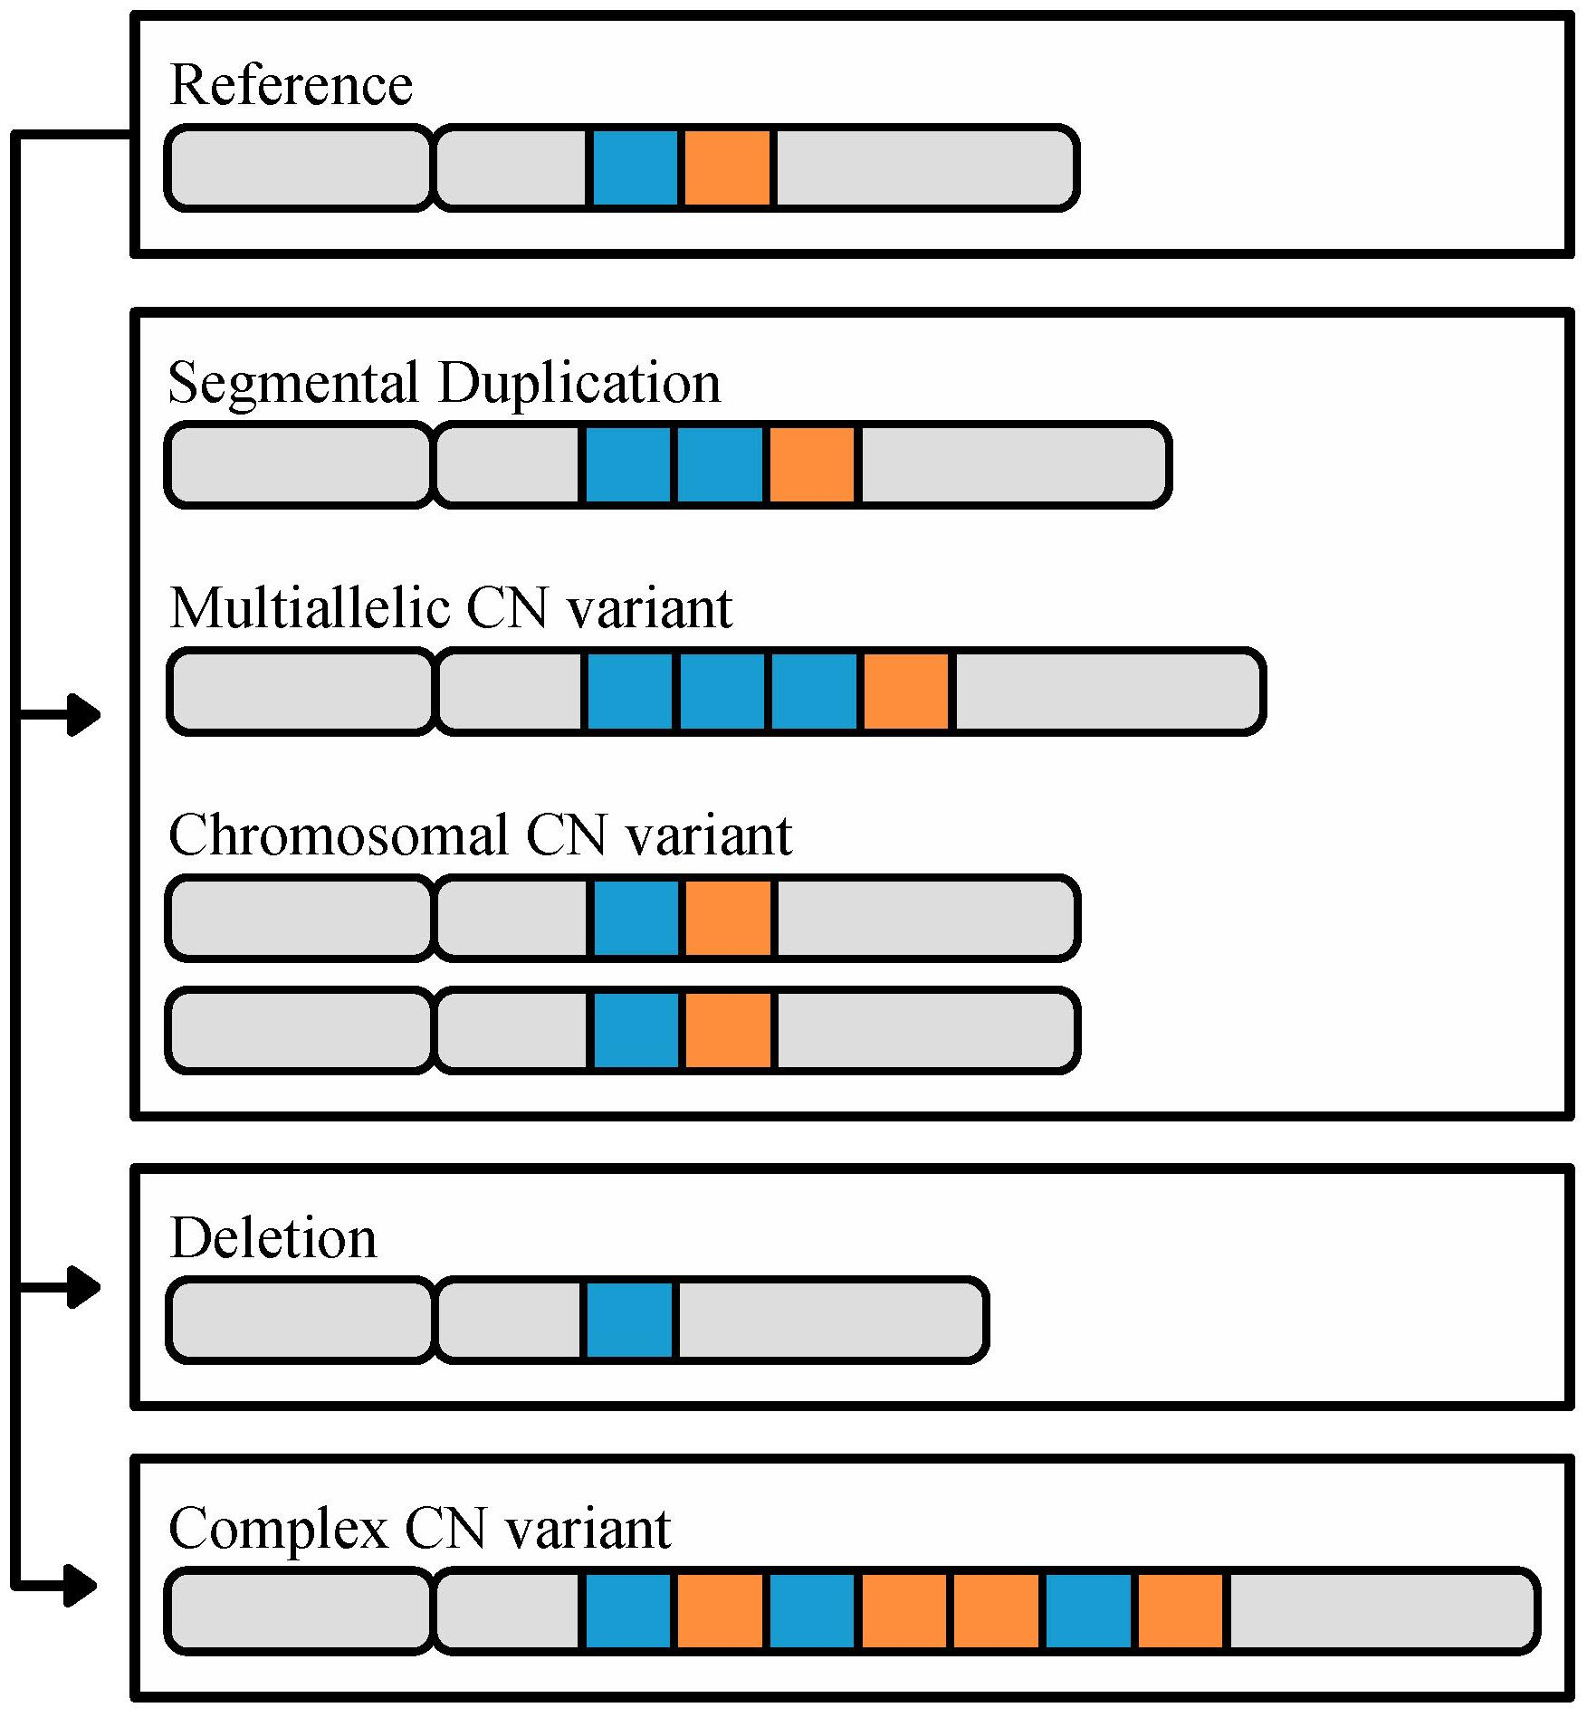
Classification
Data type: DNA
Data object: Animal
DB category: Genotype phenotype and variation
Major species: Homo sapiens
Rank
All Databases: 183/6264
Genotype, phenotype and variation :31/897
Citations: 692
Z-index: 69.2
This Photo by Unknown Author is licensed under CC BY

Slide 8
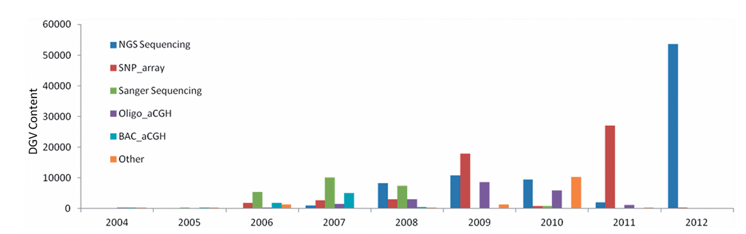
Content of the DGV. Increase in variants reported in DGV
since inception

Slide 9
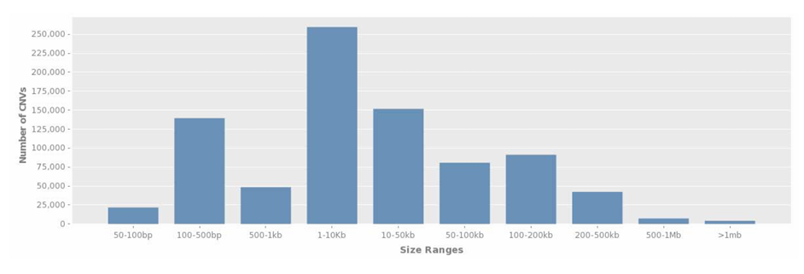
Reported Size distribution of entries in DGV.

Slide 10

Individual variant types mapped to hg19 assembly
in 2014 and 2020
Variant Subtype | 2014 Data Content | 2020 Data Content
Duplication | 668 | 72788
Gain+Loss | 3850 | 7062
Gain | 24891 | 47482
Loss | 64185 | 123868
Deletion | 77268 | 331273
Complex | 4090 | 5539
Insertion | 24140 | 116265
Novel sequence insertion | - | 12636
Inversion | 1149 | 3556
Mobile element insertion | - | 5418
Sequence alteration | - | 9480
Tandem duplication | - | 3703

Slide 11
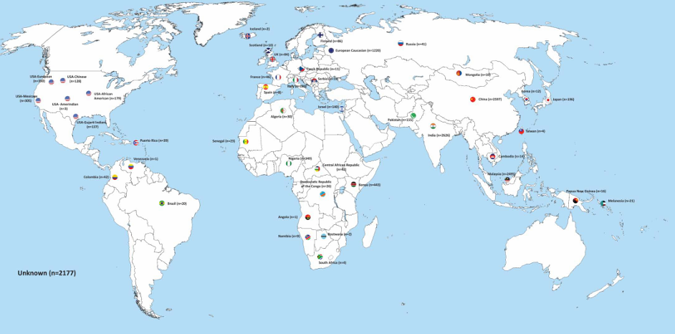
Geographic distribution of samples used

Slide 12
hg18 Data

Slide 13
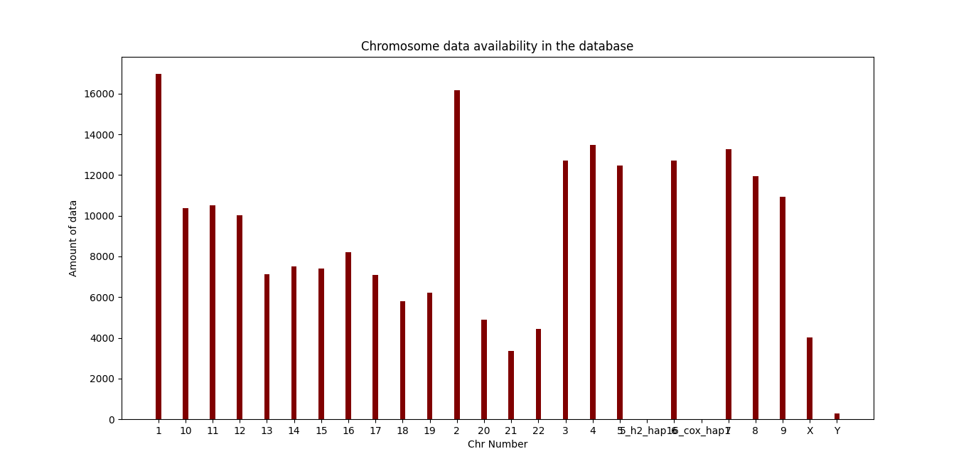

Slide 14
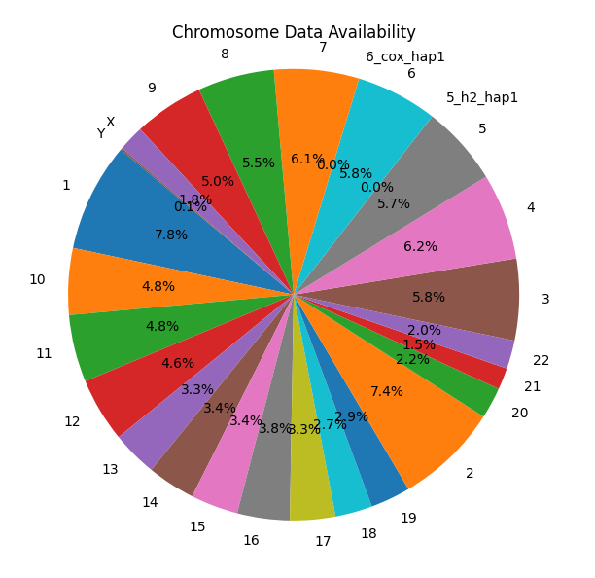

Slide 15
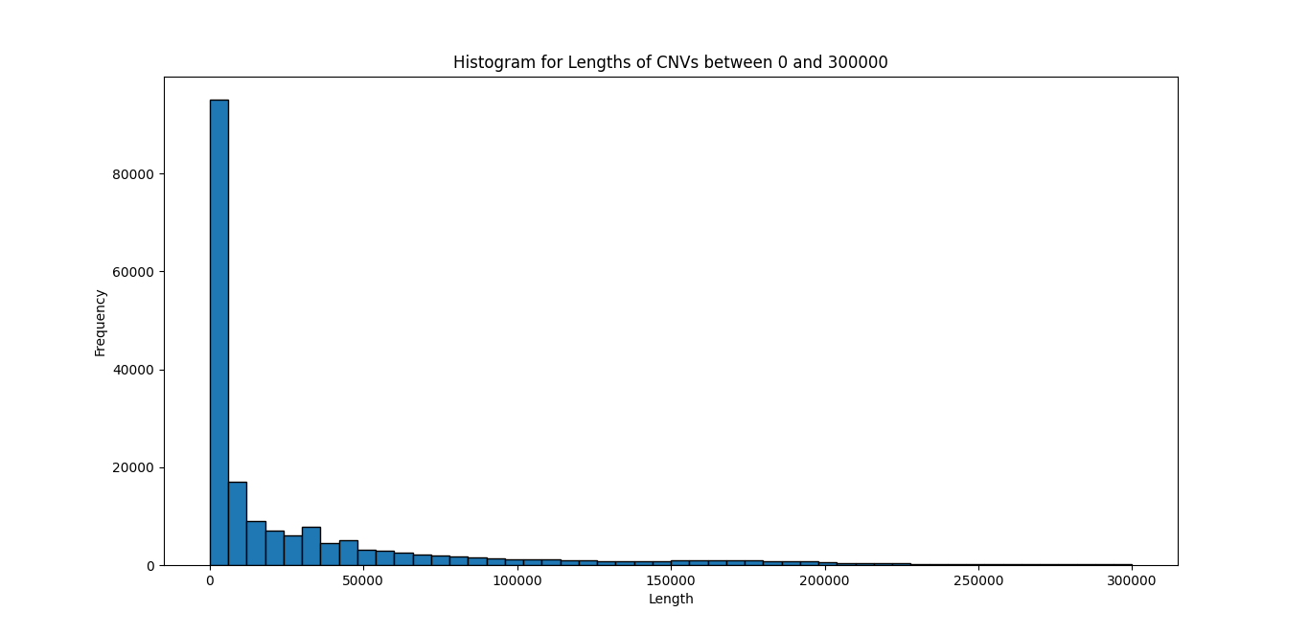

Slide 16
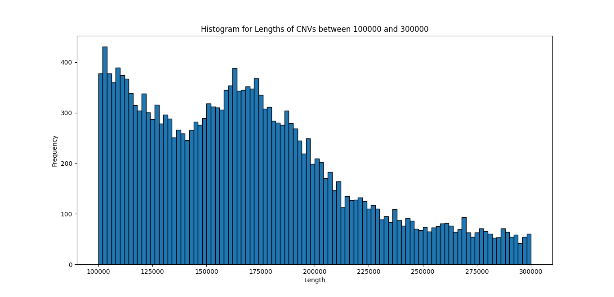

Slide 17
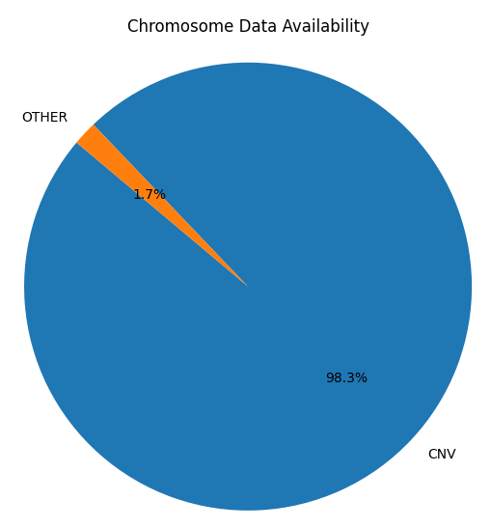

Slide 18
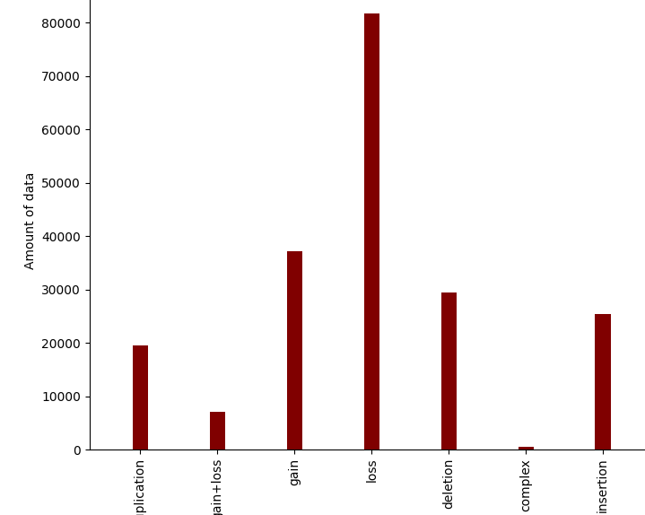

Slide 19
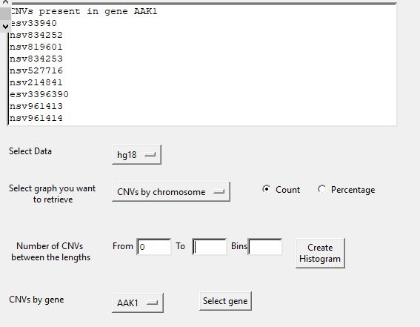

Slide 20
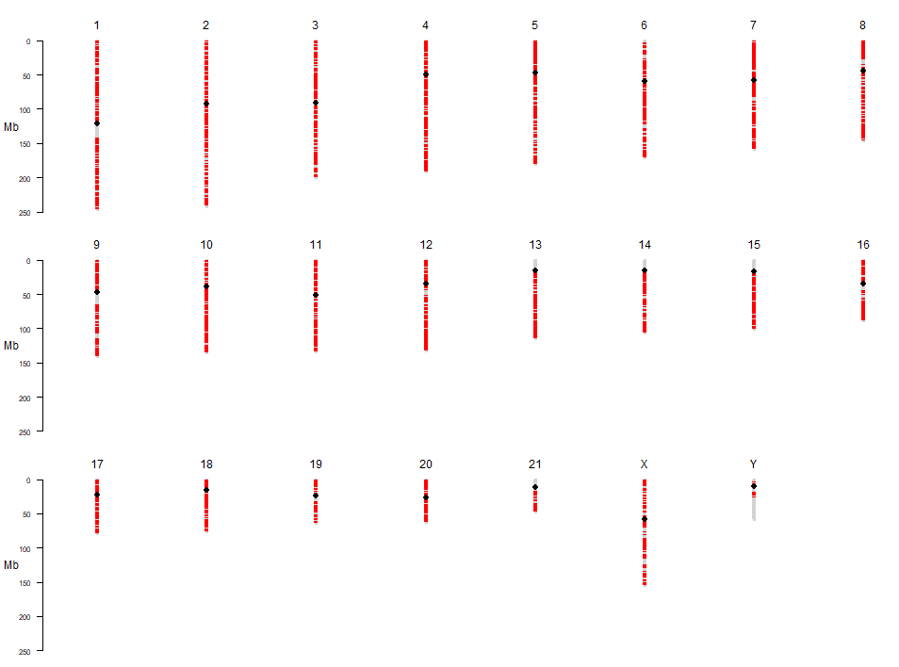


Slide 21
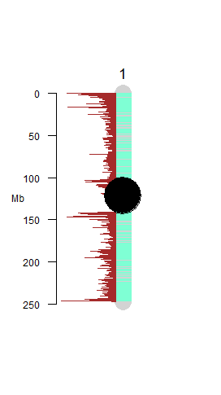
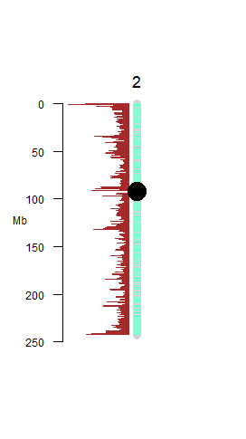
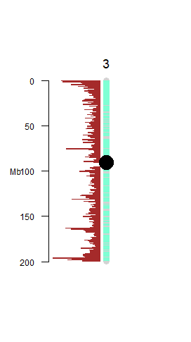
CNVs through human genome

Slide 22
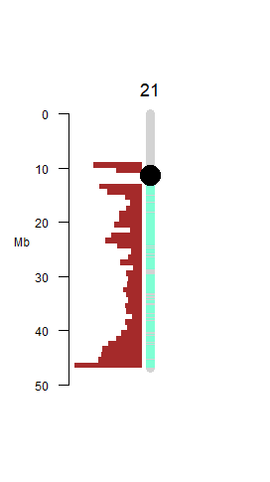
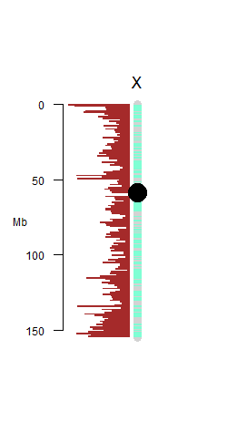
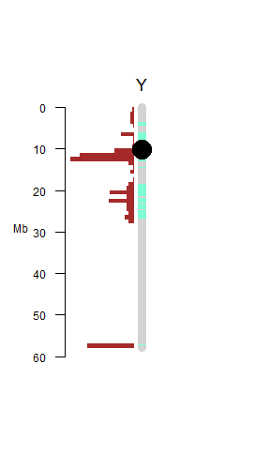

Slide 23
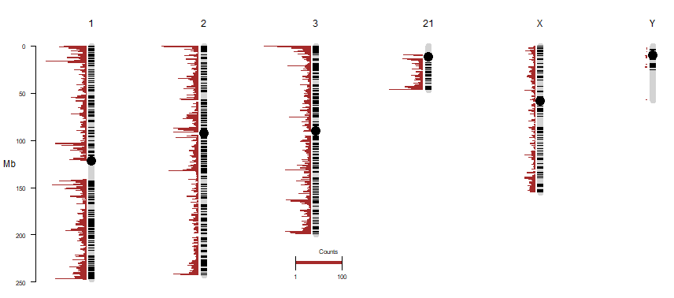
Gains

Slide 24
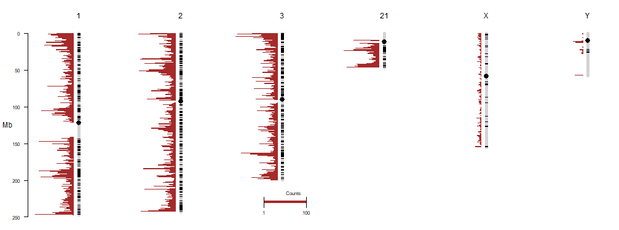
Losses

Slide 25
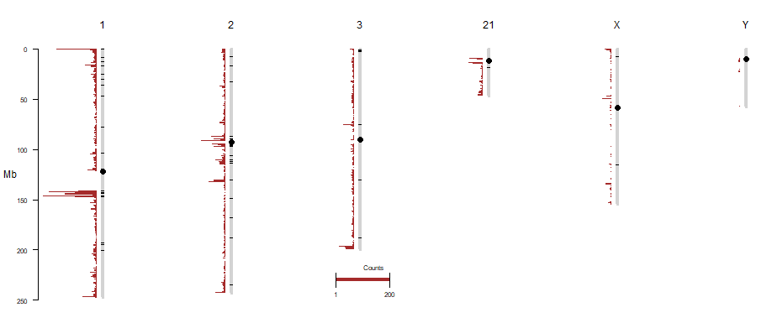
Duplications

Slide 26
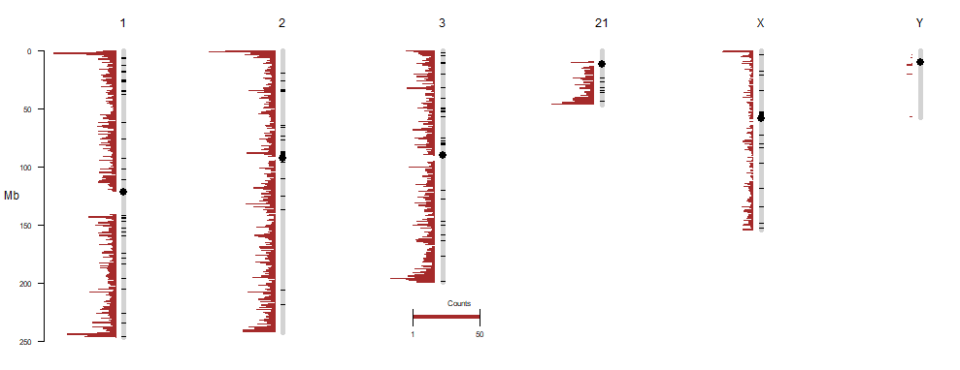
Deletions

Slide 27
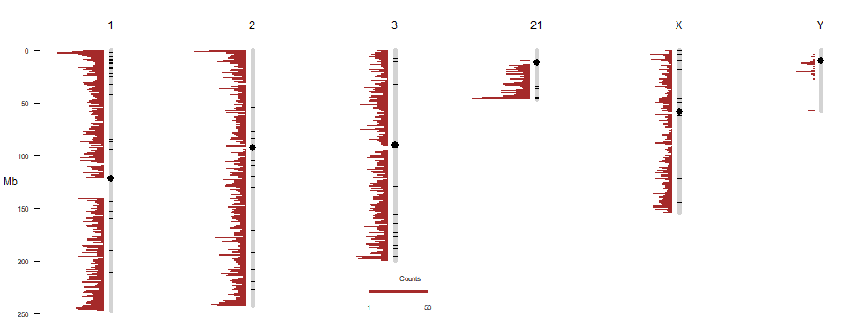
Insertions

Slide 28
Kruskal Wallis Test
Hypothesis
Alternative:
Lengths of Gains, Losses, Insertions, Deletions, Duplications are not equal to each other
Null:
Lengths of Gains, Losses, Insertions, Deletions, Duplications are equal to each other

Slide 29
Summary Statistics
 | Sub Variant | Variable | n | Min | Max | Median | iqr | Mean | SD | se | ci
1 | deletion | LengthOfCnv | 29453 | 49 | 2950766 | 818 | 4900.0 | 10754.28 | 60115.31 | 350.284 | 686.572
2 | duplication | LengthOfCnv | 19549 | 49 | 2713165 | 2803 | 6788.0 | 12486.54 | 51770.09 | 370.268 | 725.758
3 | gain | LengthOfCnv | 37200 | 49 | 2978700 | 48182 | 143705.8 | 119705.58 | 212674.48 | 1102.666 | 2161.256
4 | insertion | LengthOfCnv | 16970 | 1 | 2570323 | 179 | 24352.0 | 13244.16 | 49632.29 | 380.999 | 746.797
5 | loss | LengthOfCnv | 81727 | 49 | 2997172 | 11760 | 45765.0 | 47578.07 | 114768.35 | 401.457 | 786.853

Slide 30
Results and conclusion
.y. | n | statistic | df | p | method
LengthOfCnv | 184899 | 46320.64 | 4 | 0 | Kruskal-Wallis
P=0
Null hypothesis is rejected
At 95% confidence interval, lengths of Gains, Losses, Insertions, Deletions, Duplications are not equal to each other

Slide 31
Duncan Test results for pairwise comparison
 | .y. | group1 | group2 | n1 | n2 | statistic | p | Adj.p | p.adj.sig
1 | LengthOfCnv | deletion | duplication | 29453 | 19549 | 39.323266 | 0.000000e+00 | 0.000000e+00 | ****
2 | LengthOfCnv | deletion | gain | 29453 | 37200 | 174.469677 | 0.000000e+00 | 0.000000e+00 | ****
3 | LengthOfCnv | deletion | insertion | 29453 | 16970 | -6.596412 | 4.212278e-11 | 4.212278e-10 | ****
4 | LengthOfCnv | deletion | loss | 29453 | 81727 | 133.616202 | 0.000000e+00 | 0.000000e+00 | ****
5 | LengthOfCnv | duplication | gain | 19549 | 37200 | 112.979054 | 0.000000e+00 | 0.000000e+00 | ****
6 | LengthOfCnv | duplication | insertion | 19549 | 16970 | -40.635037 | 0.000000e+00 | 0.000000e+00 | ****
7 | LengthOfCnv | duplication | loss | 19549 | 81727 | 68.491685 | 0.000000e+00 | 0.000000e+00 | ****
8 | LengthOfCnv | gain | insertion | 37200 | 16970 | -153.764410 | 0.000000e+00 | 0.000000e+00 | ****
9 | LengthOfCnv | gain | loss | 37200 | 81727 | -72.383553 | 0.000000e+00 | 0.000000e+00 | ****
10 | LengthOfCnv | insertion | loss | 16970 | 81727 | 115.181678 | 0.000000e+00 | 0.000000e+00 | ****

Slide 32
P=0
At 95% confidence interval, lengths of Gains, Losses, Insertions, Deletions, Duplications are not equal to each other for each of the pairings

Slide 33
hg19 Data

Slide 34
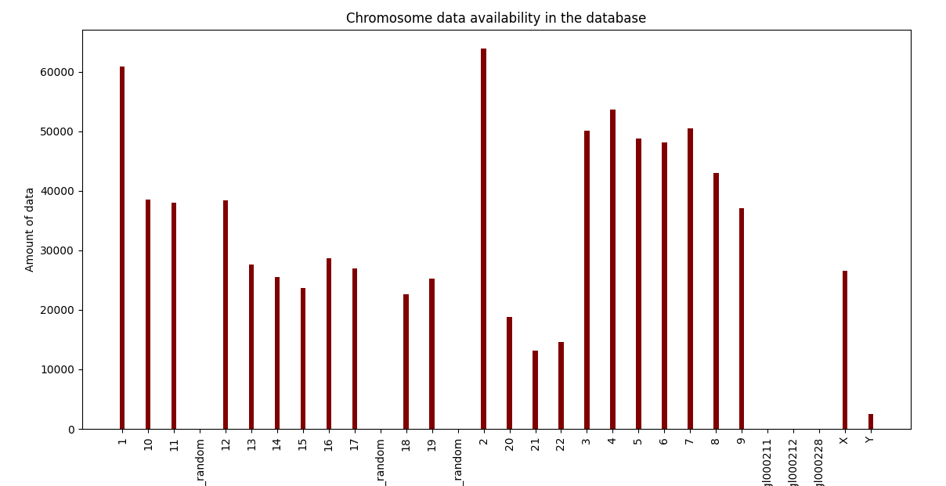

Slide 35
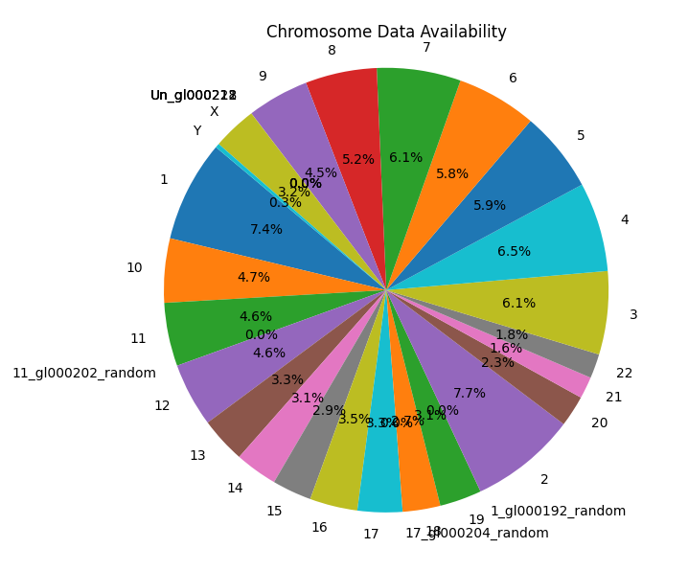

Slide 36
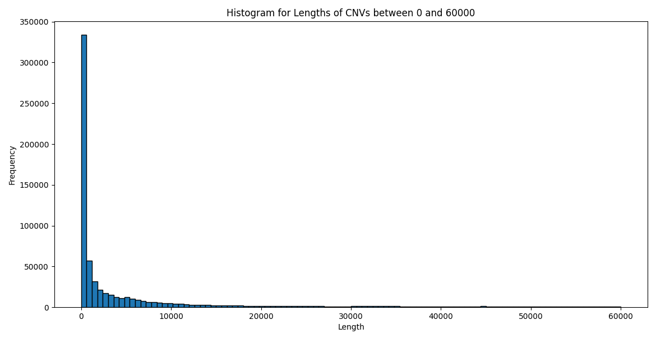

Slide 37
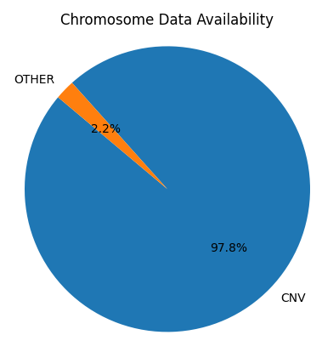

Slide 38
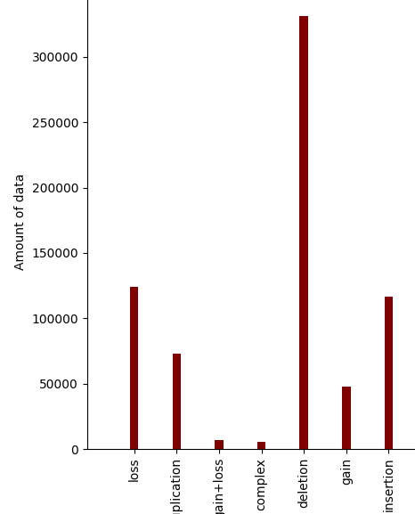

Slide 39
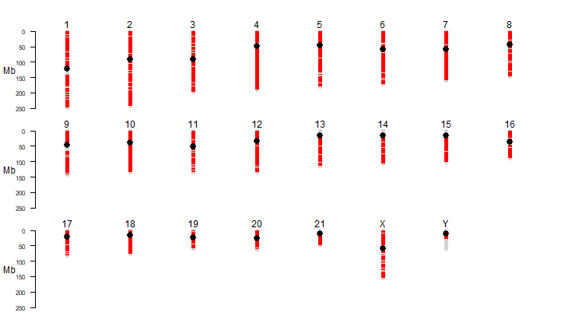

Slide 40
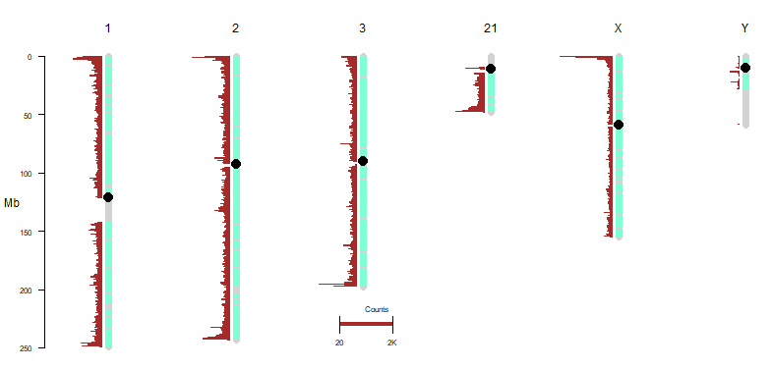
CNVs through entire human genome

Slide 41
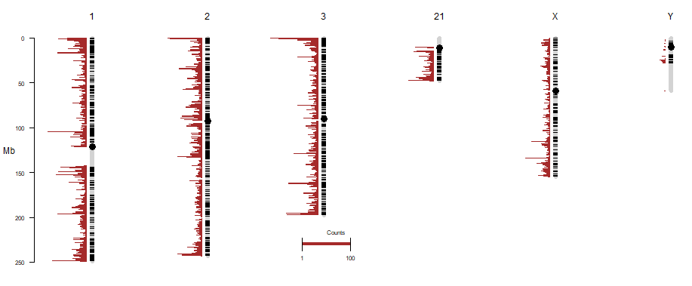
Gains

Slide 42
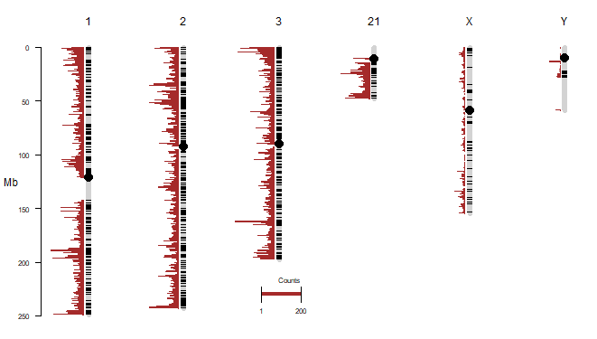
Losses

Slide 43
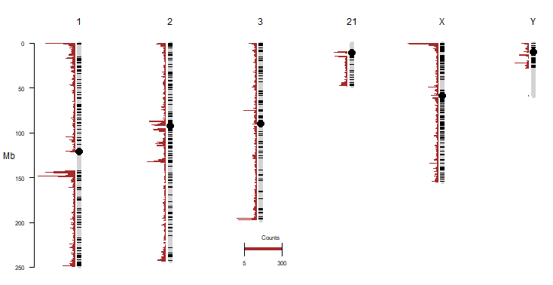
Duplications

Slide 44
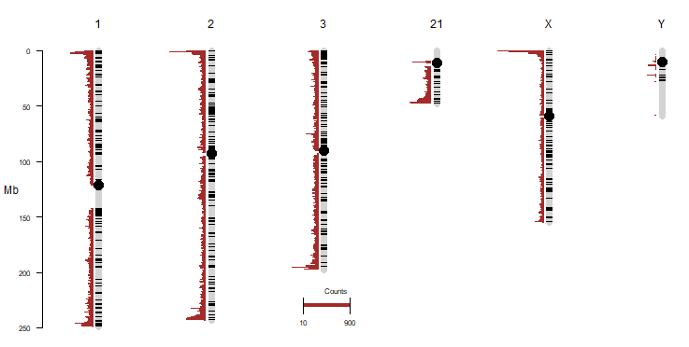
Deletions

Slide 45
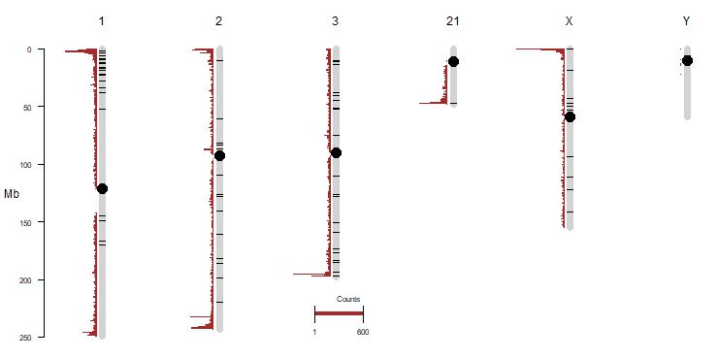
Insertions

Slide 46
Kruskal Wallis Test
Hypothesis
Alternative:
Lengths of Gains, Losses, Insertions, Deletions, Duplications are not equal to each other
Null:
Lengths of Gains, Losses, Insertions, Deletions, Duplications are equal to each other

Slide 47
Summary Statistics
 | Sub Variant | Variable | n | Min | Max | Median | iqr | Mean | SD | se | ci
1 | deletion | LengthOfCnv | 331273 | 38 | 3182484 | 442.0 | 2391.00 | 6350.464 | 45301.31 | 78.708 | 154.265
2 | duplication | LengthOfCnv | 72788 | 49 | 2713164 | 4400.0 | 14020.00 | 25640.265 | 90408.91 | 335.105 | 656.805
3 | gain | LengthOfCnv | 47482 | 49 | 3687621 | 42482.5 | 120987.75 | 108571.577 | 201420.81 | 924.357 | 1811.753
4 | insertion | LengthOfCnv | 43999 | 1 | 2789149 | 1.0 | 53.00 | 5124.726 | 32755.17 | 156.156 | 306.068
5 | loss | LengthOfCnv | 123868 | 49 | 3055198 | 7678.0 | 30886.25 | 36982.059 | 101275.29 | 287.756 | 563.996

Slide 48
Results and conclusion
.y. | n | statistic | df | p | method
1 | LengthOfCnv | 619410 | 232041.9 | 4 | 0 | Kruskal-Wallis
P=0
Null hypothesis is rejected
At 95% confidence interval, lengths of Gains, Losses, Insertions, Deletions, Duplications are not equal to each other

Slide 49
Duncan Test results for pairwise comparison
.y. | group1 | group2 | n1 | n2 | statistic | p | p.adj | p.adj.signif
1 | LengthOfCnv | deletion | duplication | 331273 | 72788 | 170.34556 | 0 | 0 | ****
2 | LengthOfCnv | deletion | gain | 331273 | 47482 | 299.28881 | 0 | 0 | ****
3 | LengthOfCnv | deletion | insertion | 331273 | 43999 | -158.08580 | 0 | 0 | ****
4 | LengthOfCnv | deletion | loss | 331273 | 123868 | 322.36963 | 0 | 0 | ****
5 | LengthOfCnv | duplication | gain | 72788 | 47482 | 130.75096 | 0 | 0 | ****
6 | LengthOfCnv | duplication | insertion | 72788 | 43999 | -248.30720 | 0 | 0 | ****
7 | LengthOfCnv | duplication | loss | 72788 | 123868 | 80.57543 | 0 | 0 | ****
8 | LengthOfCnv | gain | insertion | 47482 | 43999 | -343.15783 | 0 | 0 | ****
9 | LengthOfCnv | gain | loss | 47482 | 123868 | -73.18103 | 0 | 0 | ****
10 | LengthOfCnv | insertion | loss | 43999 | 123868 | 337.98575 | 0 | 0 | ****

Slide 50
P=0
At 95% confidence interval, lengths of Gains, Losses, Insertions, Deletions, Duplications are not equal to each other for each of the pairings

Slide 51
hg38 Data

Slide 52
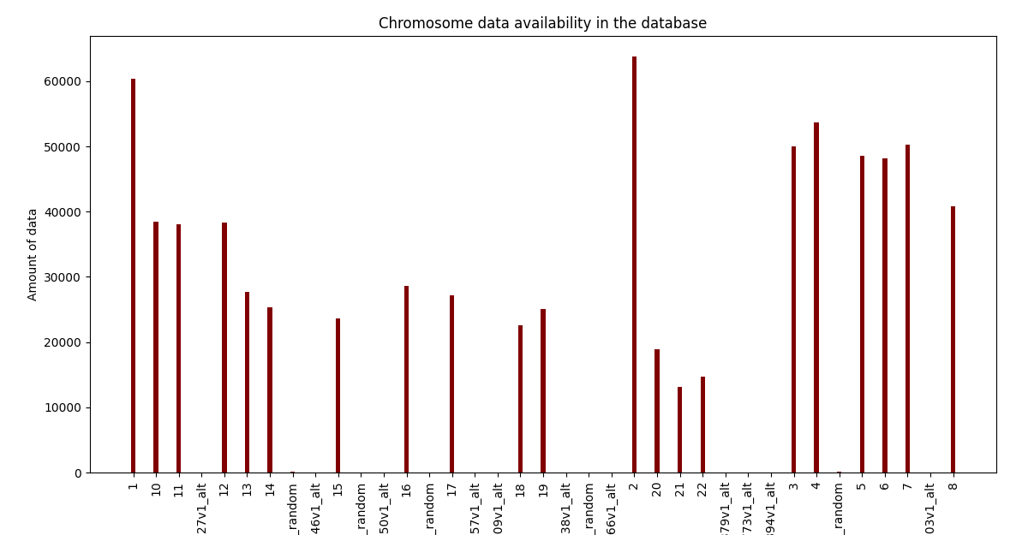

Slide 53
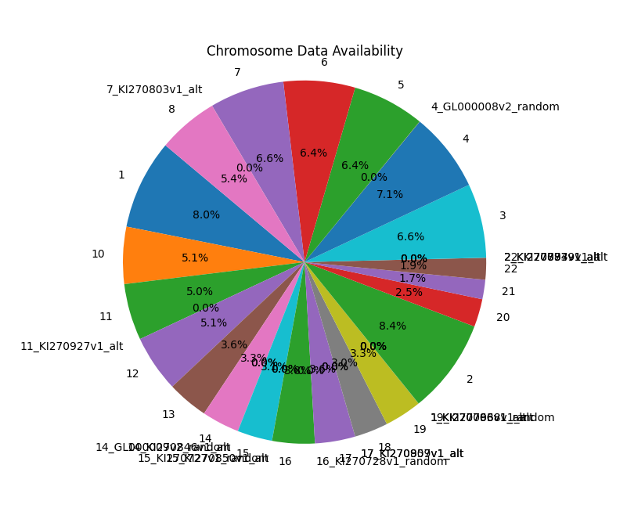

Slide 54
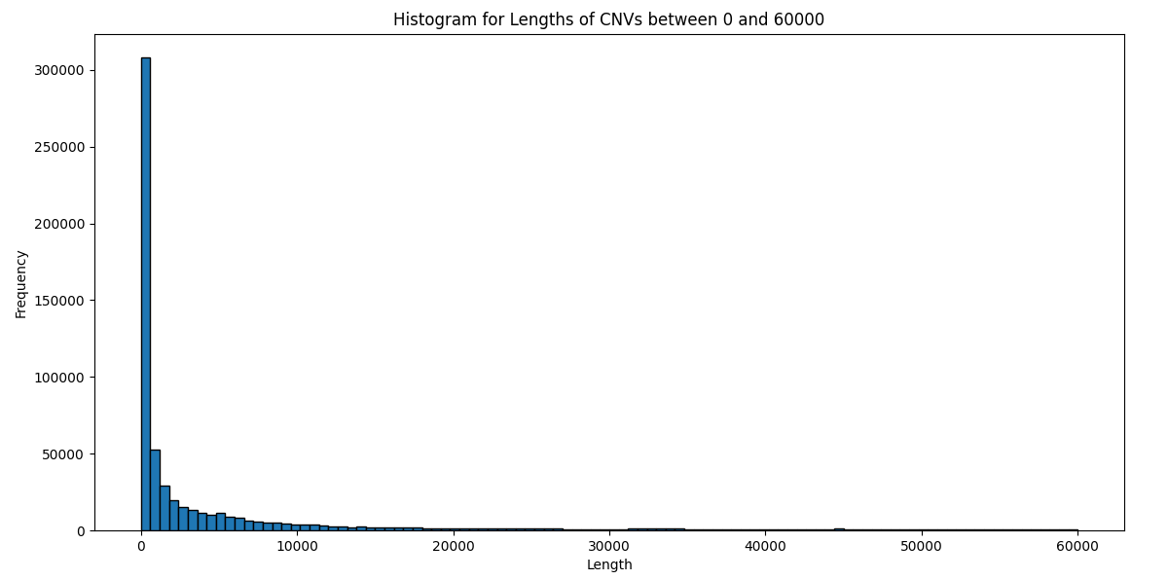

Slide 55


Slide 56
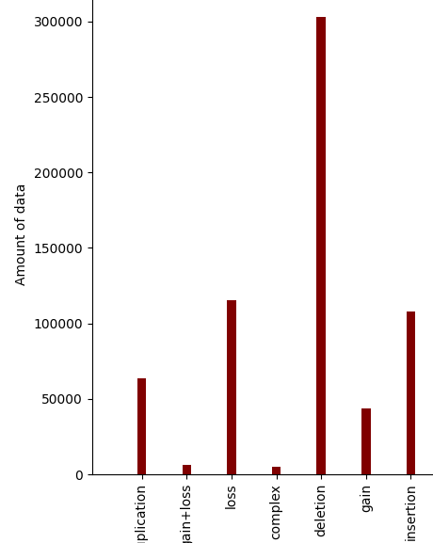

Slide 57
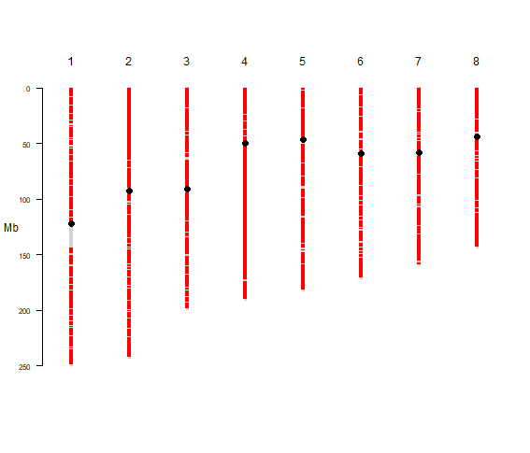
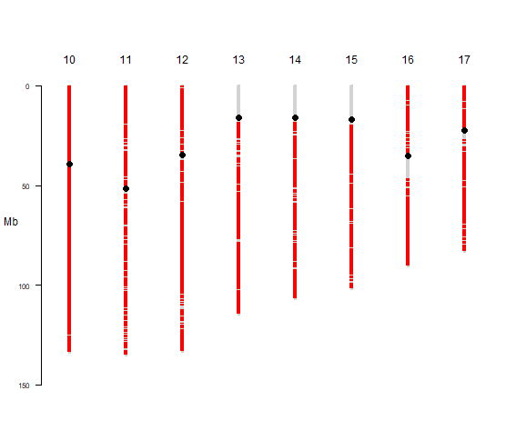
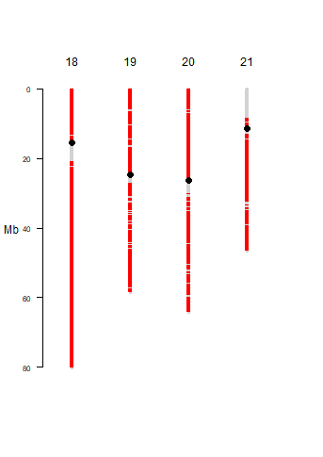

Slide 58
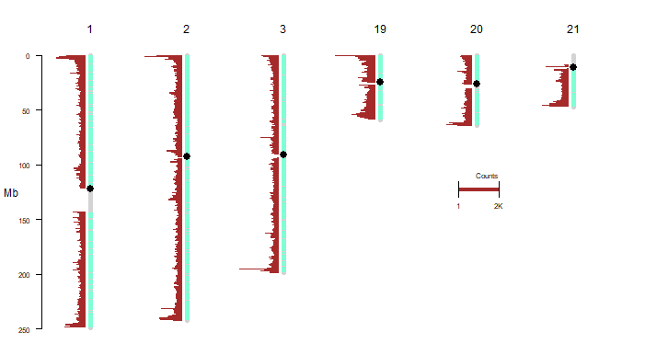
CNVs through entire human genome

Slide 59
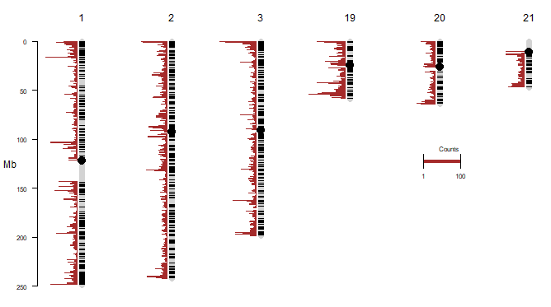
Gains

Slide 60
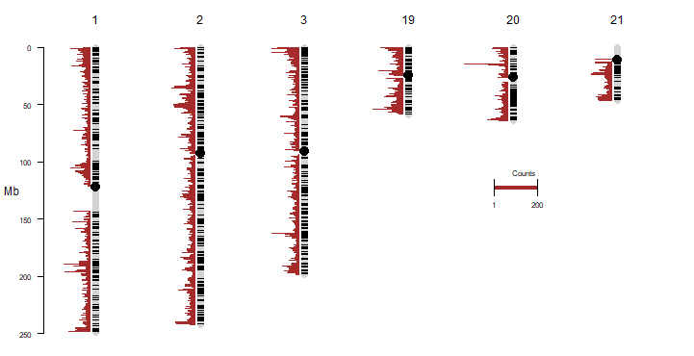
Losses

Slide 61
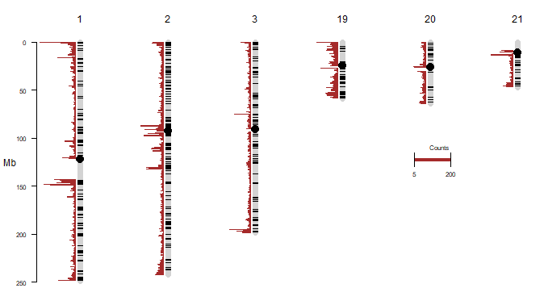
Duplications

Slide 62

Deletions

Slide 63

Insertions

Slide 64
Kruskal Wallis Test
Hypothesis
Alternative:
Lengths of Gains, Losses, Insertions, Deletions, Duplications are not equal to each other
Null:
Lengths of Gains, Losses, Insertions, Deletions, Duplications are equal to each other

Slide 65
Summary Statistics
 | subvar | variable | n | min | max | median | iqr | mean | sd | se | ci
1 | deletion | LengthOfCnv | 303097 | 44 | 3000544 | 438.0 | 2325.0 | 6074.433 | 43588.16 | 79.173 | 155.177
2 | duplication | LengthOfCnv | 63711 | 49 | 2975083 | 4044.0 | 13539.0 | 25206.127 | 93545.63 | 370.609 | 726.395
3 | gain | LengthOfCnv | 43530 | 49 | 3754095 | 42886.5 | 120641.5 | 107068.330 | 199254.17 | 955.021 | 1871.859
4 | insertion | LengthOfCnv | 40785 | 1 | 3073797 | 1.0 | 51.0 | 4908.790 | 32378.50 | 160.327 | 314.244
5 | loss | LengthOfCnv | 115461 | 49 | 3348080 | 7576.0 | 30715.0 | 36293.246 | 97464.11 | 286.832 | 562.186

Slide 66
Results and conclusion
 | .y. | n | statistic | df | p | method
1 | LengthOfCnv | 566584 | 214699.5 | 4 | 0 | Kruskal-Wallis
P=0
Null hypothesis is rejected
At 95% confidence interval, lengths of Gains, Losses, Insertions, Deletions, Duplications are not equal to each other

Slide 67
Duncan Test results for pairwise comparison
 | .y. | group1 | group2 | n1 | n2 | statistic | p | p.adj | p.adj.signif
1 | LengthOfCnv | deletion | duplication | 303097 | 63711 | 155.48581 | 0 | 0 | ****
2 | LengthOfCnv | deletion | gain | 303097 | 43530 | 287.21027 | 0 | 0 | ****
3 | LengthOfCnv | deletion | insertion | 303097 | 40785 | -153.82511 | 0 | 0 | ****
4 | LengthOfCnv | deletion | loss | 303097 | 115461 | 311.22796 | 0 | 0 | ****
5 | LengthOfCnv | duplication | gain | 63711 | 43530 | 127.76094 | 0 | 0 | ****
6 | LengthOfCnv | duplication | insertion | 63711 | 40785 | -234.79882 | 0 | 0 | ****
7 | LengthOfCnv | duplication | loss | 63711 | 115461 | 80.78108 | 0 | 0 | ****
8 | LengthOfCnv | gain | insertion | 43530 | 40785 | -331.34704 | 0 | 0 | ****
9 | LengthOfCnv | gain | loss | 43530 | 115461 | -70.37106 | 0 | 0 | ****
10 | LengthOfCnv | insertion | loss | 40785 | 115461 | 327.70705 | 0 | 0 | ****

Slide 68
P=0
At 95% confidence interval, lengths of Gains, Losses, Insertions, Deletions, Duplications are not equal to each other for each of the pairings

Slide 69
References
MacDonald, J.R., Ziman, R., Yuen, R.K.C., Feuk, L. and Scherer, S.W. (2013). The Database of Genomic Variants: a curated collection of structural variation in the human genome. Nucleic Acids Research, [online] 42(D1), pp.D986–D992. doi:https://doi.org/10.1093/nar/gkt958.
Mishra, S. and Whetstine, J.R. (2016). Different Facets of Copy Number Changes: Permanent, Transient, and Adaptive. Molecular and Cellular Biology, 36(7), pp.1050–1063. doi:https://doi.org/10.1128/mcb.00652-15.
‌
‌

