Slide 1

FHL 2026 PROJECT SHOWCASE
Catch the invisible
before it ships.
Accessibility Tree Snapshot & Diff for React Native Windows
Real Gallery · Real UIA · Real regression
Built end-to-end during FHL: implementation, tests, hardening, live validation, and demo.
Notes:
Hi everyone. Here's what we built during FHL: a tool that catches React Native Windows accessibility regressions you simply can't see in a screenshot.

Slide 2
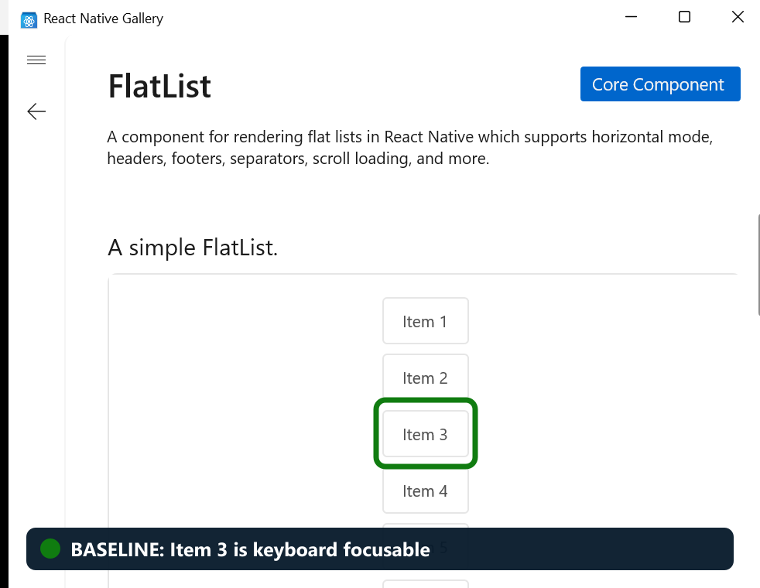
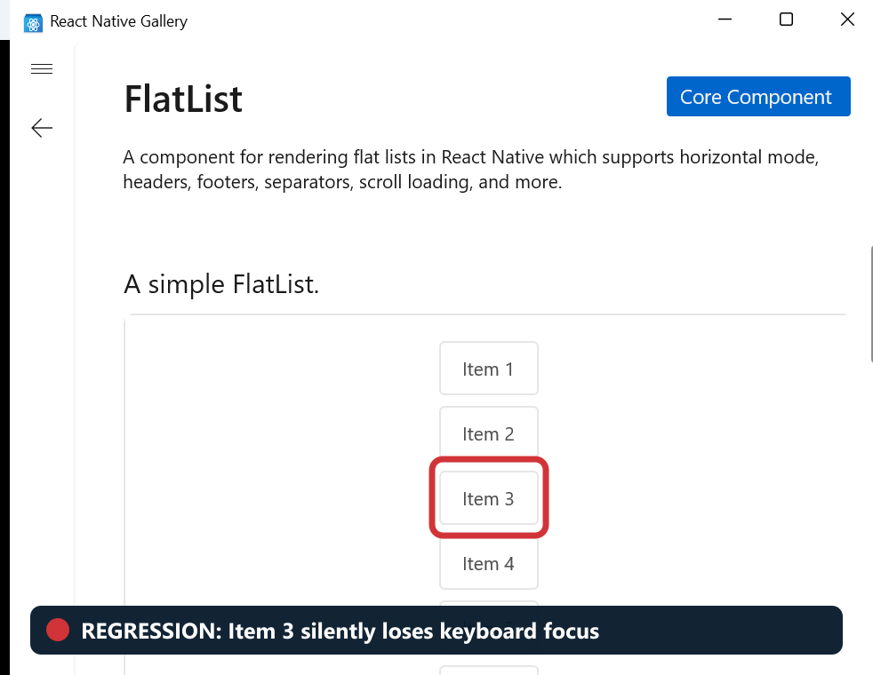
THE PROBLEM
Accessibility regressions are often invisible.
A UI can look pixel-perfect while becoming unusable to keyboard and screen-reader users.
HEALTHY BUILD
BROKEN BUILD
They look the same.
FHL 2026 · Accessibility Tree Snapshot & Diff
02
Notes:
Take a look at these two Gallery builds. They appear identical. But on the right, Item 3 has quietly dropped out of keyboard navigation. That's the problem we're solving.

Slide 3
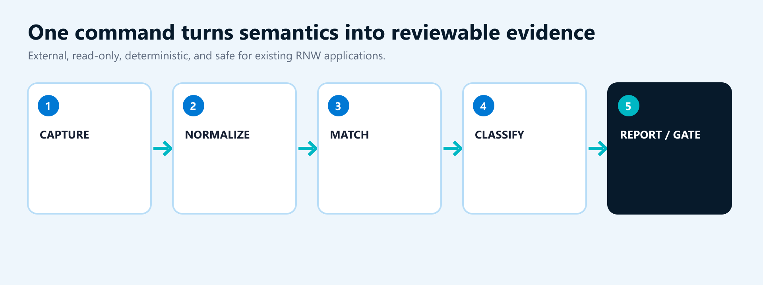
THE FHL PROJECT
A before-and-after detector for what assistive technology sees.
Capture two Windows UI Automation trees, compare them deterministically, and fail when semantics regress.
Read-only external tool · No application instrumentation · No RNW runtime changes · Works with existing Windows apps
FHL 2026 · Accessibility Tree Snapshot & Diff
03
Notes:
The idea is straightforward. Capture what assistive technology sees before a change, capture it again afterward, and highlight only the accessibility differences that deserve attention.

Slide 4
HOW ENGINEERS USE IT
Three commands turn an accessibility assumption into evidence.
The same workflow works locally, during code review, or as a CI quality gate.
Capture before
1
rnw-a11y capture --process RNTesterApp-Fabric --output before.json
Capture after
2
rnw-a11y capture --process RNTesterApp-Fabric --output after.json
Compare and gate
3
rnw-a11y diff before.json after.json --fail-on potential-regression
Exit code 1 makes the result actionable—not another report engineers have to remember to read.
FHL 2026 · Accessibility Tree Snapshot & Diff
04
Notes:
For an engineer, it's just three steps: capture before, capture after, and compare. If the change looks risky, exit code one can stop the pull request.

Slide 5
WHERE IT CATCHES ISSUES EARLY
High-risk changes where visual validation is not enough.
The tool complements—not replaces—keyboard and screen-reader testing.
Fabric migrations
Native component refactors
Accessibility bug fixes
Verify that roles, names, states, hierarchy, and focusability remain equivalent.
Catch semantic changes caused by swapping controls or automation providers.
Prove the intended tree change and expose accidental collateral regressions.
Dependency upgrades
Release validation
PR quality gates
Compare RNW, React Native, or Windows SDK versions before broad rollout.
Create repeatable semantic evidence across release branches and builds.
Fail automatically when an interactive control disappears or loses focusability.
Best moment to find an accessibility regression: before it becomes a manual test failure—or a customer bug.
FHL 2026 · Accessibility Tree Snapshot & Diff
05
Notes:
This really helps when pixels stay the same but semantics may shift—during Fabric migrations, native refactors, dependency upgrades, accessibility fixes, and release validation.

Slide 6
TECHNICAL DEPTH
Designed for trustworthy diffs—not just tree dumps.
The implementation was hardened through repeated bug-focused review and live Windows validation.
Safe on large applications
Accurate, low-noise comparisons
The tool stops at configured depth and element limits before requesting more of the accessibility tree.
Elements are matched within the same parent so one insertion does not make the rest of the page look different.
Never hides an incomplete scan
Protects data and report output
If an application changes or an element disappears during capture, the snapshot is marked incomplete—not reported as clean.
Sensitive text values and volatile IDs are excluded, and application-controlled text is sanitized before display.
15 tests · warning-free Release build · live capture/diff verified · zero RNW runtime files changed
FHL 2026 · Accessibility Tree Snapshot & Diff
06
Notes:
We also worked hard to make the results trustworthy: scans are bounded, matching avoids noisy cascades, interrupted scans can't look clean, and sensitive application data stays out.

Slide 7
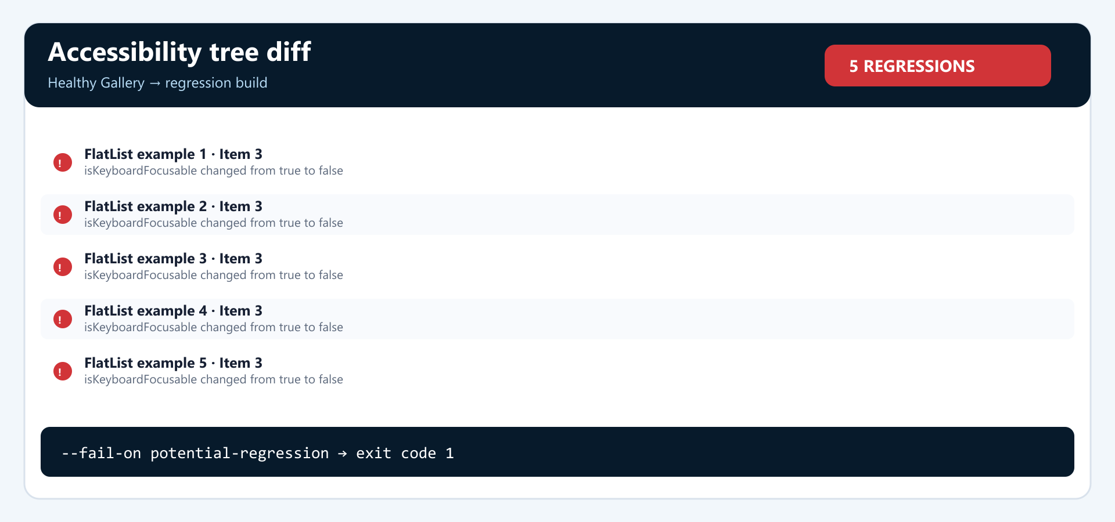
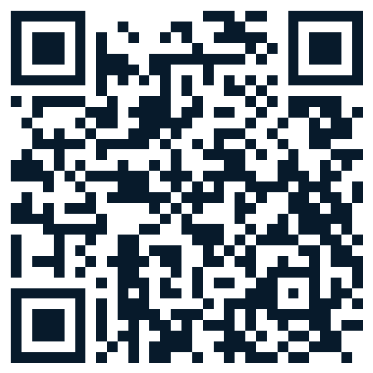
WORKING DEMO
A real regression in the React Native Gallery.
Play the embedded video or use the standalone link below.
Open demo video
https://anuagragith.github.io/react-native-windows/demo.mp4
FHL 2026 · Accessibility Tree Snapshot & Diff
07
Notes:
Here's the live proof. We start with the real React Native Gallery and capture a healthy FlatList page. Then we make one tiny change: Item 3 is no longer keyboard focusable. Visually, nothing moves. We capture again and run the diff. Because that renderer is reused, the tool finds the same regression in five examples—and returns exit code one, ready to block the change.

Slide 8
WHAT THE DEMO PROVES
The screenshot stays the same. The semantics do not.
One shared renderer caused five invisible keyboard regressions across the Gallery.
1 · Healthy baseline
2 · Visually identical regression
3 · Five issues caught
Detected: isKeyboardFocusable true → false · Classified: PotentialRegression · Gate: exit code 1
FHL 2026 · Accessibility Tree Snapshot & Diff
08
Notes:
And this is the result at a glance: same-looking screens, five real keyboard regressions, and a precise explanation of what changed.

Slide 9
MEASURED OUTCOME
From FHL idea to release-ready implementation.
The project is not a mockup: the complete capture, diff, reporting, and gate workflow works today.
15
0
5
1
automated tests
build warnings
Gallery regressions caught
CI-ready failing exit code
Low regression risk
Immediately useful
Built to extend
Standalone, read-only package. No changes to rendering, focus, accessibility providers, or application runtime.
Works with Gallery, RNTester, Playground, packaged Windows apps, and non-RNW desktop applications.
The capture model and target selector are reusable foundations for a Focus Path Recorder.
FHL 2026 · Accessibility Tree Snapshot & Diff
09
Notes:
This isn't just a concept. We finished the working tool, added fifteen tests, reached a warning-free build, and validated it against live Windows applications.

Slide 10
OVERALL IMPACT
Shift accessibility from late manual discovery to normal engineering review.
The goal is not fewer accessibility tests—it is fewer surprises when those tests run.
TODAY
WITH THIS PROJECT
Visual review passes
Capture baseline with the PR
Manual Narrator test happens late
Diff exposes semantic change
Regression becomes a bug
CI blocks risky regression
Engineer reconstructs what changed
Reviewer gets exact evidence
Impact: faster diagnosis · stronger PR evidence · safer framework evolution · fewer customer-found regressions
FHL 2026 · Accessibility Tree Snapshot & Diff
10
Notes:
The bigger win is timing. Instead of discovering accessibility problems at the end, engineers get clear evidence while the change is still in review.

Slide 11
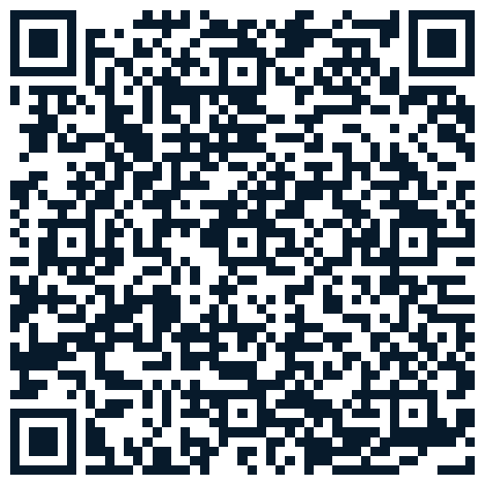
WHERE TO FIND IT
Assuming merge: part of the React Native Windows developer tooling.
The FHL branch is available today for review and demonstration.
Repository path
packages/@rnw-scripts/accessibility-diagnostics
Run it
yarn workspace @rnw-scripts/accessibility-diagnostics rnw-a11y …
FHL implementation
Branch: fhl/accessibility-tree-diff · Commit: 6909efe740
Open source branch
https://github.com/anuagragith/react-native-windows/tree/fhl/accessibility-tree-diff/packages/%40rnw-scripts/accessibility-diagnostics
README includes capture, diff, formats, exit codes, privacy guidance, and incomplete-snapshot behavior.
FHL 2026 · Accessibility Tree Snapshot & Diff
11
Notes:
Once merged, the tool fits into the existing RNW workspace. The FHL branch and full documentation are already available for anyone who wants to try it.

Slide 12
TOP NEXT STEPS
Turn the working prototype into an everyday RNW quality gate.
These three extensions deliver the clearest engineering and customer impact.
1 · Automatic PR checks
2 · Keyboard focus recorder
3 · Visual diff explorer
Run approved Gallery and RNTester scenarios in CI. Post the accessibility diff directly on the pull request and block newly introduced regressions.
Record where keyboard focus moves and flag loops, unexpected jumps, missing labels, or focus landing on hidden content.
Open snapshots in a browser, highlight exactly what changed, and manage approved baselines without reading raw JSON.
First milestone: automate one repeatable RNW Gallery scenario in CI.
FHL 2026 · Accessibility Tree Snapshot & Diff
12
Notes:
From here, the top priorities are automatic pull-request checks, a keyboard focus recorder, and a visual explorer that makes reviewing diffs even easier.

Slide 13
Accessibility should not depend
on someone noticing what cannot be seen.
Capture. Compare. Catch. Block.
Shift accessibility left.
https://anuagragith.github.io/react-native-windows/
Notes:
So that's the project: make the invisible visible, catch it early, and stop it before merge. That's what shifting accessibility left looks like. Thank you.

