Slide 1
Modelling CoVid-19 Epidemic Spread on Social
Networks
Anuran Pal, Anirban Dey, Abhinav Patra and Anubhab Sur
THE A TEAM

Slide 2
The SAIRD Model

Slide 3

Five Classes:
S - Susceptible
A - Asymptomatic
I - Infected
R - Recovered
D - Dead
The entire population can be classified into 5 mutually exclusive classes, at any given instant of time.

Slide 4

S - Susceptible
A Susceptible individual is a person, who is at risk of having the disease, once (s)he comes in contact with an infected individual. Any individual who has not been infected in the past, and does not have the disease at that particular instant of time, is basically susceptible.

Slide 5

A - Asymptomatic
Such an individual has already contracted the disease. However (s)he does not show any symptoms externally (or very mild symptoms). (S)he is most likely to recover without hospitalization or intensive treatment. However, the disease can very easily spread to others via such an individual.

Slide 6

I - Infected
An individual who belongs to this class, has not only contracted the disease, but also shows severe symptoms and will need intensive medical treatment. Such a person can spread the disease for sure, but the probability of such occurrence is low, since he’ll likely be isolated/quarantined.

Slide 7

R - Recovered
A person, who has recovered after being infected.
(S)he will have developed antibodies, thus preventing him/her from being susceptible to the disease once again. Naively speaking, (s)he is out of the game now, and healthy.

Slide 8

D - Dead
A person who dies after being infected.

Slide 9
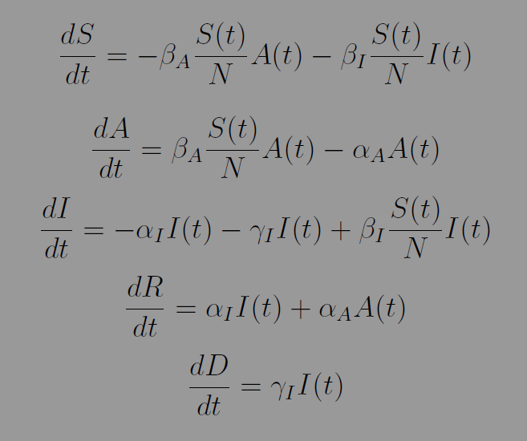
Differential Equations governing this model:

Slide 10
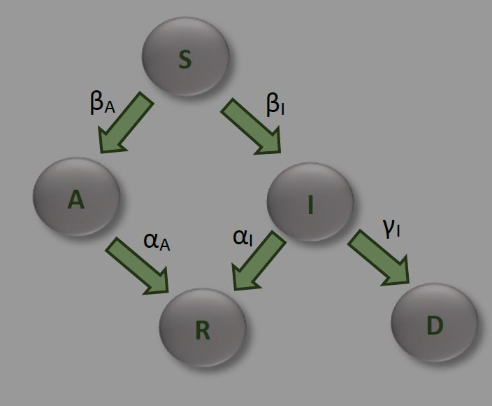
Flow-Chart:

Slide 11
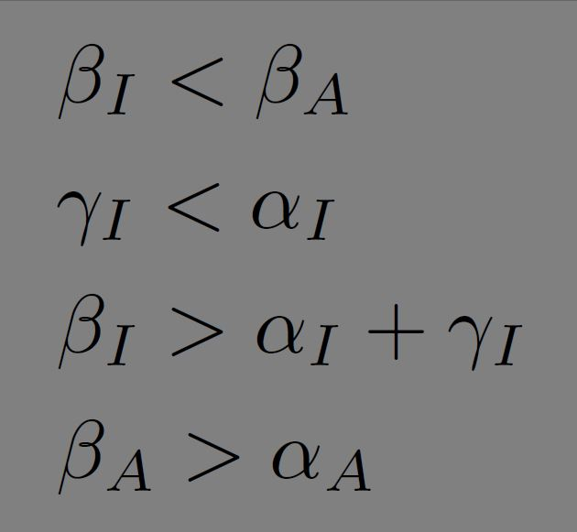
Some Observations:
Class “A” has a much higher potential of infecting class “S” than that of class “I”
Rate of persons dying should be lesser than rate of people recovering from “I”

Slide 12
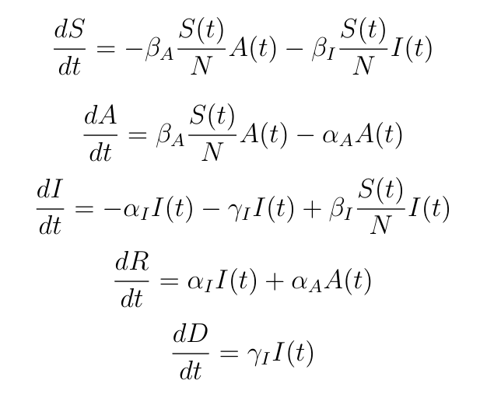
Let us consider the SAIRD model again
Consider the following initial condition: I(t=0)=1 and A(t=0)=0

Slide 13
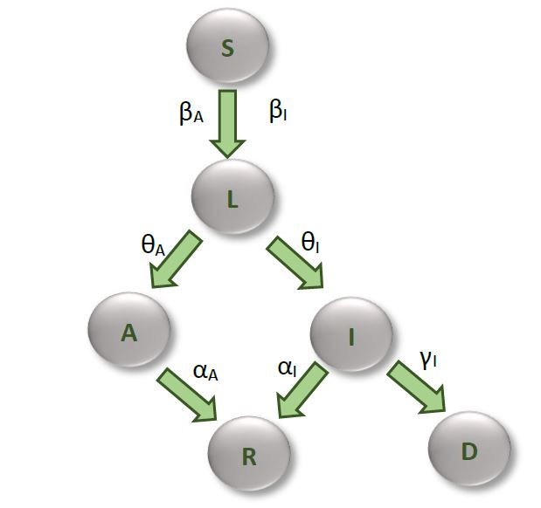
There should be a stage where the individuals affected by the virus have different probabilities to branch out into either A or I.
Transient state
Latent (L)

Slide 14
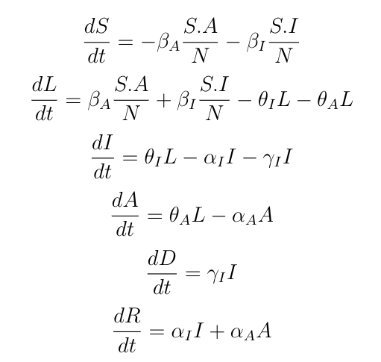
We propose the following set of modified differential equation
Latent (L) equation

Slide 15
Determining the constants
Accumulation of individuals in the states of I and A. This accumulation will play the role of spreading the virus
Number of A is greater than the number of I in the population
L state is responsible for just the coupling(?) of I and A. So the incoming and outgoing rates are more or less same. ~5 days the person doesn’t show an symptoms
Death ratio observed for the Corona virus is around 3%-4%.

Slide 16
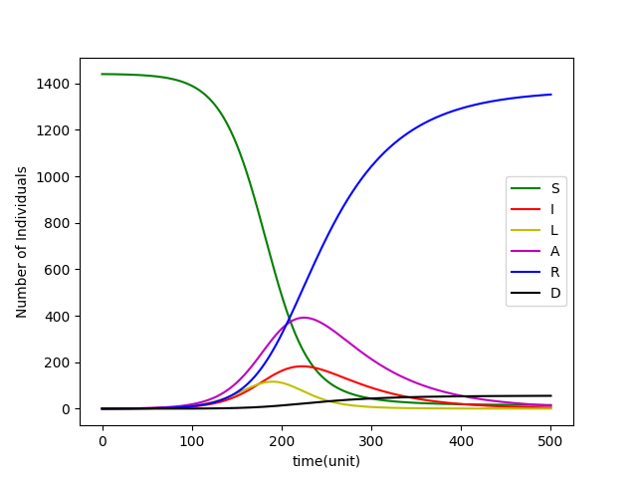
Simulation of the modified differential equation
Mortaility rate 4.08%

Slide 17
Network Structure
Model network which captures the physical interactions and proximity between individuals in a community
Categorizing these physical interactions into different levels
Grouping of nodes to form different community levels

Slide 18
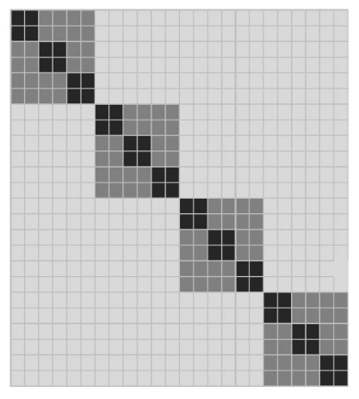
Network Structure
Shades represent the weights
of the connection
Adjacency matrix corresponds to
a community structure of (2,3,4)
Function has to contain the level/class of interaction(c)

Slide 19
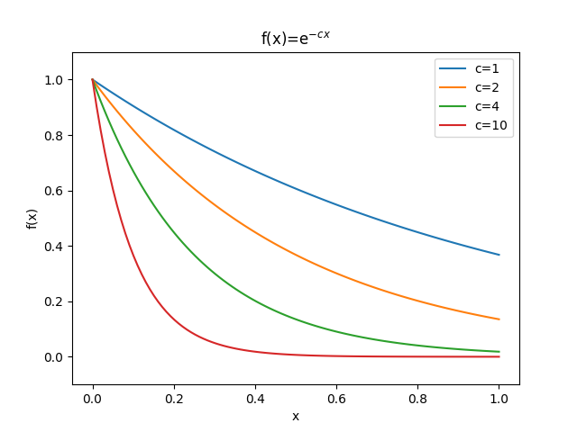
Determining the entries
C = 1
C = 2
C = 3

Slide 20
Lock-down in the Network
In the real world we see that the level 1 connections become stronger under a lock-down as we spend more time with our closest contacts
Higher the level of connection, the more hampered it is
Lock-down has to effect the contribution of the c factor in our exponential such that higher levels are hampered at a greater strength.

Slide 21
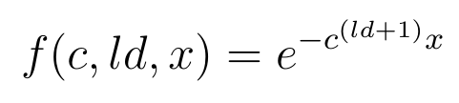
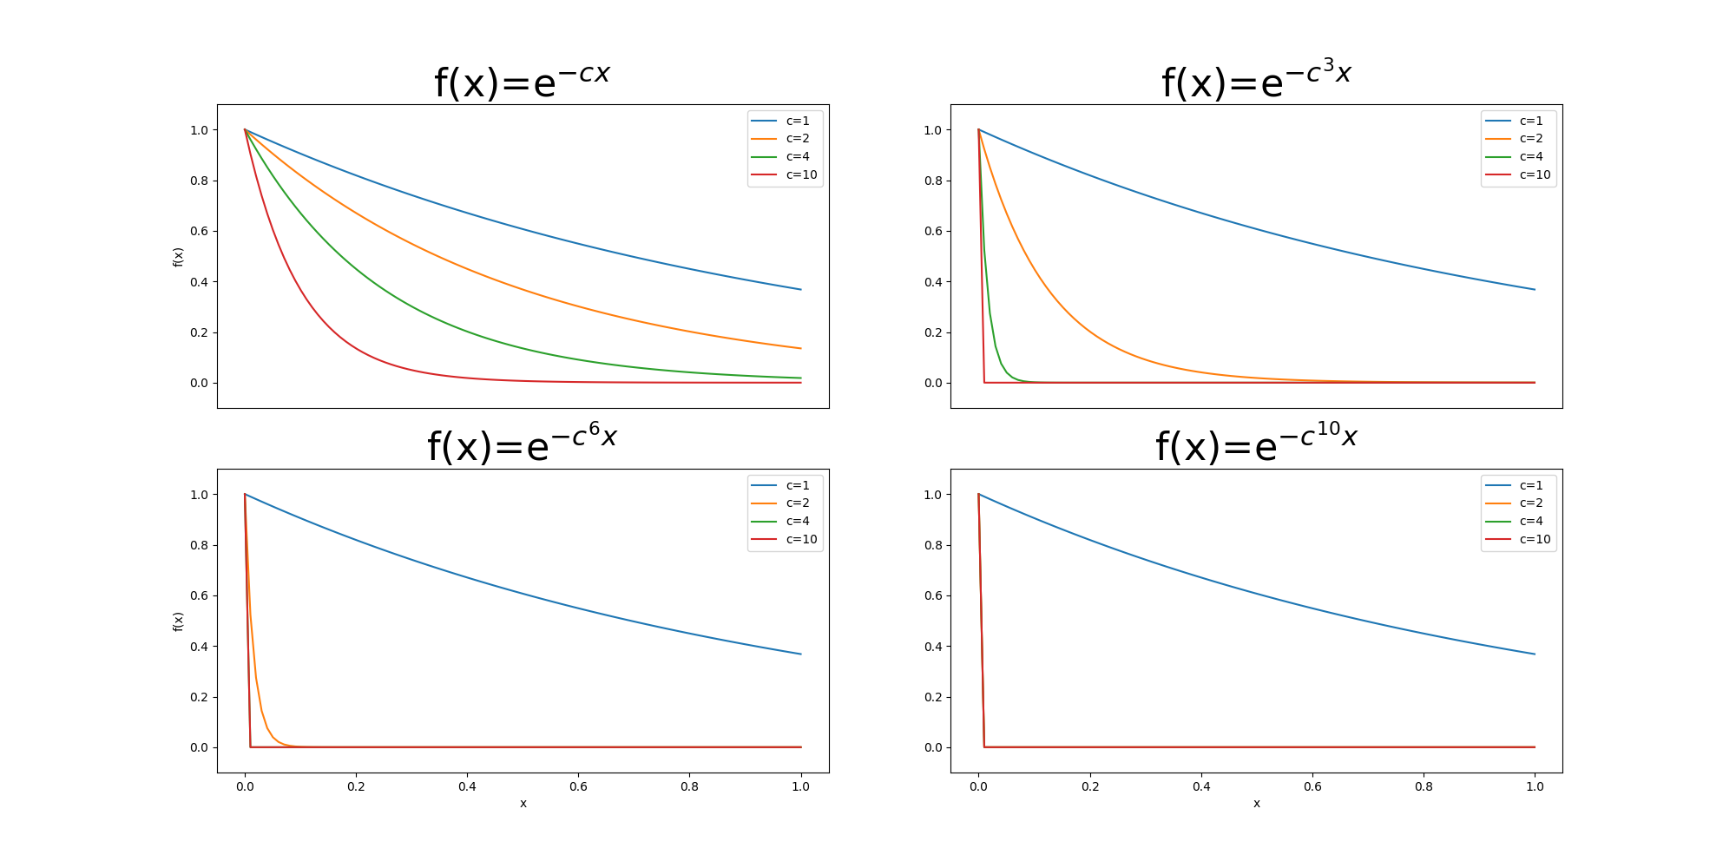
Lock-down in the network

Slide 22
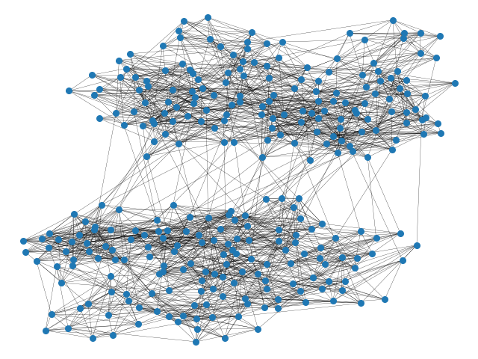
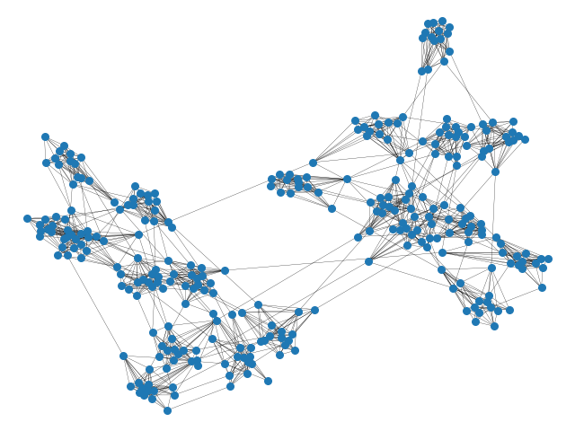
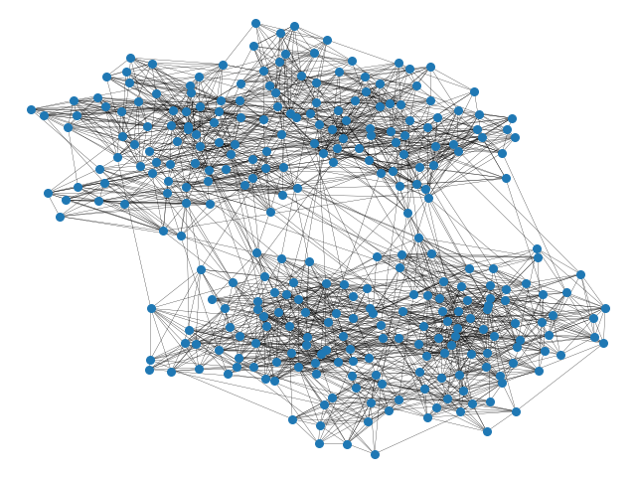
The networks under LD in physical space
ld=2
ld=4
ld=6
Community structure (15,10,2)

Slide 23
Differential Equation on Networks
Adjacency matrix captures the connection between nodes
The terms of the form SI and SA captures the node to node interaction
Rest of the terms are independent of node-node interactions and depend on just their own characters
How does the adjacency matrix of a complete network with edges having 1/N weight look?

Slide 24
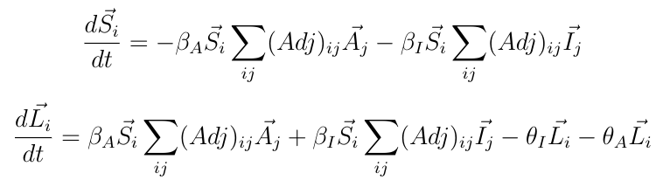
Differential Equation on Networks

Slide 25
Caveats
Diagonal entries of the adjacency matrix are 0
Positive feedback loop of the virus in lower level communities i.e. low c connections
Negligible values of L accumulated in otherwise unaffected families will become fully affected after a few time steps.
Somewhat equivalent to the real scenario

Slide 26
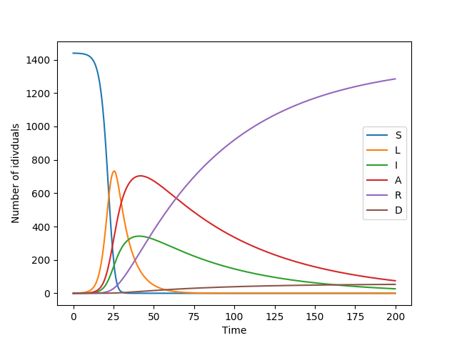
Differences b/w structured and unstructured:
No network
Network
Community structure=(3,4,5,6,2,2)

Slide 27
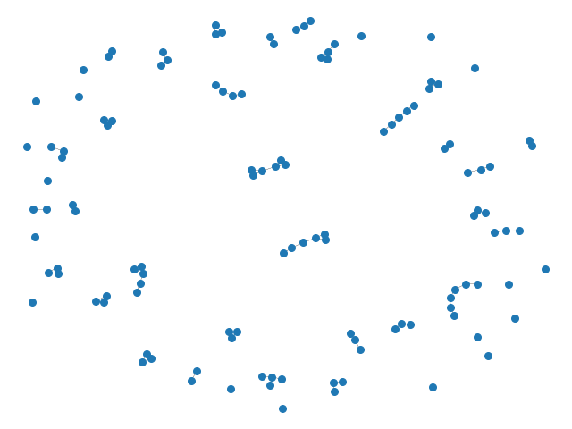
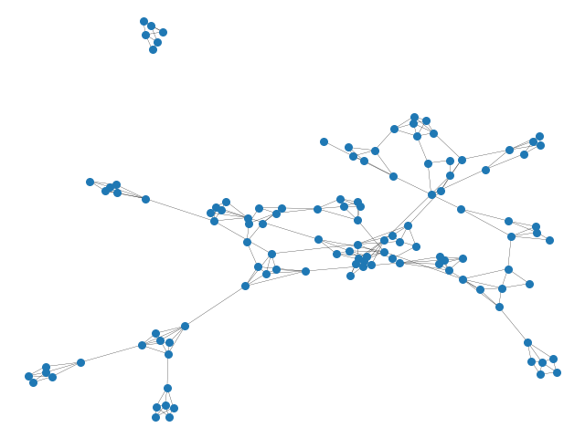
Parameters that dictate the evolution:
Strength of LockDown
Restructuring time period
Community Structure
The effects of the Community structure parameter on the network structure that is generated.
ld=5
Community Structure (654)
ld=5
Community Structure (3452)

Slide 28
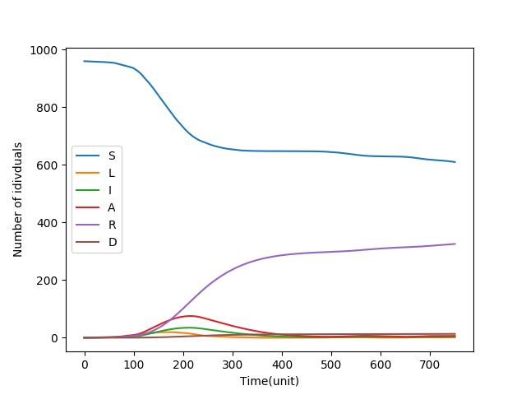
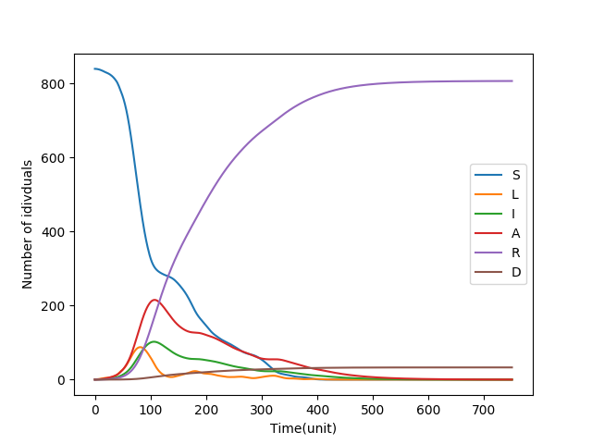
Evolution of the disease with different networks.
Other parameters ld=25, Restructuring Time Period=25
Community Structure = (3,4,5,4,4)
Community Structure = (8,7,6,3)
The average degree of the (8,7,6,3) network is higher than the (3,4,5,4,4) network

Slide 29
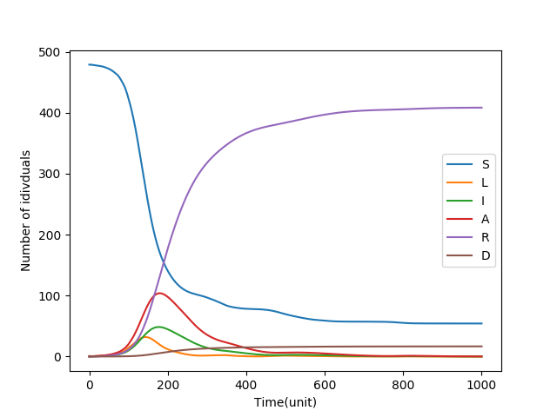
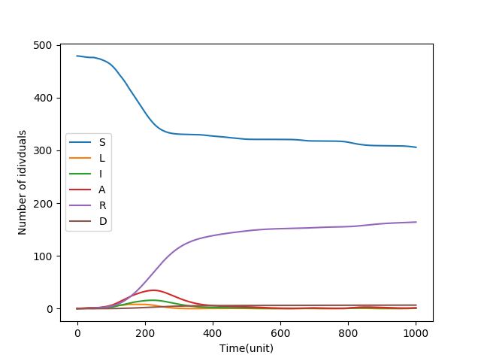
Evolution of the disease with different restructuring time period before lock-down
(3,4,5,4,2), ld=100, Restructuring time period before lockdown = 50 time steps
(3,4,5,4,2), ld=100, Restructuring time period before lockdown = 250 time steps

Slide 30
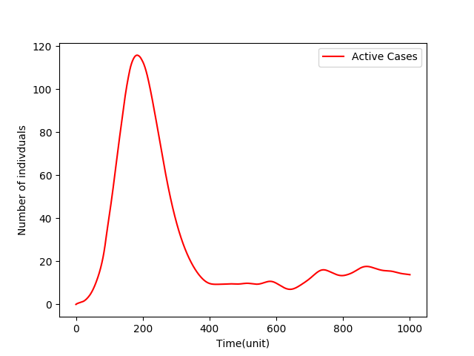
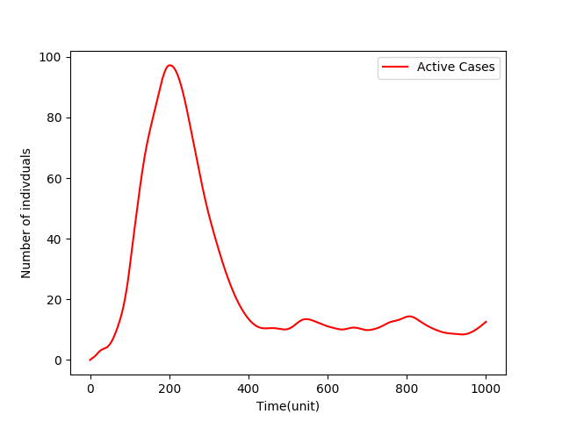
Evolution of the disease with different Restructuring Time after Lock-down
Restructuring Time Period=5
Restructuring Time Period = 150
Lower ld values will increase the contribution
Other parameters ld=100, Community Structure=(3,4,5,4,4)

Slide 31
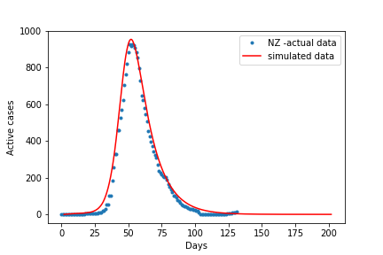
Comparison of actual and simulated data:
Parameters being use ld=1.25, Restructuring Time Period=25, Community Structure = (3,4,4,5,3,2)
New Zealand’s data of active cases is used here,
Day 0 is Feb 15,2020.

Slide 32
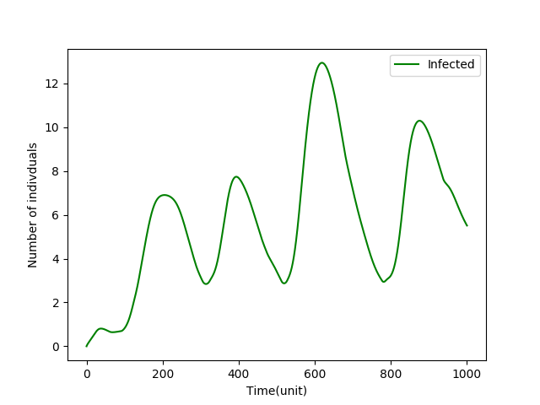
Comparison of actual and simulated data:
The expected recurring spread of infection can be modelled in the simulation by controlling the network restructuring. We assumed a constant threshold value (chosen to be 8) of infected individuals that will trigger if a Lock-Down is imposed or removed. The following plot was obtained on a (3,4,5,6,2) network with network restructuring every 30 time steps for no LD and 150 time steps during LD.

Slide 33
A STOCHASTIC APPROACH

Slide 34
Why do we need Stochastic modelling?
In a deterministic model, evolution of population categories is captured by a set of differential equations involving S,A,I,R,D. However, in recent years, there has been considerable work in the field of stochastic modelling of epidemics.
We feel that though deterministic equations are easy to formulate and provide remarkable insights into disease spread dynamics, but they do not capture the variability and uncertainty inherent in human behaviour and social interactions.
We will see how results from this approach compare against what we have obtained so far

Slide 35
A few basics...
P(exposure to virus)=1-(1-𝛃)^{n}
In case the edges are weighted with weights reflecting social ‘distance’:
P(exposure to virus)=1-Π(1-w_{i}*𝛃), where the product runs from i=1,2,...n
𝛃
𝛃
S
I
A
𝛃
n=n1+n2=Asymptotes(A)+Infected(I)

Slide 36
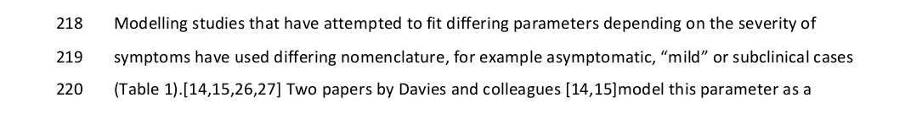
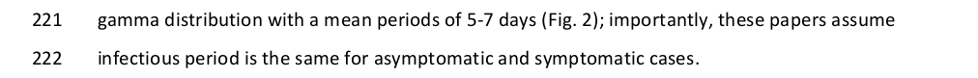
Assumptions on the recovery/removal time and death rates
Drawing inspiration from this report, we have modelled the recovery/removal time of A or I with a gamma distribution of mean=14 days and shape parameter,k=4.
Source:rapid scoping review and analysis of available evidence for SARS-Cov2, Byrne et al.

Slide 37
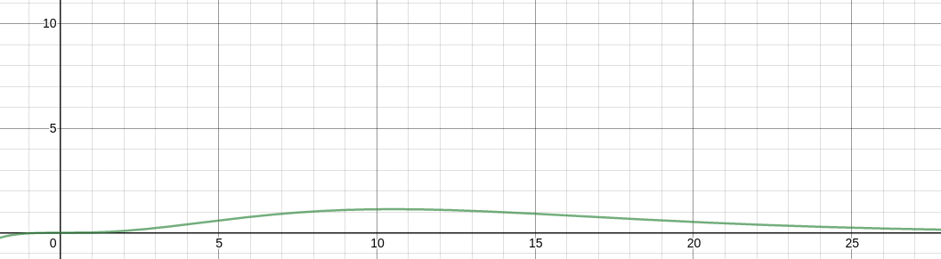
Gamma distribution with shape parameter=4 and scale parameter=14/4
Since the gamma distribution carries infinite mass in its tail, we have appropriately truncated it by arguing that most As recover within 20 days while for I, we have considered 26 days.

Slide 38

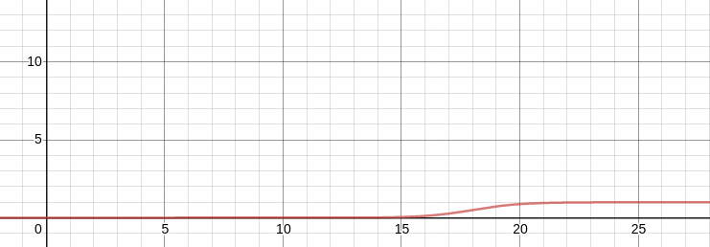
‘Death’ Function
The value of c is decided after fitting with actual data to best match the observed death rates.
The above graph is plotted for c=18 which is obtained after simulation.

Slide 39
*Why New Zealand?
A very sparsely populated country.
Advantage of geographical location. No rapid influx of cases through land borders, few international airports.
Strict administrative control measures and tracking systems kept the cases in check.
An interesting statistic: nearly 70% of infections were concentrated in 5 major cities.[*] This helped us in designing an reasonable social structure.
Stabilisation of the ‘Covid graph’, Equiibrium reached, represents a solved system.
[*]https://stats.gov.nz

Slide 40
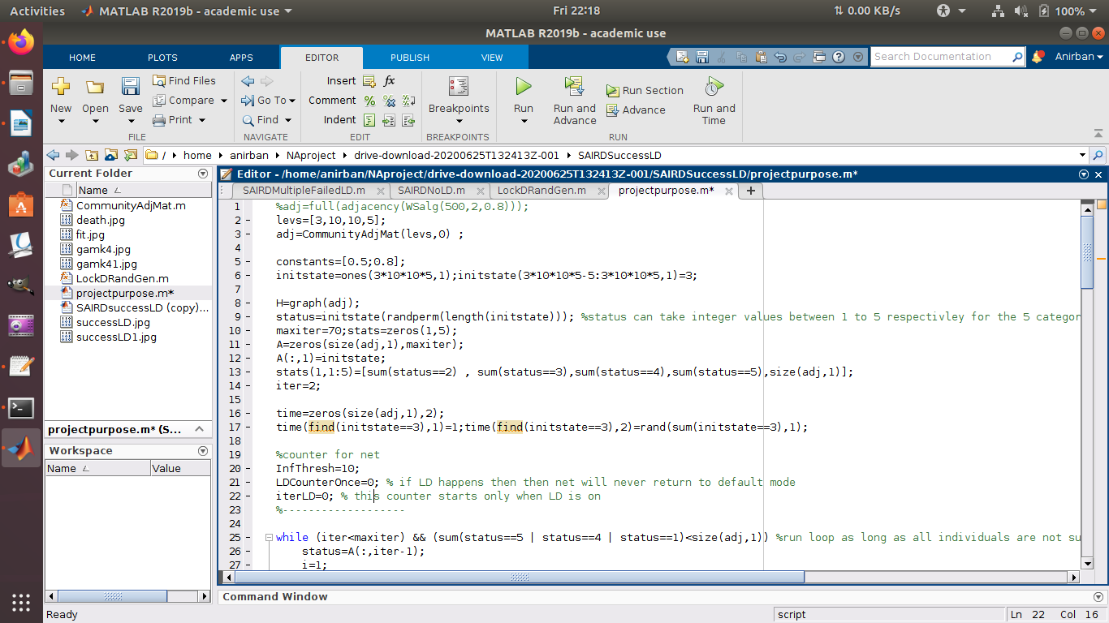
The Simulation Code
Initial conditions
Infection event recorder

Slide 41
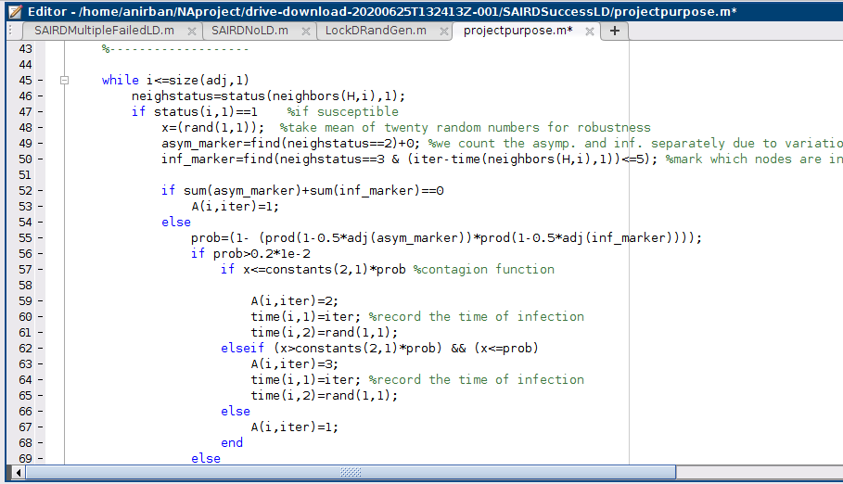
Chance of exposure
S evolution
Probability of being asymptomatic

Slide 42
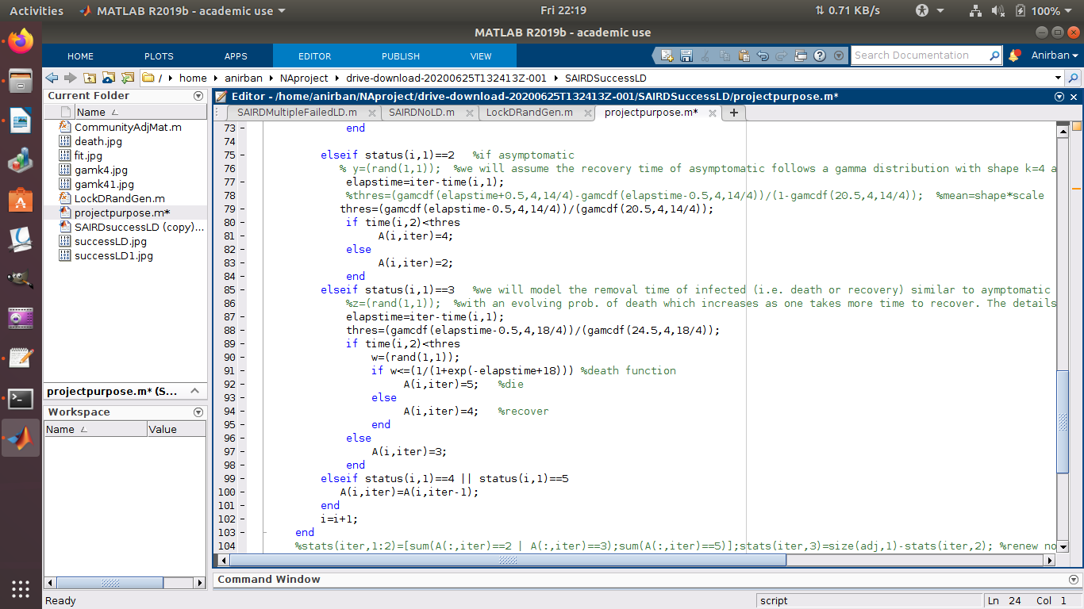
This code, being stochastic in nature was run over several iterations and the average values were plotted to investigate trends in data.
Some of the lockdown scenarios that we incorporated are:
No Lockdown
Strict Lockdown
Multiple Lockdown cycles
evolving prob. of death

Slide 43
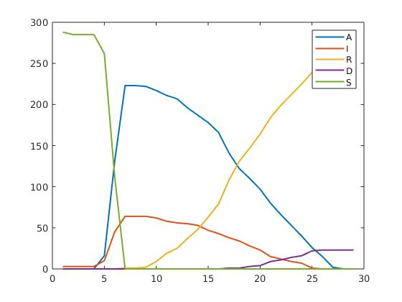
A look at some results...
Fig.: No lockdown scenario

Slide 44
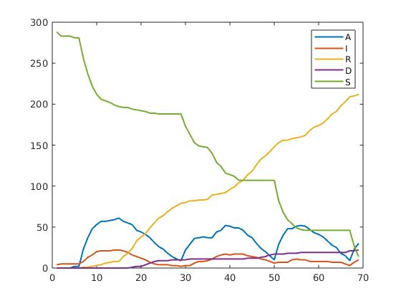
Fig.: Multiple failed Lockdowns

Slide 45
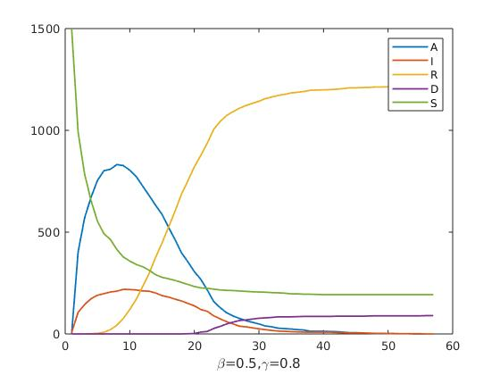
Fig.: A successful lockdown

Slide 46
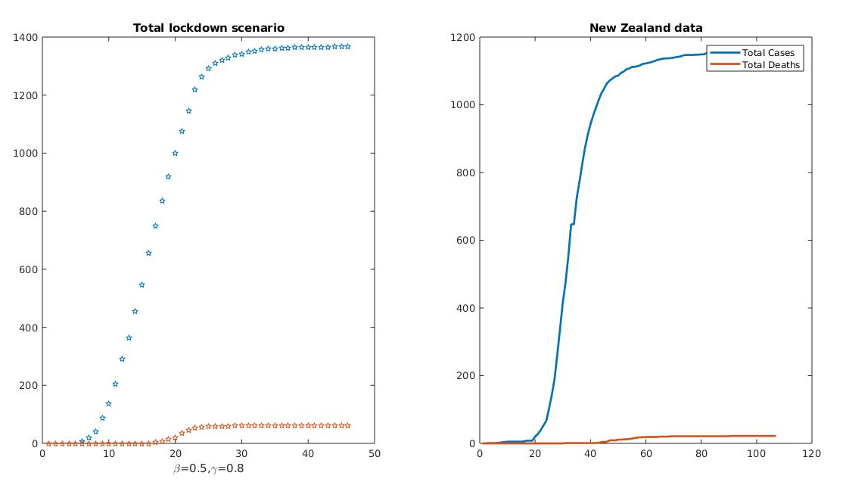
Since New Zealand imposed a strict lockdown, they kept their Covid tally to a minimum. The simulated results from the SAIRDsuccesLD.m code fit quite well after suitable variation of the parameters.

Slide 47
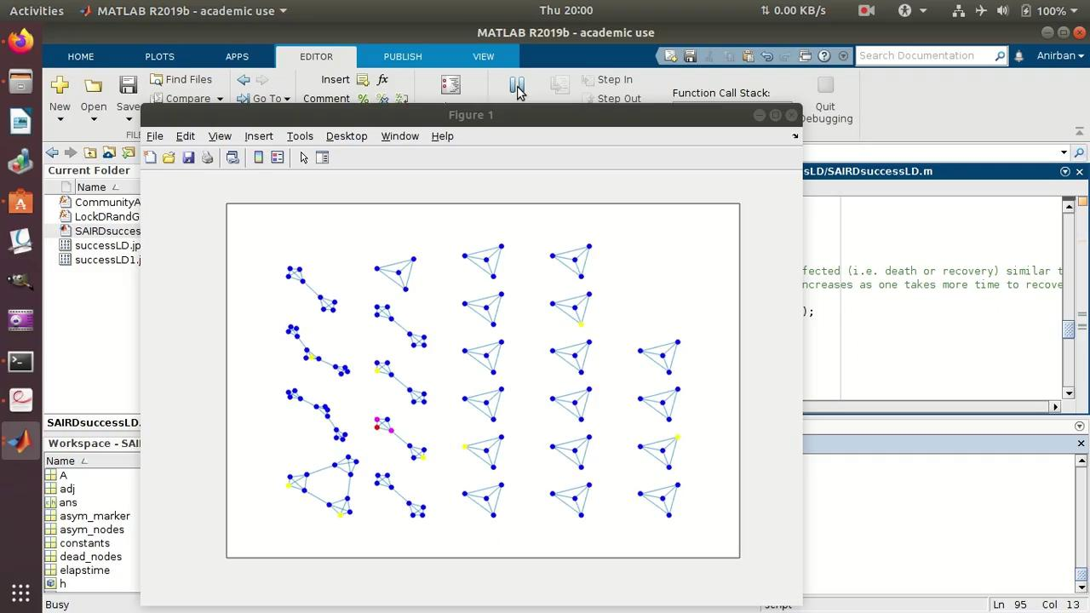
Strict Lockdown scenario

Slide 48
Conclusions:
Thus, we see that the stochastic approach, under certain assumptions, is equally well-suited to epidemic modelling. The fit with real data justify our assumptions about the various probability distributions.
We see that the stochastic simulation broadly exhibits similar behaviour as the numerical solution of the differential equations.
It is also observed that the best fit to the data occurs when exposure probability=0.5 and asymptotic probability=0.8 are considered.
Needless to say, NZ with its nominal population and strict lockdown measures was easy to simulate numerically. We look forward to apply our model to larger countries with diverse population groups to understand its limitations.

Slide 49
Thank you.

