Slide 1
Weekly update
Evolutionary Algorithm Generator for Controlling Strategies of a Batbot
安武
2024/03/05

Slide 2
Research progress and problems encountered
Focus on free flight

Slide 3
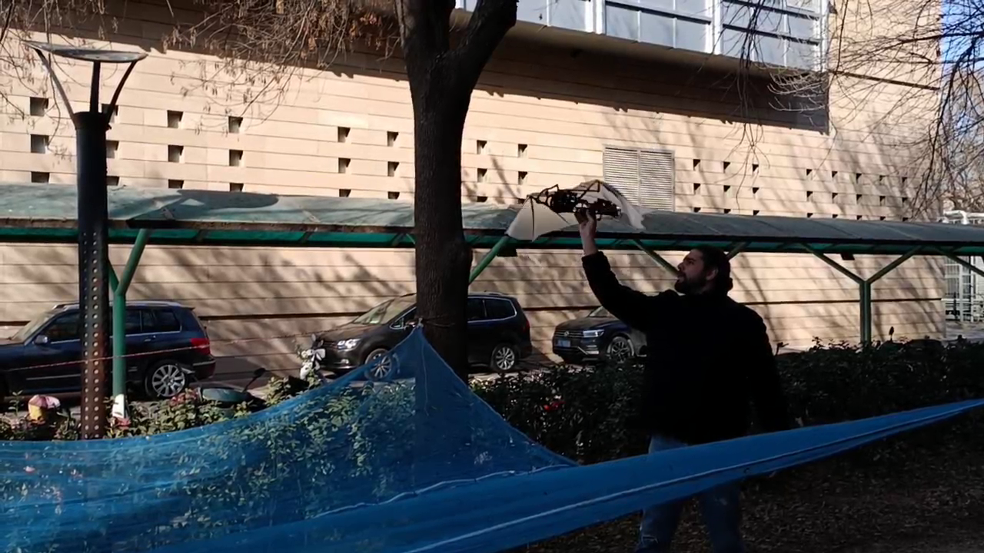
Research progress and problems encountered
Focus on free flight

Slide 4
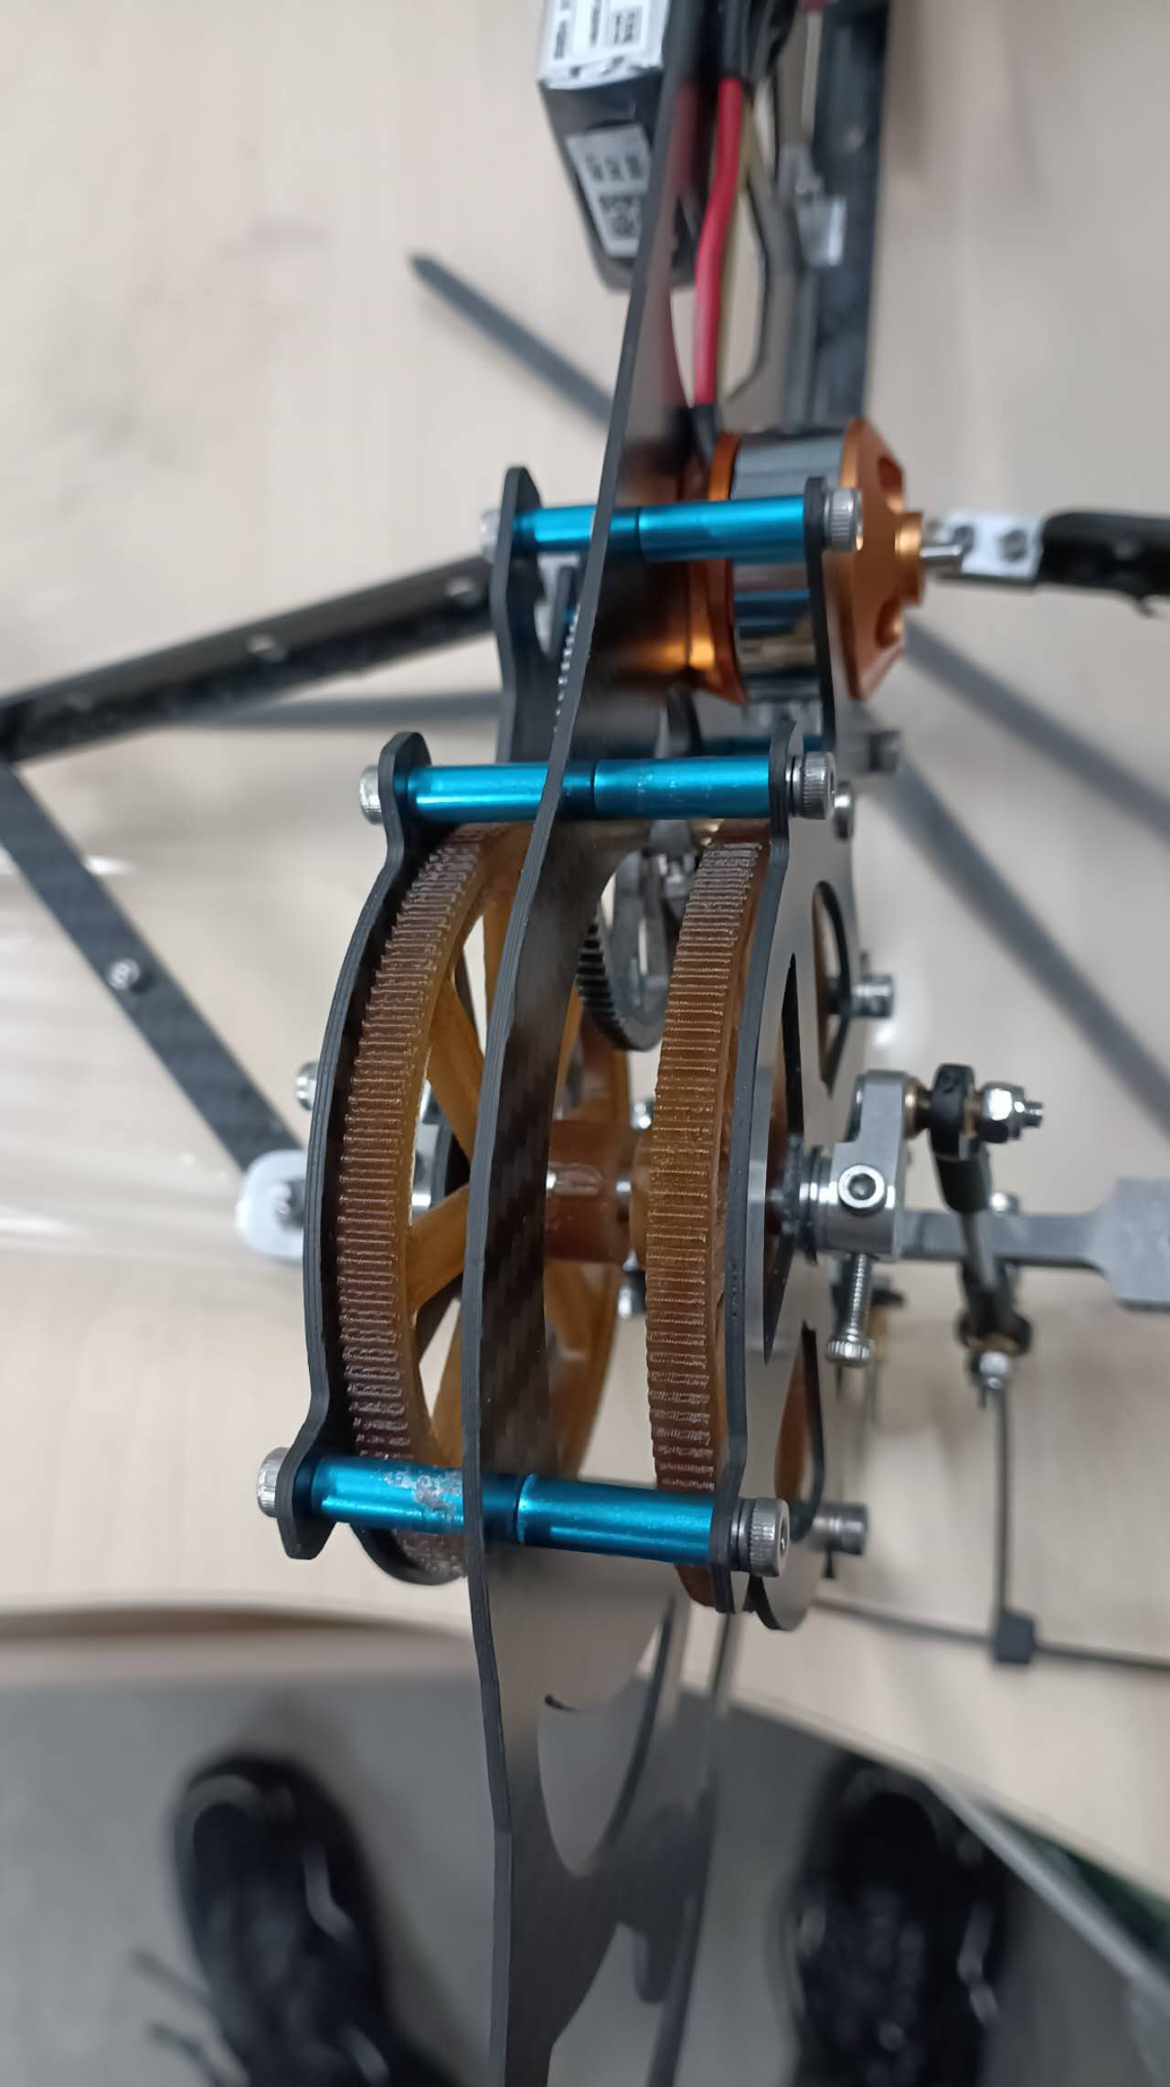
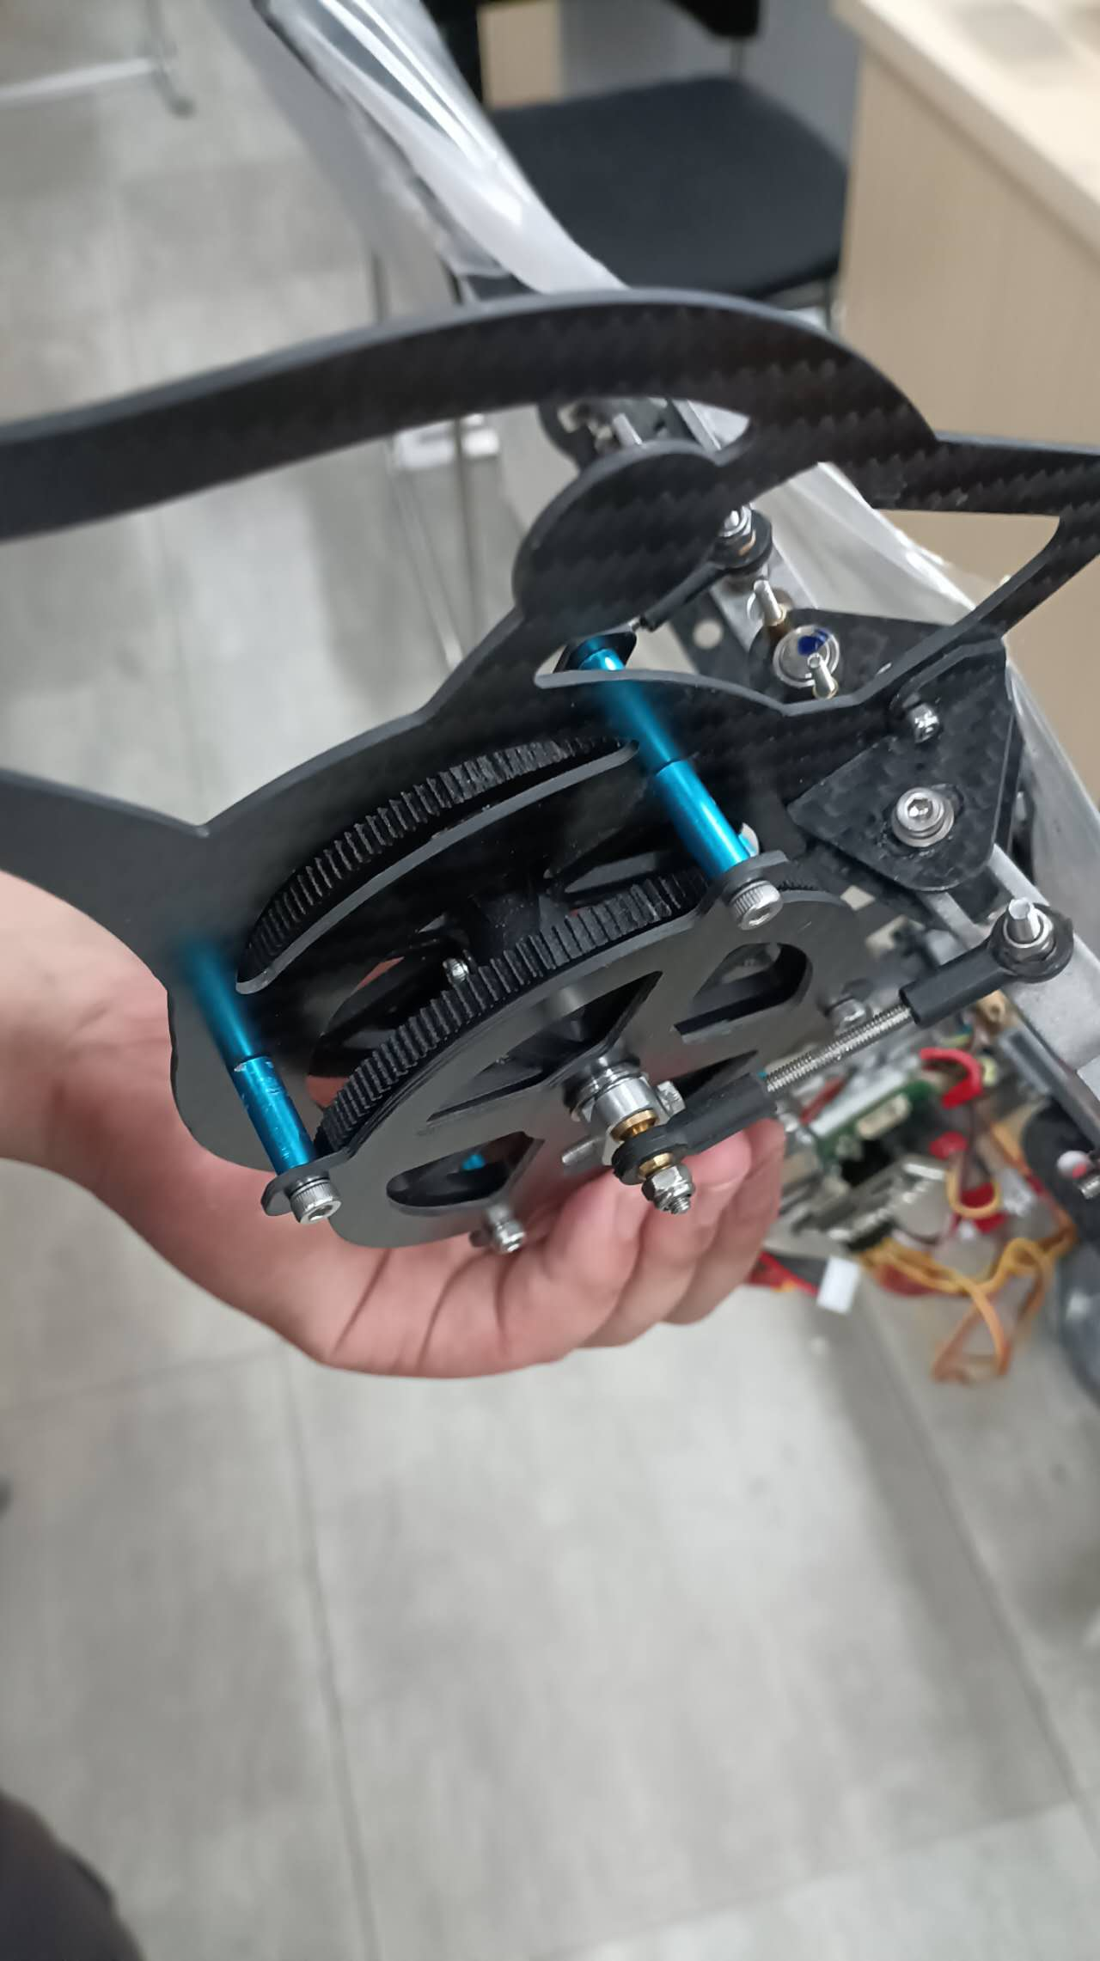
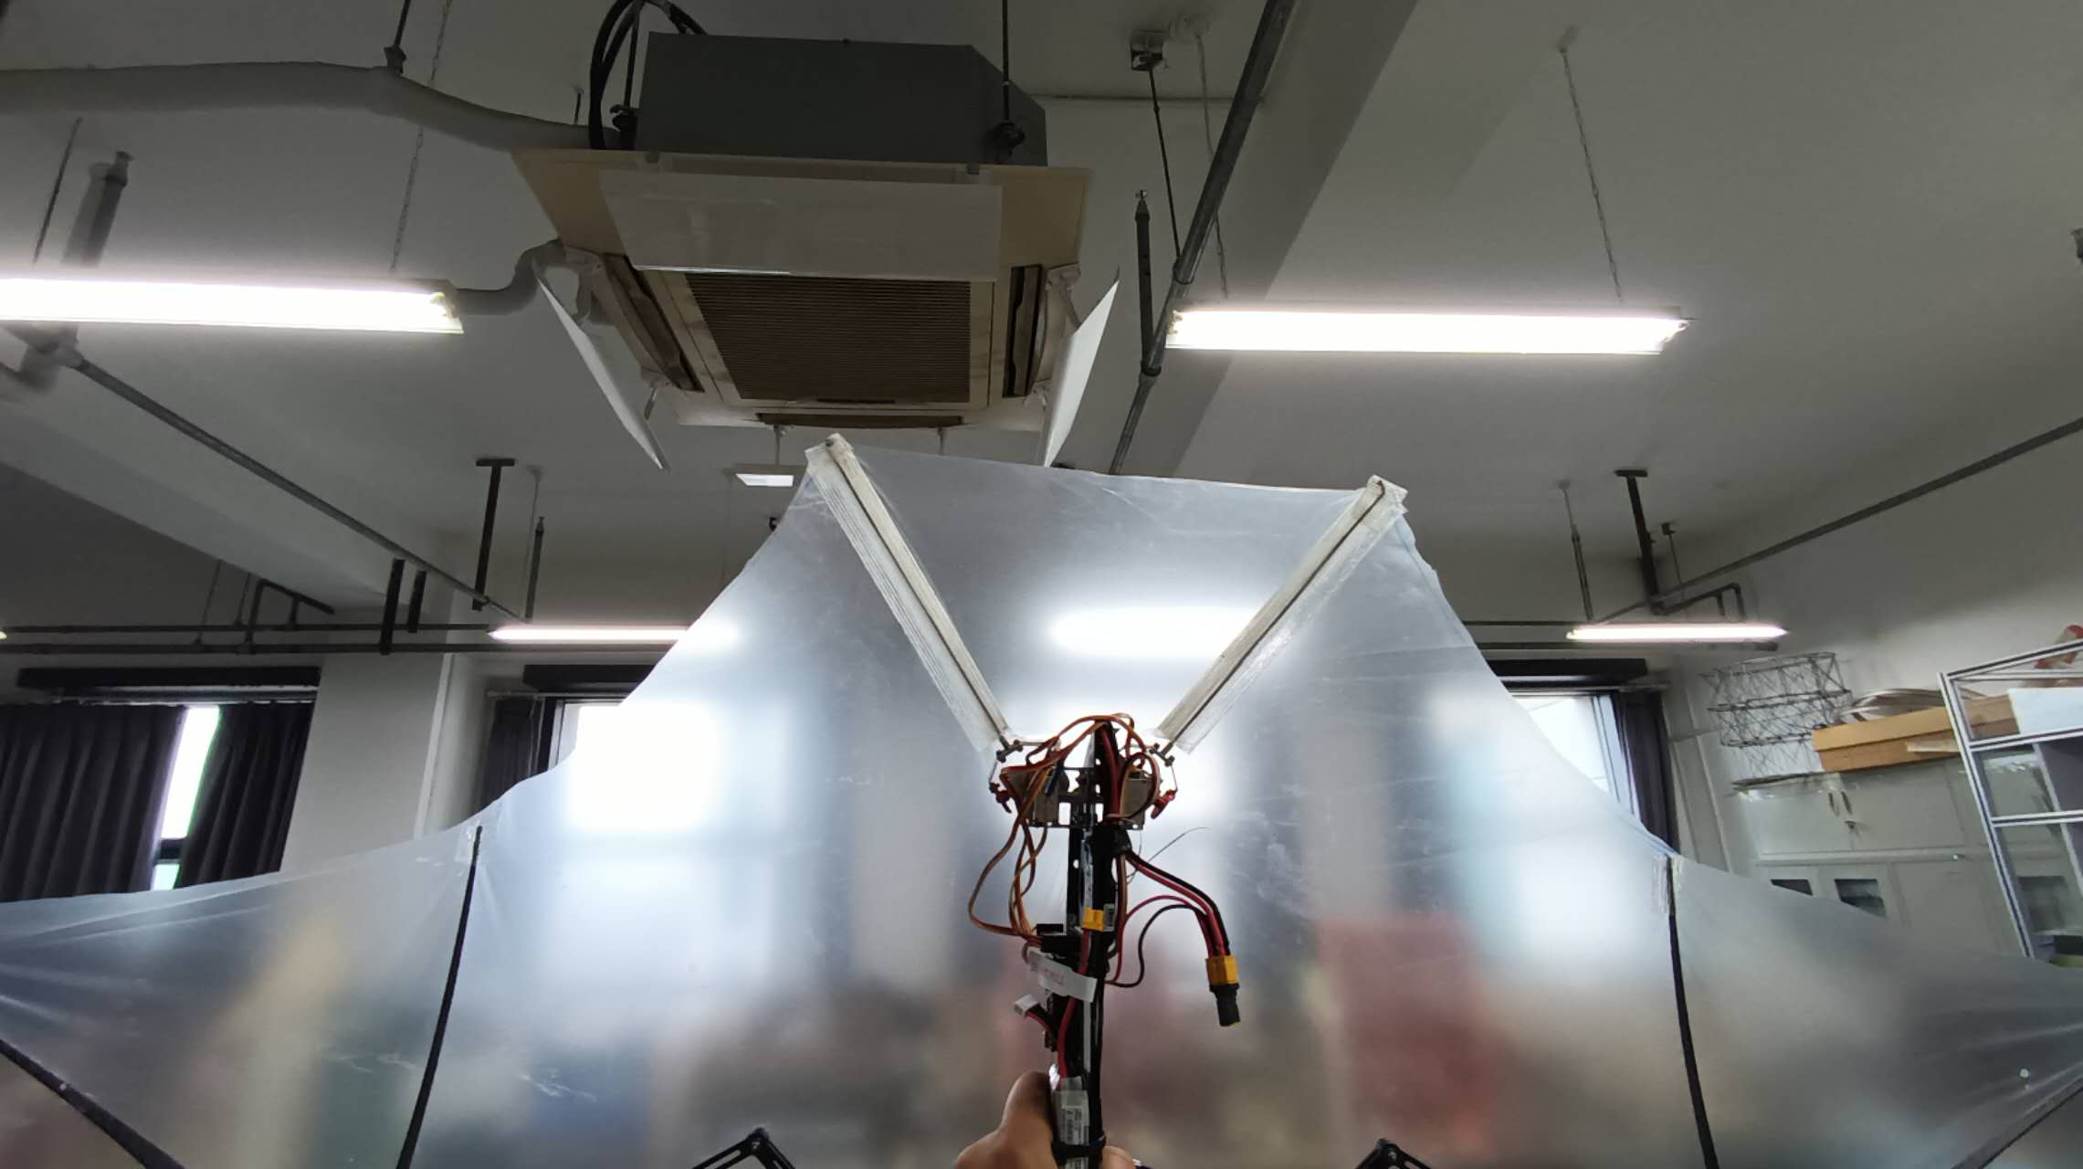
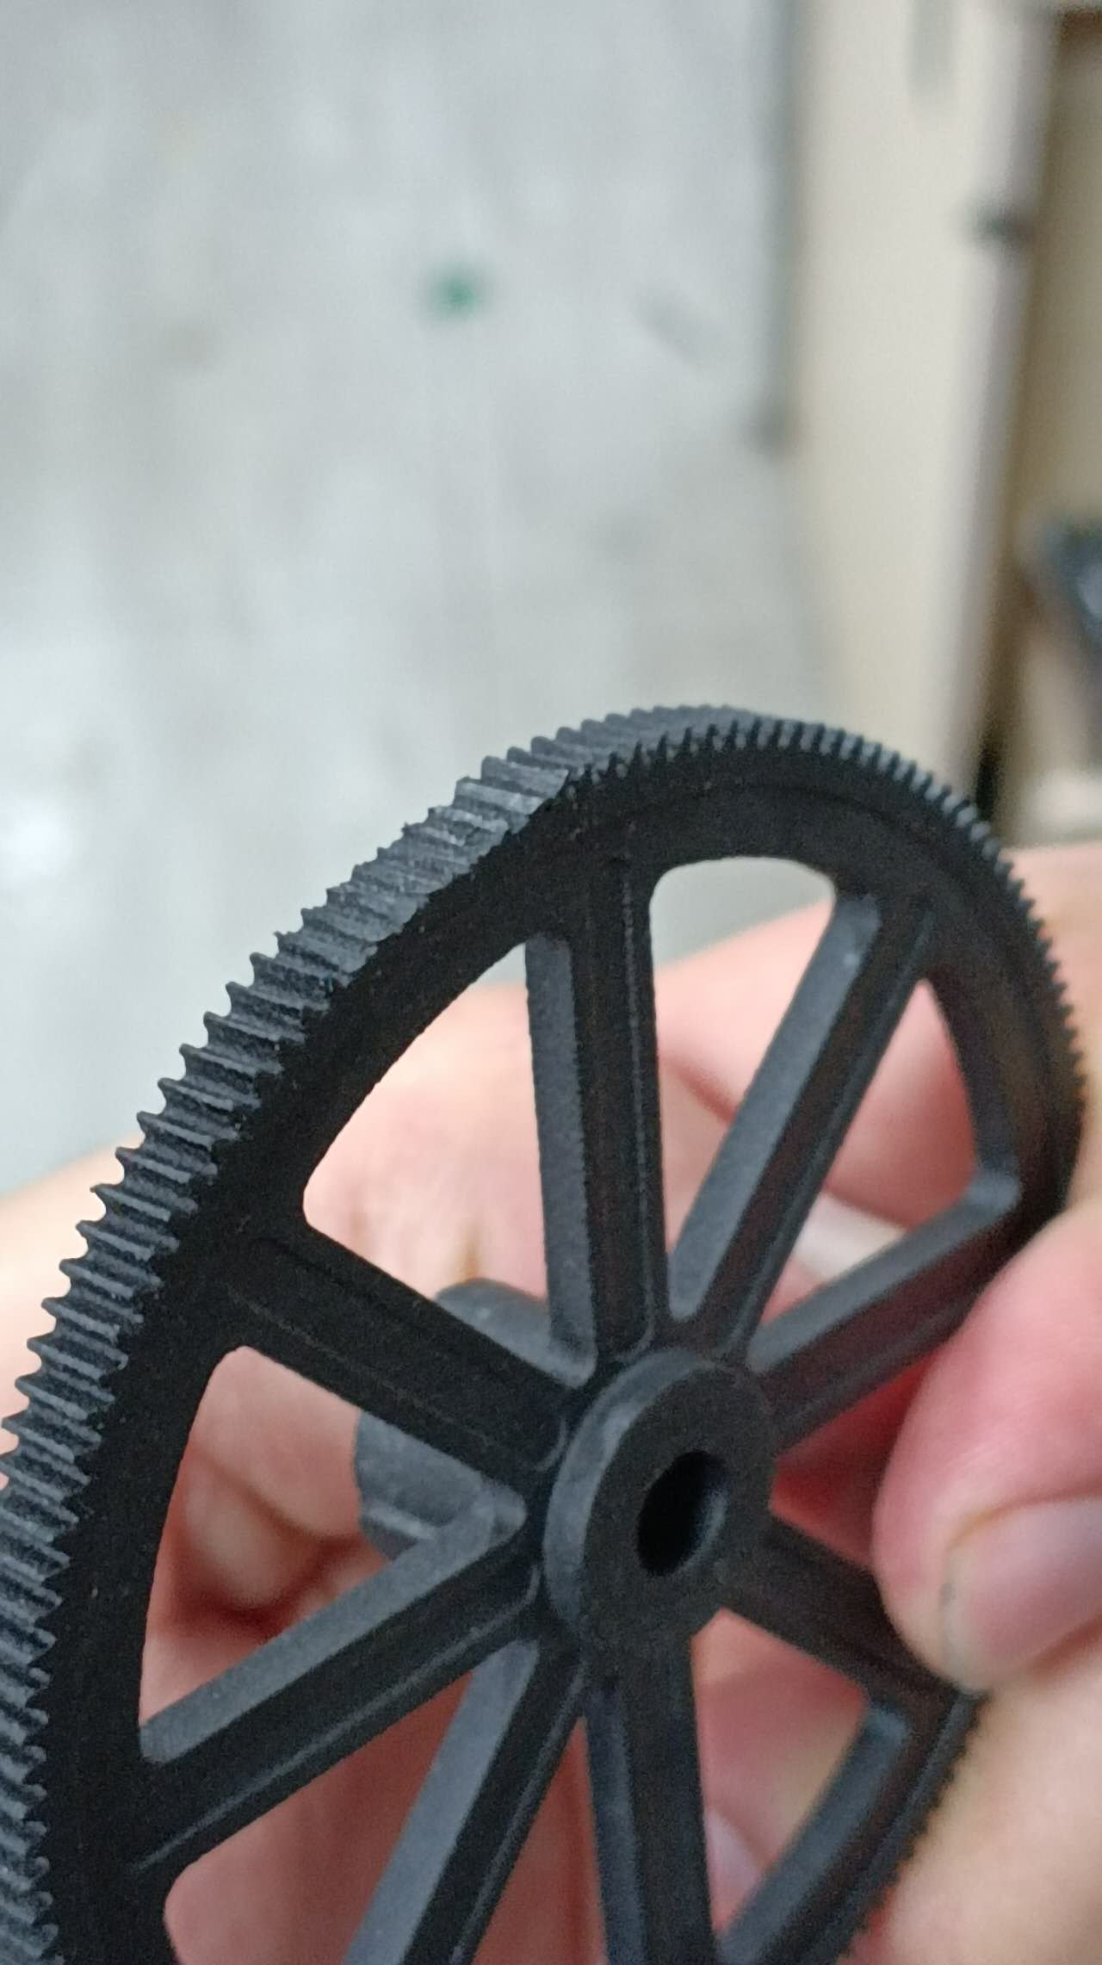
Research progress and problems encountered
Focus on free flight

Slide 5
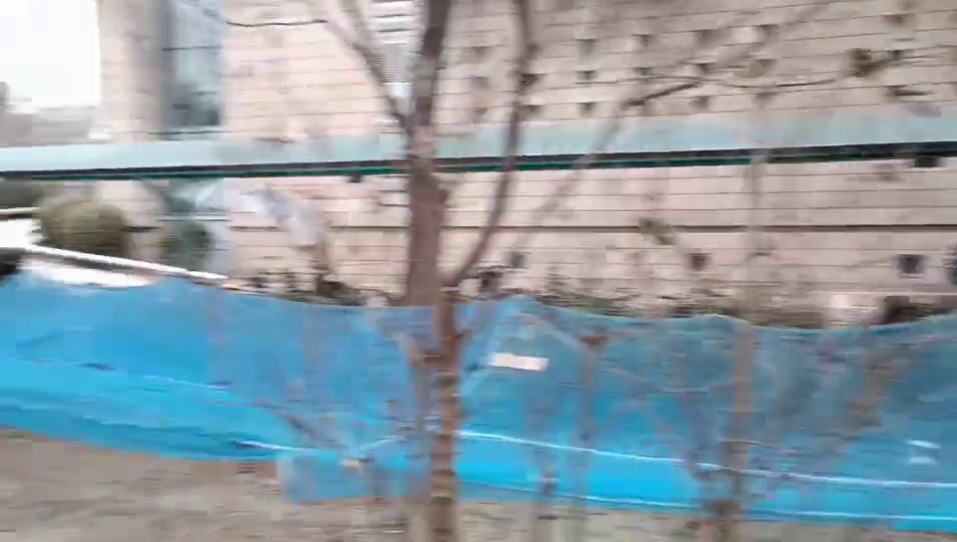
Research progress and problems encountered
Focus on free flight

Slide 6
Next steps
Develop feedback-controller
Do free flight tests on open field to understand flight dynamic and corroborate flying capabilities

Slide 7
Thank you!

