Slide 1
update
Evolutionary Algorithm Generator for Controlling Strategies of a Batbot
安武
2023/12/08

Slide 2
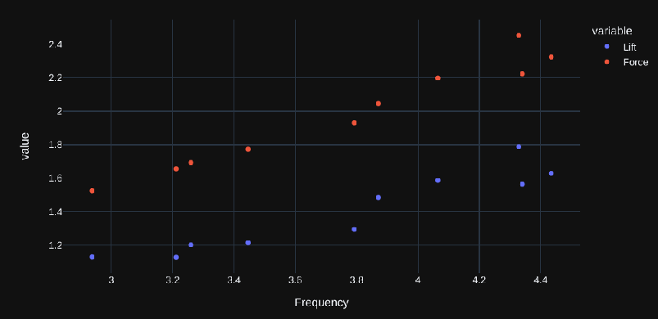
Frequency Vs Force
Experiment with increasing power to analyze average lift and resulting average force
Why so low force when flying has already been achieved? → wing foil does not generate lift in hovering.
Leg movement do not generate force → new control needed for hovering

Slide 3
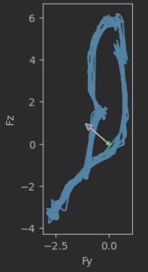
Force dynamic Results
2 main force directions → 1 resulting force
Idea: control Batbot position so that resulting force counteracts gravity
How?:
Each wing summarized in 2 forces
Leg motion can “deactivate” a wing
Combination of stroke direction knowledge we obtain torque in the 3 axis
Demonstration on Batbot

Slide 4
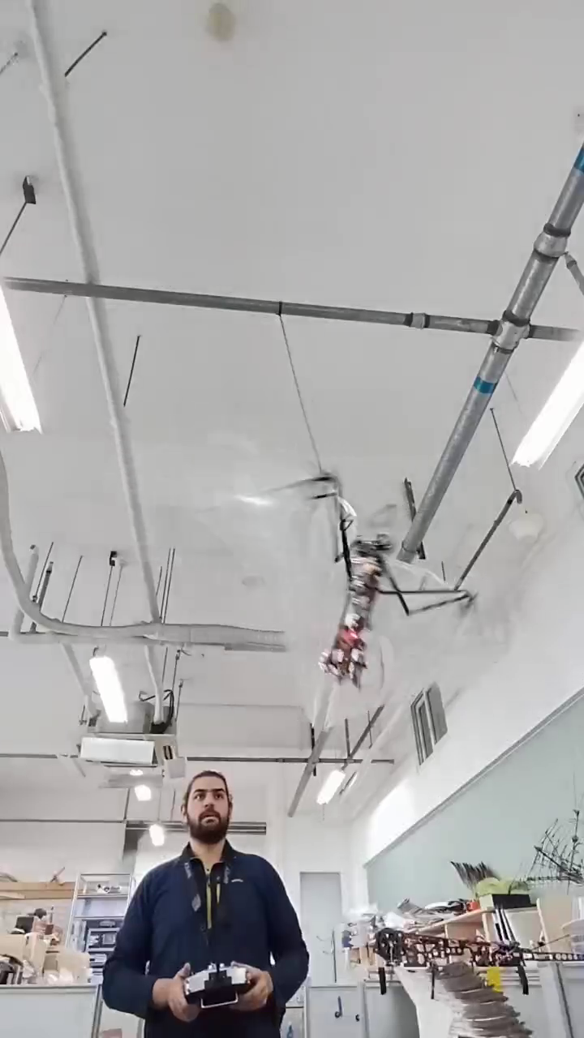
Dynamic Testbench test
Enables multiple hovering experiment whilst protecting the Batbot
If the Batbot is hovering the elastic pulls it to the center, if not a force is measured.
Using Hookes law, position can be measured from force

Slide 5
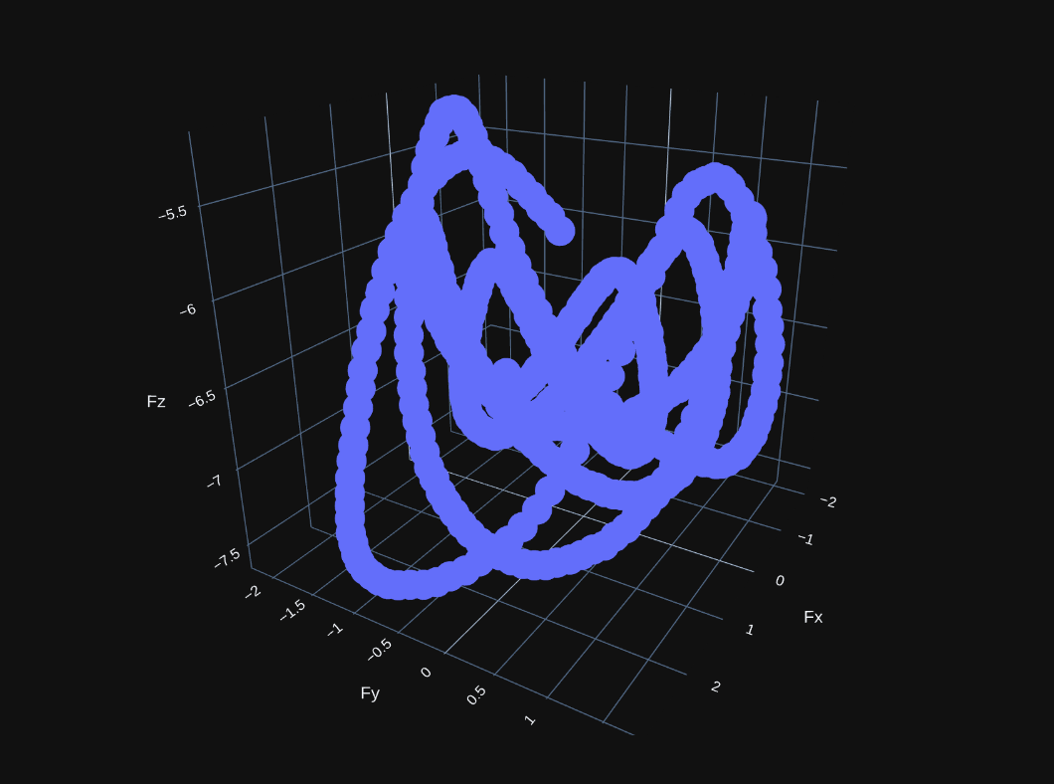
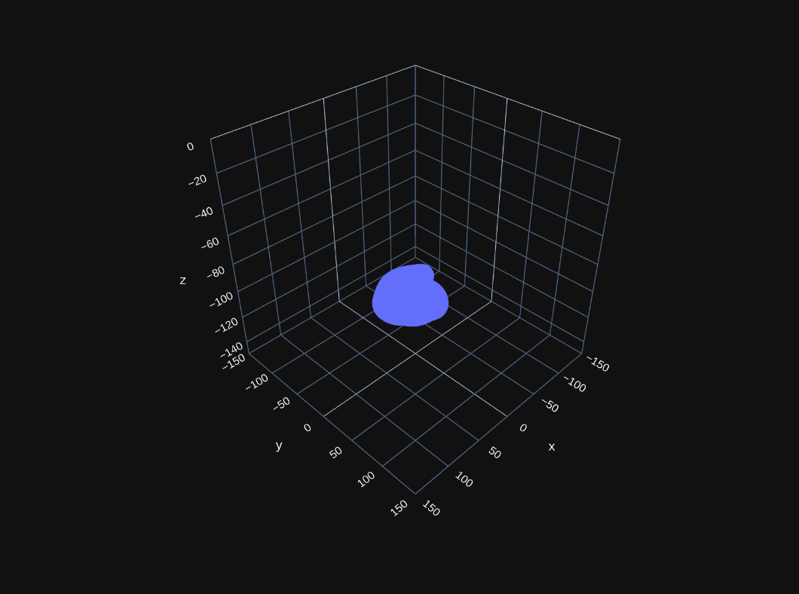
Dynamic testbench finished
Force
Position

Slide 6
Thank you!

