Slide 1
Weekly update (Broken because wrong saving)
Batbot hovering by means of evolutionary algorithm
安武
2023/04/10

Slide 2
TABLE OF CONTENT
Last Week Goals
Last Week Achievements
Current State

Slide 3


Last Week goals
Project complete Workflow
Successfully connect Data Logger to computer and achieve automatic measuring and data reading in Python. (Whole workflow completed)
Algorithm Design:
Flight Algorithm
Fitness Algorithm (score calculation from sensors)
n measurements
n solutions
n Tests in Testbench

Slide 4
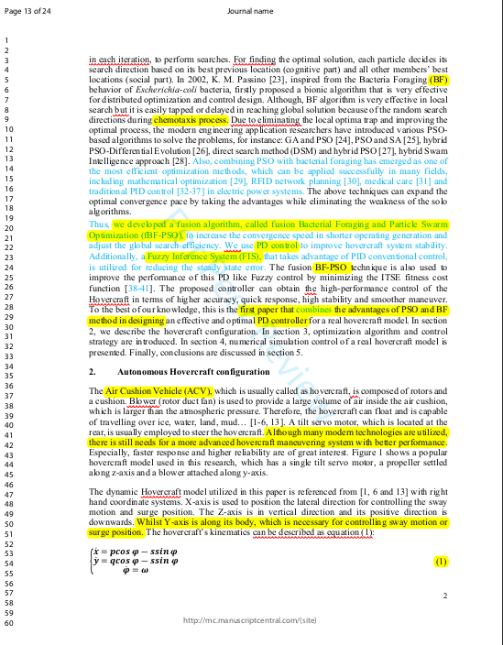
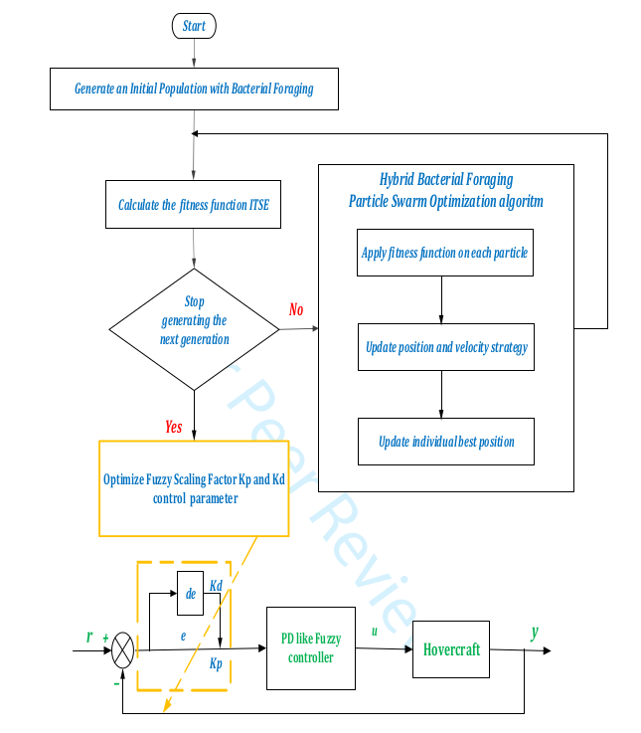
Last weeks achievements
The Professor invited me to review the paper “Fusion Bacterial Foraging and Particle Swarm Optimization Algorithm For An Autonomous Hovercraft Control”
Learned Bacterial Foraging, Particle Swarm Optimization and refreshed Fuzzy Control
Better understood reviewing process
Reviewed good scientific writing
Finished general solution research to connect DAQ with computer and found several solutions
Figure 3 “Fusion Bacterial Foraging and Particle Swarm Optimization Algorithm For An Autonomous Hovercraft Control” Huu Khoa Tran e.t. al.

Slide 5
Current state and next week goals
Current state:
First test of the many possible solutions are being carried out
Next week goals:
Connect sensors to computer and begin with programming flight algorithm

Slide 6
Thank you!

